Slide 1


Technician Licensing Class
“T1”
Valid dates:
July 1, 2010 – June 30, 2014

Slide 2
Amateur Radio Technician Class
Element 2 Course Presentation
ELEMENT 2 SUB-ELEMENTS
  T1 - FCC Rules, descriptions and definitions for the amateur radio service, operator and station license responsibilities.
  T2 - Operating Procedures
  T3 - Radio wave characteristics, radio and electromagnetic properties, propagation modes
  T4 - Amateur radio practices and station set up
  T5 - Electrical principles, math for electronics, electronic principles, Ohm’s Law
  T6 - Electrical components, semiconductors, circuit diagrams, component functions
  T7 - Station equipment, common transmitter and receiver problems, antenna measurements and troubleshooting, basic repair and testing
  T8 - Modulation modes, amateur satellite operation, operating activities, non-voice communications
  T9 - Antennas, feedlines
  T0 - AC power circuits, antenna installation, RF hazards

Slide 3
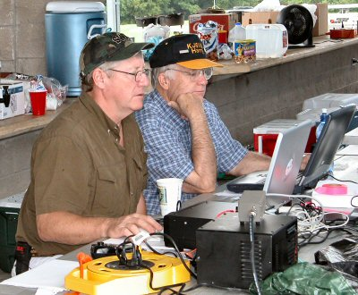
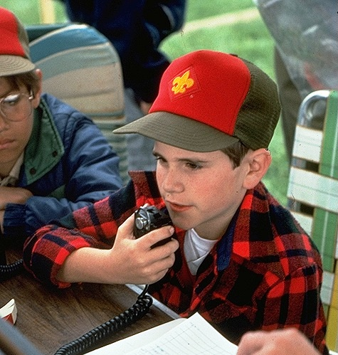
T1A: Amateur Radio services; purpose of the amateur service, amateur- satellite service, operator/primary station license grant, where FCC rules are codified, basis and purpose of FCC rules, meanings of basic terms used in FCC rules.
  T1A1 The Amateur Radio Service is intended for persons who are interested in radio technique solely with a personal aim and without pecuniary interest.
There is no minimum age requirement for holding an FCC Amateur Radio License.

Slide 4
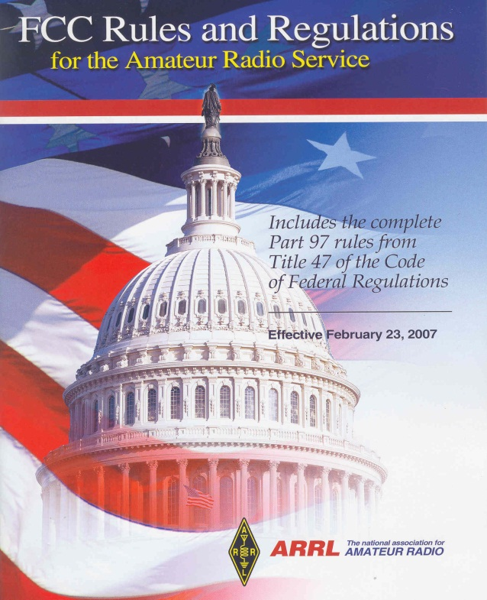
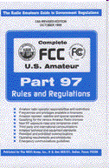
T1A: Amateur Radio services; purpose of the amateur service, amateur- satellite service, operator/primary station license grant, where FCC rules are codified, basis and purpose of FCC rules, meanings of basic terms used in FCC rules.
  T1A2 The agency that regulates and enforces the rules for the Amateur Radio Service in the United States is the FCC.
  T1A3 Part 97 of the FCC rules contains the rules and regulations governing the Amateur Radio Service.
FCC governs Amateur Radio Service
Part 97 Amateur Radio regulations are contained in Title-47 Telecommunication. (3 inches thick)

Slide 5
T1A: Amateur Radio services; purpose of the amateur service, amateur- satellite service, operator/primary station license grant, where FCC rules are codified, basis and purpose of FCC rules, meanings of basic terms used in FCC rules.
  T1A4 Any transmission that seriously degrades, obstructs, or repeatedly interrupts a radio communication service operating in accordance with the Radio Regulations is defined by the FCC as harmful interference.
  T1A5 An amateur station located more than 50 km above the Earth's surface is considered by FCC Part 97 definition a space station.
  T1A6 The FCC Part 97 definition of telecommand is a one-way transmission to initiate, modify or terminate functions of a device at a distance.
      Types of Commands
        Turning ON an amateur radio satellite
        Initiating a satellite mode change
        Turning OFF a distant propagation radio beacon
        Changing data ports on a digital repeater system

Slide 6
T1A: Amateur Radio services; purpose of the amateur service, amateur- satellite service, operator/primary station license grant, where FCC rules are codified, basis and purpose of FCC rules, meanings of basic terms used in FCC rules.
  T1A7 The FCC Part 97 definition of telemetry is a one-way transmission of measurements at a distance from the measuring instrument.
      Type of Information
        Battery condition: Full
        Outside temperature: Very cold
        Power output: Excellent
        Solar Panels: Bring on the sun!
  T1A8 A Frequency coordinator recommends transmit/receive channels and other parameters for auxiliary and repeater stations.
  T1A9 Amateur operators in a local or regional area that are eligible to be auxiliary or repeater stations select a frequency coordinator.

Slide 7
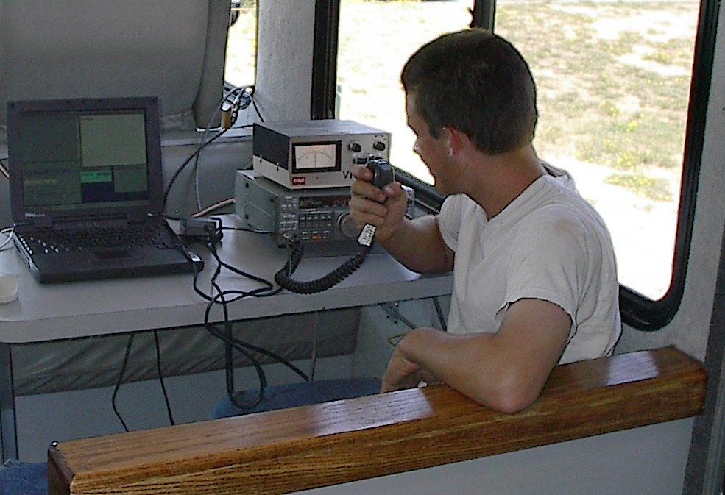
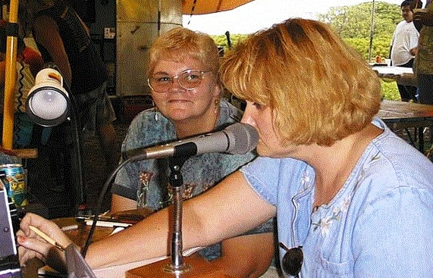
T1A: Amateur Radio services; purpose of the amateur service, amateur- satellite service, operator/primary station license grant, where FCC rules are codified, basis and purpose of FCC rules, meanings of basic terms used in FCC rules.
  T1A10 The FCC Part 97 definition of an amateur station is a station in an Amateur Radio Service consisting of the apparatus necessary for carrying on radio communications.
  T1A11 An auxiliary station transmits signals over the air from a remote receive site to a repeater for retransmission.
A control operator
Make sure the FCC has issued your call sign before you go on the air for the first time.

Slide 8


T1B: Authorized frequencies; frequency allocations, ITU regions, emission type, restricted sub-bands, spectrum sharing, transmissions near band edges.
  T1B1 The ITU (International Telecommunications Union) is a United Nations agency for information and communication technology issues.

Slide 9
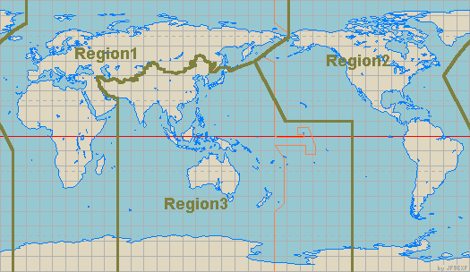
T1B: Authorized frequencies; frequency allocations, ITU regions, emission type, restricted sub-bands, spectrum sharing, transmissions near band edges.
  T1B2 North American amateur stations are located in ITU Region 2
North America
ITU
Region 2

Slide 10
T1B: Authorized frequencies; frequency allocations, ITU regions, emission type, restricted sub-bands, spectrum sharing, transmissions near band edges.
  T1B3 52.525 MHz is a frequency is within the 6 meter band .
  T1B4 146.52 MHz is a frequency is within the 2 meter band.
  T1B5 443.350 is a 70 cm frequency authorized to a Technician Class license holder operating in ITU Region 2.
        443.350 MHz is in the upper third of the 70 cm band
50 MHz 50.1 MHz
54 MHz
CW
52.525 MHz
6-Meter Wavelength Band Privileges
144 MHz 144.1 MHz
148 MHz
CW
146.52 MHz
2-Meter Wavelength Band Privileges
420 MHz
430 MHz
440 MHz
450 MHz
443.350 MHz
70-CM Wavelength Band Privileges

Slide 11
T1B: Authorized frequencies; frequency allocations, ITU regions, emission type, restricted sub-bands, spectrum sharing, transmissions near band edges.
  T1B6 A Technician Class operator is authorized to operate on a 23 cm frequency of 1296 MHz.
  T1B7 Transmitting on 223.500 MHz, you are using the 1.25 meter band.
  T1B8 When an amateur frequency band is said to be available on a secondary basis, amateurs may not cause harmful interference to primary users.
1240 MHz
1300 MHz
1296 MHz
23-CM Wavelength Band Privileges
219 MHz 220 MHz
222 MHz
225 MHz
223.50 MHz
1.25-Meter Wavelength Band Privileges

Slide 12
T1B: Authorized frequencies; frequency allocations, ITU regions, emission type, restricted sub-bands, spectrum sharing, transmissions near band edges.
  T1B9 You should not set your transmit frequency to be exactly at the edge of an amateur band or sub-band:
        so that modulation sidebands do not extend beyond the band edge;
        to allow for calibration error in the transmitter frequency display;
        and to allow for transmitter frequency drift.
  T1B10 The 6 meter, 2 meter, and 1.25 meter bands available to Technician Class operators have mode-restricted sub-bands.
      6 meters 50.0 – 50.1 No FM!
      2 meters 144.0 – 144.1 No FM!
      1.25 meters 222.0 – 222.34 No FM!
  T1B11 In the mode-restricted sub-bands at 50.0 to 50.1 MHz and 144.0 to 144.1 MHz only CW emission modes are permitted.
        CW only on these two sub-bands
12

Slide 13
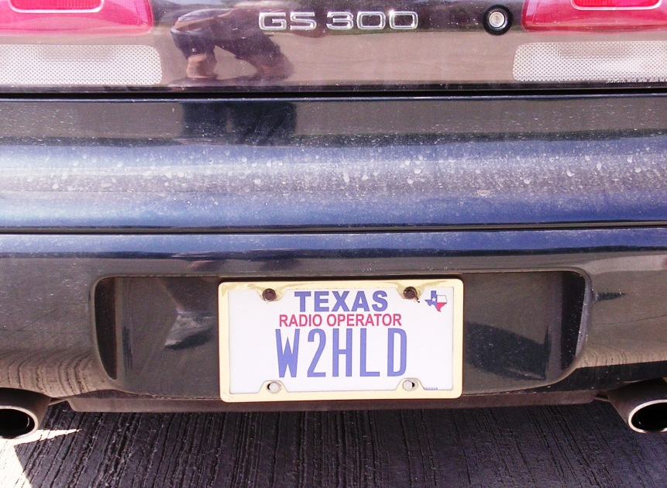
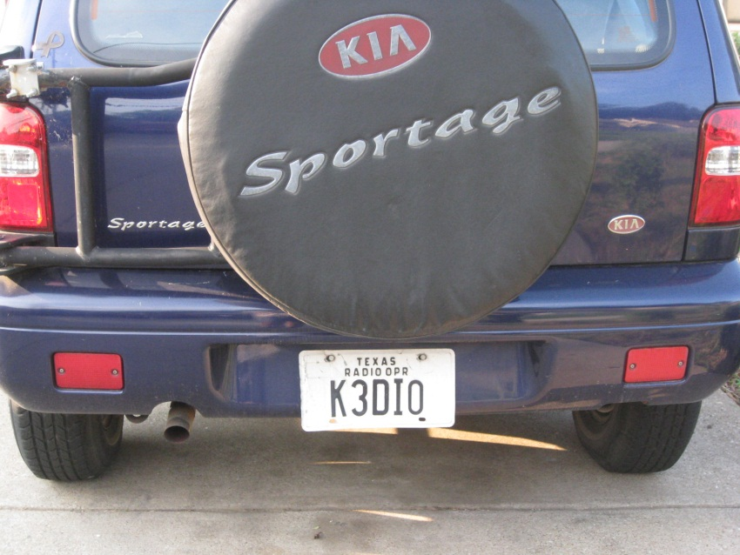
T1C: Operator classes and station call signs; operator classes, sequential, special event, and vanity call sign systems, international communications, reciprocal operation, station license and licensee, places where the amateur service is regulated by the FCC, name and address on ULS, license term, renewal, grace period.
  T1C1 A call sign that has a single letter in both the prefix and suffix is used for a Special Event.
  T1C2 W3ABC is a valid US amateur radio station call sign.
Amateur Radio call sign on license plates.
Ham radio call signs, for the U.S, begin with A, K, N, or W. They also have a single numbers 0 through 9.

Slide 14
T1C: Operator classes and station call signs; operator classes, sequential, special event, and vanity call sign systems, international communications, reciprocal operation, station license and licensee, places where the amateur service is regulated by the FCC, name and address on ULS, license term, renewal, grace period.
  T1C3 Communications incidental to the purposes of the amateur service and remarks of a personal character are types of international communications permitted by an FCC-licensed amateur station.
  T1C4 You are allowed to operate your amateur station in a foreign country when the foreign country authorizes it.
  T1C5 If you are operating on the 23 cm band and learn that you are interfering with a radio location station outside the United States you must stop operating or take steps to eliminate the harmful interference.
  T1C6 In addition to places where the FCC regulates communications, an FCC-licensed amateur station can transmit from any vessel or craft operating in international waters that is documented or registered in the United States.

Slide 15
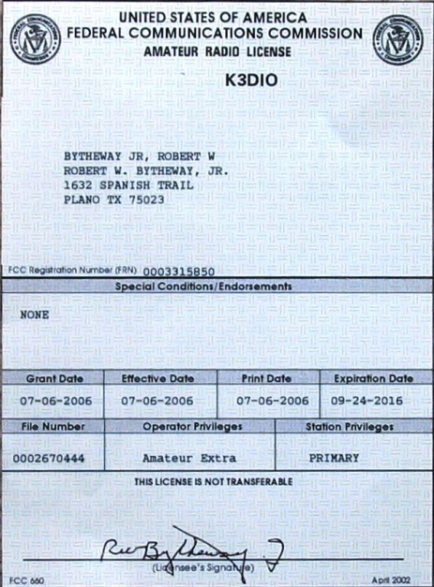
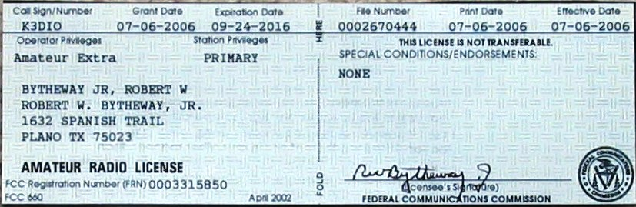
T1C: Operator classes and station call signs; operator classes, sequential, special event, and vanity call sign systems, international communications, reciprocal operation, station license and licensee, places where the amateur service is regulated by the FCC, name and address on ULS, license term, renewal, grace period.
  T1C7 Revocation of the station license or suspension of the operator license may result when correspondence from the FCC is returned as undeliverable because the grantee failed to provide the correct mailing address.
    The FCC has suspended two Amateur Radio licenses because the holders had failed to maintain correct mailing addresses in the Commission's licensee database.
    Special Counsel in the FCC Spectrum Enforcement Division Riley Hollingsworth wrote Larry L. Smith, KC7LJR, of Middleton, Idaho, and Larry J. Maniag, KD7JTG, of Payson, Arizona, on June 28, 2006 to inform them the FCC was suspending their Technician tickets for the remainder of their license terms or until each licensee provides a valid mailing address. http://www.arrl.org/news/stories/2006/07/18/100/
  T1C8 The normal term for an FCC-issued primary station/operator license grant is ten years.

Slide 16
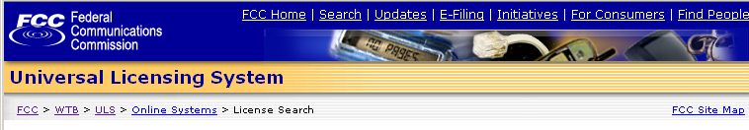
T1C: Operator classes and station call signs; operator classes, sequential, special event, and vanity call sign systems, international communications, reciprocal operation, station license and licensee, places where the amateur service is regulated by the FCC, name and address on ULS, license term, renewal, grace period.
  T1C9 The grace period following the expiration of an amateur license within which the license may be renewed is two years.
  T1C10 You may operate to transmit after you pass the examination elements required for your first amateur radio license as soon as your name and call sign appear in the FCC’s ULS database.
  T1C11 If your license has expired and is still within the allowable grace period, you may not continue to operate to transmit until the ULS database shows that the license has been renewed.

Slide 17
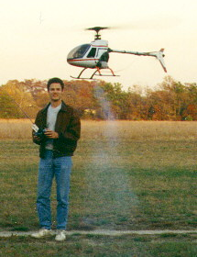
T1D: Authorized and prohibited transmissions
  T1D1 FCC-licensed amateur are prohibited from exchanging communications with any country whose administration has notified the ITU that it objects to communications with FCC-licensed amateur stations.
  T1D2 Only during an Armed Forces Day Communications Test may an FCC-licensed amateur station exchange messages with a U.S. military station.
  T1D3 The transmission of codes or ciphers is allowed to hide the meaning of a message transmitted by an amateur station only when transmitting control commands to space stations or radio control craft.
Radio control craft
Space station

Slide 18
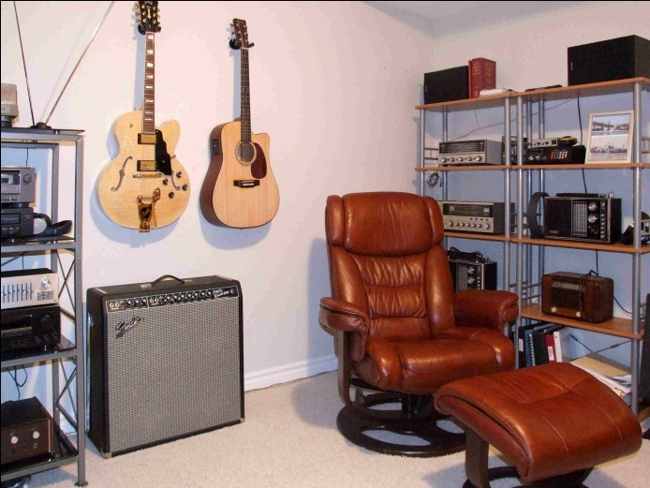
T1D: Authorized and prohibited transmissions
  T1D4 The only time an amateur station is authorized to transmit music is when it is incidental to an authorized retransmission of manned spacecraft communications.
  T1D5 Amateur radio operators may use their stations to notify other amateurs of the availability of equipment for sale or trade when the equipment is normally used in an amateur station and such activity is not conducted on a regular basis.
Music in the background at your station is not permitted.

Slide 19
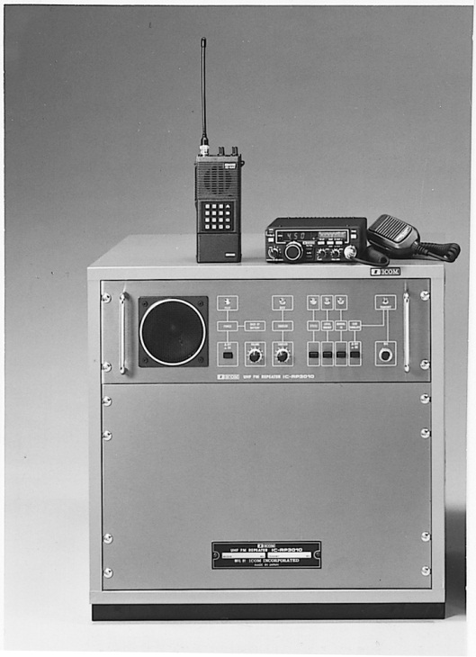
T1D: Authorized and prohibited transmissions
  T1D6 Transmissions that contain obscene or indecent words or language are prohibited.
      Absolutely not allowed = indecent and obscene language
  T1D7 Amateur station are authorized to automatically retransmit the radio signals of other amateur stations when the signals are from an auxiliary, repeater, or space station.
HandHeld
Mobile/Base Station
Repeater
A repeater: Nice clean, neat, and compact.

Slide 20
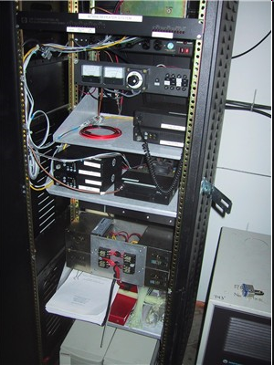
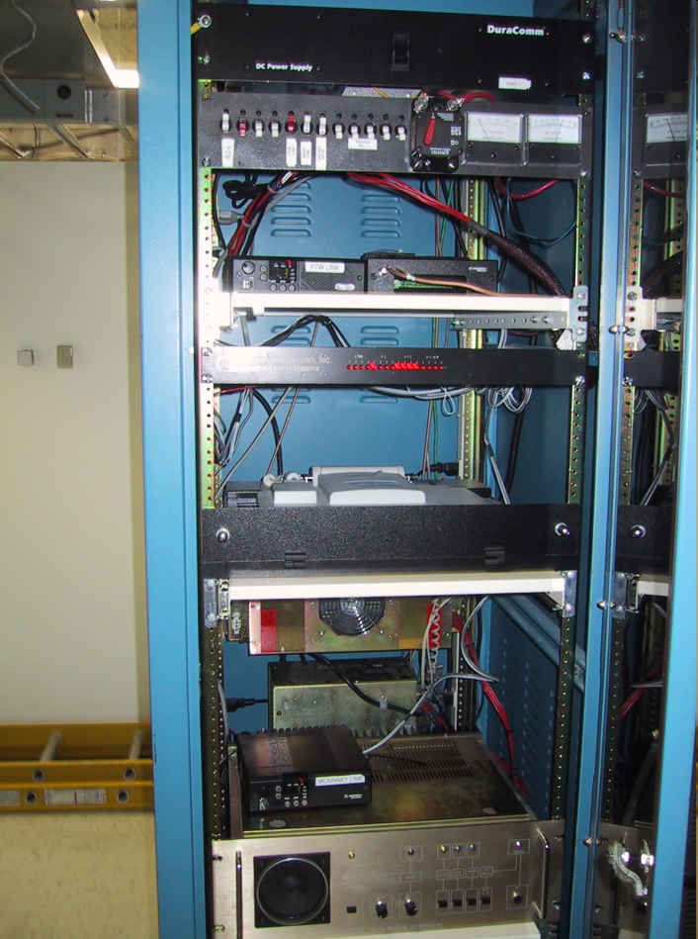
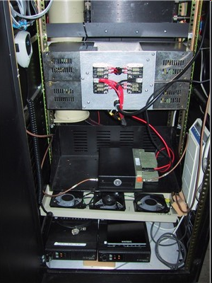
T1D: Authorized and prohibited transmissions
What repeaters really look like. Nice neat, clean, and compact.
McKinney, Tx 442.575 UHF Repeater
Dallas, Tx 442.025 UHF Repeater
McKinney, Tx 145.350 VHF Repeater

Slide 21
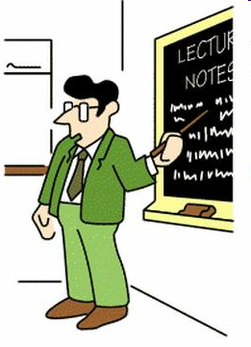
T1D: Authorized and prohibited transmissions
  T1D8 The control operator of an amateur station may receive compensation for operating a station when the communication is incidental to classroom instruction at an educational institution.
School teachers can receive their regular pay when teaching about ham radio

Slide 22
T1D: Authorized and prohibited transmissions
  T1D9 Amateur stations are authorized to transmit signals related to broadcasting, program production, or news gathering, assuming no other means is available only where such communications directly relate to the immediate safety of human life or protection of property.
        Protecting lives and property
  T1D10 Transmissions intended for reception by the general public is the meaning of the term broadcasting in the FCC rules for the amateur services.
  T1D11 Brief transmissions to make station adjustments is a type of communications permitted in the Amateur Radio Service.

Slide 23
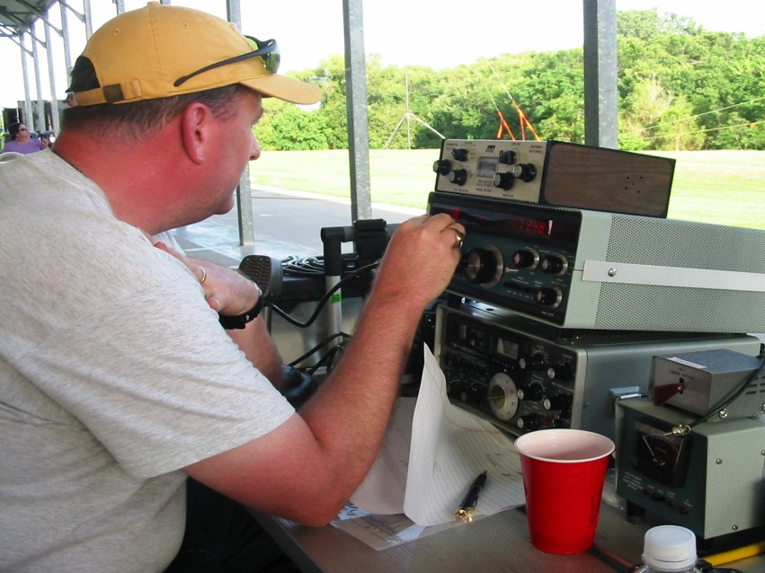
T1E: Control operator and control types; control operator required, eligibility, designation of control operator, privileges and duties, control point, local, automatic and remote control, location of control operator.
  T1E1 An amateur station must have a control operator only when the station is transmitting.
  T1E2 Only a person for whom an amateur operator/primary station license grant appears in the FCC database or who is authorized for alien reciprocal operation is eligible to be the control operator of an amateur station.
When you operate your station you are the “control operator,” and you are at the station’s “control point.”

Slide 24
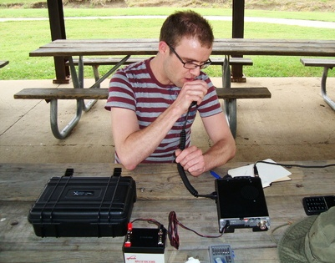
T1E: Control operator and control types; control operator required, eligibility, designation of control operator, privileges and duties, control point, local, automatic and remote control, location of control operator.
  T1E3 The station licensee must designate the station control operator.
  T1E4 The class of operator license held by the control operator determines the transmitting privileges of an amateur station.
When you operate from another ham’s station, you use your license class privileges.

Slide 25
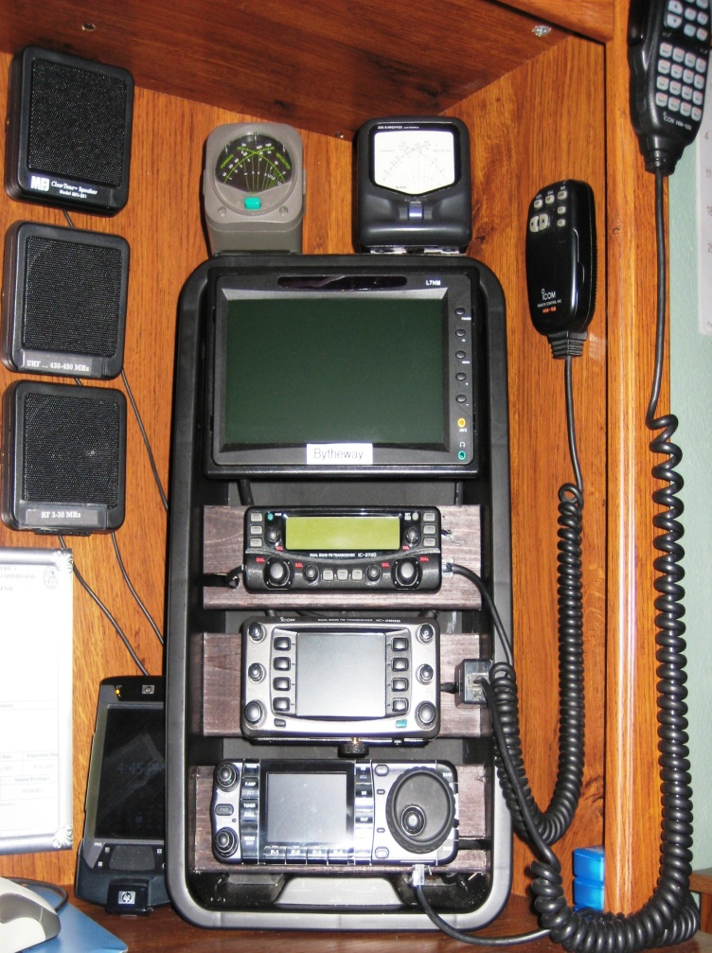
T1E: Control operator and control types; control operator required, eligibility, designation of control operator, privileges and duties, control point, local, automatic and remote control, location of control operator.
  T1E5 The location at which the control operator function is performed is considered the amateur station control point.
The control point is the spot where you have complete capability to turn your equipment on or off.

Slide 26
T1E: Control operator and control types; control operator required, eligibility, designation of control operator, privileges and duties, control point, local, automatic and remote control, location of control operator.
  T1E6 Automatic control is the type of control that is permissible for the control operator to be at a location other than the control point.
  T1E7 The control operator and the station licensee are equally responsible for the proper operation of the station when the control operator is not the station licensee.
      Both of you are responsible for the transmissions
  T1E8 Automatic control is the type of control being used for a repeater when the control operator is not present at a control point.

Slide 27
T1E: Control operator and control types; control operator required, eligibility, designation of control operator, privileges and duties, control point, local, automatic and remote control, location of control operator.
  T1E9 Local control is the type of control being used when transmitting using a handheld radio.
  T1E10 Remote control is the type of control used when the control operator is not at the station location but can indirectly manipulate the operating adjustments of a station.
  T1E11 The FCC presumes the station licensee to be the control operator of an amateur station unless documentation to the contrary is in the station records.
      Another licensee runs your gear, log who it was.

Slide 28
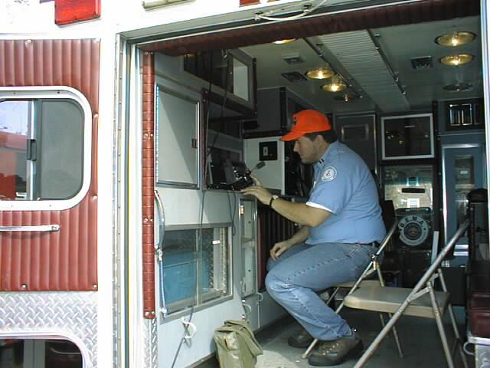
T1F: Station identification and operation standards; special operations for repeaters and auxiliary stations, third party communications, club stations, station security, FCC inspection.
  T1F1 The type of identification being used when identifying a station on the air as “Race Headquarters” is a Tactical call.
    Tactical call signs ARE permitted as long as they don’t sound like a U.S. or foreign call sign.
  T1F2 When using tactical identifiers you must transmit your station's FCC-assigned call sign every ten minutes.

Slide 29
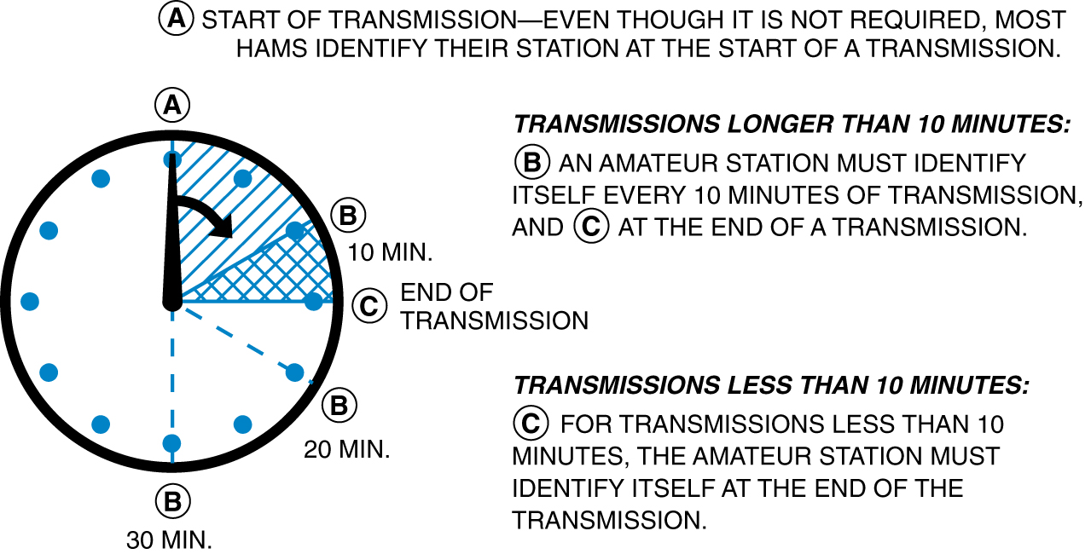
T1F: Station identification and operation standards; special operations for repeaters and auxiliary stations, third party communications, club stations, station security, FCC inspection.
  T1F03 An amateur station is required to transmit its assigned call sign at least every 10 minutes during and at the end of a contact.

Slide 30
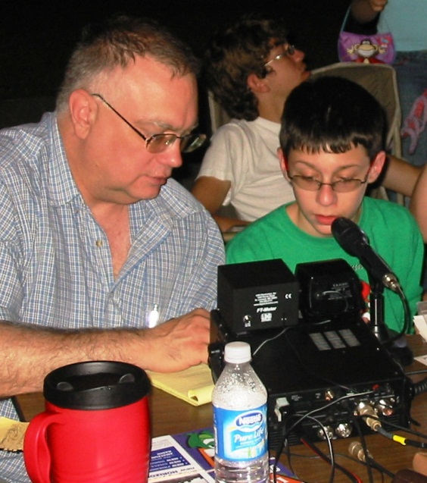
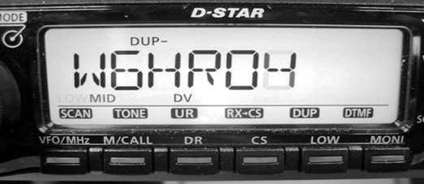
T1F: Station identification and operation standards; special operations for repeaters and auxiliary stations, third party communications, club stations, station security, FCC inspection.
  T1F4 Phone emission in the English language is an acceptable method of station identification when operating in the phone sub-band.
  T1F5 Call sign identification is required for a station transmitting phone signals by sending the call sign using CW or phone emission.
Testing your radio?
Give your call sign in English.
Repeaters can identify with a voice message announcing their call sign, or use Morse code not to exceed 20wpm to send out their station call letters

Slide 31
T1F: Station identification and operation standards; special operations for repeaters and auxiliary stations, third party communications, club stations, station security, FCC inspection.
  T1F6 KL7CC stroke W3, KL7CC slant W3 and KL7CC slash W3 are acceptable formats of self-assigned indicators when identifying using a phone transmission.
        KL7CC/W3 … Stroke
        KL7CC/W3 … Slant
        KL7CC/W3 … Slash
  T1F7 When appending a self-assigned call sign indicator there are restrictions. It must not conflict with any other indicator specified by the FCC rules or with any call sign prefix assigned to another country.
  T1F8 A Technician Class licensee may never be the control operator of a station operating in an exclusive Extra Class operator segment of the amateur bands.
        You must stay within your Technician Class band privileges.
  T1F9 A Repeater station is the type of amateur station that simultaneously retransmits the signal of another amateur station on a different channel or channels.

Slide 32
T1F: Station identification and operation standards; special operations for repeaters and auxiliary stations, third party communications, club stations, station security, FCC inspection.
  T1F9 A Repeater station is the type of amateur station that simultaneously retransmits the signal of another amateur station on a different channel or channels.
  T1F10 The control operator of the originating station is accountable should a repeater inadvertently retransmit communications that violate the FCC rules.
  T1F11 FCC rules authorize the transmission of non-emergency third party communications to foreign stations whose government permits such communications
  T1F12 At least 4 persons are required to be members of a club for a club station license to be issued by the FCC.
  T1F13 Any time upon request by an FCC representative is when the station licensee must make the station and its records available for FCC inspection.

Slide 33
Element 2 Technician Class Question Pool
T1
CC Rules, descriptions and definitions for the amateur radio service, operator and station license responsibilities
[6 Exam Questions – 6 Groups]
Valid July 1, 2010
Through
June 30, 2014

Slide 34
T1A01 For whom is the Amateur Radio Service intended?
  Persons who have messages to broadcast to the public
  Persons who need communications for the activities of their immediate family members, relatives and friends
  Persons who need two-way communications for personal reasons
  Persons who are interested in radio technique solely with a personal aim and without pecuniary interest

Slide 35
T1A02 What agency regulates and enforces the rules for the Amateur Radio Service in the United States?
FEMA
The ITU
The FCC
Homeland Security

Slide 36
T1A03 Which part of the FCC rules contains the rules and regulations governing the Amateur Radio Service?
Part 73
Part 95
Part 90
Part 97

Slide 37
T1A04 Which of the following meets the FCC definition of harmful interference?
Radio transmissions that annoy users of a repeater
Unwanted radio transmissions that cause costly harm to radio station apparatus
That which seriously degrades, obstructs, or repeatedly interrupts a radio communication service operating in accordance with the Radio Regulations
Static from lightning storms

Slide 38
T1A05 What is the FCC Part 97 definition of a space station?
Any multi-stage satellite
An Earth satellite that carries one of more amateur operators
An amateur station located less than 25 km above the Earth's surface
An amateur station located more than 50 km above the Earth's surface

Slide 39
T1A06 What is the FCC Part 97 definition of telecommand?
An instruction bulletin issued by the FCC
A one-way radio transmission of measurements at a distance from the measuring instrument
A one-way transmission to initiate, modify or terminate functions of a device at a distance
An instruction from a VEC

Slide 40
T1A07 What is the FCC Part 97 definition of telemetry?
An information bulletin issued by the FCC
A one-way transmission to initiate, modify or terminate functions of a device at a distance
A one-way transmission of measurements at a distance from the measuring instrument
An information bulletin from a VEC Congress of the United States

Slide 41
T1A08 Which of the following entities recommends transmit/receive channels and other parameters for auxiliary and repeater stations?
Frequency Spectrum Manager
Frequency Coordinator
FCC Regional Field Office
International Telecommunications Union

Slide 42
T1A09 Who selects a frequency coordinator?
The FCC Office of Spectrum Management and Coordination Policy
The local chapter of the Office of National Council of Independent Frequency Coordinators
Amateur operators in a local or regional area whose stations are eligible to be auxiliary or repeater stations
Regional field Office

Slide 43
T1A10 What is the FCC Part 97 definition of an amateur station?
A station in an Amateur Radio Service consisting of the apparatus necessary for carrying on radio communications
A building where Amateur Radio receivers, transmitters, and RF power amplifiers are installed
Any radio station operated by a non-professional
Any radio station for hobby use

Slide 44
T1A11 Which of the following stations transmits signals over the air from a remote receive site to a repeater for retransmission?
Beacon station
Relay station
Auxiliary station
Message forwarding station

Slide 45
T1B01 What is the ITU ?
An agency of the United States Department of Telecommunications Management
A United Nations agency for information and communication technology issues
An independent frequency coordination agency
A department of the FCC

Slide 46
T1B02 North American amateur stations are located in which ITU region?
Region 1
Region 2
Region 3
Region 4

Slide 47
T1B03 Which frequency is within the 6 meter band?
49.00 MHz
52.525 MHz
28.50 MHz
222.15 MHz

Slide 48
T1B04 Which amateur band are you using when your station is transmitting on 146.52 MHz?
2 meter band
20 meter band
14 meter band
6 meter band

Slide 49
T1B05 Which 70 cm frequency is authorized to a Technician Class license holder operating in ITU Region 2?
53.350 MHz
146.520 MHz
443.350 MHz
222.520 MHz

Slide 50
T1B06 Which 23 cm frequency is authorized to a Technician Class operator license?
  2315 MHz
  1296 MHz
  3390 MHz
  146.52 MHz

Slide 51
T1B07 What amateur band are you using if you are transmitting on 223.50 MHz?
15 meter band
10 meter band
2 meter band
1.25 meter band

Slide 52
T1B08 What do the FCC rules mean when an amateur frequency band is said to be available on a secondary basis?
Secondary users of a frequency have equal rights to operate
Amateurs are only allowed to use the frequency at night
Amateurs may not cause harmful interference to primary users
Secondary users are not allowed on amateur bands

Slide 53
T1B09 Why should you not set your transmit frequency to be exactly at the edge of an amateur band or sub-band?
To allow for calibration error in the transmitter frequency display
So that modulation sidebands do not extend beyond the band edge
To allow for transmitter frequency drift
All of these choices are correct

Slide 54
T1B10 Which of the bands available to Technician Class operators have mode- restricted sub-bands?
The 6 meter, 2 meter, and 70 cm bands
The 2 meter and 13 cm bands
The 6 meter, 2 meter, and 1.25 meter bands
The 2 meter and 70 cm bands

Slide 55
T1B11 What emission modes are permitted in the mode-restricted sub-bands at 50.0 to 50.1 MHz and 144.0 to 144.1 MHz?
CW only
CW and RTTY
SSB only
CW and SSB

Slide 56
T1C01 Which type of call sign has a single letter in both the prefix and suffix?
Vanity
Sequential
Special event
In-memoriam

Slide 57
T1C02 Which of the following is a valid US amateur radio station call sign?
KMA3503
W3ABC
KDKA
11Q1176

Slide 58
T1C03 What types of international communications are permitted by an FCC-licensed amateur station?
Communications incidental to the purposes of the amateur service and remarks of a personal character
Communications incidental to conducting business or remarks of a personal nature
Only communications incidental to contest exchanges, all other communications are prohibited
Any communications that would be permitted on an international broadcast station

Slide 59
T1C04 When are you allowed to operate your amateur station in a foreign country?
When the foreign country authorizes it
When there is a mutual agreement allowing third party communications
When authorization permits amateur communications in a foreign language
When you are communicating with non-licensed individuals in another country

Slide 60
T1C05 What must you do if you are operating on the 23 cm band and learn that you are interfering with a radiolocation station outside the US?
Stop operating or take steps to eliminate the harmful interference
Nothing, because this band is allocated exclusively to the amateur service
Establish contact with the radiolocation station and ask them to change frequency
Change to CW mode, because this would not likely cause interference

Slide 61
T1C06 From which of the following may an FCC-licensed amateur station transmit, in addition to places where the FCC regulates communications?
From within any country that belongs to the International Telecommunications Union
From within any country that is a member of the United Nations
From anywhere within in ITU Regions 2 and 3
From any vessel or craft located in international waters and documented or registered in the United States

Slide 62
T1C07 What may result when correspondence from the FCC is returned as undeliverable because the grantee failed to provide the correct mailing address?
Fine or imprisonment
Revocation of the station license or suspension of the operator license
Require the licensee to be re-examined
A reduction of one rank in operator class

Slide 63
T1C08 What is the normal term for an FCC-issued primary station/operator license grant?
Five years
Life
Ten years
Twenty years

Slide 64
T1C09 What is the grace period following the expiration of an amateur license within which the license may be renewed?
Two years
Three years
Five years
Ten years

Slide 65
T1C10 How soon may you operate a transmitter on an amateur service frequency after you pass the examination required for your first amateur radio license?
Immediately
30 days after the test date
As soon as your name and call sign appear in the FCC’s ULS database
You must wait until you receive your license in the mail from the FCC.

Slide 66
T1C11 If your license has expired and is still within the allowable grace period, may you continue to operate a transmitter on amateur radio frequencies?
No, transmitting is not allowed until the ULS database shows that the license has been renewed
Yes, but only if you identify using the suffix "GP"
Yes, but only during authorized nets
Yes, for up to two years
66

Slide 67
T1D01 With which countries are FCC-licensed amateur stations prohibited from exchanging communications?
Any country whose administration has notified the ITU that it objects to such communications
B. Any country whose administration has notified the United Nations that it objects to such communications
C. Any country engaged in hostilities with another country
D. Any country in violation of the War Powers Act of 1934

Slide 68
T1D02 On which of the following occasions may an FCC-licensed amateur station exchange messages with a U.S. military station?
During an Armed Forces Day Communications Test
During a Memorial Day Celebration
During an Independence Day celebration
During a propagation test

Slide 69
T1D03 When is the transmission of codes or ciphers allowed to hide the meaning of a message transmitted by an amateur station?
Only during contests
Only when operating mobile
Only when transmitting control commands to space stations or radio control craft
Only when frequencies above 1280 MHz are used

Slide 70
T1D04 What is the only time an amateur station is authorized to transmit music?
When incidental to an authorized retransmission of manned spacecraft communications
B. When the music produces no spurious emissions
C. When the purpose is to interfere with an illegal transmission
D. When the music is transmitted above 1280 MHz

Slide 71
T1D05 When may amateur radio operators use their stations to notify other amateurs of the availability of equipment for sale or trade?
When the equipment is normally used in an amateur station and such activity is not conducted on a regular basis
B. When the asking price is $100.00 or less
C. When the asking price is less than its appraised value
D. When the equipment is not the personal property of either the station licensee or the control operator or their close relatives

Slide 72
T1D06 Which of the following types of transmissions are prohibited?
Transmissions that contain obscene or indecent words or language
B. Transmissions to establish one-way communications
C. Transmissions to establish model aircraft control
D. Transmissions for third party communications

Slide 73
T1D07 When is an amateur station authorized to automatically retransmit the radio signals of other amateur stations?
When the signals are from an auxiliary, beacon, or Earth station
When the signals are from an auxiliary, repeater, or space station
When the signals are from a beacon, repeater, or space station
When the signals are from an Earth, repeater, or space station

Slide 74
T1D08 When may the control operator of an amateur station receive compensation for operating the station?
When engaging in communications on behalf of their employer
When the communication is incidental to classroom instruction at an educational institution
When re-broadcasting weather alerts during a RACES net
When notifying other amateur operators of the availability for sale or trade of apparatus

Slide 75
T1D09 Under which of the following circumstances are amateur stations authorized to transmit signals related to broadcasting, program production, or news gathering, assuming no other means is available?
Only where such communications directly relate to the immediate safety of human life or protection of property
Only when broadcasting communications to or from the space shuttle.
Only where noncommercial programming is gathered and supplied exclusively to the National Public Radio network
Only when using amateur repeaters linked to the Internet

Slide 76
T1D10 What is the meaning of the term broad- casting in the FCC rules for the amateur services?
Two-way transmissions by amateur stations
Transmission of music
Transmission of messages directed only to amateur operators
Transmissions intended for reception by the general public

Slide 77
T1D11 Which of the following types of communications are permitted in the Amateur Radio Service?
Brief transmissions to make station adjustments
Retransmission of entertainment programming from a commercial radio or TV station
Retransmission of entertainment material from a public radio or TV station
Communications on a regular basis that could reasonably be furnished alternatively through other radio services

Slide 78
T1E01 When must an amateur station have a control operator?
Only when the station is transmitting
Only when the station is being locally controlled
Only when the station is being remotely controlled
Only when the station is being automatically controlled

Slide 79
T1E02 Who is eligible to be the control operator of an amateur station?
Only a person holding an amateur service license from any country that belongs to the United Nations
Only a citizen of the United States
Only a person over the age of 18
Only a person for whom an amateur operator/primary station license grant appears in the FCC database or who is authorized for alien reciprocal operation

Slide 80
T1E03 Who must designate the station control operator?
The station licensee
The FCC
The frequency coordinator
The ITU

Slide 81
T1E04 What determines the transmitting privileges of an amateur station?
The frequency authorized by the frequency coordinator
The class of operator license held by the station licensee
The highest class of operator license held by anyone on the premises
The class of operator license held by the control operator

Slide 82
T1E05 What is an amateur station control point?
The location of the station’s transmitting antenna
The location of the station transmitting apparatus.
The location at which the control operator function is performed
The mailing address of the station licensee

Slide 83
T1E06 Under which of the following types of control is it permissible for the control operator to be at a location other than the control point?
Local control
Automatic control
Remote control
Indirect control

Slide 84
T1E07 When the control operator is not the station licensee, who is responsible for the proper operation of the station?
All licensed amateurs who are present at the operation
Only the station licensee
Only the control operator
The control operator and the station licensee are equally responsible

Slide 85
T1E08 What type of control is being used for a repeater when the control operator is not present at a control point?
Local control
Remote control
Automatic control
Unattended

Slide 86
T1E09 What type of control is being used when transmitting using a handheld radio?
Radio control
Unattended control
Automatic control
Local control

Slide 87
T1E10 What type of control is used when the control operator is not at the station location but can indirectly manipulate the operating adjustments of a station?
Local
Remote
Automatic
Unattended

Slide 88
T1E11 Who does the FCC presume to be the control operator of an amateur station, unless documentation to the contrary is in the station records?
The station custodian
The third party participant
The person operating the station equipment
The station licensee

Slide 89
T1F01 What type of identification is being used when identifying a station on the air as “Race Headquarters”?
Tactical call
Self-assigned designator
SSID
Broadcast station

Slide 90
T1F02 When using tactical identifiers, how often must your station transmit the station’s FCC-assigned call sign?
Never, the tactical call is sufficient
Once during every hour
Every ten minutes
At the end of every communication

Slide 91
T1F03 When is an amateur station required to transmit its assigned call sign?
At the beginning of each contact, and every 10 minutes thereafter
At least once during each transmission
At least every 15 minutes during and at the end of a contact
At least every 10 minutes during and at the end of a contact

Slide 92
T1F04 Which of the following is an acceptable method of station identification when operating in the phone sub-band?
Any language recognized by the United Nations
Any language recognized by the ITU
The English language
English, French, or Spanish

Slide 93
T1F05 What method of call sign identification is required for a station transmitting phone signals?
Send the call sign followed by the indicator RPT
Send the call sign using CW or phone emission
Send the call sign followed by the indicator R
Send the call sign using only phone emission

Slide 94
T1F06 Which of the following formats of a self- assigned indicator is acceptable when identifying using a phone transmission?
KL7CC stroke W3
KL7CC slant W3
KL7CC slash W3
All of these choices are correct

Slide 95
T1F07 Which of the following restrictions apply when appending a self-assigned call sign indicator?
It must be more than three letters and less than five letters
It must be less than five letters
It must start with the letters AA through AL, K, N, or W and be not less than two characters or more than five characters in length
It must not conflict with any other indicator specified by the FCC rules or with any call sign prefix assigned to another country

Slide 96
T1F08 When may a Technician Class licensee be the control operator of a station operating in an exclusive Extra Class operator segment of the amateur bands?
Never
On Armed Forces Day
As part of a multi-operator contest team
When using a club station whose trustee is an Extra Class operator licensee

Slide 97
T1F09 What type of amateur station simultaneously retransmits the signal of another amateur station on a different channel or channels?
Beacon station
Earth station
Repeater station
Message forwarding station

Slide 98
T1F10 Who is accountable should a repeater inadvertently retransmit communications that violate the FCC rules?
The control operator of the originating station
The control operator of the repeater
The owner of the repeater
Both the originating station and the repeater owner

Slide 99
T1F11 To which foreign stations do the FCC rules authorize the transmission of non-emergency third party communications?
Any station whose government permits such communications
Those in ITU Region 2 only
Those in ITU Regions 2 and 3 only
Those in ITU Region 3 only

Slide 100
T1F12 How many persons are required to be members of a club for a club station license to be issued by the FCC?
At least 5
At least 4
A trustee and 2 officers
At least 2

Slide 101
T1F13 When must the station licensee make the station and its records available for FCC inspection?
Any time upon request by an official observer
Any time upon request by an FCC representative
30 days prior to renewal of the station license
10 days before the first transmission

Slide 102
Technician Licensing Class
“T2”
Valid dates:
July 1, 2010 – June 30, 2014

Slide 103
Amateur Radio Technician Class
Element 2 Course Presentation
ELEMENT 2 SUB-ELEMENTS
  T1 - FCC Rules, descriptions and definitions for the amateur radio service, operator and station license responsibilities.
  T2 – Operating Procedures
  T3 – Radio wave characteristics, radio and electromagnetic properties, propagation modes
  T4 – Amateur radio practices and station set up
  T5 – Electrical principles, math for electronics, electronic principles, Ohm’s Law
  T6 – Electrical components, semiconductors, circuit diagrams, component functions
  T7 – Station equipment, common transmitter and receiver problems, antenna measurements and troubleshooting, basic repair and testing
  T8 – Modulation modes, amateur satellite operation, operating activities, non-voice communications
  T9 – Antennas, feedlines
  T0 – AC power circuits, antenna installation, RF hazards

Slide 104
T2A: Station operation; choosing an operating frequency, calling another station, test transmissions, use of minimum power, frequency use, band plans.
  T2A1 The most common repeater frequency offset in the 2 meter band is plus or minus 600 kHz.
  T2A2 The national calling frequency is 446.000 MHz for FM simplex operation on the 70 cm band.
  T2A3 Plus or minus 5 MHz is a common repeater frequency offset in the 70 cm band.
  T2A4 An appropriate way to call another station on a repeater if you know the other station's call sign is to say the station's call sign then identify with your call sign.
        W2HLD this is K3DIO
  T2A5 When responding to a call of CQ you should transmit the other station’s call sign followed by your call sign.
        W5YI this is K3DIO

Slide 105
T2A: Station operation; choosing an operating frequency, calling another station, test transmissions, use of minimum power, frequency use, band plans.
  T2A6 When making on-air transmissions to test equipment or antennas an amateur operator must properly identify the transmitting station.
        All transmissions must be identified
  T2A7 When making a test transmission a station identification is required at least every ten minutes during the test and at the end.
        Just like normal ID requirements for a QSO
  T2A8 The procedural signal "CQ" means calling any station.
  T2A9 A brief statement of saying your call sign is often used in place of "CQ" to indicate that you are listening on a repeater.
  T2A10 A band plan, beyond the privileges established by the FCC, is a voluntary guideline for using different modes or activities within an amateur band.

Slide 106
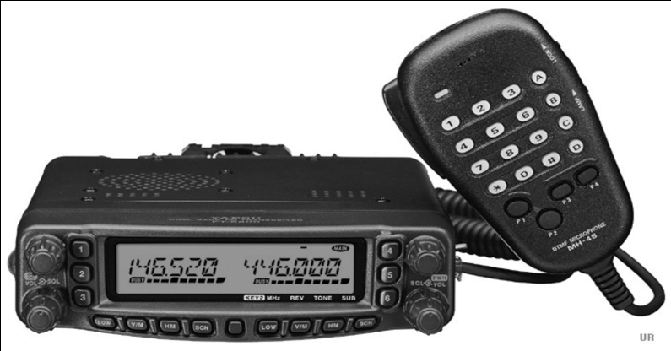
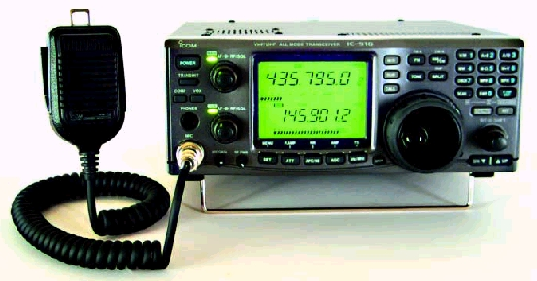
T2A: Station operation; choosing an operating frequency, calling another station, test transmissions, use of minimum power, frequency use, band plans.
T2A11 FCC rules regarding power levels used in the amateur bands state that an amateur must use the minimum transmitter power necessary to carry out the desired communication.
Amateur accepted simplex frequencies
Use the minimum amount of power output to make contact with another station

Slide 107


T2B: VHF/UHF operating practices; SSB phone, FM repeater, simplex, frequency offsets, splits and shifts, CTCSS, DTMF, tone squelch, carrier squelch, phonetics.
T2B1 Simplex communication is the term used to describe an amateur station that is transmitting and receiving on the same frequency.
  No offset frequency used for simplex like with a repeater
Xcvr #1
Xcvr #2
Xcvr #3
Xcvr #4
Transmitting
Frequency:
146.52 MHz
Receiving
Frequency
146.52 MHz
Receiving
Frequency
446.00 MHz
Transmitting
Frequency:
446.00 MHz
One way
One Way

Slide 108
T2B: VHF/UHF operating practices; SSB phone, FM repeater, simplex, frequency offsets, splits and shifts, CTCSS, DTMF, tone squelch, carrier squelch, phonetics.
T2B2 CTCSS is the term used to describe the use of a sub-audible tone transmitted with normal voice audio to open the squelch of a receiver (CTCSS – Continuous Tone-Coded Squelch System)
        Also called a PL tone.
CTCSS Tones In Use
67.0 Hz 94.8 Hz 131.8 Hz 171.3 Hz 203.5 Hz
69.3 Hz 97.4 Hz 136.5 Hz 173.8 Hz 206.5 Hz
71.9 Hz 100.0 Hz 141.3 Hz 177.3 Hz 210.7 Hz
74.4 Hz 103.5 Hz 146.2 Hz 179.9 Hz 218.1 Hz
77.0 Hz 107.2 Hz 151.4 Hz 183.5 Hz 225.7 Hz
79.7 Hz 110.9 Hz 156.7 Hz 186.2 Hz 229.1 Hz
82.5 Hz 114.8 Hz 159.8 Hz 189.9 Hz 233.6 Hz
85.4 Hz 118.8 Hz 162.2 Hz 192.8 Hz 241.8 Hz
88.5 Hz 123.0 Hz 165.5 Hz 196.6 Hz 250.3 Hz
91.5 Hz 127.3 Hz 167.9 Hz 199.5 Hz 254.1 Hz

Slide 109
T2B: VHF/UHF operating practices; SSB phone, FM repeater, simplex, frequency offsets, splits and shifts, CTCSS, DTMF, tone squelch, carrier squelch, phonetics.
T2B3 Carrier squelch describes the muting of receiver audio controlled solely by the presence or absence of an RF signal.
T2B4 Common problems that cause you to be able to hear but not access a repeater even when transmitting with the proper offset:
    The repeater receiver requires audio burst for access
    The repeater receiver requires a CTCSS tone for access
        CTCSS – Continuous Tone Control Squelch System
    The repeater receiver may require a DCS tone sequence for access
        DCS – Digital Code Squelch

Slide 110
T2B: VHF/UHF operating practices; SSB phone, FM repeater, simplex, frequency offsets, splits and shifts, CTCSS, DTMF, tone squelch, carrier squelch, phonetics.
T2B5 The amplitude of the modulating signal determines the amount of deviation of an FM signal.
T2B6 When the deviation of an FM transmitter is increased its signal occupies more bandwidth.
T2B7 If you receive a report that your station’s transmissions are causing splatter or interference on nearby frequencies check your transmitter for off-frequency operation or spurious emissions.
T2B8 The proper course of action to take if your station’s transmission unintentionally interferes with another station is to properly identify your transmission and move to a different frequency.

Slide 111
T2B: VHF/UHF operating practices; SSB phone, FM repeater, simplex, frequency offsets, splits and shifts, CTCSS, DTMF, tone squelch, carrier squelch, phonetics.
  T2B9 Use of a phonetic alphabet is the method encouraged by the FCC when identifying your station when using phone.
  T2B10 QRM is the "Q" signal used to indicate that you are receiving interference from other stations.
  T2B11 QSY is the "Q" signal used to indicate that you are changing frequency.
111

Slide 112
T2B: VHF/UHF operating practices; SSB phone, FM repeater, simplex, frequency offsets, splits and shifts, CTCSS, DTMF, tone squelch, carrier squelch, phonetics.
QRM
Something is causing interference
I am troubled by static/noise.
I am running low power.
I am going off the air.
Who is calling me?
Your signal is fading.
I received the message.
I will communicate with ________ directly.
I am changing frequency to _____.
My location is _______.
QRN
QRP
QRT
QRZ
QSB
QSL
QSO
QSY
QTH
112
112
Notes:
112

Slide 113

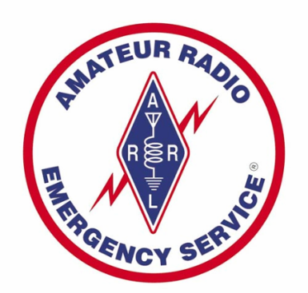
T2C: Public service; emergency and non-emergency operations, message traffic handling
  T2C1 FCC rules apply to proper operation of your station when using amateur radio at the request of public service officials.
      Amateur radio operators are not relieved from FCC rules at request from FBI, FEMA, or any other Federal agency.
  T2C4 Both RACES (Radio Amateur Civil Emergency Service) and ARES (Amateur Radio Emergency Service) organizations may provide communications during emergencies.
  T2C5 Radio Amateur Civil Emergency Service (RACES) is a radio service using amateur stations for emergency management or civil defense communications.

Slide 114
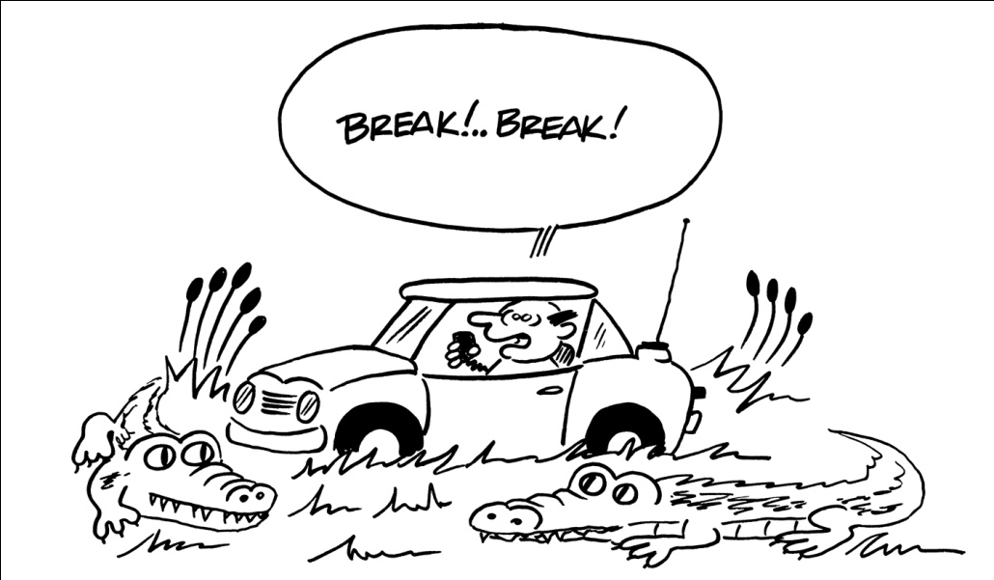
T2C: Public service; emergency and non-emergency operations, message traffic handling
  T2C6 Common practice during net operations to get the immediate attention of the net control station when reporting an emergency is to begin your transmission with “Priority” or “Emergency” followed by your call sign.
Another way to interrupt a conversation to signal a distress call is to say the word “BREAK” several times to indicate a priority or emergency distress call.

Slide 115
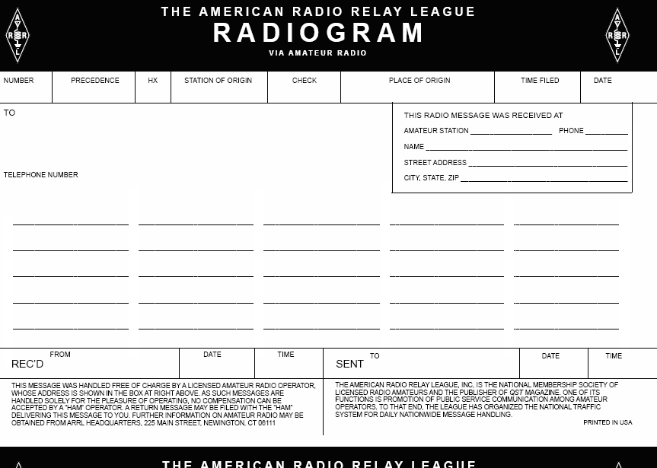
T2C: Public service; emergency and non-emergency operations, message traffic handling
T2C7 In order to minimize disruptions to an emergency traffic net once you have checked in, do not transmit on the net frequency until asked to do so by the net control station.
T2C8 Passing messages exactly as written, spoken or as received is usually considered to be the most important job of an amateur operator when handling emergency traffic messages.
      Write in block letters, word for word.

Slide 116
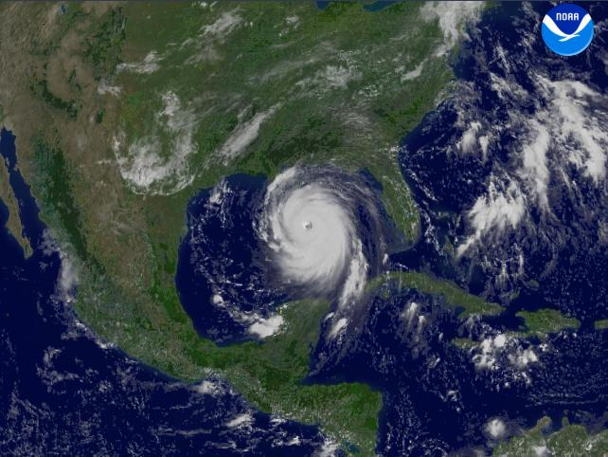
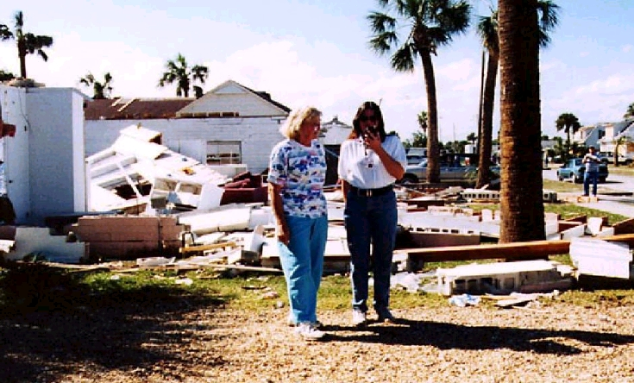
T2C: Public service; emergency and non-emergency operations, message traffic handling
  T2C9 When normal communications systems are not available, an amateur station may use any means of radio communications at its disposal for essential communications in connection with immediate safety of human life and protection of property.
        in an emergency, anything goes!

Slide 117
T2C: Public service; emergency and non-emergency operations, message traffic handling
  T2C10 In a formal traffic message the information needed to track the message as it passes through the amateur radio traffic handling system is called the preamble.
      Keep track of emergency messages as they pass through the well structured amateur radio traffic-handling system.
  T2C11 The term "check" in reference to a formal traffic message is a count of the number of words or word equivalents in the text portion of the message.
      include a ‘check’ to make sure all words in a message indeed were received in their entirety.

Slide 118
Element 2 Technician Class Question Pool
T2
Operating Procedures
[3 Exam Questions – 3 Groups]
Valid July 1, 2010
Through
June 30, 2014

Slide 119
T2A01 What is the most common repeater frequency offset in the 2 meter band?
  Plus 500 kHz
  Plus or minus 600 kHz
  Minus 500 kHz
  Only plus 600 kHz

Slide 120
T2A02 What is the national calling frequency for FM simplex operations in the 70 cm band?
146.520 MHz
145.000 MHz
432.100 MHz
446.000 MHz

Slide 121
T2A03 What is a common repeater frequency offset in the 70 cm band?
Plus or minus 5 MHz
Plus or minus 600 kHz
Minus 600 kHz
Plus 600 kHz

Slide 122
T2A04 What is an appropriate way to call another station on a repeater if you know the other station's call sign?
Say "break, break" then say the station's call sign
Say the station's call sign then identify with your call sign
Say "CQ" three times then the other station's call sign
Wait for the station to call "CQ" then answer it

Slide 123
T2A05 What should you transmit when responding to a call of CQ?
CQ followed by the other station’s call sign
Your call sign followed by the other station’s call sign
The other station’s call sign followed by your call sign
A signal report followed by your call sign

Slide 124
T2A06 What must an amateur operator do when making on-air transmissions to test equipment or antennas?
Properly identify the transmitting station
Make test transmissions only after 10:00 p.m. local time
Notify the FCC of the test transmission
State the purpose of the test during the test procedure

Slide 125
T2A07 Which of the following is true when making a test transmission?
Station identification is not required if the transmission is less than 15 seconds
Station identification is not required if the transmission is less than 1 watt
Station identification is required only if your station can be heard
Station identification is required at least every ten minutes during the test and at the end

Slide 126
T2A08 What is the meaning of the procedural signal "CQ"?
Call on the quarter hour
A new antenna is being tested (no station should answer)
Only the called station should transmit
Calling any station

Slide 127
T2A09 What brief statement is often used in place of "CQ" to indicate that you are listening on a repeater?
Say "Hello test" followed by your call sign
Say your call sign
Say the repeater call sign followed by your call sign
Say the letters "QSY" followed by your call sign

Slide 128
T2A10 What is a band plan, beyond the privileges established by the FCC?
A voluntary guideline for using different modes or activities within an amateur band
A mandated list of operating schedules
A list of scheduled net frequencies
A plan devised by a club to use a frequency band during a contest

Slide 129
T2A11 What are the FCC rules regarding power levels used in the amateur bands?
Always use the maximum power allowed to ensure that you complete the contact
An amateur may use no more than 200 watts PEP to make an amateur contact
An amateur may use up to 1500 watts PEP on any amateur frequency
An amateur must use the minimum transmitter power necessary to carry out the desired communication

Slide 130
T2B01 What is the term used to describe an amateur station that is transmitting and receiving on the same frequency?
Full duplex communication
Diplex communication
Simplex communication
Half duplex communication

Slide 131
T2B02 What is the term used to describe the use of a sub-audible tone transmitted with normal voice audio to open the squelch of a receiver?
Carrier squelch
Tone burst
DTMF
CTCSS

Slide 132
T2B03 Which of the following describes the muting of receiver audio controlled solely by the presence or absence of an RF signal?
Tone squelch
Carrier squelch
CTCSS
Modulated carrier

Slide 133
T2B04 Which of the following common problems might cause you to be able to hear but not access a repeater even when transmitting with the proper offset?
The repeater receiver requires audio tone burst for access
The repeater receiver requires a CTCSS tone for access
The repeater receiver may require a DCS tone sequence for access
All of these choices are correct

Slide 134
T2B05 What determines the amount of deviation of an FM signal?
Both the frequency and amplitude of the modulating signal
The frequency of the modulating signal
The amplitude of the modulating signal
The relative phase of the modulating signal and the carrier

Slide 135
T2B06 What happens when the deviation of an FM transmitter is increased?
Its signal occupies more bandwidth
Its output power increases
Its output power and bandwidth increases
Asymmetric modulation occurs

Slide 136
T2B07 What should you do if you receive a report that your station’s transmissions are causing splatter or interference on nearby frequencies?
Increase transmit power
Change mode of transmission
Report the interference to the equipment manufacturer
Check your transmitter for off-frequency operation or spurious emissions

Slide 137
T2B08 What is the proper course of action if your station’s transmission unintentionally interferes with another station?
Rotate your antenna slightly
Properly identify your transmission and move to a different frequency
Increase power
Change antenna polarization

Slide 138
T2B09 Which of the following methods is encouraged by the FCC when identifying your station when using phone?
Use of a phonetic alphabet
Send your call sign in CW as well as voice
Repeat your call sign three times
Increase your signal to full power when identifying

Slide 139
T2B10 What is the "Q" signal used to indicate that you are receiving interference from other stations?
QRM
QRN
QTH
QSB

Slide 140
T2B11 What is the "Q" signal used to indicate that you are changing frequency?
QRU
QSY
QSL
QRZ

Slide 141
T2C01 What set of rules applies to proper operation of your station when using amateur radio at the request of public service officials?
RACES Rules
ARES Rules
FCC Rules
FEMA Rules

Slide 142
T2C04 What do RACES and ARES have in common?
They represent the two largest ham clubs in the United States
Both organizations broadcast road and weather traffic information
Neither may handle emergency traffic supporting public service agencies
Both organizations may provide communications during emergencies

Slide 143
T2C05 What is the Radio Amateur Civil Emergency Service?
An emergency radio service organized by amateur operators
A radio service using amateur stations for emergency management or civil defense communications
A radio service organized to provide communications at civic events
A radio service organized by amateur operators to assist non-military persons

Slide 144
T2C06 Which of the following is common practice during net operations to get the immediate attention of the net control station when reporting an emergency?
Repeat the words SOS three times followed by the call sign of the reporting station
Press the push-to-talk button three times
Begin your transmission with “Priority” or “Emergency” followed by your call sign
Play a pre-recorded emergency alert tone followed by your call sign

Slide 145
T2C07 What should you do to minimize disruptions to an emergency traffic net once you have checked in?
Whenever the net frequency is quiet, announce your call sign and location
Move 5 kHz away from the net's frequency and use high power to ask other hams to keep clear of the net frequency
Do not transmit on the net frequency until asked to do so by the net control station
Wait until the net frequency is quiet, then ask for any emergency traffic for your area

Slide 146
T2C08 What is usually considered to be the most important job of an amateur operator when handling emergency traffic messages?
Passing messages exactly as written, spoken or as received
Estimating the number of people affected by the disaster
Communicating messages to the news media for broadcast outside the disaster area
Broadcasting emergency information to the general public

Slide 147
T2C09 When may an amateur station use any means of radio communications at its disposal for essential communications in connection with immediate safety of human life and protection of property?
Only when FEMA authorizes it by declaring an emergency
When normal communications systems are not available
Only when RACES authorizes it by declaring an emergency
Only when authorized by the local MARS program director

Slide 148
T2C10 What is the preamble in a formal traffic message?
The first paragraph of the message text
The message number
The priority handling indicator for the message
The information needed to track the message as it passes through the amateur radio traffic handling system

Slide 149
T2C11 What is meant by the term "check" in reference to a formal traffic message?
The check is a count of the number of words or word equivalents in the text portion of the message
The check is the value of a money order attached to the message
The check is a list of stations that have relayed the message
The check is a box on the message form that tells you the message was received

Slide 150
Technician Licensing Class
“T3”
Valid dates:
July 1, 2010 – June 30, 2014

Slide 151
Amateur Radio Technician Class
Element 2 Course Presentation
ELEMENT 2 SUB-ELEMENTS
  T1 - FCC Rules, descriptions and definitions for the amateur radio service, operator and station license responsibilities.
  T2 – Operating Procedures
  T3 – Radio wave characteristics, radio and electromagnetic properties, propagation modes
  T4 – Amateur radio practices and station set up
  T5 – Electrical principles, math for electronics, electronic principles, Ohm’s Law
  T6 – Electrical components, semiconductors, circuit diagrams, component functions
  T7 – Station equipment, common transmitter and receiver problems, antenna measurements and troubleshooting, basic repair and testing
  T8 – Modulation modes, amateur satellite operation, operating activities, non-voice communications
  T9 – Antennas, feedlines
  T0 – AC power circuits, antenna installation, RF hazards

Slide 152
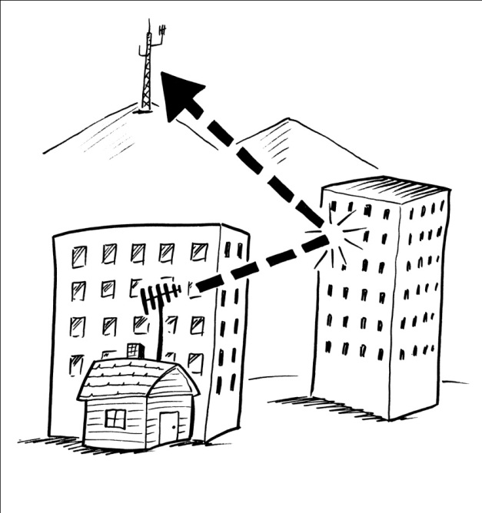
T3A: Radio wave characteristics; how a radio signal travels; distinctions of HF, VHF, and UHF; fading, multipath; wavelengths vs. penetration; antenna orientation.
  T3A1 Should another operator reports that your stations 2 meter signals were strong just a moment ago, but now they are weak or distorted, try moving a few feet, as random reflections may be causing multi-path distortion.
  T3A2 UHF signals are often more effective from inside buildings than VHF signals as the shorter wavelength allows them to more easily penetrate the structure of buildings.
UHF signals are short enough in wavelength to permit bouncing around inside buildings and penetrating of walls.

Slide 153
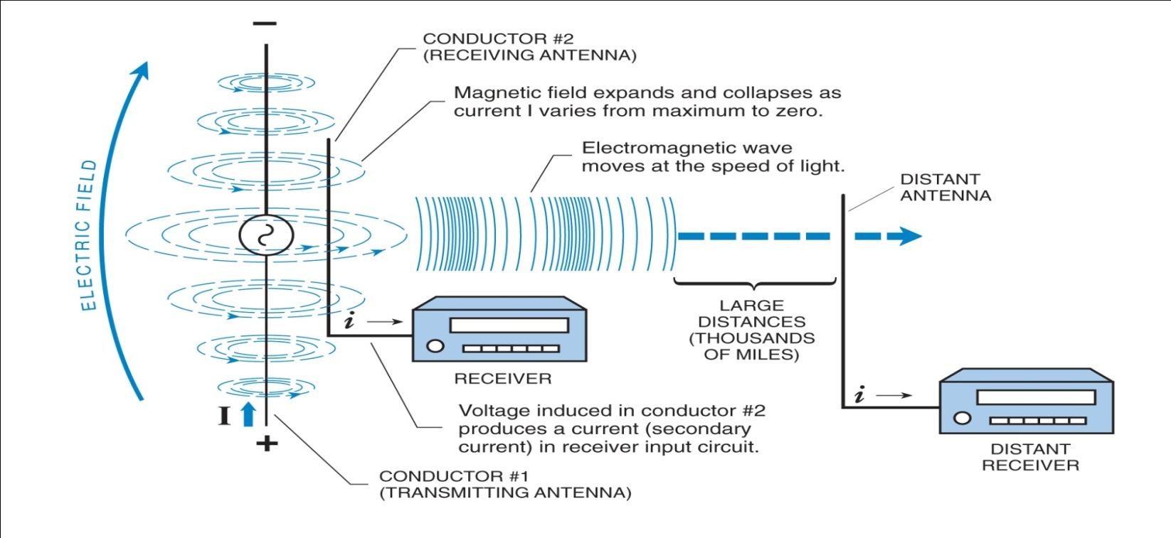
T3A: Radio wave characteristics; how a radio signal travels; distinctions of HF, VHF, and UHF; fading, multipath; wavelengths vs. penetration; antenna orientation.
  T3A3 Horizontal antenna polarization is normally used for long-distance weak-signal CW and SSB contacts using the VHF and UHF bands.
  T3A4 Signals could be significantly weaker if the antennas at opposite ends of a VHF or UHF line of sight radio link are not using the same polarization.
Transmitter to Receiver – Radio waves from transmitting antennas induce signals in receiving antennas as they pass by

Slide 154
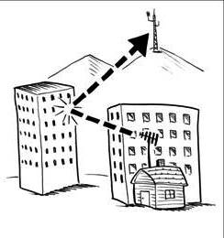
T3A: Radio wave characteristics; how a radio signal travels; distinctions of HF, VHF, and UHF; fading, multipath; wavelengths vs. penetration; antenna orientation.
  T3A5 When using a directional antenna, your station might be able to access a distant repeater if buildings or obstructions are blocking the direct line of sight path by finding a path that reflects signals to the repeater.
Directional Antenna can be used to bounce signal to reach repeater blocked by building

Slide 155
T3A: Radio wave characteristics; how a radio signal travels; distinctions of HF, VHF, and UHF; fading, multipath; wavelengths vs. penetration; antenna orientation.
  T3A6 Picket fencing is the term commonly used to describe the rapid fluttering sound sometimes heard from mobile stations that are moving while transmitting.
  T3A7 Electromagnetic waves carry radio signals between transmitting and receiving stations.
  T3A8 The cause of irregular fading of signals from distant stations during times of generally good reception is due to random combining of signals arriving via different path lengths.

Slide 156
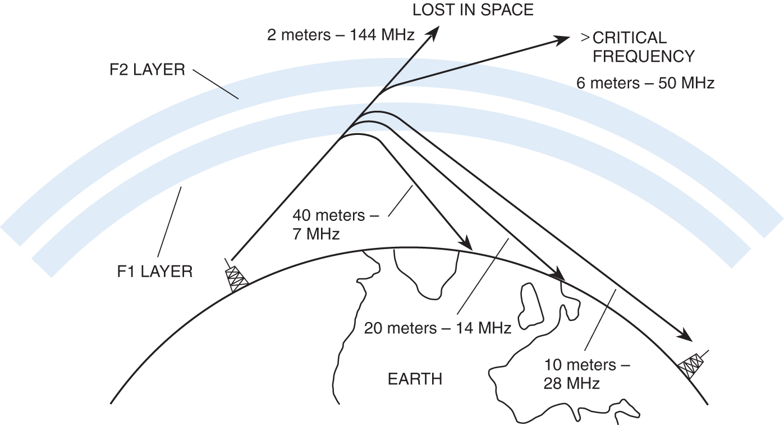
T3A: Radio wave characteristics; how a radio signal travels; distinctions of HF, VHF, and UHF; fading, multipath; wavelengths vs. penetration; antenna orientation.
  T3A9 A common effect of "skip" reflections between the Earth and the ionosphere is the polarization of the original signal becomes randomized.
      Skip happens when signals refract and reflect off the ionosphere.
        DX stations 1000 miles away come booming in.
      Every 30 seconds signal goes from strong to weak and back.
        Caused by random, ever changing polarization of the original signal.
156
Critical Frequency

Slide 157
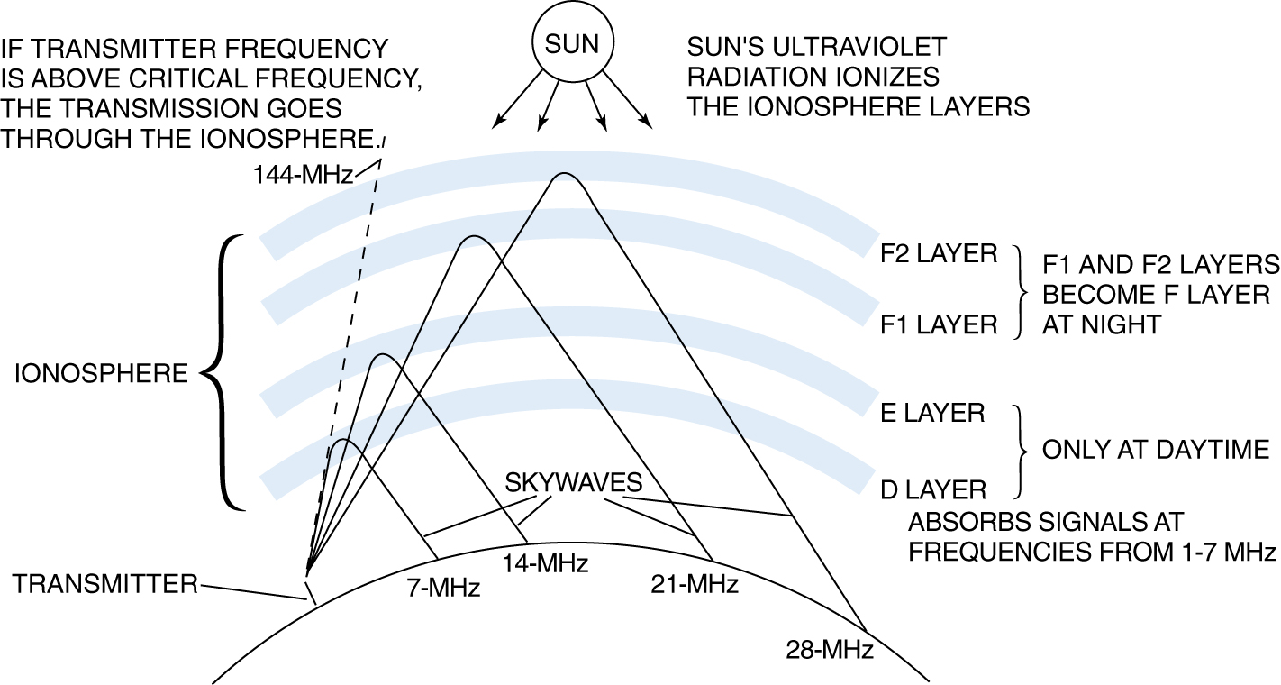
T3A: Radio wave characteristics; how a radio signal travels; distinctions of HF, VHF, and UHF; fading, multipath; wavelengths vs. penetration; antenna orientation.
  T3A10 Error rates are likely to increase on VHF or UHF data signals propagated over multiple paths.
  T3A11 The ionosphere is the part of the atmosphere that enables the propagation of radio signals around the world.
Ionosphere and its layers

Slide 158
T3B: Radio and electromagnetic wave properties; the electromagnetic spectrum, wavelength vs. frequency, velocity of electromagnetic waves.
  T3B1 The name for the distance a radio wave travels during one complete cycle is wavelength. Keywords: distance and wavelength
  T3B2 The term that describes the number of times per second that an alternating current reverses direction is frequency.
V+
One Cycle
0V
V-
time
One Wavelength
158

Slide 159
T3B: Radio and electromagnetic wave properties; the electromagnetic spectrum, wavelength vs. frequency, velocity of electromagnetic waves.
  T3B3 Electric and magnetic fields are the two components of a radio wave.
  T3B4 Radio waves travel through free space at the speed of light.
  T3B5 The wavelength of a radio wave relates to its frequency inversely, as the wavelength gets shorter the frequency increases.
      Higher in frequency the shorter the distance between each wave.
      They are at right angles to each other and together are called “electromagnetic” radio waves

Slide 160


T3B: Radio and electromagnetic wave properties; the electromagnetic spectrum, wavelength vs. frequency, velocity of electromagnetic waves.
  T3B6 The formula for converting frequency to wavelength in meters is the wavelength in meters equals 300 divided by frequency in megahertz. (One answer ends with word Megahertz)
Conversions Between Wavelength and Frequency
Converting Frequency to Wavelength
Converting Wavelength to Frequency
To find wavelength ( ) in meters, if you know fre3quency (f) in megahertz (MHz) Solve:
To find frequency (f) in megahertz (MHz), if you know wavelength ( ) in meters, Solve:
(meters) =
300
f(MHz) =
300
f(MHz)
(meters)
160

Slide 161
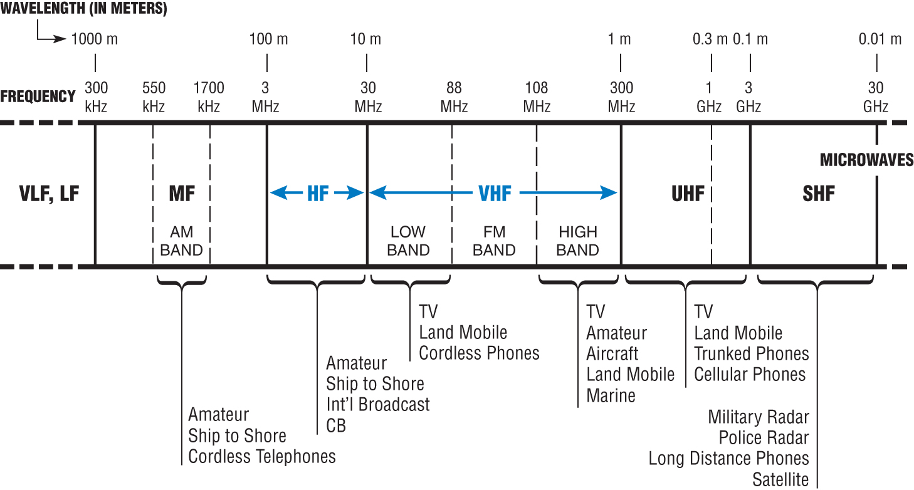
T3B: Radio and electromagnetic wave properties; the electromagnetic spectrum, vs. frequency, velocity of electromagnetic waves.
  T3B7 The property of radio waves often used to identify the different frequency bands is the approximate wavelength.
    Wavelength of the band: 2 meters; 20 meters; 40 meters, etc
  T3B8 The frequency limits of the VHF spectrum are 30 MHz to 300 MHz.
2-meters
70 CM
161

Slide 162
T3B: Radio and electromagnetic wave properties; the electromagnetic spectrum, vs. frequency, velocity of electromagnetic waves.
  T3B9 The frequency limits of the UHF spectrum are 300 MHz to 3000 MHz.
        UHF is 300 MHz to 3000 MHz
  T3B10 The frequency range referred to as HF is 3 MHz to 30 MHz.
  T3B11 The approximate velocity of a radio wave as it travels through free space is 300,000,000 meters per second.

Slide 163
T3C: Propagation modes; line of sight, sporadic E, meteor, aurora scatter, tropospheric ducting, F layer skip, radio horizons
  T3C1 UHF signals "direct" (not via a repeater) are rarely heard from stations outside your local coverage area because UHF signals are usually not reflected by the ionosphere.
    REFRACTION IN THE IONOSPHERE:
      When a radio wave is transmitted into an ionized layer, refraction, or bending of the wave, occurs.
      Refraction is caused by an abrupt change in the velocity of the upper part of a radio wave as it strikes or enters a new medium.
      The amount of refraction that occurs depends on three main factors:
        (1) the density of ionization of the layer,
        (2) the frequency of the radio wave,
        (3) the angle at which the wave enters the layer
    REFLECTION IN THE IONOSPHERE:
      When a radio wave hits an obstacle, some or all of the wave is reflected, with a loss of intensity.
      Reflection is such that the angle of incidence is equal to the angle of reflection.

Slide 164
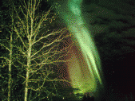
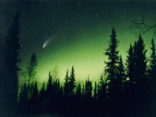
T3C: Propagation modes; line of sight, sporadic E, meteor, aurora scatter, tropospheric ducting, F layer skip, radio horizons
  T3C2 When VHF signals are being received from long distances these signals are being refracted from a sporadic E layer.
      Sporadic-E refractions off ionized patches of the ionospheric E-layer are common in summer on 6-meters.
  T3C3 A characteristic of VHF signals received via auroral reflection is that the signals exhibit rapid fluctuations of strength and often sound distorted.
Incoming signals from a distant station heard hundreds of miles away will sound fluttery and distorted by auroral bounce

Slide 165
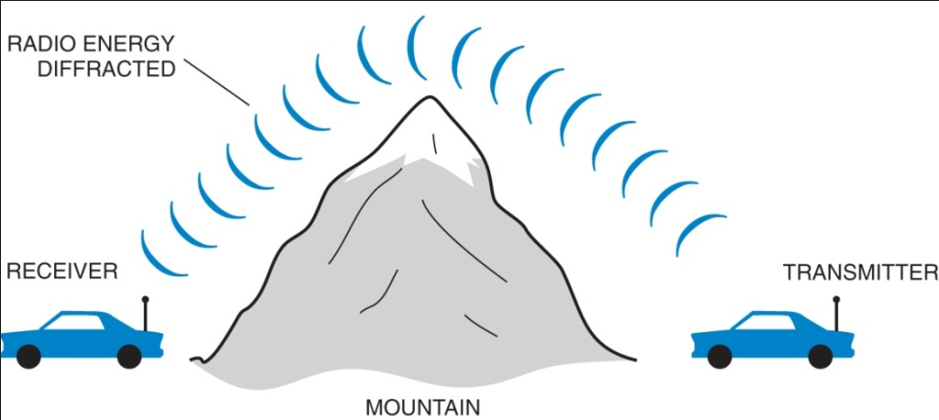
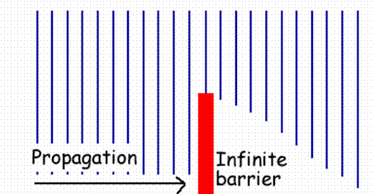
T3C: Propagation modes; line of sight, sporadic E, meteor, aurora scatter, tropospheric ducting, F layer skip, radio horizons
  T3C4 Sporadic E propagation is most commonly associated with occasional strong over-the-horizon signals on the 10, 6, and 2 meter bands.
  T3C5 The term "knife-edge" propagation refers to signals that are partially refracted around solid objects exhibiting sharp edges.
Knife-Edge Diffraction

Slide 166
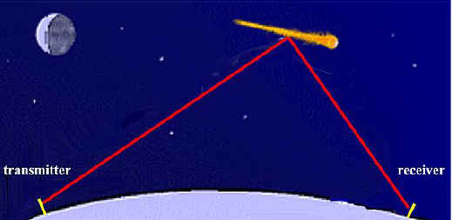
T3C: Propagation modes; line of sight, sporadic E, meteor, aurora scatter, tropospheric ducting, F layer skip, radio horizons
  T3C6 Tropospheric scatter is responsible for allowing over-the-horizon VHF and UHF communications to ranges of approximately 300 miles on a regular basis.
  T3C7 The 6 meter band is best suited to communicating via meteor scatter.
      Leonids and Geminids meteor showers provide these conditions
      Bounce signals off meteor tail

Slide 167
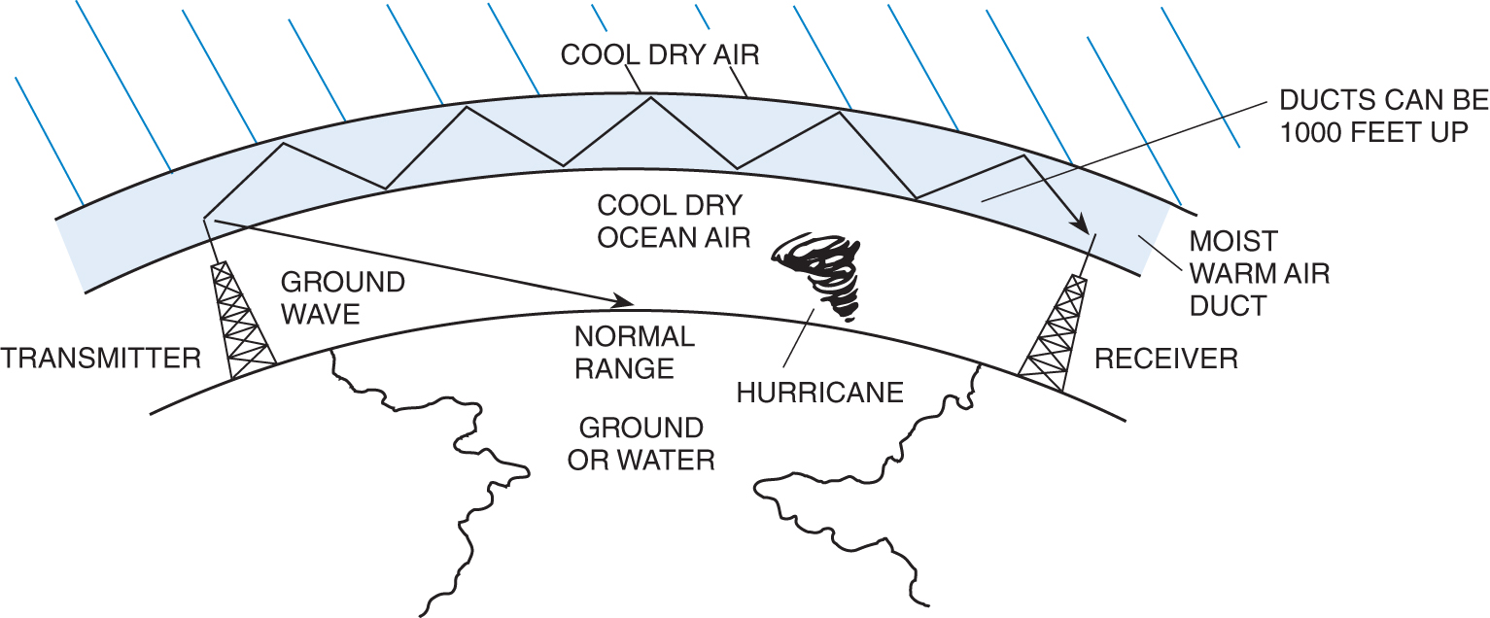
T3C: Propagation modes; line of sight, sporadic E, meteor, aurora scatter, tropospheric ducting, F layer skip, radio horizons
  T3C8 Temperature inversions in the atmosphere causes "tropospheric ducting".
Tropospheric Ducting

Slide 168
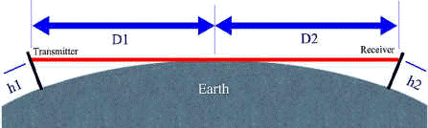
T3C: Propagation modes; line of sight, sporadic E, meteor, aurora scatter, tropospheric ducting, F layer skip, radio horizons
  T3C9 During daylight hours is generally the best time for long-distance 10 meter band propagation.
  T3C10 The distance at which radio signals between two points are effectively blocked by the curvature of the Earth is the radio horizon.
      VHF & UHF radio signals will generally travel “line of sight.”
      VHF & UHF radio signals are blocked by the curvature of the Earth.
  T3C11 VHF and UHF radio signals usually travel somewhat farther than the visual line of sight distance between two stations because the Earth seems less curved to radio waves than to light.
        the Earth seems less curved to VHF and UHF radio signals.

Slide 169
Element 2 Technician Class
Question Pool
T3
Radio wave characteristics, radio and electromagnetic properties, propagation modes
[3 Exam Questions – 3 Groups]
Valid July 1, 2010
Through
June 30, 2014

Slide 170
T3A01 What should you do if another operator reports that your station’s 2 meter signals were strong just a moment ago, but now they are weak or distorted?
  Change the batteries in your radio to a different type
  Turn on the CTCSS tone
  Ask the other operator to adjust his squelch control
  Try moving a few feet, as random reflections may be causing multi-path distortion

Slide 171
T3A02 Why are UHF signals often more effective from inside buildings than VHF signals?
  Change the batteries in your radio to a different type
  The shorter wavelength allows them to more easily penetrate the structure of buildings
  This is incorrect; VHF works better than UHF inside buildings
  UHF antennas are more efficient than VHF antennas

Slide 172
T3A03 What antenna polarization is normally used for long-distance weak-signal CW and SSB contacts using the VHF and UHF bands?
  Right-hand circular
  Left-hand circular
  Horizontal
  Vertical

Slide 173
T3A04 What can happen if the antennas at opposite ends of a VHF or UHF line of sight radio link are not using the same polarization?
  The modulation sidebands might become inverted
  Signals could be significantly weaker
  Signals have an echo effect on voices
  Nothing significant will happen

Slide 174
T3A05 When using a directional antenna, how might your station be able to access a distant repeater if buildings or obstructions are blocking the direct line of sight path?
Change from vertical to horizontal polarization
Try to find a path that reflects signals to the repeater
Try the long path
Increase the antenna SWR

Slide 175
T3A06 What term is commonly used to describe the rapid fluttering sound sometimes heard from mobile stations that are moving while transmitting?
  Flip-flopping
  Picket fencing
  Frequency shifting
  Pulsing

Slide 176
T3A07 What type of wave carries radio signals between transmitting and receiving stations?
  Electromagnetic
  Electrostatic
  Surface acoustic
  Magnetostrictive

Slide 177
T3A08 What is the cause of irregular fading of signals from distant stations during times of generally good reception.
  Absorption of signals by the "D" layer of the ionosphere
  Absorption of signals by the "E" layer of the ionosphere
  Random combining of signals arriving via different path lengths
  Intermodulation distortion in the local receiver

Slide 178
T3A09 Which of the following is a common effect of "skip" reflections between the Earth and the ionosphere?
  The sidebands become reversed at each reflection
  The polarization of the original signal is randomized
  The apparent frequency of the received signal is shifted by a random amount
  Signals at frequencies above 30 MHz become stronger with each reflection

Slide 179
T3A10 What may occur if VHF or UHF data signals propagate over multiple paths?
  Transmission rates can be increased by a factor equal to the number of separate paths observed
  Transmission rates must be decreased by a factor equal to the number of separate paths observed
  No significant changes will occur if the signals are transmitting using FM
  Error rates are likely to increase

Slide 180
T3A11 Which part of the atmosphere enables the propagation of radio signals around the world?
  The stratosphere
  The troposphere
  The ionosphere
  The magnetosphere

Slide 181
T3B01 What is the name for the distance a radio wave travels during one complete cycle?
  Wave speed
  Waveform
  Wavelength
  Wave spread

Slide 182
T3B02 What term describes the number of times per second that an alternating current reverses direction?
  Pulse rate
  Speed
  Wavelength
  Frequency

Slide 183
T3B03 What are the two components of a radio wave?
  AC and DC
  Voltage and current
  Electric and magnetic fields
  Ionizing and non-ionizing radiation

Slide 184
T3B04 How fast does a radio wave travel through free space?
  At the speed of light
  At the speed of sound
  Its speed is inversely proportional to its wavelength
  Its speed increases as the frequency increases

Slide 185
T3B05 How does the wavelength of a radio wave relate to its frequency?
  The wavelength gets longer as the frequency increases
  The wavelength gets shorter as the frequency increases
  There is no relationship between wavelength and frequency
  The wavelength depends on the bandwidth of the signal

Slide 186
T3B06 What is the formula for converting frequency to wavelength in meters?
  Wavelength in meters equals frequency in hertz multiplied by 300
  Wavelength in meters equals frequency in hertz divided by 300
  Wavelength in meters equals frequency in megahertz divided by 300
  Wavelength in meters equals 300 divided by frequency in megahertz

Slide 187
T3B07 What property of radio waves is often used to identify the different frequency bands?
  The approximate wavelength
  The magnetic intensity of waves
  The time it takes for waves to travel one mile
  The voltage standing wave ratio of waves

Slide 188
T3B08 What are the frequency limits of the VHF spectrum?
  30 to 300 kHz
  30 to 300 MHz
  300 to 3000 kHz
  300 to 3000 MHz

Slide 189
T3B09 What are the frequency limits of the UHF spectrum?
  30 to 300 kHz
  30 to 300 MHz
  300 to 3000 kHz
  300 to 3000 MHz

Slide 190
T3B10 What frequency range is referred to as HF?
  300 to 3000 MHz
  30 to 300 MHz
  3 to 30 MHz
  300 to 3000 kHz

Slide 191
T3B11 What is the approximate velocity of a radio wave as it travels through free space?
  3000 kilometers per second
  300,000,000 meters per second
  300,000 miles per hour
  186,000 miles per hour

Slide 192
T3C01 Why are "direct" (not via a repeater) UHF signals rarely heard from stations outside your local coverage area?
  They are too weak to go very far
  FCC regulations prohibit them from going more than 50 miles
  UHF signals are usually not reflected by the ionosphere
  They collide with trees and shrubbery and fade out

Slide 193
T3C02 Which of the following might be happening when VHF signals are being received from long distances?
Signals are being reflected from outer space
Signals are arriving by sub-surface ducting
Signals are being reflected by lightning storms in your area
Signals are being refracted from a sporadic E layer

Slide 194
T3C03 What is a characteristic of VHF signals received via auroral reflection?
  Signals from distances of 10,000 or more miles are common
  The signals exhibit rapid fluctuations of strength and often sound distorted
  These types of signals occur only during winter nighttime hours
  These types of signals are generally strongest when your antenna is aimed to the south (for stations in the Northern Hemisphere)

Slide 195
T3C04 Which of the following propagation types is most commonly associated with occasional strong over-the- horizon signals on the 10, 6, and 2 meter bands?
  Backscatter
  Sporadic E
  D layer absorption
  Gray-line propagation

Slide 196
T3C05 What is meant by the term "knife-edge" propagation?
  Signals are reflected back toward the originating station at acute angles
  Signals are sliced into several discrete beams and arrive via different paths
  Signals are partially refracted around solid objects exhibiting sharp edges
  Signals propagated close to the band edge exhibiting a sharp cutoff

Slide 197
T3C06 What mode is responsible for allowing over-the- horizon VHF and UHF communications to ranges of approximately 300 miles on a regular basis?
  Tropospheric scatter
  D layer refraction
  F2 layer refraction
  Faraday rotation

Slide 198
T3C07 What band is best suited to communicating via meteor scatter?
  10 meters
  6 meters
  2 meters
  70 cm

Slide 199
T3C08 What causes "tropospheric ducting"?
  Discharges of lightning during electrical storms
  Sunspots and solar flares
  Updrafts from hurricanes and tornadoes
  Temperature inversions in the atmosphere

Slide 200
T3C09 What is generally the best time for long- distance 10 meter band propagation?
  During daylight hours
  During nighttime hours
  When there are coronal mass ejections
  Whenever the solar flux is low

Slide 201
T3C10 What is the radio horizon?
  The distance at which radio signals between two points are effectively blocked by the curvature of the Earth
  The distance from the ground to a horizontally mounted antenna
  The farthest point you can see when standing at the base of your antenna tower
  The shortest distance between two points on the Earth's surface

Slide 202
T3C11 Why do VHF and UHF radio signals usually travel somewhat farther than the visual line of sight distance between two stations?
  Radio signals move somewhat faster than the speed of light
  Radio waves are not blocked by dust particles
  The Earth seems less curved to radio waves than to light
  Radio waves are blocked by dust particles

Slide 203
Technician Licensing Class
“T4”
Valid dates:
July 1, 2010 – June 30, 2014

Slide 204
Amateur Radio Technician Class
Element 2 Course Presentation
ELEMENT 2 SUB-ELEMENTS
  T1 - FCC Rules, descriptions and definitions for the amateur radio service, operator and station license responsibilities.
  T2 – Operating Procedures
  T3 – Radio wave characteristics, radio and electromagnetic properties, propagation modes
  T4 – Amateur radio practices and station set up
  T5 – Electrical principles, math for electronics, electronic principles, Ohm’s Law
  T6 – Electrical components, semiconductors, circuit diagrams, component functions
  T7 – Station equipment, common transmitter and receiver problems, antenna measurements and troubleshooting, basic repair and testing
  T8 – Modulation modes, amateur satellite operation, operating activities, non-voice communications
  T9 – Antennas, feedlines
  T0 – AC power circuits, antenna installation, RF hazards

Slide 205
T4A: Station setup; microphone, speaker, headphones, filters, power source, connecting a computer, RF grounding
  T4A1 Concerning the microphone connectors on amateur transceivers, some connectors include push-to-talk and voltages for powering the microphone.
VHF/UHF Transceiver
Push to talk button
Connector

Slide 206
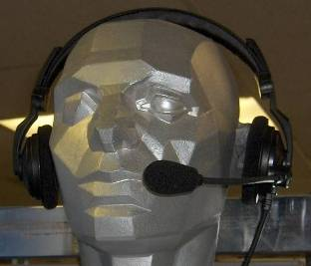
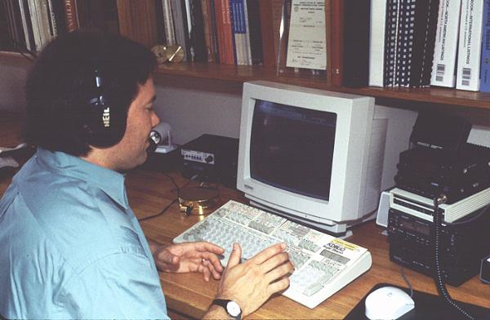
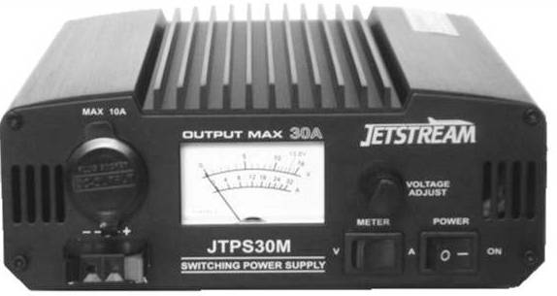
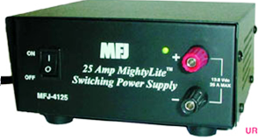
T4A: Station setup; microphone, speaker, headphones, filters, power source, connecting a computer, RF grounding
  T4A2 A set of headphones could be used in place of a regular speaker to help you copy signals in a noisy area.
  T4A3 Preventing voltage fluctuations from reaching sensitive circuits is a good reason to use a regulated power supply for communications equipment.
206
MFJ-4125 13.8VDC@22Amp
Jetstream JTPS30M Regulated Power Supply

Slide 207

T4A: Station setup; microphone, speaker, headphones, filters, power source, connecting a computer, RF grounding
  T4A4 Install a filter between the transmitter and antenna to reduce harmonic emissions.
There are low-pass filters like this one, band-pass filters, and high-pass filters that can be used to solve interference problems.
Drake TV-3300-LP Low Pass Filter. 80 db attenuation above 41 MHz. 1000 Watts below 30 MHz.
207

Slide 208


T4A: Station setup; microphone, speaker, headphones, filters, power source, connecting a computer, RF grounding
  T4A5 A band-reject filter should be connected to a TV receiver as the first step in trying to prevent RF overload from a nearby 2 meter transmitter.
Passes low frequencies and cuts high frequencies
Low Pass Filter on Transmitter
High Pass Filter on TV
Low Pass Filter
208

Slide 209


T4A: Station setup; microphone, speaker, headphones, filters, power source, connecting a computer, RF grounding
  T4A6 A terminal node controller would be connected between a transceiver and computer in a packet radio station.
A Packet Radio System.
Some Packet equipment
209

Slide 210

T4A: Station setup; microphone, speaker, headphones, filters, power source, connecting a computer, RF grounding
  T4A7 The sound card provides audio to the microphone input and converts received audio to digital form when conducting digital communications using a computer.
  T4A8 A Flat strap conductor is best to use for RF grounding.
      Offers best surface area
        Bleed off static and minimize ground currents
        Straps usually are 3 inches wide
        Folding okay to snake down to a healthy ground rod
Copper Foil Ground Strap Provides Good Surface Area Ground

Slide 211

T4A: Station setup; microphone, speaker, headphones, filters, power source, connecting a computer, RF grounding
  T4A9 You would use a ferrite choke to reduce RF current flowing on the shield of an audio cable.
  T4A10 The alternator is the source of a high-pitched whine that varies with engine speed in a mobile transceiver’s receive audio.
  T4A11 A mobile transceiver’s power negative connection should be made at the battery or engine block ground strap.
    Ham radio power leads need to be connected directly at the battery source.
Clam shell iron devices just snap on over wiring

Slide 212


T4B: Operating controls; tuning, use of filters, squelch, AGC, repeater offset, memory channels
  T4B1 If a transmitter is operated with the microphone gain set too high the output signal might become distorted.
  T4B2 The keypad or VFO knob can be used to enter the operating frequency on a modern transceiver.
      VFO – Variable Frequency Oscillator
VFO knob
Mic Keypad
212

Slide 213


T4B: Operating controls; tuning, use of filters, squelch, AGC, repeater offset, memory channels
  T4B3 The purpose of the squelch control on a transceiver is to mute receiver output noise when no signal is being received.
      Squelch control silences the background noise
  T4B4 Quick access to a favorite frequency on your transceiver can be done by storing the frequency in a memory channel.
squelch control
squelch control
With a transceiver (HT) like one of these, you can hold your ham station in the palm of your hand.
213

Slide 214

T4B: Operating controls; tuning, use of filters, squelch, AGC, repeater offset, memory channels
  T4B5 Turning on the noise blanker would reduce ignition interference to a receiver.
    Not on common FM handheld or mobile FM radios
    On bigger high-frequency, multi-mode tranceiver
Even this older Icom 730 has the NB function
PreAmp built in
NB – Noise Blanker
214

Slide 215

T4B: Operating controls; tuning, use of filters, squelch, AGC, repeater offset, memory channels
  T4B6 The receiver RIT or clarifier controls could be used if the voice pitch of a single-sideband signal seems too high or low.
  T4B7 The term "RIT" means Receiver Incremental Tuning.
Set knob to neutral, press RIT button to turn on function, and then adjust slightly for proper SSB voice reception
RIT adjusts voice pitch, not the frequency of received station.
215

Slide 216

T4B: Operating controls; tuning, use of filters, squelch, AGC, repeater offset, memory channels
  T4B8 The advantage of having multiple receive bandwidth choices on a multimode transceiver will permit noise or interference reduction by selecting a bandwidth matching the mode.
  T4B9 2400 Hz is an appropriate receive filter to select in order to minimize noise and interference for SSB reception.
SSB Filter
Slots for optional filters
216
Receiver section in a communications transceiver

Slide 217
T4B: Operating controls; tuning, use of filters, squelch, AGC, repeater offset, memory channels
  T4B10 500 Hz is an appropriate receive filter to select in order to minimize noise and interference for CW reception.
      Bandwidth filters vary for the mode being received.
  T4B11 The difference between the repeater's transmit and receive frequencies describes the common meaning of the term “repeater offset”.

Slide 218
Element 2 Technician Class
Question Pool
T4
Amateur radio practices and station set up
[2 Exam Questions – 2 Groups]
Valid July 1, 2010
Through
June 30, 2014

Slide 219
T4A01 Which of the following is true concerning the microphone connectors on amateur transceivers?
  All transceivers use the same microphone connector type
  Some connectors include push-to-talk and voltages for powering the microphone
  All transceivers using the same connector type are wired identically
  Un-keyed connectors allow any microphone to be connected

Slide 220
T4A02 What could be used in place of a regular speaker to help you copy signals in a noisy area?
  A video display
  A low pass filter
  A set of headphones
  A boom microphone

Slide 221
T4A03 Which is a good reason to use a regulated power supply for communications equipment?
  It prevents voltage fluctuations from reaching sensitive circuits
  A regulated power supply has FCC approval
  A fuse or circuit breaker regulates the power
  Power consumption is independent of load

Slide 222
T4A04 Where must a filter be installed to reduce harmonic emissions?
  Between the transmitter and the antenna
  Between the receiver and the transmitter
  At the station power supply
  At the microphone

Slide 223
T4A05 What type of filter should be connected to a TV receiver as the first step in trying to prevent RF overload from a nearby 2 meter transmitter?
  Low-pass filter
  High-pass filter
  Band-pass filter
  Band-reject filter

Slide 224
T4A06 Which of the following would be connected between a transceiver and computer in a packet radio station?
  Transmatch
  Mixer
  Terminal node controller
  Antenna

Slide 225
T4A07 How is the computer’s sound card used when conducting digital communications using a computer?
  The sound card communicates between the computer CPU and the video display
  The sound card records the audio frequency for video display
  The sound card provides audio to the microphone input and converts received audio to digital form
  All of these choices are correct

Slide 226
T4A08 Which type of conductor is best to use for RF grounding?
  Round stranded wire
  Round copper-clad steel wire
  Twisted-pair cable
  Flat strap

Slide 227
T4A09 Which would you use to reduce RF current flowing on the shield of an audio cable?
  Band-pass filter
  Low-pass filter
  Preamplifier
  Ferrite choke

Slide 228
T4A10 What is the source of a high-pitched whine that varies with engine speed in a mobile transceiver’s receive audio?
  The ignition system
  The alternator
  The electric fuel pump
  Anti-lock braking system controllers

Slide 229
T4A11 Where should a mobile transceiver’s power negative connection be made?
  At the battery or engine block ground strap
  At the antenna mount
  To any metal part of the vehicle
  Through the transceiver’s mounting bracket

Slide 230
T4B01 What may happen if a transmitter is operated with the microphone gain set too high?
  The output power might be too high
  The output signal might become distorted
  The frequency might vary
  The SWR might increase

Slide 231
T4B02 Which of the following can be used to enter the operating frequency on a modern transceiver?
  The keypad or VFO knob
  The CTCSS or DTMF encoder
  The Automatic Frequency Control
  All of these choices are correct

Slide 232
T4B03 What is the purpose of the squelch control on a transceiver?
  To set the highest level of volume desired
  To set the transmitter power level
  To adjust the automatic gain control
  To mute receiver output noise when no signal is being received

Slide 233
T4B04 What is a way to enable quick access to a favorite frequency on your transceiver?
  Enable the CTCSS tones
  Store the frequency in a memory channel
  Disable the CTCSS tones
  Use the scan mode to select the desired frequency

Slide 234
T4B05 Which of the following would reduce ignition interference to a receiver?
  Change frequency slightly
  Decrease the squelch setting
  Turn on the noise blanker
  Use the RIT control

Slide 235
T4B06 Which of the following controls could be used if the voice pitch of a single-sideband signal seems too high or low?
  The AGC or limiter
  The bandwidth selection
  The tone squelch
  The receiver RIT or clarifier

Slide 236
T4B07 What does the term "RIT" mean?
  Receiver Input Tone
  Receiver Incremental Tuning
  Rectifier Inverter Test
  Remote Input Transmitter

Slide 237
T4B08 What is the advantage of having multiple receive bandwidth choices on a multimode transceiver?
  Permits monitoring several modes at once
  Permits noise or interference reduction by selecting a bandwidth matching the mode
  Increases the number of frequencies that can be stored in memory
  Increases the amount of offset between receive and transmit frequencies

Slide 238
T4B09 Which of the following is an appropriate receive filter to select in order to minimize noise and interference for SSB reception?
  500 Hz
  1000 Hz
  2400 Hz
  5000 Hz

Slide 239
T4B10 Which of the following is an appropriate receive filter to select in order to minimize noise and interference for CW reception?
  500 Hz
  1000 Hz
  2400 Hz
  5000 Hz

Slide 240
T4B11 Which of the following describes the common meaning of the term “repeater offset”?
  The distance between the repeater’s transmit and receive antennas
  The time delay before the repeater timer resets
  The difference between the repeater’s transmit and receive frequencies
  The maximum frequency deviation permitted on the repeater’s input signal

Slide 241
Technician Licensing Class
“T5”
Valid dates:
July 1, 2010 – June 30, 2014

Slide 242
Amateur Radio Technician Class
Element 2 Course Presentation
ELEMENT 2 SUB-ELEMENTS
  T1 - FCC Rules, descriptions and definitions for the amateur radio service, operator and station license responsibilities.
  T2 – Operating Procedures
  T3 – Radio wave characteristics, radio and electromagnetic properties, propagation modes
  T4 – Amateur radio practices and station set up
  T5 – Electrical principles, math for electronics, electronic principles, Ohm’s Law
  T6 – Electrical components, semiconductors, circuit diagrams, component functions
  T7 – Station equipment, common transmitter and receiver problems, antenna measurements and troubleshooting, basic repair and testing
  T8 – Modulation modes, amateur satellite operation, operating activities, non-voice communications
  T9 – Antennas, feedlines
  T0 – AC power circuits, antenna installation, RF hazards

Slide 243

T5A: Electrical principles; current and voltage, conductors and insulators, alternating and direct current
  T5A1 Electrical current is measured in amperes.
  T5A2 Electrical power is measured in watts.
        The power meter outside is called ‘watt meter’
  T5A3 Current is the name for the flow of electrons in an electric circuit.
        Think of the flow of water in a pipe (not the force)
  T5A4 Direct current is the name for a current that flows only in one direction.
9 Volt battery
AAA battery
Motor cycle battery
Hand held battery

Slide 244


T5A: Electrical principles; current and voltage, conductors and insulators, alternating and direct current
  T5A5 Voltage is the electrical term for the electromotive force (EMF) that causes electron flow.
      Think of voltage as water pressure in the pipes (not the flow)
  T5A6 A mobile transceiver usually requires about 12 volts.
  T5A7 Copper is a good electrical conductor.
  T5A8 Glass is a good electrical insulator.
Copper is a good conductor
Glass is a good insulator

Slide 245

T5A: Electrical principles; current and voltage, conductors and insulators, alternating and direct current
  T5A9 Alternating current is the name for a current that reverses direction on a regular basis.
  T5A10 Power is the term that describes the rate at which electrical energy is used.
  T5A11 The volt is the basic unit of electromotive force.

Slide 246
T5B: Math for electronics; decibels, electrical units and the metric system
  T5B1 1,500 milliamperes is 1.5 amperes.
  T5B2 1500 kHz is another way to specify a radio signal frequency of 1,500,000 hertz.
  T5B3 One thousand volts are equal to one kilovolt.
  T5B4 One one-millionth of a volts is equal to one microvolt.
  T5B5 0.5 watts is equivalent to 500 milliwatts.
  T5B6 If an ammeter calibrated in amperes is used to measure a 3000-milliampere of current, the reading would it to be 3 amperes.

Slide 247
T5B: Math for electronics; decibels, electrical units and the metric system
  Metric Exponent English
  Tera 10¹² Trillion
  Giga 10⁹ Billion
  Mega 10⁶ Million
  Kilo 10³ Thousand
  Centi 10⁻² Hundredth
  Milli 10⁻³ Thousandth
  Micro 10⁻⁶ Millionth
  Nano 10⁻⁹ Billionth
  Pico 10⁻¹² Trillionth
Scientific Notation
____________________________________________________
Prefix Multiplication Factor Prefix Multiplication Factor
tera
giga
mega
kilo
hecto
deca
unit
10¹²
10⁹
10⁶
10³
10²
10¹
10⁰
1,000,000,000,000
1,000,000,000
1,000,000
1,000
100
10
1
deci
centi
milli
micro
nano
pico
femto
10⁻¹
10⁻²
10⁻³
10⁻⁶
10⁻⁹
10⁻¹²
10⁻¹⁵
0.1
0.01
0.001
0.000001
0.000000001
0.000000000001
0.000000000000001
247

Slide 248

T5B: Math for electronics; decibels, electrical units and the metric system
  T5B7 If a frequency readout calibrated in megahertz shows a reading of 3.525 MHz, it would show 3525 kHz if it were calibrated in kilohertz.
  T5B8 One microfarads is equal to 1,000,000 picofarads.
  T5B9 The approximate amount of change, measured in decibels (dB), of a power increase from 5 watts to 10 watts is 3dB. 3 dB gain is a double of power
  T5B10 The approximate amount of change, measured in decibels (dB), of a power decrease from 12 watts to 3 watts is 6dB.
  T5B11 The approximate amount of change, measured in decibels (dB), of a power increase from 20 watts to 200 watts is 10 dB.
dB Power Change
3 dB
6 dB
9 dB
10 dB
20 dB
30 dB
40 dB
2x
4x
8x
10x
100x
1000x
10,000x
Power change
Power change
Power change
Power change
Power change
Power change
Power change

Slide 249
T5C: Electronic principles; capacitance, inductance, current flow in circuits, alternating current, definition of RF, power calculations
  T5C1 The ability to store energy in an electric field is called capacitance.
  T5C2 The basic unit of capacitance is the farad.
  T5C3 The ability to store energy in a magnetic field is called inductance.
  T5C4 The basic unit of inductance is the henry.
  T5C5 Hertz is the unit of frequency.

Slide 250

T5C: Electronic principles; capacitance, inductance, current flow in circuits, alternating current, definition of RF, power calculations
  T5C6 RF is the abbreviation that refers to radio frequency signals of all types.
  Term “RF” refers to radio frequency
250

Slide 251


T5C: Electronic principles; capacitance, inductance, current flow in circuits, alternating current, definition of RF, power calculations
  T5C7 Radio waves is a usual name for electromagnetic waves that travel through space.
      Electromagnetic waves are RADIO WAVES
251

Slide 252

T5C: Electronic principles; capacitance, inductance, current flow in circuits, alternating current, definition of RF, power calculations
  T5C8 Power (P) equals voltage (E) multiplied by current (I) is the formula used to calculate electrical power in a DC circuit.
        P is for power, E is for Voltage, and I is for current
The math is easy
Two known numbers are given, solve for the unknown
Cover up the unknown and plug the numbers in the other two
P = I x E
Finding Power
I = P / E
Finding Amperes
E = P / I
Finding Voltage
252

Slide 253

T5C: Electronic principles; capacitance, inductance, current flow in circuits, alternating current, definition of RF, power calculations
  T5C9 138 watts of power is being used in a circuit when the applied voltage is 13.8 volts DC and the current is 10 amperes.
      Solving for “P” so cover up the P and plug in the other two numbers
      E is given as 13.8 volts and I is given as 10 amperes
P = I x E
P = 10 x 13.8
P = 138 watts
253

Slide 254
T5C: Electronic principles; capacitance, inductance, current flow in circuits, alternating current, definition of RF, power calculations
  T5C10 30 watts of power is being used in a circuit when the applied voltage is 12 volts DC and the current is 2.5 amperes.
      Solving for “P” so cover up the “P” and plug in the other two numbers
      E is given as 12 volts and I is given as 2.5 amperes
P = I x E
P = 2.5 x 12
P = 30 watts
254

Slide 255

T5C: Electronic principles; capacitance, inductance, current flow in circuits, alternating current, definition of RF, power calculations
  T5C11 10 amperes are flowing in a circuit when the applied voltage is 12 volts DC and the load is 120 watts.
      Solving for “I” so cover up the “I” and plug in the other two numbers
      P is given as 120 watts and E is given as 12 volts and
I = P / E
I = 120 / 12
I = 10 Amperes
255

Slide 256

T5D Ohm’s Law
  T5D1 The formula Current (I) equals voltage (E) divided by resistance (R) is used to calculate current in a circuit.
      E is for Voltage, I is for current, and R is for resistance
The math is easy
Two known numbers are given, solve for the unknown
Cover up the unknown and plug the numbers in the other two
I = E / R
Finding Amperes
E = I x R
Finding Voltage
R= E / I
Finding Resistance
256

Slide 257
T5D Ohm’s Law
  T5D2 The formula Voltage (E) equals current (I) multiplied by resistance (R) is used to calculate voltage in a circuit.
      E is for Voltage, I is for current, and R is for resistance
The math is easy
Two known numbers are given, solve for the unknown
Cover up the unknown and plug the numbers in the other two
E = I x R
Finding Voltage
I = E / R
Finding Amperes
R= E / I
Finding Resistance
257

Slide 258
T5D Ohm’s Law
  T5D3 The formula Resistance (R) equals voltage (E) divided by current (I) is used to calculate resistance in a circuit.
      E is for Voltage, I is for current, and R is for resistance
The math is easy
Two known numbers are given, solve for the unknown
Cover up the unknown and plug the numbers in the other two
R= E / I
Finding Resistance
I = E / R
Finding Amperes
E = I x R
Finding Voltage
258

Slide 259

T5D Ohm’s Law
  T5D4 The resistance of a circuit in which a current of 3 amperes flows through a resistor connected to 90 volts is 30 ohms.
    Solving for “R” so cover up the “R” and plug in the other two numbers
    E is given as 90 volts and I is given as 3 amperes
R = E / I
R = 90 / 3
R = 30 ohms
259

Slide 260
T5D Ohm’s Law
  T5D5 The resistance in a circuit for which the applied voltage is 12 volts and the current flow is 1.5 amperes is 8 ohms.
    Solving for “R” so cover up the “R” and plug in the other two numbers
    E is given as 12 volts and I is given as 1.5 amperes
R = E / I
R = 12 / 1.5
R = 8 ohms
260

Slide 261
T5D Ohm’s Law
  T5D6 The resistance of a circuit that draws 4 amperes from a 12-volt source is 3 ohms.
    Solving for “R” so cover up the “R” and plug in the other two numbers
    E is given as 12 volts and I is given as 4 amperes
R = E / I
R = 12 / 4
R = 3 ohms
261

Slide 262

T5D Ohm’s Law
  T5D7 The current flow in a circuit with an applied voltage of 120 volts and a resistance of 80 ohms is 1.5 amperes.
    Solving for “I” so cover up the “I” and plug in the other two numbers
    E is given as 120 volts and R is given as 80 ohms
I = E / R
I = 120 / 80
I = 1.5 amperes
262

Slide 263
T5D Ohm’s Law
  T5D8 The current flowing through a 100-ohm resistor connected across 200 volts 2 amperes.
    Solving for “I” so cover up the “I” and plug in the other two numbers
    E is given as 200 volts and R is given as 100 ohms
I = E / R
I = 200 / 100
I = 2 amperes
263

Slide 264
T5D Ohm’s Law
  T5D9 The current flowing through a 24-ohm resistor connected across 240 volts 10 amperes.
    Solving for “I” so cover up the “I” and plug in the other two numbers
    E is given as 240 volts and R is given as 24 ohms
I = E / R
I = 240 / 24
I = 10 amperes
264

Slide 265

T5D Ohm’s Law
  T5D10 The voltage across a 2-ohm resistor if a current of 0.5 amperes flows through it is 1 volt.
    Solving for “E” so cover up the “E” and plug in the other two numbers
    I is given as 0.5 amperes and R is given as 2 ohms
E = I x R
E = 0.5 x 2
E= 1 volt
265

Slide 266
T5D Ohm’s Law
  T5D11 The voltage across a 10-ohm resistor if a current of 1 amperes flows through it is 10 volts.
    Solving for “E” so cover up the “E” and plug in the other two numbers
    I is given as 1 ampere and R is given as 10 ohms
E = I x R
E = 1 x 10
E= 10 volts
266

Slide 267
T5D Ohm’s Law
  T5D12 The voltage across a 10-ohm resistor if a current of 2 amperes flows through it is 20 volts.
    Solving for “E” so cover up the “E” and plug in the other two numbers
    I is given as 1 ampere and R is given as 10 ohms
E = I x R
E = 2 x 10
E= 20 volts
267

Slide 268

T5D Ohm’s Law
268

Slide 269
Element 2 Technician Class
Question Pool
T5
Electrical principles, math for electronics, electronic principles, Ohm’s Law
[4 Exam Questions – 4 Groups]
Valid July 1, 2010
Through
June 30, 2014

Slide 270
T5A01 Electrical current is measured in which of the following units?
  Volts
  Watts
  Ohms
  Amperes

Slide 271
T5A02 Electrical power is measured in which of the following units?
  Volts
  Watts
  Ohms
  Amperes

Slide 272
T5A03 What is the name for the flow of electrons in an electric circuit?
  Voltage
  Resistance
  Capacitance
  Current

Slide 273
T5A04 What is the name for a current that flows only in one direction?
  Alternating current
  Direct current
  Normal current
  Smooth current

Slide 274
T5A05 What is the electrical term for the electromotive force (EMF) that causes electron flow?
  Voltage
  Ampere-hours
  Capacitance
  Inductance

Slide 275
T5A06 How much voltage does a mobile transceiver usually require?
  About 12 volts
  About 30 volts
  About 120 volts
  About 240 volts

Slide 276
T5A07 Which of the following is a good electrical conductor?
  Glass
  Wood
  Copper
  Rubber

Slide 277
T5A08 Which of the following is a good electrical insulator?
  Copper
  Glass
  Aluminum
  Mercury

Slide 278
T5A09 What is the name for a current that reverses direction on a regular basis?
  Alternating current
  Direct current
  Circular current
  Vertical current

Slide 279
T5A10 Which term describes the rate at which electrical energy is used?
  Resistance
  Current
  Power
  Voltage

Slide 280
T5A11 What is the basic unit of electromotive force?
  The volt
  The watt
  The ampere
  The ohm

Slide 281
T5B01 How many milliamperes is 1.5 amperes?
  15 milliamperes
  150 milliamperes
  1,500 milliamperes
  15,000 milliamperes

Slide 282
T5B02 What is another way to specify a radio signal frequency of 1,500,000 hertz?
  1500 kHz
  1500 MHz
  15 GHz
  15 kHz

Slide 283
T5B03 How many volts are equal to one kilovolt?
  One one-thousandth of a volt
  One hundred volts
  One thousand volts
  One million volts

Slide 284
T5B04 How many volts are equal to one microvolt?
  One one-millionth of a volt
  One million volts
  One thousand kilovolts
  One one-thousandth of a volt

Slide 285
T5B05 Which of the following is equivalent to 500 milliwatts?
  0.02 watts
  0.5 watts
  5 watts
  50 watts

Slide 286
T5B06 If an ammeter calibrated in amperes is used to measure a 3000-milliampere current, what reading would it show?
  0.003 amperes
  0.3 amperes
  3 amperes
  3,000,000 amperes

Slide 287
T5B07 If a frequency readout calibrated in megahertz shows a reading of 3.525 MHz, what would it show if it were calibrated in kilohertz?
  0.003525 kHz
  35.25 kHz
  3525 kHz
  3,525,000 kHz

Slide 288
T5B08 How many microfarads are 1,000,000 picofarads?
  0.001 microfarads
  1 microfarad
  1000 microfarads
  1,000,000,000 microfarads

Slide 289
T5B09 What is the approximate amount of change, measured in decibels (dB), of a power increase from 5 watts to 10 watts?
  2 dB
  3 dB
  5 dB
  10 dB

Slide 290
T5B10 What is the approximate amount of change, measured in decibels (dB), of a power decrease from 12 watts to 3 watts?
  1 dB
  3 dB
  6 dB
  9 dB

Slide 291
T5B11 What is the approximate amount of change, measured in decibels (dB), of a power increase from 20 watts to 200 watts?
  10 dB
  12 dB
  18 dB
  28 dB

Slide 292
T5C01 What is the ability to store energy in an electric field called?
  Inductance
  Resistance
  Tolerance
  Capacitance

Slide 293
T5C02 What is the basic unit of capacitance?
  The farad
  The ohm
  The volt
  The henry

Slide 294
T5C03 What is the ability to store energy in a magnetic field called?
  Admittance
  Capacitance
  Resistance
  Inductance

Slide 295
T5C04 What is the basic unit of inductance?
  The coulomb
  The farad
  The henry
  The ohm

Slide 296
T5C05 What is the unit of frequency?
  Hertz
  Henry
  Farad
  Tesla

Slide 297
T5C06 What is the abbreviation that refers to radio frequency signals of all types?
  AF
  HF
  RF
  VHF

Slide 298
T5C07 What is a usual name for electromagnetic waves that travel through space?
  Gravity waves
  Sound waves
  Radio waves
  Pressure waves

Slide 299
T5C08 What is the formula used to calculate electrical power in a DC circuit?
  Power (P) equals voltage (E) multiplied by current (I)
  Power (P) equals voltage (E) divided by current (I)
  Power (P) equals voltage (E) minus current (I)
  Power (P) equals voltage (E) plus current (I)

Slide 300
T5C09 How much power is being used in a circuit when the applied voltage is 13.8 volts DC and the current is 10 amperes?
  138 watts
  0.7 watts
  23.8 watts
  3.8 watts

Slide 301
T5C10 How much power is being used in a circuit when the applied voltage is 12 volts DC and the current is 2.5 amperes?
  4.8 watts
  30 watts
  14.5 watts
  0.208 watts

Slide 302
T5C11 How many amperes are flowing in a circuit when the applied voltage is 12 volts DC and the load is 120 watts?
  0.1 amperes
  10 amperes
  12 amperes
  132 amperes

Slide 303
T5D01 What formula is used to calculate current in a circuit?
  Current (I) equals voltage (E) multiplied by resistance (R)
  Current (I) equals voltage (E) divided by resistance (R)
  Current (I) equals voltage (E) added to resistance (R)
  Current (I) equals voltage (E) minus resistance (R)

Slide 304
T5D02 What formula is used to calculate voltage in a circuit?
  Voltage (E) equals current (I) multiplied by resistance (R)
  Voltage (E) equals current (I) divided by resistance (R)
  Voltage (E) equals current (I) added to resistance (R)
  Voltage (E) equals current (I) minus resistance (R)

Slide 305
T5D03 What formula is used to calculate resistance in a circuit?
  Resistance (R) equals voltage (E) multiplied by current (I)
  Resistance (R) equals voltage (E) divided by current (I)
  Resistance (R) equals voltage (E) added to current (I)
  Resistance (R) equals voltage (E) minus current (I)

Slide 306
T5D04 What is the resistance of a circuit in which a current of 3 amperes flows through a resistor connected to 90 volts?
  3 ohms
  30 ohms
  93 ohms
  270 ohms

Slide 307
T5D05 What is the resistance in a circuit for which the applied voltage is 12 volts and the current flow is 1.5 amperes?
  18 ohms
  0.125 ohms
  8 ohms
  13.5 ohms

Slide 308
T5D06 What is the resistance of a circuit that draws 4 amperes from a 12-volt source?
  3 ohms
  16 ohms
  48 ohms
  8 ohms

Slide 309
T5D07 What is the current flow in a circuit with an applied voltage of 120 volts and a resistance of 80 ohms?
  9600 amperes
  200 amperes
  0.667 amperes
  1.5 amperes

Slide 310
T5D08 What is the current flowing through a 100- ohm resistor connected across 200 volts?
  20,000 amperes
  0.5 amperes
  2 amperes
  100 amperes

Slide 311
T5D09 What is the current flowing through a 24- ohm resistor connected across 240 volts?
  24,000 amperes
  0.1 amperes
  10 amperes
  216 amperes

Slide 312
T5D10 What is the voltage across a 2-ohm resistor if a current of 0.5 amperes flows through it?
  1 volt
  0.25 volts
  2.5 volts
  1.5 volts

Slide 313
T5D11 What is the voltage across a 10-ohm resistor if a current of 1 ampere flows through it?
  1 volt
  10 volts
  11 volts
  9 volts

Slide 314
T5D12 What is the voltage across a 10-ohm resistor if a current of 2 amperes flows through it?
  8 volts
  0.2 volts
  12 volts
  20 volts

Slide 315
Technician Licensing Class
“T6”
Valid dates:
July 1, 2010 – June 30, 2014

Slide 316
Amateur Radio Technician Class
Element 2 Course Presentation
ELEMENT 2 SUB-ELEMENTS
  T1 - FCC Rules, descriptions and definitions for the amateur radio service, operator and station license responsibilities.
  T2 – Operating Procedures
  T3 – Radio wave characteristics, radio and electromagnetic properties, propagation modes
  T4 – Amateur radio practices and station set up
  T5 – Electrical principles, math for electronics, electronic principles, Ohm’s Law
  T6 – Electrical components, semiconductors, circuit diagrams, component functions
  T7 – Station equipment, common transmitter and receiver problems, antenna measurements and troubleshooting, basic repair and testing
  T8 – Modulation modes, amateur satellite operation, operating activities, non-voice communications
  T9 – Antennas, feedlines
  T0 – AC power circuits, antenna installation, RF hazards

Slide 317




T6A: Electrical components; fixed and variable resistors, capacitors, and inductors; fuses, switches, batteries
  T6A1 A resistor is the electrical component used to oppose the flow of current in a DC circuit.
  T6A2 The potentiometer is the type of component often used as an adjustable volume control.
  T6A3 Resistance is the electrical parameter controlled by a potentiometer.
Schematic Symbol
Schematic Symbol

Slide 318


T6A: Electrical components; fixed and variable resistors, capacitors, and inductors; fuses, switches, batteries
  T6A4 A capacitor is the electrical component that stores energy in an electric field.
Various fixed capacitors
Typical construction and schematic symbol for capacitors.
318

Slide 319



T6A: Electrical components; fixed and variable resistors, capacitors, and inductors; fuses, switches, batteries
  T6A5 The capacitor is the type of electrical component consisting of two or more conductive surfaces separated by an insulator.
        Paper, mica, air…
  T6A6 An inductor is the type of electrical component that stores energy in a magnetic field.
  T6A7 The inductor is an electrical component usually composed of a coil of wire.
Schematic Symbol
319

Slide 320







T6A: Electrical components; fixed and variable resistors, capacitors, and inductors; fuses, switches, batteries
  T6A8 A switch is an electrical component that is used to connect or disconnect electrical circuits.
  T6A9 A fuse is an electrical component used to protect other circuit components from current overloads.
Schematic Symbol
Toggle Switch
Slide Switch
Rocker Switch
Slow Blow Fuse
Schematic Symbol
Automobile Fuse
320

Slide 321

T6A: Electrical components; fixed and variable resistors, capacitors, and inductors; fuses, switches, batteries
  T6A10 1.2 volts is the nominal voltage of a fully charged nickel-cadmium cell.
  T6A11 A carbon-zinc battery type is not rechargeable.
Small and compact just like Ham Radio hand helds.
Rubber duck antenna
Ni-Cad rechargeable 1.25 volt batteries in a marine hand held.
321

Slide 322

T6B: Semiconductors; basic principles of diodes and transistors
  T6B1 Transistors are a class of electronic components capable of using a voltage or current signal to control current flow.
  T6B2 A diode is an electronic component that allows current to flow in only one direction.
      Rectification is process of changing AC to pulsating DC
      Diode stops current flow when it tries to go in the reverse direction
Rows of Transistors

Slide 323




T6B: Semiconductors; basic principles of diodes and transistors
  T6B3 A transistor is a component that can be used as an electronic switch or amplifier.
  T6B4 The bipolar junction transistor is a component that is made of three layers of semiconductor material.
Small Signal Transistors
Schematic Symbol

Slide 324



T6B: Semiconductors; basic principles of diodes and transistors
  T6B5 The transistor is an electronic components that can amplify signals.
  T6B6 A semiconductor diode’s cathode lead is usually identified with a stripe.
  T6B7 The abbreviation "LED" stands for Light Emitting Diode.
324

Slide 325



T6B: Semiconductors; basic principles of diodes and transistors
  T6B8 The abbreviation "FET" stands for Field Effect Transistor.
  T6B9 Anode and cathode are the names of the two electrodes of a diode.
Semiconductor Diode
Zener Diode

Slide 326

T6B: Semiconductors; basic principles of diodes and transistors
  T6B10 The bipolar transistor semiconductor component has an emitter electrode.
  T6B11 The field effect transistor semiconductor component has a gate electrode.
  T6B12 Gain is the term that describes a transistor's ability to amplify a signal.
Gate Electrode
Emitter Electrode

Slide 327







T6C: Circuit diagrams; schematic symbols
  T6C1 Schematic symbols is the name for standardized representations of components in an electrical wiring diagram.
327

Slide 328
T6C: Circuit diagrams; schematic symbols
  T6C2 Component 1 in figure T1 is a resistor.
Resistor
Figure T1
328

Slide 329
T6C: Circuit diagrams; schematic symbols
  T6C3 Component 2 in figure T1 is a transistor.
Transistor
Figure T1
329

Slide 330
T6C: Circuit diagrams; schematic symbols
  T6C4 Component 3 in figure T1 is a lamp.
Lamp
Figure T1
330

Slide 331
T6C: Circuit diagrams; schematic symbols
  T6C5 Component 4 in figure T1 is a battery.
Battery
Figure T1
331

Slide 332
T6C: Circuit diagrams; schematic symbols
  T6C6 Component 6 in figure T2 is a capacitor.
Figure T2
Capacitor
332

Slide 333
T6C: Circuit diagrams; schematic symbols
  T6C7 Component 8 in figure T2 is a light emitting diode.
Figure T2
Light Emitting Diode
333

Slide 334
T6C: Circuit diagrams; schematic symbols
  T6C8 Component 9 in figure T2 is a variable resistor.
Variable Resistor
Figure T2
334

Slide 335
T6C: Circuit diagrams; schematic symbols
  T6C9 Component 4 in figure T2 is a transformer.
Figure T2
Transformer
335

Slide 336
T6C: Circuit diagrams; schematic symbols
  T6C10 Component 3 in figure T3 is a variable inductor.
Variable Inductor
Figure T3
336

Slide 337
T6C: Circuit diagrams; schematic symbols
  T6C11 Component 4 in figure T3 is an antenna.
Antenna
Figure T3
337

Slide 338



T6C: Circuit diagrams; schematic symbols
  T6C12 The symbols on an electrical circuit schematic diagram represent electrical components.
  T6C13 The way electrical components are interconnected accurately represent electrical circuit schematic diagrams.

Slide 339

T6D: Component functions
  T6D1 Rectifier devices or circuits change an alternating current into a varying direct current signal.
Power supply contains: Transformer, rectifier (diodes), filter choke, capacitors, and regulators.
This circuitry converts the house 120 VAC to varying DC and that is filtered and smoothed out to produce DC current that we need for our ham radio equipment.
339

Slide 340



T6D: Component functions
  T6D2 A switch controlled by an electromagnet best describes a relay.
Relays
Electromagnets
340

Slide 341
T6D: Component functions
  T6D3 A single-pole single-throw switch is represented by item 3 in figure T2.
Single-Pole Single-Throw Switch
Figure T2
341

Slide 342


T6D: Component functions
  T6D4 A meter can be used to display signal strength on a numeric scale.
S-Meter
Icom 7700
342

Slide 343



T6D: Component functions
  T6D5 A regulator is a type of circuit that controls the amount of voltage from a power supply.
  T6D6 A transformer is a component commonly used to change 120V AC house current to a lower AC voltage for other uses.
  T6D7 An LED is commonly used as a visual indicator.
Voltage Regulators
Voltage Transformer
An array of LEDs and resistors mounted on a printed circuit board

Slide 344



T6D: Component functions
  T6D8 A capacitor is used together with an inductor to make a tuned circuit.
  T6D9 Integrated circuit is the name of a device that combines several semiconductors and other components into one package.
Capacitor (variable)
Inductor
Tank Circuit or Tuned Circuit
Tank Circuit Schematic
Large-scale integrated circuit chip
344

Slide 345
T6D: Component functions
  T6D10 To control the flow of current is the function of component 2 in Figure T1.
  T6D11 A common use of coaxial cable is to carry RF signals between a radio and antenna.
Component 2
Figure T1
345

Slide 346
Element 2 Technician Class
Question Pool
T6
Electrical components, semiconductors, circuit diagrams, component functions
[4 Exam Questions – 4 Groups]
Valid July 1, 2010
Through
June 30, 2014

Slide 347
T6A01 What electrical component is used to oppose the flow of current in a DC circuit?
  Inductor
  Resistor
  Voltmeter
  Transformer

Slide 348
T6A02 What type of component is often used as an adjustable volume control?
  Fixed resistor
  Power resistor
  Potentiometer
  Transformer

Slide 349
T6A03 What electrical parameter is controlled by a potentiometer?
  Inductance
  Resistance
  Capacitance
  Field strength

Slide 350
T6A04 What electrical component stores energy in an electric field?
  Resistor
  Capacitor
  Inductor
  Diode

Slide 351
T6A05 What type of electrical component consists of two or more conductive surfaces separated by an insulator?
  Resistor
  Potentiometer
  Oscillator
  Capacitor

Slide 352
T6A06 What type of electrical component stores energy in a magnetic field?
  Resistor
  Capacitor
  Inductor
  Diode

Slide 353
T6A07 What electrical component is usually composed of a coil of wire?
  Switch
  Capacitor
  Diode
  Inductor

Slide 354
T6A08 What electrical component is used to connect or disconnect electrical circuits?
  Zener diode
  Switch
  Inductor
  Variable resistor

Slide 355
T6A09 What electrical component is used to protect other circuit components from current overloads?
  Fuse
  Capacitor
  Shield
  Inductor

Slide 356
T6A10 What is the nominal voltage of a fully charged nickel-cadmium cell?
  1.0 volts
  1.2 volts
  1.5 volts
  2.2 volts

Slide 357
T6A11 Which battery type is not rechargeable?
Nickel-cadmium
Carbon-zinc
Lead-acid
Lithium-ion

Slide 358
T6B01 What class of electronic components is capable of using a voltage or current signal to control current flow?
    Capacitors
    Inductors
    Resistors
    Transistors

Slide 359
T6B02 What electronic component allows current to flow in only one direction?
  Resistor
  Fuse
  Diode
  Driven element

Slide 360
T6B03 Which of these components can be used as an electronic switch or amplifier?
  Oscillator
  Potentiometer
  Transistor
  Voltmeter

Slide 361
T6B04 Which of these components is made of three layers of semiconductor material?
  Alternator
  Bipolar junction transistor
  Triode
  Pentagrid converter

Slide 362
T6B05 Which of the following electronic components can amplify signals?
  Transistor
  Variable resistor
  Electrolytic capacitor
  Multi-cell battery

Slide 363
T6B06 How is a semiconductor diode’s cathode lead usually identified?
  With the word “cathode”
  With a stripe
  With the letter “C”
  All of these choices are correct

Slide 364
T6B07 What does the abbreviation "LED" stand for?
  Low Emission Diode
  Light Emitting Diode
  Liquid Emission Detector
  Long Echo Delay

Slide 365
T6B08 What does the abbreviation "FET" stand for?
  Field Effect Transistor
  Fast Electron Transistor
  Free Electron Transition
  Field Emission Thickness

Slide 366
T6B09 What are the names of the two electrodes of a diode?
  Plus and minus
  Source and drain
  Anode and cathode
  Gate and base

Slide 367
T6B10 Which semiconductor component has an emitter electrode?
  Bipolar transistor
  Field effect transistor
  Silicon diode
  Bridge rectifier

Slide 368
T6B11 Which semiconductor component has a gate electrode?
  Bipolar transistor
  Field effect transistor
  Silicon diode
  Bridge rectifier

Slide 369
T6B12 What is the term that describes a transistor's ability to amplify a signal?
  Gain
  Forward resistance
  Forward voltage drop
  On resistance

Slide 370
T6C01 What is the name for standardized representations of components in an electrical wiring diagram?
  Electrical depictions
  Grey sketch
  Schematic symbols
  Component callouts

Slide 371

T6C02 What is component 1 in figure T1?
  Resistor
  Transistor
  Battery
  connector

Slide 372
T6C03 What is component 2 in figure T1?
  Resistor
  Transistor
  Indicator lamp
  Connector

Slide 373
T6C04 What is component 3 in figure T1?
  Resistor
  Transistor
  Lamp
  Ground symbol

Slide 374
T6C05 What is component 4 in figure T1?
  Resistor
  Transistor
  Battery
  Ground symbol

Slide 375

T6C06 What is component 6 in figure T2?
  Resistor
  Capacitor
  Regulator IC
  Transistor

Slide 376
T6C07 What is component 8 in figure T2?
  Resistor
  Inductor
  Regulator IC
  Light emitting diode

Slide 377
T6C08 What is component 9 in figure T2?
  Variable capacitor
  Variable inductor
  Variable resistor
  Variable transformer

Slide 378
T6C09 What is component 4 in figure T2?
  Variable inductor
  Double-pole switch
  Potentiometer
  Transformer

Slide 379

T6C10 What is component 3 in figure T3?
  Connector
  Meter
  Variable capacitor
  Variable inductor

Slide 380
T6C11 What is component 4 in figure T3?
  Antenna
  Transmitter
  Dummy load
  Ground

Slide 381
T6C12 What do the symbols on an electrical circuit schematic diagram represent?
  Electrical components
  Logic states
  Digital codes
  Traffic nodes

Slide 382
T6C13 Which of the following is accurately represented in electrical circuit schematic diagrams?
  Wire lengths
  Physical appearance of components
  The way components are interconnected
  All of these choices

Slide 383
T6D01 Which of the following devices or circuits changes an alternating current into a varying direct current signal?
  Transformer
  Rectifier
  Amplifier
  Reflector

Slide 384
T6D02 What best describes a relay?
  A switch controlled by an electromagnet
  A current controlled amplifier
  An optical sensor
  A pass transistor

Slide 385
T6D03 What type of switch is represented by item 3 in figure T2?
  Single-pole single-throw
  Single-pole double-throw
  Double-pole single-throw
  Double-pole double-throw

Slide 386
T6D04 Which of the following can be used to display signal strength on a numeric scale?
  Potentiometer
  Transistor
  Meter
  Relay

Slide 387
T6D05 What type of circuit controls the amount of voltage from a power supply?
  Regulator
  Oscillator
  Filter
  Phase inverter

Slide 388
T6D06 What component is commonly used to change 120V AC house current to a lower AC voltage for other uses?
  Variable capacitor
  Transformer
  Transistor
  Diode

Slide 389
T6D07 Which of the following is commonly used as a visual indicator?
  LED
  FET
  Zener diode
  Bipolar transistor

Slide 390
T6D08 Which of the following is used together with an inductor to make a tuned circuit?
  Resistor
  Zener diode
  Potentiometer
  Capacitor

Slide 391
T6D09 What is the name of a device that combines several semiconductors and other components into one package?
  Transducer
  Multi-pole relay
  Integrated circuit
  Transformer

Slide 392
T6D10 What is the function of component 2 in Figure T1?
  Give off light when current flows through it
  Supply electrical energy
  Control the flow of current
  Convert electrical energy into radio waves

Slide 393
T6D11 Which of the following is a common use of coaxial cable?
  Carry dc power from a vehicle battery to a mobile radio
  Carry RF signals between a radio and antenna
  Secure masts, tubing, and other cylindrical objects on towers
  Connect data signals from a TNC to a computer

Slide 394
Technician Licensing Class
“T7”
Valid dates:
July 1, 2010 – June 30, 2014

Slide 395
Amateur Radio Technician Class
Element 2 Course Presentation
ELEMENT 2 SUB-ELEMENTS
  T1 - FCC Rules, descriptions and definitions for the amateur radio service, operator and station license responsibilities.
  T2 – Operating Procedures
  T3 – Radio wave characteristics, radio and electromagnetic properties, propagation modes
  T4 – Amateur radio practices and station set up
  T5 – Electrical principles, math for electronics, electronic principles, Ohm’s Law
  T6 – Electrical components, semiconductors, circuit diagrams, component functions
  T7 – Station equipment, common transmitter and receiver problems, antenna measurements and troubleshooting, basic repair and testing
  T8 – Modulation modes, amateur satellite operation, operating activities, non-voice communications
  T9 – Antennas, feedlines
  T0 – AC power circuits, antenna installation, RF hazards

Slide 396

T7A: Station radios; receivers, transmitters, transceivers.
  T7A1 The function of a product detector is to detect CW and SSB signals.
      Block 1 as a product detector will detect CW and SSB
      A Product detector is necessary in a simple Morse code (CW) and single-sideband (SSB) receiver.
396

Slide 397
T7A: Station radios; receivers, transmitters, transceivers.
  T7A2 The type of receiver shown in Figure T6 is a single-conversion superheterodyne.
    Single-conversion superhet has only one IF amplifier.
(Block 1 is a detector)
397

Slide 398
T7A: Station radios; receivers, transmitters, transceivers.
  T7A3 The function of a mixer in a superheterodyne receiver is to shift the incoming signal to an intermediate frequency.
      Usually referred to as “ I F “
Station Signal
MIXER
(In AM Broadcast
Receiver)
Signal C at 455 kHz
Signal A at 800 kHz (or at 1200 kHz)
Intermediate Frequency
Local Oscillator
Signal B at 1255 kHz (or at 1655 kHz)
Block Diagram of an AM Broadcast Receiver Mixer
398

Slide 399
T7A: Station radios; receivers, transmitters, transceivers.
  T7A4 The circuit pictured in Figure T7, if block 1 is a frequency discriminator, is an FM receiver.
    Recovers information contained in the incoming signal
    Also referred to as a demodulator
Radio
Frequency
Amplifier
Mixer
Wide
Filter
Intermediate
Frequency
Amplifier
Oscillator
Limiter
Block 1
Audio
Amplifier
Figure T7
399

Slide 400
T7A: Station radios; receivers, transmitters, transceivers.
  T7A5 The function of block 1, if figure T4 is a simple CW transmitter is an oscillator.
Antenna
1
Driver
Power
Amplifier
Telegraph
Key
Figure T4
400

Slide 401

T7A: Station radios; receivers, transmitters, transceivers.
  T7A6 A transverter is a device that takes the output of a low-powered 28 MHz SSB exciter and produces a 222 MHz output signal.
Multi-mode radio
Transverter
10 GHz Dish
WB6NOA using a 10 GHz transverter that down converts the received signal to 144 MHz into his weak-signal, multi-mode radio.
401

Slide 402
T7A: Station radios; receivers, transmitters, transceivers.
  T7A7 If figure T5 represents a transceiver in which block 1 is the transmitter portion and block 3 is the receiver portion, the function of block 2 is a transmit-receive switch.
1
2
3
Transmitter
Receiver
T/R Switch
Figure T5
402

Slide 403

T7A: Station radios; receivers, transmitters, transceivers.
  T7A8 A circuit that combines a speech signal and an RF carrier is a modulator.
  T7A9 A multi-mode VHF transceiver is most useful for VHF weak-signal communication.
Multi-mode VHF/UHF transceiver
403

Slide 404

T7A: Station radios; receivers, transmitters, transceivers.
  T7A10 An RF power amplifier increases the low-power output from a handheld transceiver.
  T7A11 A discriminator demodulates FM signals.
      Also a detector or demodulator
      Recovers information
  T7A12 Selectivity is the term that describes the ability of a receiver to discriminate between multiple signals.
  T7A13 An RF preamplifier is installed between the antenna and receiver.

Slide 405


T7B: Common transmitter and receiver problems; symptoms of overload and overdrive, distortion, interference, over and under modulation, RF feedback, off frequency signals; fading and noise; problems with digital communications interfaces
  T7B1 If you are told your FM handheld or mobile transceiver is over deviating, talk farther away from the microphone.
  T7B2 In reference to a receiver, interference by very strong signals causes fundamental overload.
Good TV reception.
Front end overloaded TV reception

Slide 406
T7B: Common transmitter and receiver problems; symptoms of overload and overdrive, distortion, interference, over and under modulation, RF feedback, off frequency signals; fading and noise; problems with digital communications interfaces
  T7B3 Causes of radio frequency interference:
      Fundamental overload;
      Harmonics;
      Spurious emissions.
  T7B4 The most likely cause of interference to a non-cordless telephone from a nearby transmitter is that the telephone inadvertently acts as a radio receiver.
      Be aware of inexpensive corded telephones
  T7B5 Install an RF filter at the telephone as a logical first step when attempting to cure a radio frequency interference problem in a nearby telephone.
      Snap filters over telephone power cord
      Snap filters over curly cord
      Snap filters on the actual incoming telephone line cord
        The more you add, the less likely you’ll have interference

Slide 407

T7B: Common transmitter and receiver problems; symptoms of overload and overdrive, distortion, interference, over and under modulation, RF feedback, off frequency signals; fading and noise; problems with digital communications interfaces
  T7B6 If someone tells you that your station’s transmissions are interfering with their radio or TV reception make sure that your station is operating properly and that it does not cause interference to your own television.
      Double check that your TV is working okay when transmitting
  T7B7 The following may be useful in correcting a radio frequency interference problem:
      Snap-on ferrite chokes;
      Low-pass and high-pass filters;
      Band-reject and band-pass filters.

Slide 408

T7B: Common transmitter and receiver problems; symptoms of overload and overdrive, distortion, interference, over and under modulation, RF feedback, off frequency signals; fading and noise; problems with digital communications interfaces
  T7B8 If a "Part 15" device in your neighbor’s home is causing harmful interference to your amateur station:
      Work with your neighbor to identify the offending device;
      Politely inform your neighbor about the rules that require him to stop using the device if it causes interference;
      Check your station and make sure it meets the standards of good amateur practice.
A simple snap-on choke filter like this one can help resolve harmful interference problems on Part 15 devices.
408

Slide 409
T7B: Common transmitter and receiver problems; symptoms of overload and overdrive, distortion, interference, over and under modulation, RF feedback, off frequency signals; fading and noise; problems with digital communications interfaces
  T7B9 If another operator reports a variable high-pitched whine on the audio from your mobile transmitter, noise on the vehicle’s electrical system is being transmitted along with your speech audio.
      Automobile alternator without filters on leads
  T7B10 If you receive a report that your audio signal through the repeater is distorted or unintelligible:
      Your transmitter may be slightly off frequency,
      Your batteries may be running low,
      You could be in a bad location.
  T7B11 Reports of garbled, distorted, or unintelligible transmissions can be caused by RF feedback in a transmitter or transceiver.
      Most likely cause is RF feedback between your antenna and mic
  T7B12 When applied to digital communications systems, the acronym "BER" means Bit Error Rate.

Slide 410



T7C: Antenna measurements and troubleshooting; measuring SWR, dummy loads, feedline failure modes.
  T7C1 The primary purpose of a dummy load is to prevent the radiation of signals when making tests.
    Prevents signals from being sent out over the air
    Allows observation of signal on Spectrum Analyzer
300 Watt Dry Dummy Load
Dummy Load-Can 1kw with oil
Dry Dummy Load
410

Slide 411

T7C: Antenna measurements and troubleshooting; measuring SWR, dummy loads, feedline failure modes.
  T7C2 An antenna analyzer can be used to determine if an antenna is resonant at the desired operating frequency.
  T7C3 In general terms, standing wave ratio (SWR) is a measure of how well a load is matched to a transmission line.
MFJ-269 SWR Analyzer

Slide 412

T7C: Antenna measurements and troubleshooting; measuring SWR, dummy loads, feedline failure modes.
  T7C4 A 1 to 1 reading on an SWR meter indicates a perfect impedance match between the antenna and the feedline.
  SWR Reading Antenna Condition
  1:1 Perfectly Matched
  1.5:1 Good Match
  2:1 Fair Match
  3:1 Poor Match
  4:1 Something definitely Wrong
A battery operated SWR analyzer for tower antenna work
412

Slide 413
T7C: Antenna measurements and troubleshooting; measuring SWR, dummy loads, feedline failure modes.
  T7C5 2 to 1 is the approximate SWR value above which the protection circuits in most solid-state transmitters begin to reduce transmitter power.
  T7C6 An SWR reading of 4:1 means there is an impedance mismatch.
  T7C7 Power lost in a feedline is converted into heat.

Slide 414



T7C: Antenna measurements and troubleshooting; measuring SWR, dummy loads, feedline failure modes.
  T7C8 Other than an SWR meter you could use a directional wattmeter to determine if a feedline and antenna are properly matched.
414
Dual/Twin Needle
Single Needle

Slide 415


T7C: Antenna measurements and troubleshooting; measuring SWR, dummy loads, feedline failure modes.
  T7C9 The most common cause for failure of coaxial cables is moisture contamination.
    Regular BNC, Type N, and PL259 connectors are not water-tight.
  T7C10 The outer jacket of coaxial cable should be resistant to ultraviolet light because UV light can damage the jacket and allow water to enter the cable.
  T7C11 A disadvantage of "air core" coaxial cable, when compared to foam or solid dielectric types is that it requires special techniques to prevent water absorption.
Smaller Heliax
Large coax, with hollow center conductor, low loss

Slide 416
T7D: Basic repair and testing; soldering, use of a voltmeter, ammeter and ohmmeter
  T7D1 A voltmeter is an instrument you would use to measure electric potential or electromotive force.
  T7D2 The correct way to connect a voltmeter to a circuit is in parallel with the circuit.
      Car battery is measured in parallel
      House wall sockets are measured in parallel

Slide 417
T7D: Basic repair and testing; soldering, use of a voltmeter, ammeter and ohmmeter
Voltmeter
Measure at the equipment to factor in any loss in cables from power source.
Power Supply
Transceiver
417
417
Notes:
417
417

Slide 418

T7D: Basic repair and testing; soldering, use of a voltmeter, ammeter and ohmmeter
  T7D3 An ammeter is connected to a circuit in series with the circuit.
  T7D4 An ammeter is an instrument used to measure electric current.

Slide 419


T7D: Basic repair and testing; soldering, use of a voltmeter, ammeter and ohmmeter
  T7D5 An ohmmeter is an instrument used to measure resistance.
Both use internal batteries.
Caution: NEVER measure voltage or current in the Ohm position
A D’Arsonval-type meter uses a mechanical needle to indicate the test results.
Digital meter

Slide 420

T7D: Basic repair and testing; soldering, use of a voltmeter, ammeter and ohmmeter
  T7D6 Attempting to measure voltage when using the resistance setting might damage a multimeter.
  T7D7 Voltage and resistance are measurements commonly made using a multimeter.
  Basic Measuring
  Parameter Unit Instrument
  Voltage (E) Volts Voltmeter
  Current (I) Amperes Ammeter
  Resistance Ohms10³ Ohmmeter
  Power (P) Watts Wattmeter
Digital Volt Ohm Meter Much more accurate
Volt Ohm Meter VOM

Slide 421

T7D: Basic repair and testing; soldering, use of a voltmeter, ammeter and ohmmeter
  T7D8 Rosin-core solder is best for radio and electronic use.
  T7D9 A grainy or dull surface is the characteristic appearance of a "cold" solder joint.
  T7D10 When an ohmmeter is connected across a circuit and initially indicates a low resistance and then shows increasing resistance with time, the circuit contains a large capacitor.
  T7D11 A precaution taken when measuring circuit resistance with an ohmmeter is to ensure that the circuit is not powered.
Learning how to use a multimeter is an essential skill in testing and repairing radio gear

Slide 422
Element 2 Technician Class
Question Pool
T7
Station equipment; common transmitter and receiver problems, antenna measurements and troubleshooting, basic repair and testing
[4 Exam Questions – 4 Groups]
Valid July 1, 2010
Through
June 30, 2014

Slide 423
T7A01 What is the function of a product detector?
  Detect phase modulated signals
  Demodulate FM signals
  Detect CW and SSB signals
  Combine speech and RF signals

Slide 424
T7A02 What type of receiver is shown in Figure T6?
Direct conversion
Super-regenerative
Single-conversion superheterodyne
Dual-conversion superheterodyne

Slide 425
T7A03 What is the function of a mixer in a superheterodyne receiver?
  To reject signals outside of the desired passband
  To combine signals from several stations together
  To shift the incoming signal to an intermediate frequency
  To connect the receiver with an auxiliary device, such as a TNC

Slide 426
T7A04 What circuit is pictured in Figure T7, if block 1 is a frequency discriminator?
  A double-conversion receiver
  A regenerative receiver
  A superheterodyne receiver
  An FM receiver
Radio
Frequency
Amplifier
Mixer
Wide
Filter
Intermediate
Frequency
Amplifier
Oscillator
Limiter
Block 1
Audio
Amplifier
Figure T7

Slide 427
T7A05 What is the function of block 1 if figure T4 is a simple CW transmitter?
  Reactance modulator
  Product detector
  Low-pass filter
  Oscillator
Antenna
1
Driver
Power
Amplifier
Telegraph
Key
Figure T4

Slide 428
T7A06 What device takes the output of a low- powered 28 MHz SSB exciter and produces a 222 MHz output signal?
  High-pass filter
  Low-pass filter
  Transverter
  Phase converter

Slide 429
T7A07 If figure T5 represents a transceiver in which block 1 is the transmitter portion and block 3 is the receiver portion, what is the function of block 2?
  A balanced modulator
  A transmit-receive switch
  A power amplifier
  A high-pass filter

Slide 430
T7A08 Which of the following circuits combines a speech signal and an RF carrier?
  Beat frequency oscillator
  Discriminator
  Modulator
  Noise blanker

Slide 431
T7A09 Which of the following devices is most useful for VHF weak-signal communication?
  A quarter-wave vertical antenna
  A multi-mode VHF transceiver
  An omni-directional antenna
  A mobile VHF FM transceiver

Slide 432
T7A10 What device increases the low-power output from a handheld transceiver?
  A voltage divider
  An RF power amplifier
  An impedance network
  A voltage regulator

Slide 433
T7A11 Which of the following circuits demodulates FM signals?
  Limiter
  Discriminator
  Product detector
  Phase inverter

Slide 434
T7A12 Which term describes the ability of a receiver to discriminate between multiple signals?
  Tuning rate
  Sensitivity
  Selectivity
  Noise floor

Slide 435
T7A13 Where is an RF preamplifier installed?
  Between the antenna and receiver
  At the output of the transmitter’s power amplifier
  Between a transmitter and antenna tuner
  At the receiver’s audio output

Slide 436
T7B01 What can you do if you are told your FM handheld or mobile transceiver is over deviating?
  Talk louder into the microphone
  Let the transceiver cool off
  Change to a higher power level
  Talk farther away from the microphone

Slide 437
T7B02 What is meant by fundamental overload in reference to a receiver?
  Too much voltage from the power supply
  Too much current from the power supply
  Interference caused by very strong signals
  Interference caused by turning the volume up too high

Slide 438
T7B03 Which of the following may be a cause of radio frequency interference?
  Fundamental overload
  Harmonics
  Spurious emissions
  All of these choices are correct

Slide 439
T7B04 What is the most likely cause of interference to a non-cordless telephone from a nearby transmitter?
  Harmonics from the transmitter
  The telephone is inadvertently acting as a radio receiver
  Poor station grounding
  Improper transmitter adjustment

Slide 440
T7B05 What is a logical first step when attempting to cure a radio frequency interference problem in a nearby telephone?
  Install a low-pass filter at the transmitter
  Install a high-pass filter at the transmitter
  Install an RF filter at the telephone
  Improve station grounding

Slide 441
T7B06 What should you do first if someone tells you that your station’s transmissions are interfering with their radio or TV reception?
  Make sure that your station is functioning properly and that it does not cause interference to your own television
  Immediately turn off your transmitter and contact the nearest FCC office for assistance
  Tell them that your license gives you the right to transmit and nothing can be done to reduce the interference
  Continue operating normally because your equipment cannot possibly cause any interference

Slide 442
T7B07 Which of the following may be useful in correcting a radio frequency interference problem?
  Snap-on ferrite chokes
  Low-pass and high-pass filters
  band-reject and band-pass filters
  All of these choices are correct

Slide 443
T7B08 What should you do if a "Part 15" device in your neighbor’s home is causing harmful interference to your amateur station?
  Work with your neighbor to identify the offending device
  Politely inform your neighbor about the rules that require him to stop using the device if it causes interference
  Check your station and make sure it meets the standards of good amateur practice
  All of these choices are correct

Slide 444
T7B09 What could be happening if another operator reports a variable high-pitched whine on the audio from your mobile transmitter?
  Your microphone is picking up noise from an open window
  You have the volume on your receiver set too high
  You need to adjust your squelch control
  Noise on the vehicle’s electrical system is being transmitted along with your speech audio

Slide 445
T7B10 What might be the problem if you receive a report that your audio signal through the repeater is distorted or unintelligible?
  Your transmitter may be slightly off frequency
  Your batteries may be running low
  You could be in a bad location
  All of these choices are correct

Slide 446
T7B11 What is a symptom of RF feedback in a transmitter or transceiver?
  Excessive SWR at the antenna connection
  The transmitter will not stay on the desired frequency
  Reports of garbled, distorted, or unintelligible transmissions
  Frequent blowing of power supply fuses

Slide 447
T7B12 What does the acronym "BER" mean when applied to digital communications systems?
  Baud Enhancement Recovery
  Baud Error Removal
  Bit Error Rate
  Bit Exponent Resource

Slide 448
T7C01 What is the primary purpose of a dummy load?
  To prevent the radiation of signals when making tests
  To prevent over-modulation of your transmitter
  To improve the radiation from your antenna
  To improve the signal to noise ratio of your receiver

Slide 449
T7C02 Which of the following instruments can be used to determine if an antenna is resonant at the desired operating frequency?
  A VTVM
  An antenna analyzer
  A “Q” meter
  A frequency counter

Slide 450
T7C03 What, in general terms, is standing wave ratio (SWR)?
  A measure of how well a load is matched to a transmission line
  The ratio of high to low impedance in a feedline
  The transmitter efficiency ratio
  An indication of the quality of your station’s ground connection

Slide 451
T7C04 What reading on an SWR meter indicates a perfect impedance match between the antenna and the feedline?
  2 to 1
  1 to 3
  1 to 1
  10 to 1

Slide 452
T7C05 What is the approximate SWR value above which the protection circuits in most solid-state transmitters begin to reduce transmitter power?
  2 to 1
  1 to 2
  6 to 1
  10 to 1

Slide 453
T7C06 What does an SWR reading of 4:1 mean?
  An antenna loss of 4 dB
  A good impedance match
  An antenna gain of 4
  An impedance mismatch

Slide 454
T7C07 What happens to power lost in a feedline?
  It increases the SWR
  It comes back into your transmitter and could cause damage
  It is converted into heat
  It can cause distortion of your signal

Slide 455
T7C08 What instrument other than an SWR meter could you use to determine if a feedline and antenna are properly matched?
  Voltmeter
  Ohmmeter
  Iambic pentameter
  Directional wattmeter

Slide 456
T7C09 Which of the following is the most common cause for failure of coaxial cables?
  Moisture contamination
  Gamma rays
  The velocity factor exceeds 1.0
  Overloading

Slide 457
T7C10 Why should the outer jacket of coaxial cable be resistant to ultraviolet light?
  Ultraviolet resistant jackets prevent harmonic radiation
  Ultraviolet light can increase losses in the cable’s jacket
  Ultraviolet and RF signals can mix together, causing interference
  Ultraviolet light can damage the jacket and allow water to enter the cable

Slide 458
T7C11 What is a disadvantage of "air core" coaxial cable when compared to foam or solid dielectric types?
  It has more loss per foot
  It cannot be used for VHF or UHF antennas
  It requires special techniques to prevent water absorption
  It cannot be used at below freezing temperatures

Slide 459
T7D01 Which instrument would you use to measure electric potential or electromotive force?
  An ammeter
  A voltmeter
  A wavemeter
  An ohmmeter

Slide 460
T7D02 What is the correct way to connect a voltmeter to a circuit?
  In series with the circuit
  In parallel with the circuit
  In quadrature with the circuit
  In phase with the circuit

Slide 461
T7D03 How is an ammeter usually connected to a circuit?
  In series with the circuit
  In parallel with the circuit
  In quadrature with the circuit
  In phase with the circuit

Slide 462
T7D04 Which instrument is used to measure electric current?
  An ohmmeter
  A wavemeter
  A voltmeter
  An ammeter

Slide 463
T7D05 What instrument is used to measure resistance?
  An oscilloscope
  A spectrum analyzer
  A noise bridge
  An ohmmeter

Slide 464
T7D06 Which of the following might damage a multimeter?
  Measuring a voltage too small for the chosen scale
  Leaving the meter in the milliamps position overnight
  Attempting to measure voltage when using the resistance setting
  Not allowing it to warm up properly

Slide 465
T7D07 Which of the following measurements are commonly made using a multimeter?
  SWR and RF power
  Signal strength and noise
  Impedance and reactance
  Voltage and resistance

Slide 466
T7D08 Which of the following types of solder is best for radio and electronic use?
  Acid-core solder
  Silver solder
  Rosin-core solder
  Aluminum solder

Slide 467
T7D09 What is the characteristic appearance of a "cold" solder joint?
  Dark black spots
  A bright or shiny surface
  A grainy or dull surface
  A greenish tint

Slide 468
T7D10 What is probably happening when an ohmmeter, connected across a circuit, initially indicates a low resistance and then shows increasing resistance with time?
  The ohmmeter is defective
  The circuit contains a large capacitor
  The circuit contains a large inductor
  The circuit is a relaxation oscillator

Slide 469
T7D11 Which of the following precautions should be taken when measuring circuit resistance with an ohmmeter?
  Ensure that the applied voltages are correct
  Ensure that the circuit is not powered
  Ensure that the circuit is grounded
  Ensure that the circuit is operating at the correct frequency

Slide 470
Technician Licensing Class
“T8”
Valid dates:
July 1, 2010 – June 30, 2014

Slide 471
Amateur Radio Technician Class
Element 2 Course Presentation
ELEMENT 2 SUB-ELEMENTS
  T1 - FCC Rules, descriptions and definitions for the amateur radio service, operator and station license responsibilities.
  T2 – Operating Procedures
  T3 – Radio wave characteristics, radio and electromagnetic properties, propagation modes
  T4 – Amateur radio practices and station set up
  T5 – Electrical principles, math for electronics, electronic principles, Ohm’s Law
  T6 – Electrical components, semiconductors, circuit diagrams, component functions
  T7 – Station equipment, common transmitter and receiver problems, antenna measurements and troubleshooting, basic repair and testing
  T8 – Modulation modes, amateur satellite operation, operating activities, non-voice communications
  T9 – Antennas, feedlines
  T0 – AC power circuits, antenna installation, RF hazards

Slide 472



T8A: Modulation modes; bandwidth of various signals
  T8A1 Single sideband is a form of amplitude modulation.
Voice or Phone Station
Carrier only CW
Tones produce both side bands or AM
Remove one sideband and suppress carrier becomes SSB
472

Slide 473
T8A: Modulation modes; bandwidth of various signals
  T8A2 FM is the type of modulation most commonly used for VHF packet radio transmissions.
  T8A3 SSB is the type of voice modulation most often used for long-distance or weak signal contacts on the VHF and UHF bands.
  T8A4 FM is the type of modulation most commonly used for VHF and UHF voice repeaters.
  T8A5 CW is the type of emission that has the narrowest bandwidth.
  T8A6 The sideband normally used for 10 meter HF, VHF and UHF single-sideband communications is upper sideband.
      Upper sideband is always used on VHF & UHF
473

Slide 474

T8A: Modulation modes; bandwidth of various signals
  T8A7 The primary advantage of single sideband over FM for voice transmissions is that SSB signals have narrower bandwidth.
      SSB uses less bandwidth than FM signals.
  T8A8 3 kHz is the approximate bandwidth of a single sideband voice signal.
SSB signals are Amplitude Modulated (AM) with the carrier and one sideband suppressed.
474

Slide 475

T8A: Modulation modes; bandwidth of various signals
  T8A9 The approximate bandwidth of a VHF repeater FM phone signal is between 5 and 15 kHz.
  T8A10 The typical bandwidth of analog fast-scan TV transmissions on the 70 cm band about 6 MHz.
Amateur TV signals can be received on a variety of equipment – even a small hand-held monitor.
475

Slide 476

T8A: Modulation modes; bandwidth of various signals
  T8A11 150 Hz is the approximate maximum bandwidth required to transmit a CW signal.
CW Signal 500 Hz wide
SSB Signal 2 - 3 kHz wide
FM Signal 5 - 15 kHz wide
UHF Fast-Scan TV ~ 6 MHz
476

Slide 477

T8B: Amateur satellite operation; Doppler shift, basic orbits, operating protocols.
  T8B1 Any amateur whose license privileges allow them to transmit on the satellite uplink frequency may be the control operator of a station communicating through an amateur satellite or space station.
  T8B2 The minimum amount of power needed to complete the contact is how much transmitter power should be used on the uplink frequency of an amateur satellite or space station.
      Just a repeat of previous mention about amount of power output
To work satellites with your handheld, buy a small directional antenna for your satellite radio. You probably won’t hear much with your rubber duck antenna.
477

Slide 478

T8B: Amateur satellite operation; Doppler shift, basic orbits, operating protocols.
  T8B3 Talking to amateur radio operators in other countries can be done using an amateur radio satellite.
  T8B4 Any amateur holding a Technician or higher class license may make contact with an amateur station on the International Space Station using 2-meter and 70 cm band amateur radio frequencies.
The International Space Station downlink, FM is 145.800 MHz. Use an HT to listen when it’s passing over you.
Many Astronaults are licensed radio amateurs.
International Space Station has a big ham station on board.
478

Slide 479

T8B: Amateur satellite operation; Doppler shift, basic orbits, operating protocols.
  T8B5 A satellite beacon is a transmission from a space station that contains information about a satellite.
  T8B6 A satellite tracking program can be used to determine the time period during which an amateur satellite or space station can be accessed.
Computer programs and websites can show you where and when an amateur satellite or the Space Station will be in range of your ham station.
479

Slide 480

T8B: Amateur satellite operation; Doppler shift, basic orbits, operating protocols.
  T8B7 With regards to satellite communications Doppler shift is a change in signal frequency caused by relative motion between the satellite and the earth station.
  T8B8 The statement that a satellite is operating in "mode U/V" means that the satellite uplink is in the 70 cm band and the downlink is in the 2 meter band.
Doppler Effect
Frequency Bands Frequency Range Modes
High Frequency 21 - 30 MHz Mode H
VHF 144 - 146 MHz Mode V
UHF 435 - 438 MHz Mode U
L band 1.26 - 1.27 GHz Mode L
S band 2.4 - 2.45 GHz Mode S
C band 5.8 GHz Mode C
X band 10.4 GHz Mode X
K band 24 Ghz Mode K
480

Slide 481

T8B: Amateur satellite operation; Doppler shift, basic orbits, operating protocols.
  T8B9 Rotation of the satellite and its antennas causes "spin fading" when referring to satellite signals.
      Rotation in space makes the signals fade in and out.
      This rotation keeps solar panels from overheating.
Tracking and communicating through amateur satellites can be done with a cross-polarized satellite antenna
481

Slide 482

T8B: Amateur satellite operation; Doppler shift, basic orbits, operating protocols.
  T8B10 The initials LEO tell you an amateur satellite is in a Low Earth Orbit.
  T8B11 A commonly used method of sending signals to and from a digital satellite is FM Packet.
      FM packet a very popular digital communications system
      Packets usually stored and forwarded, via satellite or space station
Orbiting Satellites
482

Slide 483


T8C: Operating activities; radio directing finding, radio control, contests, special event stations, basic linking over Internet
  T8C1 Radio direction finding methods are used to locate sources of noise interference or jamming.
483
2-element Yagi DF Antenna
3-element Quad DF Antenna

Slide 484

T8C: Operating activities; radio directing finding, radio control, contests, special event stations, basic linking over Internet
  T8C2 A directional antenna would be useful for a hidden transmitter hunt.
Hidden Transmitter Hunts are called Fox Hunting
All ages participate in a Fox Hunt
484

Slide 485



T8C: Operating activities; radio directing finding, radio control, contests, special event stations, basic linking over Internet
  T8C3 Contesting is a popular operating activity that involves contacting as many stations as possible during a specified period of time.
Field Day Every June Enjoyed By Hams the World Over
485

Slide 486

T8C: Operating activities; radio directing finding, radio control, contests, special event stations, basic linking over Internet
  T8C4 A good procedure when contacting another station in a radio contest is to send only the minimum information needed for proper identification and the contest exchange.
Chit chat is great for normal QSO’s, but not for contests.
Contesting needs your call sign and info for contest only.
486

Slide 487

T8C: Operating activities; radio directing finding, radio control, contests, special event stations, basic linking over Internet
  T8C5 A grid locator is a letter-number designator assigned to a geographic location.
487

Slide 488

T8C: Operating activities; radio directing finding, radio control, contests, special event stations, basic linking over Internet
  T8C6 The purpose of a temporary "1 by 1" format (letter-number-letter) assigned call sign is for operations in conjunction with an activity of special significance to the amateur community.
      W5P N3G W9I
  T8C7 The maximum power allowed when transmitting telecommand signals to radio controlled models is 1 watt.
    Telecommand signals are unidentified commands permitted by rule.
488
Hams can use frequencies on the 6-Meter Band to radio control a model aircraft.

Slide 489

T8C: Operating activities; radio directing finding, radio control, contests, special event stations, basic linking over Internet
  T8C8 It is required that a label indicating the licensee's name, call sign and address must be affixed to the transmitter in place of on-air station identification when sending signals to a radio control model using amateur frequencies.
      Strange radio control signals can be heard using RC:
        50.800 to 51.0 MHz and 53.1 to 53.9 MHz.
50 MHz
54 MHz
6-Meter Wavelength Band Privileges
51 MHz
52 MHz
53.1 MHz
53.9 MHz
Licensee’s call sign
489

Slide 490
T8C: Operating activities; radio directing finding, radio control, contests, special event stations, basic linking over Internet
  T8C9 You might obtain a list of active nodes that use VoIP from a repeater directory.
      The Internet is your best source. (But this is the question for the exam.)
  T8C10 You can select a specific IRLP node when using a portable transceiver by use of the keypad to transmit the IRLP node ID.
  T8C11 A gateway is the name given to an amateur radio station that is used to connect other amateur stations to the Internet.
      Similar to a Gateway in connection to a computer network
Keypad on this rig’s top corner and on back of microphone. (Not necessarily this way on all rigs.)
490

Slide 491

T8D: Non-voice communications; image data, digital modes CW, packet, PSK31
  T8D1 The following are examples of digital communications methods.
        Packet
        PSK31
        MFSK.
  T8D2 The term APRS means Automatic Position Reporting System.
Kenwood dual bander plugged into the Avmap G5 GPS position plotter.
491

Slide 492





T8D: Non-voice communications; image data, digital modes CW, packet, PSK31
  T8D4 The type of transmission indicated by the term NTSC is an analog fast scan color TV signal.
When you’re ready, you can add the fun of ATV to your ham shack.
492

Slide 493
T8D: Non-voice communications; image data, digital modes CW, packet, PSK31
  T8D5 Data emission modes may be used by a Technician Class operator between 219 and 220 MHz.
        219 to 220 MHz for point-to-point digital message forwarding
  T8D6 The abbreviation PSK mean Phase Shift Keying.
219 MHz
220 MHz
222 MHz
225 MHz
223.50 MHz
1.25-Meter Wavelength Band Privileges
493

Slide 494


T8D: Non-voice communications; image data, digital modes CW, packet, PSK31
  T8D7 PSK31 is a low-rate data transmission mode.
    PSK-31 transmission rate is about normal typing speed.
    PSK is a remarkable digital mode that slices through interference and gets message across sometimes to the moon and back.
You can connect a PSK-31 and RTTY data reader to your radio to decode messages
494

Slide 495


T8D: Non-voice communications; image data, digital modes CW, packet, PSK31
  T8D8 Packet transmissions may include:
      A check sum which permits error detection;
      A header which contains the call sign of the station to which the information is being sent;
      Automatic repeat request in case of error.
Laptop, TNC, and Handheld comprise Packet Station.
495

Slide 496
T8D: Non-voice communications; image data, digital modes CW, packet, PSK31
  T8D9 The code used when sending CW in the amateur bands is International Morse.
  T8D10 The following devices can be used to transmit CW in the amateur bands:
        Straight Key
        Electronic Keyer
        Computer Keyboard
  T8D11 A "parity" bit is an extra code element used to detect errors in received data.
        Just like a ‘parity bit’ in computers
496

Slide 497
Element 2 Technician Class
Question Pool
T8
Modulation modes; amateur satellite operation, operating activities, non-voice communications
[4 Exam Questions – 4 Groups]
Valid July 1, 2010
Through
June 30, 2014

Slide 498
T8A01 Which of the following is a form of amplitude modulation?
  Spread-spectrum
  Packet radio
  Single sideband
  Phase shift keying

Slide 499
T8A02 What type of modulation is most commonly used for VHF packet radio transmissions?
  FM
  SSB
  AM
  Spread Spectrum

Slide 500
T8A03 Which type of voice modulation is most often used for long-distance or weak signal contacts on the VHF and UHF bands?
  FM
  AM
  SSB
  PM

Slide 501
T8A04 Which type of modulation is most commonly used for VHF and UHF voice repeaters?
  AM
  SSB
  PSK
  FM

Slide 502
T8A05 Which of the following types of emission has the narrowest bandwidth?
  FM voice
  SSB voice
  CW
  Slow-scan TV

Slide 503
T8A06 Which sideband is normally used for 10 meter HF, VHF and UHF single-sideband communications?
  Upper sideband
  Lower sideband
  Suppressed sideband
  Inverted sideband

Slide 504
T8A07 What is the primary advantage of single sideband over FM for voice transmissions?
  SSB signals are easier to tune
  SSB signals are less susceptible to interference
  SSB signals have narrower bandwidth
  All of these choices are correct

Slide 505
T8A08 What is the approximate bandwidth of a single sideband voice signal?
  1 kHz
  3 kHz
  6 kHz
  15 kHz

Slide 506
T8A09 What is the approximate bandwidth of a VHF repeater FM phone signal?
  Less than 500 Hz
  About 150 kHz
  Between 5 and 15 kHz
  Between 50 and 125 kHz

Slide 507
T8A10 What is the typical bandwidth of analog fast-scan TV transmissions on the 70 cm band?
  More than 10 MHz
  About 6 MHz
  About 3 MHz
  About 1 MHz

Slide 508
T8A11 What is the approximate maximum bandwidth required to transmit a CW signal?
  2.4 kHz
  150 Hz
  1000 Hz
  15 kHz

Slide 509
T8B01 Who may be the control operator of a station communicating through an amateur satellite or space station?
  Only an Amateur Extra Class operator
  A General Class licensee or higher licensee who has a satellite operator certification
  Only an Amateur Extra Class operator who is also an AMSAT member
  Any amateur whose license privileges allow them to transmit on the satellite uplink frequency

Slide 510
T8B02 How much transmitter power should be used on the uplink frequency of an amateur satellite or space station?
  The maximum power of your transmitter
  The minimum amount of power needed to complete the contact
  No more than half the rating of your linear amplifier
  Never more than 1 watt

Slide 511
T8B03 Which of the following can be done using an amateur radio satellite?
  Talk to amateur radio operators in other countries
  Get global positioning information
  Make telephone calls
  All of these choices are correct

Slide 512
T8B04 Which amateur stations may make contact with an amateur station on the International Space Station using 2 meter and 70 cm ban amateur radio frequencies?
  Only members of amateur radio clubs at NASA facilities
  Any amateur holding a Technician or higher class license
  Only the astronaut's family members who are hams
  You cannot talk to the ISS on amateur radio frequencies

Slide 513
T8B05 What is a satellite beacon?
  The primary transmit antenna on the satellite
  An indicator light that that shows where to point your antenna
  A reflective surface on the satellite
  A transmission from a space station that contains information about a satellite

Slide 514
T8B06 What can be used to determine the time period during which an amateur satellite or space station can be accessed?
  A GPS receiver
  A field strength meter
  A telescope
  A satellite tracking program

Slide 515
T8B07 With regard to satellite communications, what is Doppler shift?
  A change in the satellite orbit
  A mode where the satellite receives signals on one band and transmits on another
  An observed change in signal frequency caused by relative motion between the satellite and the earth station.
  A special digital communications mode for some satellites

Slide 516
T8B08 What is meant by the statement that a satellite is operating in "mode U/V"?
  The satellite uplink is in the 15 meter band and the downlink is in the 10 meter band
  The satellite uplink is in the 70 cm band and the downlink is in the 2 meter band
  The satellite operates using ultraviolet frequencies
  The satellite frequencies are usually variable

Slide 517
T8B09 What causes "spin fading" when referring to satellite signals?
  Circular polarized noise interference radiated from the sun
  Rotation of the satellite and its antennas
  Doppler shift of the received signal
  Interfering signals within the satellite uplink band

Slide 518
T8B10 What do the initials LEO tell you about an amateur satellite?
  The satellite battery is in Low Energy Operation mode
  The satellite is performing a Lunar Ejection Orbit maneuver
  The satellite is in a Low Earth Orbit
  The satellite uses Light Emitting Optics

Slide 519
T8B11 What is a commonly used method of sending signals to and from a digital satellite?
  USB AFSK
  PSK31
  FM Packet
  WSJT

Slide 520
T8C01 Which of the following methods is used to locate sources of noise interference or jamming?
  Echolocation
  Doppler radar
  Radio direction finding
  Phase locking

Slide 521
T8C02 Which of these items would be useful for a hidden transmitter hunt?
    Calibrated SWR meter
    A directional antenna
    A calibrated noise bridge
    All of these choices are correct

Slide 522
T8C03 What popular operating activity involves contacting as many stations as possible during a specified period of time?
  Contesting
  Net operations
  Public service events
  Simulated emergency exercises

Slide 523
T8C04 Which of the following is good procedure when contacting another station in a radio contest?
    Be sure to sign only the last two letters of your call if there is a pileup calling the station
    Work the station twice to be sure that you are in his log
    Send only the minimum information needed for proper identification and the contest exchange
    All of these choices are correct

Slide 524
T8C05 What is a grid locator?
  A letter-number designator assigned to a geographic location
  A letter-number designator assigned to an azimuth and elevation
  An instrument for neutralizing a final amplifier
  An instrument for radio direction finding

Slide 525
T8C06 For what purpose is a temporary "1 by 1" format (letter-number- letter) call sign assigned?
  To designate an experimental station
  To honor a deceased relative who was a radio amateur
  For operations in conjunction with an activity of special significance to the amateur community
  All of these choices are correct

Slide 526
T8C07 What is the maximum power allowed when transmitting telecommand signals to radio controlled models?
  500 milliwatts
  1 watt
  25 watts
  1500 watts

Slide 527
T8C08 What is required in place of on-air station identification when sending signals to a radio control model using amateur frequencies?
  Voice identification must be transmitted every 10 minutes
  Morse code ID must be sent once per hour
  A label indicating the licensee's name, call sign and address must be affixed to the transmitter
  A flag must be affixed to the transmitter antenna with the station call sign in 1 inch high letters or larger

Slide 528
T8C09 How might you obtain a list of active nodes that use VoIP?
  From the FCC Rulebook
  From your local emergency coordinator
  From a repeater directory
  From the local repeater frequency coordinator

Slide 529
T8C10 How do you select a specific IRLP node when using a portable transceiver?
  Choose a specific CTCSS tone
  Choose the correct DSC tone
  Access the repeater autopatch
  Use the keypad to transmit the IRLP node ID

Slide 530
T8C11 What name is given to an amateur radio station that is used to connect other amateur stations to the Internet?
  A gateway
  A repeater
  A digipeater
  A beacon

Slide 531
T8D01 Which of the following is an example of a digital communications method?
  Packet
  PSK31
  MFSK
  All of these choices are correct

Slide 532
T8D02 What does the term APRS mean?
  Automatic Position Reporting System
  Associated Public Radio Station
  Auto Planning Radio Set-up
  Advanced Polar Radio System

Slide 533
T8D03 Which of the following is normally used when sending automatic location reports via amateur radio?
  A connection to the vehicle speedometer
  A WWV receiver
  A connection to a broadcast FM sub-carrier receiver
  A Global Positioning System receiver

Slide 534
T8D04 What type of transmission is indicated by the term NTSC?
  A Normal Transmission mode in Static Circuit
  A special mode for earth satellite uplink
  An analog fast scan color TV signal
  A frame compression scheme for TV signals

Slide 535
T8D05 Which of the following emission modes may be used by a Technician Class operator between 219 and 220 MHz?
  Spread spectrum
  Data
  SSB voice
  Fast-scan television

Slide 536
T8D06 What does the abbreviation PSK mean?
  Pulse Shift Keying
  Phase Shift Keying
  Packet Short Keying
  Phased Slide Keying

Slide 537
T8D07 What is PSK31?
  A high-rate data transmission mode
  A method of reducing noise interference to FM signals
  A method of compressing digital television signal
  A low-rate data transmission mode

Slide 538
T8D08 Which of the following may be included in packet transmissions?
  A check sum which permits error detection
  A header which contains the call sign of the station to which the information is being sent
  Automatic repeat request in case of error
  All of these choices are correct

Slide 539
T8D09 What code is used when sending CW in the amateur bands?
  Baudot
  Hamming
  International Morse
  Gray

Slide 540
T8D10 Which of the following can be used to transmit CW in the amateur bands?
  Straight Key
  Electronic Keyer
  Computer Keyboard
  All of these choices are correct

Slide 541
T8D11 What is a "parity" bit?
  A control code required for automatic position reporting
  A timing bit used to ensure equal sharing of a frequency
  An extra code element used to detect errors in received data
  A "triple width" bit used to signal the end of a character

Slide 542
Technician Licensing Class
“T9”
Valid dates:
July 1, 2010 – June 30, 2014

Slide 543
Amateur Radio Technician Class
Element 2 Course Presentation
ELEMENT 2 SUB-ELEMENTS
  T1 - FCC Rules, descriptions and definitions for the amateur radio service, operator and station license responsibilities.
  T2 – Operating Procedures
  T3 – Radio wave characteristics, radio and electromagnetic properties, propagation modes
  T4 – Amateur radio practices and station set up
  T5 – Electrical principles, math for electronics, electronic principles, Ohm’s Law
  T6 – Electrical components, semiconductors, circuit diagrams, component functions
  T7 – Station equipment, common transmitter and receiver problems, antenna measurements and troubleshooting, basic repair and testing
  T8 – Modulation modes, amateur satellite operation, operating activities, non-voice communications
  T9 – Antennas, feedlines
  T0 – AC power circuits, antenna installation, RF hazards

Slide 544

T9A: Antennas; vertical and horizontal, concept of gain, common portable and mobile antennas, relationships between antenna length and frequency
  T9A1 A beam antenna concentrates signals in one direction
A Beam Antenna – The Yagi Antenna
544

Slide 545


T9A: Antennas; vertical and horizontal, concept of gain, common portable and mobile antennas, relationships between antenna length and frequency
  T9A2 The electric field of vertical antennas is perpendicular to the Earth.
545
Vertical and Horizontal Polarization
H & V Polarized Antennas

Slide 546


T9A: Antennas; vertical and horizontal, concept of gain, common portable and mobile antennas, relationships between antenna length and frequency
  T9A3 A simple dipole mounted so the conductor is parallel to the Earth's surface is a horizontally polarized antenna.
Simple Dipole
Three element beam
546

Slide 547

T9A: Antennas; vertical and horizontal, concept of gain, common portable and mobile antennas, relationships between antenna length and frequency
  T9A4 A disadvantage of the "rubber duck" antenna supplied with most handheld radio transceivers is that it does not transmit or receive as effectively as a full-sized antenna.
  T9A5 You would change a dipole antenna to make it resonant on a higher frequency by making it shorter..
  T9A6 Directional antennas are the quad, Yagi, and dish.
Highest concentration of power
Directional Radiation Pattern of a Yagi Beam

Slide 548

T9A: Antennas; vertical and horizontal, concept of gain, common portable and mobile antennas, relationships between antenna length and frequency
  T9A7 A good reason not to use a "rubber duck" antenna inside your car is that signals can be significantly weaker than when it is outside of the vehicle.
Modern dual- and tri-band handheld tranceivers like these have amazing built-in capabilities that make ham radio easy, fun, and portable.

Slide 549


T9A: Antennas; vertical and horizontal, concept of gain, common portable and mobile antennas, relationships between antenna length and frequency
  T9A8 The approximate length of a quarter-wavelength vertical antenna for 146 MHz is 19 inches.
______
234
f (MHz)
Length of vertical in feet =
(for quarter-wave dipole)
(2-meters is 144-148 MHz)
Feet = 234/146 = 1.6
1.6 x 12 = 19 inches
19”
549
Radiation Pattern of an Antenna Changes as Height Above Ground is Varied

Slide 550

T9A: Antennas; vertical and horizontal, concept of gain, common portable and mobile antennas, relationships between antenna length and frequency
  T9A9 The approximate length of a 6 meter 1/2-wavelength wire dipole antenna is 112 inches.
  T9A10 The strongest radiation from a half-wave dipole antenna in free space is broadside to the antenna.
468
f (MHz)
112 inches
Length of vertical in feet =
_______
(for half-wave dipole)
Feet = 468/50 = 9.36
9.36 x 12 = 112.3 inches
Six Meter ½ Wavelength Dipole
550

Slide 551


T9A: Antennas; vertical and horizontal, concept of gain, common portable and mobile antennas, relationships between antenna length and frequency
  T9A11 The gain of an antenna is the increase in signal strength in a specified direction when compared to a reference antenna.
Isotropic Radiator Pattern
“Gain” of an antenna
551

Slide 552


T9B: Feedlines; types, losses vs. frequency, SWR concepts, matching weather protection, connectors.
  T9B1 It is important to have a low SWR in an antenna system that uses coaxial cable feedline to provide efficient transfer of power and reduce losses.
  T9B2 50 ohms is the impedance of the most commonly used coaxial cable in typical amateur radio installations.
  T9B3 Coaxial cable is used more often than any other feedline for amateur radio antenna systems because it is easy to use and requires few special installation considerations.
Copper Wire
Outside Insulation
Mesh
552
Insulation

Slide 553





T9B: Feedlines; types, losses vs. frequency, SWR concepts, matching weather protection, connectors.
  T9B4 An antenna tuner matches the antenna system impedance to the transceiver's output impedance.
MFJ-971 Portable QRP 200 Watt Tuner
Icom 7000 with LDG 7000 Auto-Tuner
Miracle QPak 50 Watt Manual Tuner
Palstar 1500 Watt Auto-Tuner
MFJ-994B 1500 Watt Auto-Tuner
553

Slide 554

T9B: Feedlines; types, losses vs. frequency, SWR concepts, matching weather protection, connectors.
  T9B5 As the frequency of a signal passing through coaxial cable is increased the loss increases.
      The Higher the frequency the more the loss
  T9B6 A Type N connector is most suitable for frequencies above 400 MHz?
  T9B7 PL-259 type coax connectors are commonly used at HF frequencies.
554
BNC, Type N, and PL 259 Connectors

Slide 555

T9B: Feedlines; types, losses vs. frequency, SWR concepts, matching weather protection, connectors.
N Male
N Female
Male VHF PL-259
Male BNC
Male SMA
Female SMA
Female BNC
Female SO-239
Understand the type of connector on your radio
You may need an adapter from your coax connector to your radio
Never buy cheap coax, connectors, or adapters
555

Slide 556

T9B: Feedlines; types, losses vs. frequency, SWR concepts, matching weather protection, connectors.
  T9B8 Coax connectors exposed to the weather should be sealed against water intrusion to prevent an increase in feedline loss.
  T9B9 A loose connection in an antenna or a feedline might cause erratic changes in SWR readings.
Make sure all coax connections are tight to help minimize interference
556

Slide 557
T9B: Feedlines; types, losses vs. frequency, SWR concepts, matching weather protection, connectors.
  T9B10 Electrical differences exists between the smaller RG-58 and larger RG-8 coaxial cables in that RG-8 cable has less loss at a given frequency.
  T9B11 The lowest loss feedline at VHF and UHF is an Air-insulated hard line..
Coax Cable Type, Size, and Loss per 100 feet
  Coax Type Size @ 100 MHz @ 400 MHz
  RG-58U Small 4.3 dB 9.4 dB
  RG-8X Medium 3.7 dB 8.0 dB
  RG-8U Large 1.9 dB 4.1 dB
  RG-213 Large 1.9 dB 4.5 dB
  Hardline Large, Rigid 0.5 dB 1.5 dB
557

Slide 558
T9B: Feedlines; types, losses vs. frequency, SWR concepts, matching weather protection, connectors.
558

Slide 559
Element 2 Technician Class
Question Pool
T9
Antennas, feedlines
[2 Exam Questions – 2 Groups]
Valid July 1, 2010
Through
June 30, 2014

Slide 560
T9A01 What is a beam antenna?
  An antenna built from aluminum I-beams
  An omnidirectional antenna invented by Clarence Beam
  An antenna that concentrates signals in one direction
  An antenna that reverses the phase of received signals

Slide 561
T9A02 Which of the following is true regarding vertical antennas?
  The magnetic field is perpendicular to the Earth
  The electric field is perpendicular to the Earth
  The phase is inverted
  The phase is reversed

Slide 562
T9A03 Which of the following describes a simple dipole mounted so the conductor is parallel to the Earth's surface?
  A ground wave antenna
  A horizontally polarized antenna
  A rhombic antenna
  A vertically polarized antenna

Slide 563
T9A04 What is a disadvantage of the "rubber duck" antenna supplied with most handheld radio transceivers?
  It does not transmit or receive as effectively as a full-sized antenna
  It transmits a circularly polarized signal
  If the rubber end cap is lost it will unravel very quickly
  All of these choices are correct

Slide 564
T9A05 How would you change a dipole antenna to make it resonant on a higher frequency?
  Lengthen it
  Insert coils in series with radiating wires
  Shorten it
  Add capacity hats to the ends of the radiating wires

Slide 565
T9A06 What type of antennas are the quad, Yagi, and dish?
  Non-resonant antennas
  Loop antennas
  Directional antennas
  Isotropic antennas

Slide 566
T9A07 What is a good reason not to use a "rubber duck" antenna inside your car?
  Signals can be significantly weaker than when it is outside of the vehicle
  It might cause your radio to overheat
  The SWR might decrease, decreasing the signal strength
  All of these choices are correct

Slide 567
T9A08 What is the approximate length, in inches, of a quarter-wavelength vertical antenna for 146 MHz?
  112
  50
  19
  12

Slide 568
T9A09 What is the approximate length, in inches, of a 6 meter 1/2-wavelength wire dipole antenna?
  6
  50
  112
  236

Slide 569
T9A10 In which direction is the radiation strongest from a half-wave dipole antenna in free space?
  Equally in all directions
  Off the ends of the antenna
  Broadside to the antenna
  In the direction of the feedline

Slide 570
T9A11 What is meant by the gain of an antenna?
  The additional power that is added to the transmitter power
  The additional power that is lost in the antenna when transmitting on a higher frequency
  The increase in signal strength in a specified direction when compared to a reference antenna
  The increase in impedance on receive or transmit compared to a reference antenna

Slide 571
T9B01 Why is it important to have a low SWR in an antenna system that uses coaxial cable feedline?
  To reduce television interference
  To allow the efficient transfer of power and reduce losses
  To prolong antenna life
  All of these choices are correct

Slide 572
T9B02 What is the impedance of the most commonly used coaxial cable in typical amateur radio installations?
  8 ohms
  50 ohms
  600 ohms
  12 ohms

Slide 573
T9B03 Why is coaxial cable used more often than any other feedline for amateur radio antenna systems?
    It is easy to use and requires few special installation considerations
    It has less loss than any other type of feedline
    It can handle more power than any other type of feedline
    It is less expensive than any other types of feedline

Slide 574
T9B04 What does an antenna tuner do?
  It matches the antenna system impedance to the transceiver's output impedance
  It helps a receiver automatically tune in weak stations
  It allows an antenna to be used on both transmit and receive
  It automatically selects the proper antenna for the frequency band being used

Slide 575
T9B05 What generally happens as the frequency of a signal passing through coaxial cable is increased?
  The apparent SWR increases
  The reflected power increases
  The characteristic impedance increases
  The loss increases

Slide 576
T9B06 Which of the following connectors is most suitable for frequencies above 400 MHz?
  A UHF (PL-259/SO-239) connector
  A Type N connector
  An RS-213 connector
  A DB-23 Connector

Slide 577
T9B07 Which of the following is true of PL-259 type coax connectors?
  They are good for UHF frequencies
  They are water tight
  The are commonly used at HF frequencies
  They are a bayonet type connector

Slide 578
T9B08 Why should coax connectors exposed to the weather be sealed against water intrusion?
  To prevent an increase in feedline loss
  To prevent interference to telephones
  To keep the jacket from becoming loose
  All of these choices are correct

Slide 579
T9B09 What might cause erratic changes in SWR readings?
  The transmitter is being modulated
  A loose connection in an antenna or a feedline
  The transmitter is being over-modulated
  Interference from other stations is distorting your signal

Slide 580
T9B10 What electrical difference exists between the smaller RG-58 and larger RG-8 coaxial cables?
  There is no significant difference between the two types
  RG-58 cable has less loss at a given frequency
  RG-8 cable has less loss at a given frequency
  RG-58 cable can handle higher power levels

Slide 581
T9B11 Which of the following types of feedline has the lowest loss at VHF and UHF?
  50-ohm flexible coax
  Multi-conductor unbalanced cable
  Air-insulated hard line
  75-ohm flexible coax

Slide 582
Technician Licensing Class
“T0”
Valid dates:
July 1, 2010 – June 30, 2014

Slide 583
Amateur Radio Technician Class
Element 2 Course Presentation
ELEMENT 2 SUB-ELEMENTS
  T1 - FCC Rules, descriptions and definitions for the amateur radio service, operator and station license responsibilities.
  T2 – Operating Procedures
  T3 – Radio wave characteristics, radio and electromagnetic properties, propagation modes
  T4 – Amateur radio practices and station set up
  T5 – Electrical principles, math for electronics, electronic principles, Ohm’s Law
  T6 – Electrical components, semiconductors, circuit diagrams, component functions
  T7 – Station equipment, common transmitter and receiver problems, antenna measurements and troubleshooting, basic repair and testing
  T8 – Modulation modes, amateur satellite operation, operating activities, non-voice communications
  T9 – Antennas, feedlines
  T0 – AC power circuits, antenna installation, RF hazards

Slide 584

T0A: AC power circuits; hazardous voltages, fuses and circuit breakers, grounding, lightning protection, battery safety, electrical code compliance.
  T0A1 A commonly accepted value for the lowest voltage that can cause a dangerous electric shock is 30 volts.
  T0A2 Current flowing through the body cause a health hazard:
      By heating tissue;
      It disrupts the electrical functions of cells;
      It causes involuntary muscle contractions.
  T0A3 The green wire in a three-wire electrical AC plug is safety ground.
Hot (Live)
Neutral
Ground
AC Line Connections

Slide 585

T0A: AC power circuits; hazardous voltages, fuses and circuit breakers, grounding, lightning protection, battery safety, electrical code compliance.
  T0A4 The purpose of a fuse in an electrical circuit is to interrupt power in case of overload.
Slow-Blow fuse
Automobile fuse
Fuses
Place the fuses as close to the battery as possible
585

Slide 586


T0A: AC power circuits; hazardous voltages, fuses and circuit breakers, grounding, lightning protection, battery safety, electrical code compliance.
  T0A5 It is unwise to install a 20-ampere fuse in the place of a 5-ampere fuse because excessive current could cause a fire.
  T0A6 A good way to guard against electrical shock at your station:
      Use three-wire cords and plugs for all AC powered equipment;

Slide 587
T0A: AC power circuits; hazardous voltages, fuses and circuit breakers, grounding, lightning protection, battery safety, electrical code compliance.
  T0A7 Precautions should be taken when installing devices for lightning protection in a coaxial cable feedline by grounding all of the protectors to a common plate which is in turn connected to an external ground.
      Good for nearby lightning strikes
      Direct hits, forget it, kiss everything goodbye for good
  T0A8 One way to recharge a 12-volt lead-acid station battery if the commercial power is out is to connect the battery to a car's battery and run the engine.

Slide 588
T0A: AC power circuits; hazardous voltages, fuses and circuit breakers, grounding, lightning protection, battery safety, electrical code compliance.
  T0A9 A hazard is presented by a conventional 12-volt storage battery with its explosive gas that can collect if not properly vented.
      Dangerous acid could spill
      Enough power to cause a fire
  T0A10 If a lead-acid storage battery is charged or discharged too quickly it could overheat and give off flammable gas or explode.
  T0A11 A good practice when installing ground wires on a tower for lightning protection is to ensure that connections are short and direct.

Slide 589


T0B: Antenna installation; tower safety, overhead power lines.
  T0B1 Members of a tower work team should wear a hard hat and safety glasses at all times when any work is being done on the tower.
        On ground or up the tower
        Wear hard hat and safety glasses
  T0B2 Putting on a climbing harness and safety glasses is a good precaution to observe before climbing an antenna tower.
Climbing Harness
Safety Glasses
And
Hard Hat
589

Slide 590

T0B: Antenna installation; tower safety, overhead power lines.
  T0B3 It is never safe to climb a tower without a helper or observer.
      Never work on a tower without a helper
  T0B4 Looking for and staying clear of any overhead electrical wires is an important safety precaution to observe when putting up an antenna tower.
      Overhead electrical wires carry more than 120 VAC
      Use common sense and think safety first
  T0B5 The purpose of a gin pole is to lift tower sections or antennas.

Slide 591
T0B: Antenna installation; tower safety, overhead power lines.
  T0B6 The minimum safe distance to allow from a power line when installing an antenna so that if the antenna falls unexpectedly, no part of it can come closer than 10 feet to the power wires.
      This is a ‘minimum’ distance
  T0B7 An important safety rule to remember when using a crank-up tower is that this type of tower must never be climbed unless it is in the fully retracted position.
      Think weight overload and never climb a cranked up tower
  T0B8 Proper grounding method for a tower is to have separate eight-foot long ground rods for each tower leg, bonded to the tower and each other.

Slide 592
T0B: Antenna installation; tower safety, overhead power lines.
  T0B9 You should avoid attaching an antenna to a utility pole as the antenna could contact high-voltage power wires.
      And it may be illegal to do
  T0B10 Concerning grounding conductors used for lightning protection, sharp bends must be avoided.
  T0B11 Grounding requirements for an amateur radio tower or antenna are established by local electrical codes
      Always wear hard hat and safety glasses
      Check local codes before putting up an antenna

Slide 593

T0C: RF hazards; radiation exposure, proximity to antennas, recognized safe power levels, exposure to others.
  T0C1 VHF and UHF radio signals are non-ionizing radiation.
      Quite different from X-ray, gamma ray, and ultra violet radiation
  T0C2 With 3.5 MHz, 50 MHz, 440 MHz, and 1296 MHz; a 50 MHz frequency has the lowest Maximum Permissible Exposure limit.
  T0C3 The maximum power level that an amateur radio station may use at VHF frequencies before an RF exposure evaluation is required is 50 watts PEP at the antenna.
Never stand in front of a microwave feedhorn antenna.
On transmit, it radiates a concentrated beam of RF energy.

Slide 594


T0C: RF hazards; radiation exposure, proximity to antennas, recognized safe power levels, exposure to others.
  T0C4 Factors affecting the RF exposure of people near an amateur station antenna:
      Frequency and power level of the RF field
      Distance from the antenna to a person
      Radiation pattern of the antenna
Controlled
Uncontrolled
594

Slide 595
T0C: RF hazards; radiation exposure, proximity to antennas, recognized safe power levels, exposure to others.
  T0C5 Exposure limits vary with frequency because the human body absorbs more RF energy at some frequencies than at others.
  T0C6 Acceptable methods to determine that your station complies with FCC RF exposure regulations:
      By calculation based on FCC OET Bulletin 65
      By calculation based on computer modeling
      By measurement of field strength using calibrated equipment

Slide 596

T0C: RF hazards; radiation exposure, proximity to antennas, recognized safe power levels, exposure to others.
  T0C7 If a person accidentally touched your antenna while you were transmitting they might receive a painful RF burn.
      Accidentally or on purpose, depending on the power too.
Be sure to place your antennas where no one can touch them. All antennas, not just the mobile ones.
596

Slide 597

T0C: RF hazards; radiation exposure, proximity to antennas, recognized safe power levels, exposure to others.
  T0C8 An action amateur operators might take to prevent exposure to RF radiation in excess of FCC-supplied limits is to relocate antennas.
  T0C9 To make sure your station stays in compliance with RF safety regulations, re-evaluate the station whenever an item of equipment is changed.
The safest place to mount the mobile antenna for minimum RF exposure is on the metal roof as shown.

Slide 598

T0C: RF hazards; radiation exposure, proximity to antennas, recognized safe power levels, exposure to others.
  T0C10 Duty cycle is one of the factors used to determine safe RF radiation exposure levels because it affects the average exposure of people to radiation.
  T0C11 When referring to RF exposure, "duty cycle" is the ratio of "on-air" time of a transmitted signal to the total time.
598

Slide 599
Element 2 Technician Class
Question Pool
T0
AC power circuits, antenna installation, RF hazards
[3 Exam Questions – 3 Groups]
Valid July 1, 2010
Through
June 30, 2014

Slide 600
T0A01 Which is a commonly accepted value for the lowest voltage that can cause a dangerous electric shock?
  12 volts
  30 volts
  120 volts
  300 volts

Slide 601
T0A02 How does current flowing through the body cause a health hazard?
  By heating tissue
  It disrupts the electrical functions of cells
  It causes involuntary muscle contractions
  All of these choices are correct

Slide 602
T0A03 What is connected to the green wire in a three-wire electrical AC plug?
  Neutral
  Hot
  Safety ground
  The white wire

Slide 603
T0A04 What is the purpose of a fuse in an electrical circuit?
  To prevent power supply ripple from damaging a circuit
  To interrupt power in case of overload
  To limit current to prevent shocks
  All of these choices are correct

Slide 604
T0A05 Why is it unwise to install a 20-ampere fuse in the place of a 5-ampere fuse?
  The larger fuse would be likely to blow because it is rated for higher current
  The power supply ripple would greatly increase
  Excessive current could cause a fire
  All of these choices are correct

Slide 605
T0A06 What is a good way to guard against electrical shock at your station?
  Use three-wire cords and plugs for all AC powered equipment
  Connect all AC powered station equipment to a common safety ground
  Use a circuit protected by a ground-fault interrupter
  All of these choices are correct

Slide 606
T0A07 Which of these precautions should be taken when installing devices for lightning protection in a coaxial cable feedline?
  Include a parallel bypass switch for each protector so that it can be switched out of the circuit when running high power
  Include a series switch in the ground line of each protector to prevent RF overload from inadvertently damaging the protector
  Keep the ground wires from each protector separate and connected to station ground
  Ground all of the protectors to a common plate which is in turn connected to an external ground

Slide 607
T0A08 What is one way to recharge a 12-volt lead- acid station battery if the commercial power is out?
  Cool the battery in ice for several hours
  Add acid to the battery
  Connect the battery to a car's battery and run the engine
  All of these choices are correct

Slide 608
T0A09 What kind of hazard is presented by a conventional 12-volt storage battery?
  It emits ozone which can be harmful to the atmosphere
  Shock hazard due to high voltage
  Explosive gas can collect if not properly vented
  All of these choices are correct

Slide 609
T0A10 What can happen if a lead-acid storage battery is charged or discharged too quickly?
  The battery could overheat and give off flammable gas or explode
  The voltage can become reversed
  The “memory effect” will reduce the capacity of the battery
  All of these choices are correct

Slide 610
T0A11 Which of the following is good practice when installing ground wires on a tower for lightning protection?
  Put a loop in the ground connection to prevent water damage to the ground system
  Make sure that all bends in the ground wires are clean, right angle bends
  Ensure that connections are short and direct
  All of these choices are correct

Slide 611
T0A12 What kind of hazard might exist in a power supply when it is turned off and disconnected?
  Static electricity could damage the grounding system
  Circulating currents inside the transformer might cause damage
  The fuse might blow if you remove the cover
  You might receive an electric shock from stored charge in large capacitors

Slide 612
T0A13 What safety equipment should always be included in home-built equipment that is powered from 120V AC power circuits?
  A fuse or circuit breaker in series with the AC "hot" conductor
  An AC voltmeter across the incoming power source
  An inductor in series with the AC power source
  A capacitor across the AC power source

Slide 613
T0B01 When should members of a tower work team wear a hard hat and safety glasses?
  At all times except when climbing the tower
  At all times except when belted firmly to the tower
  At all times when any work is being done on the tower
  Only when the tower exceeds 30 feet in height

Slide 614
T0B02 What is a good precaution to observe before climbing an antenna tower?
  Make sure that you wear a grounded wrist strap
  Remove all tower grounding connections
  Put on a climbing harness and safety glasses
  All of the these choices are correct

Slide 615
T0B03 Under what circumstances is it safe to climb a tower without a helper or observer?
  When no electrical work is being performed
  When no mechanical work is being performed
  When the work being done is not more than 20 feet above the ground
  Never

Slide 616
T0B04 Which of the following is an important safety precaution to observe when putting up an antenna tower?
  Wear a ground strap connected to your wrist at all times
  Insulate the base of the tower to avoid lightning strikes
  Look for and stay clear of any overhead electrical wires
  All of these choices are correct

Slide 617
T0B05 What is the purpose of a gin pole?
  To temporarily replace guy wires
  To be used in place of a safety harness
  To lift tower sections or antennas
  To provide a temporary ground

Slide 618
T0B06 What is the minimum safe distance from a power line to allow when installing an antenna?
  Half the width of your property
  The height of the power line above ground
  1/2 wavelength at the operating frequency
  So that if the antenna falls unexpectedly, no part of it can come closer than 10 feet to the power wires

Slide 619
T0B07 Which of the following is an important safety rule to remember when using a crank-up tower?
  This type of tower must never be painted
  This type of tower must never be grounded
  This type of tower must never be climbed unless it is in the fully retracted position
  All of these choices are correct

Slide 620
T0B08 What is considered to be a proper grounding method for a tower?
  A single four-foot ground rod, driven into the ground no more than 12 inches from the base
  A ferrite-core RF choke connected between the tower and ground
  Separate eight-foot long ground rods for each tower leg, bonded to the tower and each other
  A connection between the tower base and a cold water pipe

Slide 621
T0B09 Why should you avoid attaching an antenna to a utility pole?
  The antenna will not work properly because of induced voltages
  The utility company will charge you an extra monthly fee
  The antenna could contact high-voltage power wires
  All of these choices are correct

Slide 622
T0B10 Which of the following is true concerning grounding conductors used for lightning protection?
  Only non-insulated wire must be used
  Wires must be carefully routed with precise right-angle bends
  Sharp bends must be avoided
  Common grounds must be avoided

Slide 623
T0B11 Which of the following establishes grounding requirements for an amateur radio tower or antenna?
  FCC Part 97 Rules
  Local electrical codes
  FAA tower lighting regulations
  Underwriters Laboratories' recommended practices

Slide 624
T0C01 What type of radiation are VHF and UHF radio signals?
  Gamma radiation
  Ionizing radiation
  Alpha radiation
  Non-ionizing radiation

Slide 625
T0C02 Which of the following frequencies has the lowest Maximum Permissible Exposure limit?
  3.5 MHz
  50 MHz
  440 MHz
  1296 MHz

Slide 626
T0C03 What is the maximum power level that an amateur radio station may use at VHF frequencies before an RF exposure evaluation is required?
  1500 watts PEP transmitter output
  1 watt forward power
  50 watts PEP at the antenna
  50 watts PEP reflected power

Slide 627
T0C04 What factors affect the RF exposure of people near an amateur station antenna?
  Frequency and power level of the RF field
  Distance from the antenna to a person
  Radiation pattern of the antenna
  All of these choices are correct

Slide 628
T0C05 Why do exposure limits vary with frequency?
  Lower frequency RF fields have more energy than higher frequency fields
  Lower frequency RF fields do not penetrate the human body
  Higher frequency RF fields are transient in nature
  The human body absorbs more RF energy at some frequencies than at others

Slide 629
T0C06 Which of the following is an acceptable method to determine that your station complies with FCC RF exposure regulations?
  By calculation based on FCC OET Bulletin 65
  By calculation based on computer modeling
  By measurement of field strength using calibrated equipment
  All of these choices are correct

Slide 630
T0C07 What could happen if a person accidentally touched your antenna while you were transmitting?
  Touching the antenna could cause television interference
  They might receive a painful RF burn
  They might develop radiation poisoning
  All of these choices are correct

Slide 631
T0C08 Which of the following actions might amateur operators take to prevent exposure to RF radiation in excess of FCC-supplied limits?
  Relocate antennas
  Relocate the transmitter
  Increase the duty cycle
  All of these choices are correct

Slide 632
T0C09 How can you make sure your station stays in compliance with RF safety regulations?
  By informing the FCC of any changes made in your station
  By re-evaluating the station whenever an item of equipment is changed
  By making sure your antennas have low SWR
  All of these choices are correct

Slide 633
T0C10 Why is duty cycle one of the factors used to determine safe RF radiation exposure levels?
  It affects the average exposure of people to radiation
  It affects the peak exposure of people to radiation
  It takes into account the antenna feedline loss
  It takes into account the thermal effects of the final amplifier

Slide 634
T0C11 What is meant by "duty cycle" when referring to RF exposure?
  The difference between lowest usable output and maximum rated output power of a transmitter
  The difference between PEP and average power of an SSB signal
  The ratio of "on-air" time of a transmitted signal to the total time.
  The amount of time the operator spends transmitting

