Slide 1
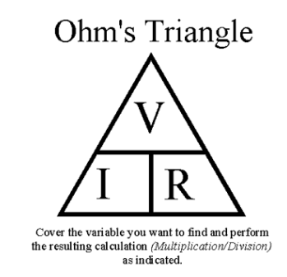

Slide 2
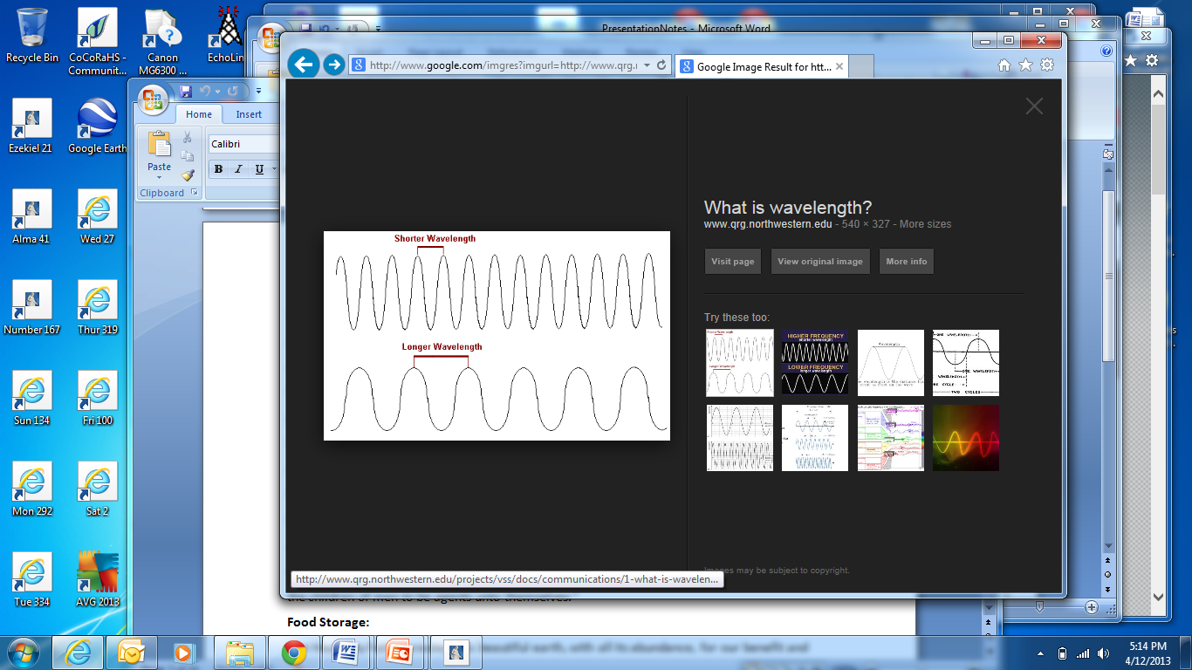

Slide 3
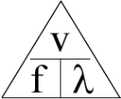

Slide 4
V = 300
f in MHz
Lamda in meters
f = 300 / 2 = 150 MHz
Lamda = 300 / 440 MHz = ~70 cm

Slide 5
