Slide 1
General Licensing Class
G9A – G9D
Antennas
Your organization and dates here
Notes:
1

Slide 2
General Class Element 3 Course Presentation
ELEMENT 3 SUB-ELEMENTS
  G1 – Commission’s Rules
  G2 – Operating Procedures
  G3 – Radio Wave Propagation
  G4 – Amateur Radio Practices
  G5 – Electrical Principles
  G6 – Circuit Components
  G7 – Practical Circuits
  G8 – Signals and Emissions
  G9 – Antennas
  G0 – Electrical and RF Safety

Slide 3
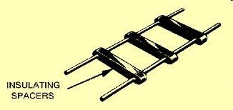

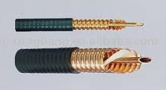
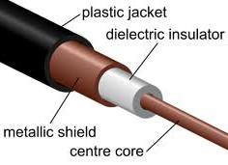
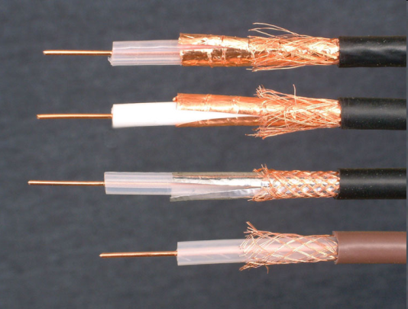
Antennas
The distance between the centers of the conductors and the radius of the conductors determine the characteristic impedance of a parallel conductor antenna feed line. (G9A01)
50 and 75 ohms are the typical characteristic impedances of coaxial cables used for antenna feed lines at amateur stations. (G9A02)
300 Ohm Twin Lead
Air Dielectric Coaxial Cable
Parallel two-wire line

Slide 4
Antennas
300 ohms is the characteristic impedance of flat ribbon TV type twinlead. (G9A03)
A difference between feed-line impedance and antenna feed-point impedance is the reason for the occurrence of reflected power at the point where a feed line connects to an antenna. (G9A04)
The attenuation of coaxial cable increases as the frequency of the signal it is carrying increases. (G9A05)
RF feed line losses usually expressed in dB per 100 ft. (G9A06)

Slide 5
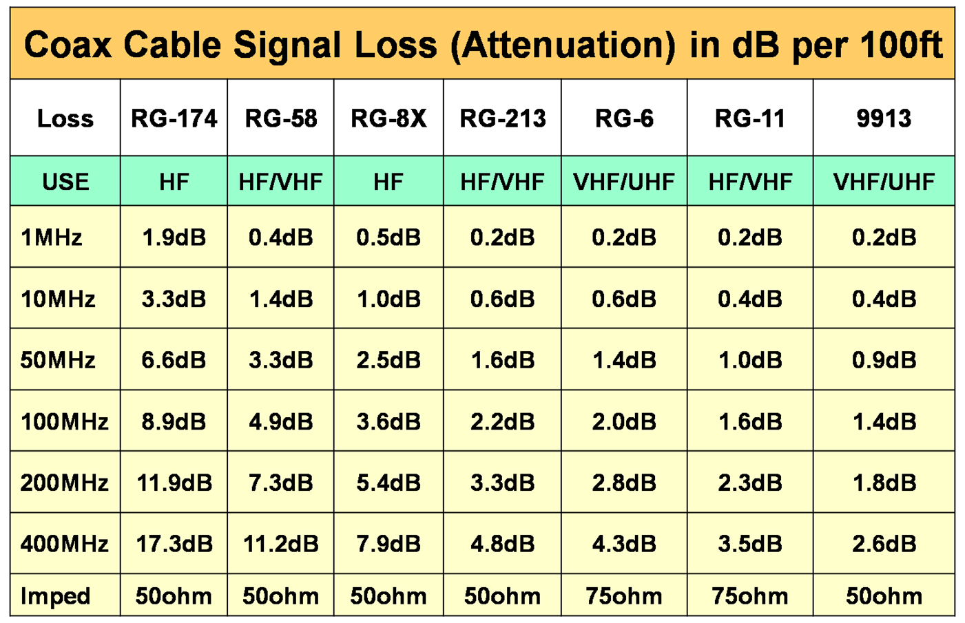
Antennas

Slide 6
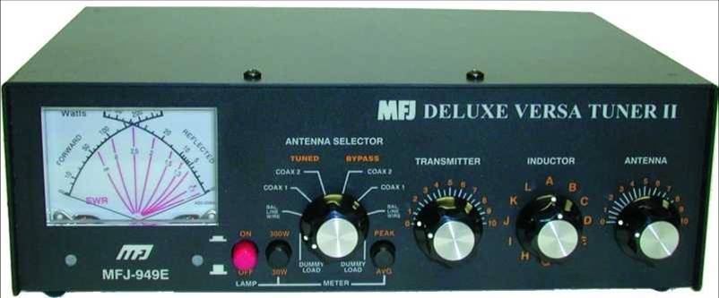
Antennas
To prevent standing waves on an antenna feed line, the antenna feed-point impedance must be matched to the characteristic impedance of the feed line. (G9A07)
If the SWR on an antenna feed line is 5 to 1, and a matching network at the transmitter end of the feed line is adjusted to 1 to 1 SWR, the resulting SWR on the feed line is still 5 to 1. (G9A08)
    The antenna tuner allows the transmitter to see a matched impedance
    This delivers full power.
    It does not change the antenna or feedline impedance on its output.
Antenna tuner with built in dual needle SWR meter

Slide 7
Antennas
A 4:1 standing wave ratio will result from the connection of a 50-ohm feed line to a non-reactive load having a 200-ohm impedance. (G9A09)
A standing wave ratio of 5:1 will result from the connection of a 50-ohm feed line to a non-reactive load having a 10-ohm impedance. (G9A10)
SWR = Z₁ / Z₂
200/ 50
4:1 VSWR
SWR = Z₁ / Z₂
50/ 10
5:1 VSWR

Slide 8
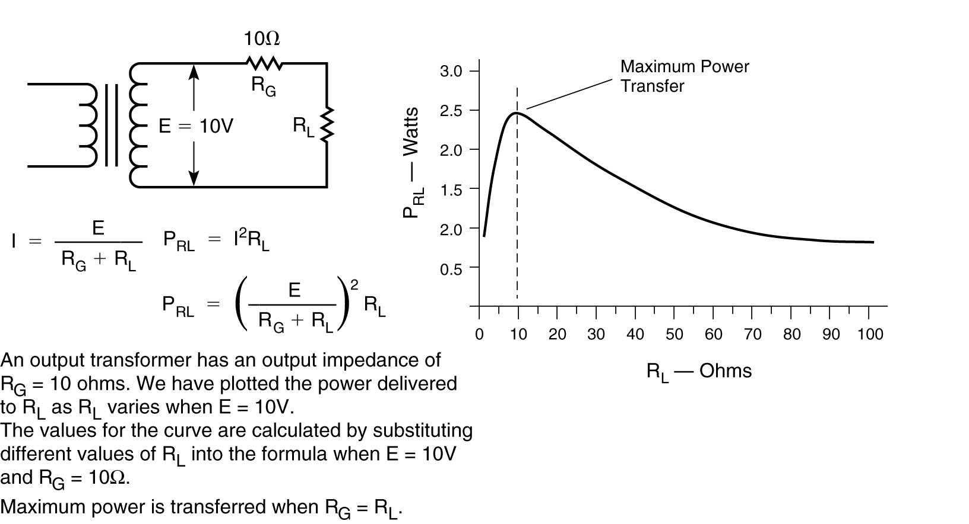
Antennas
A standing wave ratio of 1:1 will result from the connection of a 50-ohm feed line to a non-reactive load having a 50-ohm impedance. (G9A11)
SWR = Z₁ / Z₂
50 / 50
1 : 1 VSWR

Slide 9
Antennas
If you feed a vertical antenna that has a 25-ohm feed-point impedance with 50-ohm coaxial cable, the SWR will be 2:1. (G9A12)
If you feed an antenna that has a 300-ohm feed-point impedance with 50-ohm coaxial cable, the SWR will be 6:1. (G9A13)
One disadvantage of a directly fed random-wire antenna is that you may experience RF burns when touching metal objects in your station. (G9B01)
    As the name implies, random-wire antennas are a random-length.
    To match the antenna to the transmitter, you’ll need an antenna tuner
    Because of this, there may be high RF levels in the shack when you are transmitting.
SWR = Z₁ / Z₂
50 / 25
2:1 VSWR
SWR = Z₁ / Z₂
300/ 50
6:1 VSWR

Slide 10
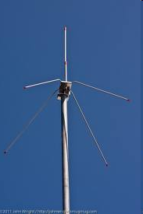
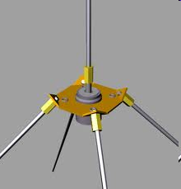
Antennas
An advantage of downward sloping radials on a quarter wave ground-plane antenna is that they bring the feed-point impedance closer to 50 ohms. (G9B02)
The natural feed point of a quarter-wave vertical is 35 ohms, but the feed-point impedance of a ground-plane antenna increases when its radials are changed from horizontal to downward-sloping. (G9B03)
  Bending the radials changes the impedance up towards 50 ohms.
Notice ground plane elements are angled downwards.

Slide 11
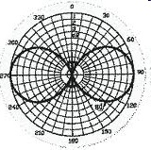
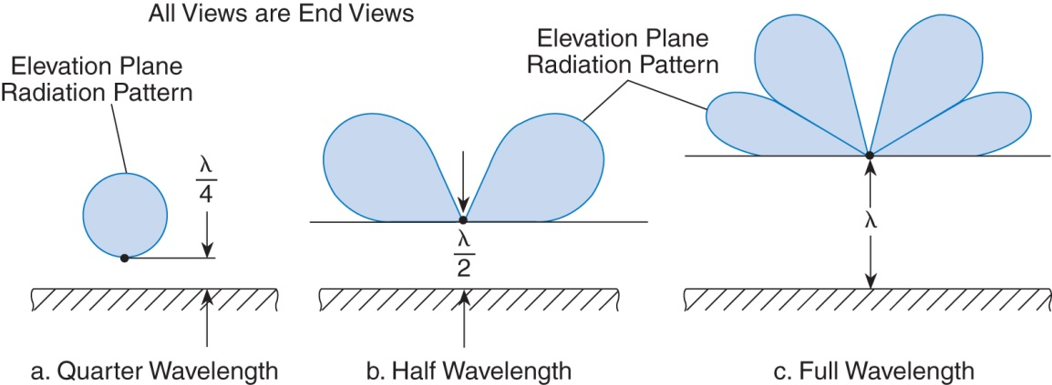
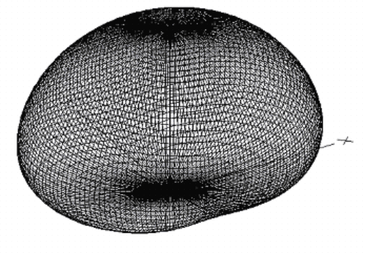
Antennas
The low angle azimuthal radiation pattern of an ideal half-wavelength dipole antenna installed 1/2 wavelength high and parallel to the Earth is a figure-eight at right angles to the antenna. (G9B04)
If the antenna is less than 1/2 wavelength high, the azimuthal pattern is almost omnidirectional and maximum straight up. (G9B05)
Omni-directional pattern
Patterns change as height above ground is varied

Slide 12
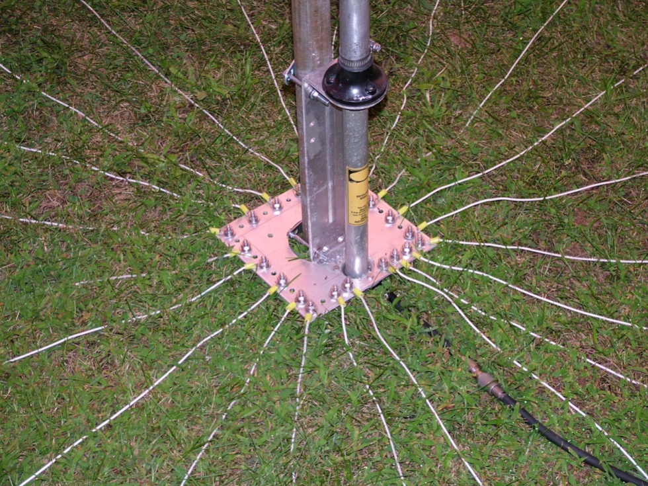
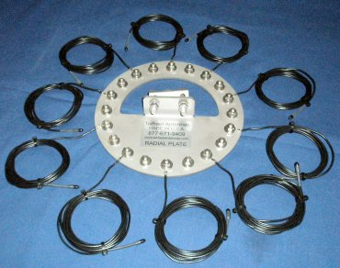
Antennas
The radial wires of a ground-mounted vertical antenna system should be placed on the surface or buried a few inches below the ground. (G9B06)
Calculate ½ wavelength in feet by dividing 468 by the frequency in MHz.
468/28.5
16.4 Feet
A ¼ wave antenna would be ½ the length of a ½ wave antenna
16.4/2
8.2 Feet
Surface mounted ground wires.
Ground wire kit.

Slide 13
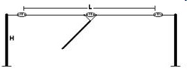
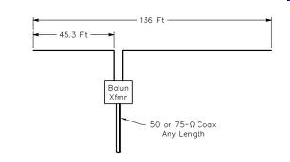
Antennas
As the antenna is lowered from 1/4 wave above ground, the feed-point impedance of a 1/2 wave dipole antenna steadily decreases. (G9B07)
  Antenna height affects the feed point impedance.
The feed-point impedance of a 1/2 wave dipole steadily increases as the feed-point location is moved from the center toward the ends. (G9B08)

Slide 14
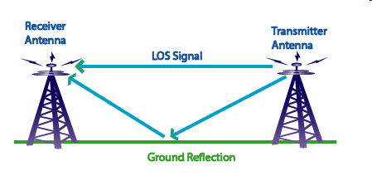
Antennas
An advantage of a horizontally polarized as compared to vertically polarized HF antenna is lower ground reflection losses. (G9B09)
  Propagation via multi-hop refraction:
    RF energy is lost each time the radio wave is reflected from the Earth's surface.
  The amount of energy lost depends on:
    Frequency of the wave
    Angle of incidence
    Ground irregularities
    Electrical conductivity of the point of reflection.

Slide 15
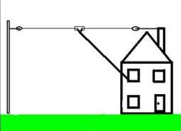
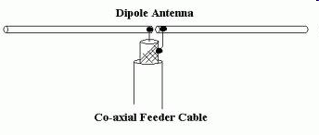
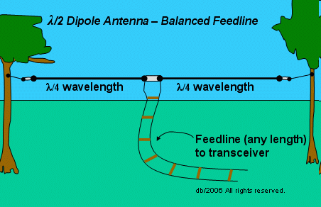
Antennas
32 feet is the approximate length for a 1/2-wave dipole antenna cut for 14.250 MHz. (G9B10)
    Calculate ½ wavelength in feet by dividing 468 by the frequency in MHz.
    468 / 14.250
    32.8 Feet
The approximate length for a 1/2-wave dipole antenna cut for 3.550 MHz is 131 feet. (G9B11)
    Calculate ½ wavelength in feet by dividing 468 by the frequency in MHz.
    468 / 3.550 or
    131.8 Feet
Half-wave Dipole with 450 ohm feedline (not coax).

Slide 16
Antennas
The approximate length for a 1/4-wave vertical antenna cut for 28.5 MHz is 8 feet. (G9B12)
Calculate ½ wavelength in feet by dividing 468 by the frequency in MHz.
468/28.5
16.4 Feet
A ¼ wave antenna would be ½ the length of a ½ wave antenna
16.4/2
8.2 Feet

Slide 17
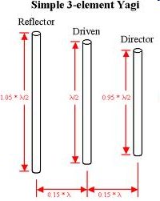
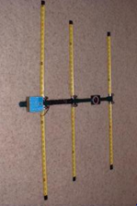
Antennas
Larger diameter elements increase the bandwidth of a Yagi antenna. (G9C01)
The approximate length of the driven element of a Yagi antenna is 1/2 wavelength. (G9C02)
In a three-element, single-band Yagi antenna, the director is normally the shortest parasitic element. (G9C03)
The reflector is normally the longest parasitic element of a three-element, single-band Yagi antenna. (G9C04)

Slide 18
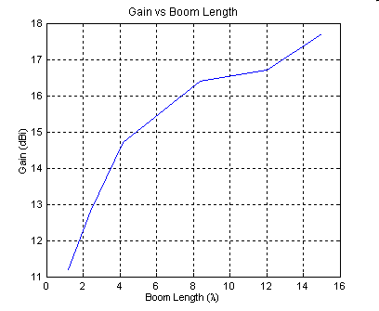
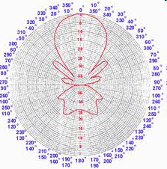
Antennas
The gain increases when you increase boom length and add directors to a Yagi antenna. (G9C05)
A Yagi antenna is often used for radio communications on the 20 meter band because it helps reduce interference from other stations to the side or behind the antenna. (G9C06)

Slide 19
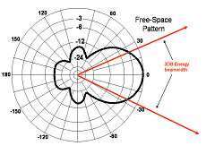
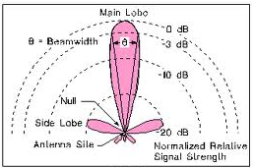
Antennas
The "front-to-back ratio" of a Yagi antenna is the power radiated in the major radiation lobe compared to the power radiated in exactly the opposite direction. (G9C07)
The “major lobe” or "main lobe" of a directive antenna is the direction of maximum radiated field strength from the antenna. (G9C08)

Slide 20
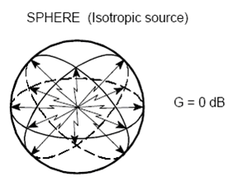
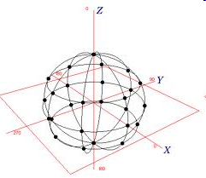
Antennas
The approximate maximum theoretical forward gain of a three element, single-band Yagi antenna is 9.7 dBi. (G9C09)
  dBi refers to a reference level of dB Isotropic
  which is the signal strength from an ideal point source of energy
  that radiates equally in all directions in a sphere surrounding the point RF source.
  Isotropic radiators are used as reference radiators
  An isotropic radiator is a theoretical point source of electromagnetic or sound waves.

Slide 21
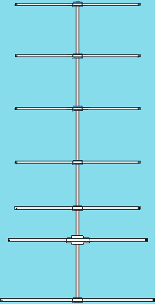
Antennas
In a Yagi antenna design, the following variables that could be adjusted to optimize forward gain, front-to-back ratio, or SWR bandwidth (G9C10)
  The physical length of the boom
  The number of elements on the boom
  The spacing of each element along the boom
All of these choices are correct

Slide 22
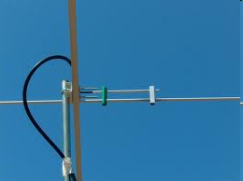
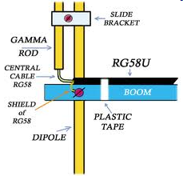
Antennas
The purpose of a gamma match used with Yagi antennas is to match the relatively low feed-point impedance to 50 ohms. (G9C11)
An advantage of using a gamma match for impedance matching of a Yagi antenna to 50-ohm coax feed line is that it does not require that the elements be insulated from the boom. (G9C12)

Slide 23
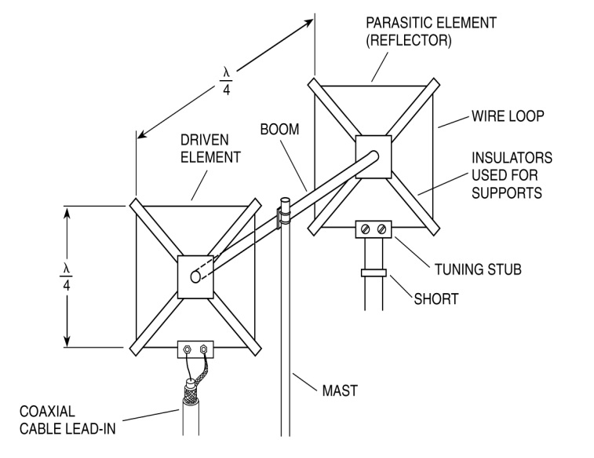
Antennas
The elements of a quad antenna are square loops. Each side of a quad antenna driven element is approximately 1/4 wavelength. (G9C13)
Driven Element for each side (in feet) =
1005
f (MHz)
/
4
Horizontal polarization feed-point

Slide 24
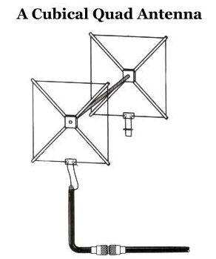
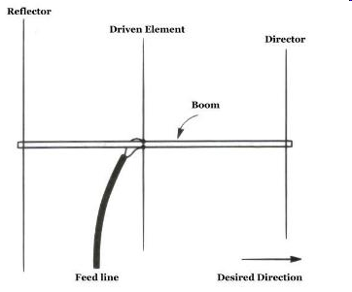
Antennas
The forward gain of a two-element quad antenna is about the same as the forward gain of a three-element Yagi antenna. (G9C14)
Each side of a quad antenna reflector element is slightly more than 1/4 wavelength. (G9C15)

Slide 25

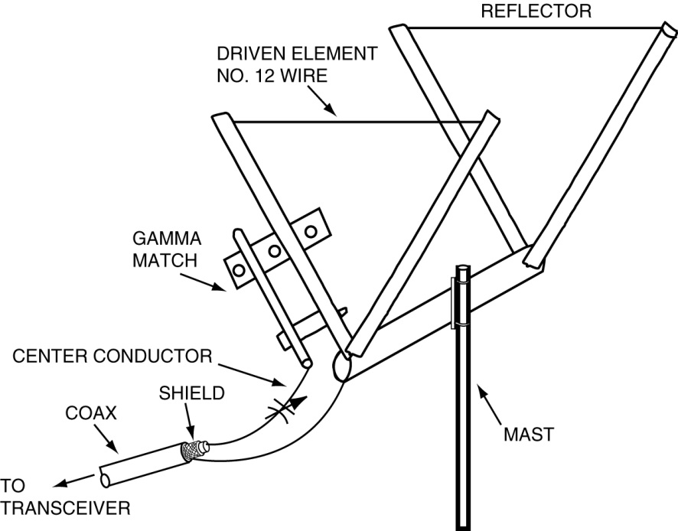
Antennas
The gain of a two-element delta-loop beam is about the same as the gain of a two-element quad antenna. (G9C16)
Each leg of a symmetrical delta-loop antenna is approximately 1/3 wavelength. (G9C17)
Driven Element for each side (in feet) =
1005
f (MHz)
/
3

Slide 26
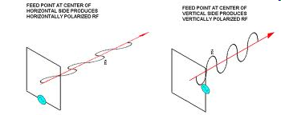
Antennas
The polarization of the radiated signal changes from horizontal to vertical when the feed point of a quad antenna is changed from the center of the either horizontal wire to the center of either vertical wire. (G9C18)
The reflector element must be approximately 5% longer than the driven element for a two-element quad antenna when the antenna is meant to operate as a beam antenna, assuming one of the elements is used as a reflector. (G9C19)
Yagi antennas spaced vertically 1/2 wavelength apart typically is approximately 3 dB higher than the gain of a single 3-element Yagi. (G9C20)

Slide 27
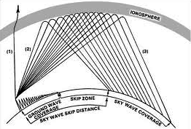
Antennas
The term "NVIS" means Near Vertical Incidence Sky wave when related to antennas. (G9D01)
An advantage of an NVIS antenna is high vertical angle radiation for working stations within a radius of a few hundred kilometers. (G9D02)
Angle of radiation determines the area of coverage

Slide 28
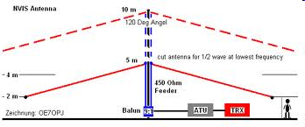
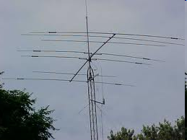
Antennas
An NVIS antenna typically installed between 1/10 and 1/4 wavelength above ground. (G9D03)
The primary purpose of antenna traps is to permit multiband operation. (G9D04)

Slide 29
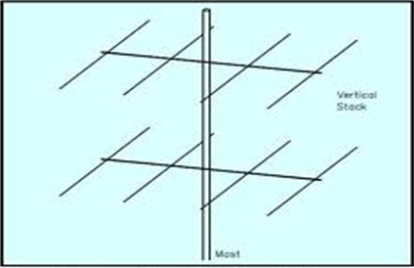
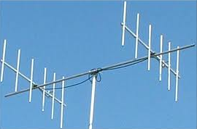
Antennas
The advantage of vertical stacking of horizontally polarized Yagi antennas is that it narrows the main lobe in elevation. (G9D05)
Vertical Stacking of Horizontally polarized.
Horizontal Stacking of Vertically polarized.

Slide 30
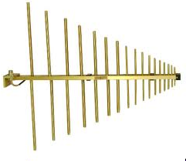
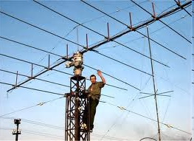
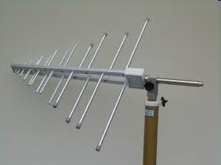
Antennas
The gain of a log periodic antenna is less than that of a Yagi, but an advantage of a log periodic antenna is wide bandwidth. (G9D06)
For a log periodic antenna, the length and spacing of the elements increases logarithmically from one end of the boom to the other. (G9D07)
EW8DQ, and his rotatable HF log-periodic beam antenna in Belarus
290 – 2000 MHz
0.15 – 300 MHz

Slide 31
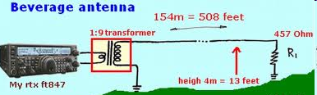
Antennas
A Beverage antenna is not used for transmitting because it has high losses compared to other types of antennas. (G9D08)
An application for a Beverage antenna is as a directional receiving for low HF bands. (G9D09)
A Beverage antenna is a very long and low directional receiving antenna. (G9D10)

Slide 32
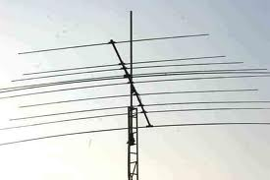
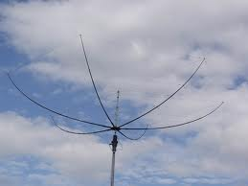
Antennas
A disadvantage of multiband antennas is that they have poor harmonic rejection. (G9D11)
Five band beam 20‑10m
Hex Wire Beam multi band

