Slide 1
General Licensing Class
G8A – G8B
Signals and Emissions
Your organization and dates here
Notes:
1

Slide 2
General Class Element 3 Course Presentation
ELEMENT 3 SUB-ELEMENTS
  G1 – Commission’s Rules
  G2 – Operating Procedures
  G3 – Radio Wave Propagation
  G4 – Amateur Radio Practices
  G5 – Electrical Principles
  G6 – Circuit Components
  G7 – Practical Circuits
  G8 – Signals and Emissions
  G9 – Antennas
  G0 – Electrical and RF Safety

Slide 3
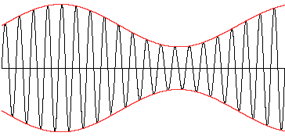

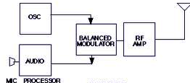
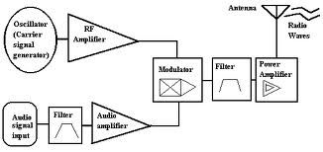
Signals and Emissions
Amplitude modulation is the name of the process that changes the envelope of an RF wave to carry information. (G8A01)
Basic Xmtr
Block Diagram of Radio Transmitter

Slide 4
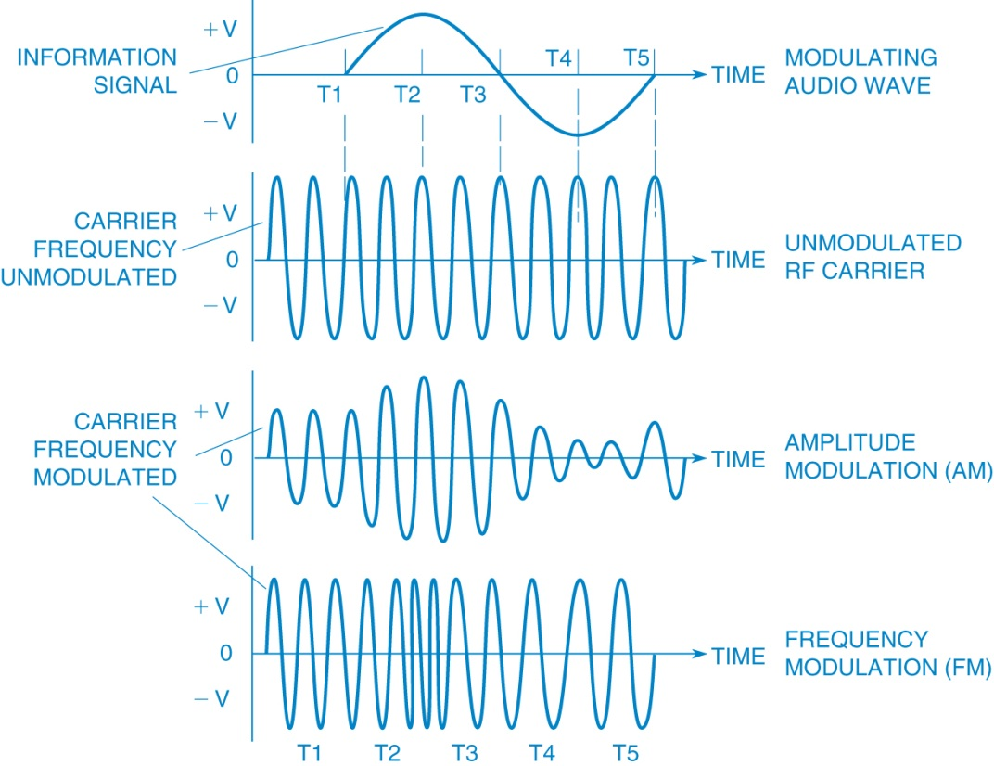
Signals and Emissions
Phase modulation is the name of the process that changes the phase angle of an RF wave to convey information. (G8A02)
Frequency modulation is the name of the process which changes the frequency of an RF wave to convey information. (G8A03)
Modulation of RF Carrier

Slide 5
Signals and Emissions
Phase modulation is produced by a reactance modulator connected to an RF power amplifier. (G8A04)
Amplitude modulation is the type of modulation that varies the instantaneous power level of the RF signal. (G8A05)
One advantage of carrier suppression in a single-sideband phone transmission is that the available transmitter power can be used more effectively. (G8A06)
Another advantage is that the phone emission that uses the narrowest frequency bandwidth is single sideband. (G8A07)
Another effect of over-modulation is excessive bandwidth. (G8A08)

Slide 6
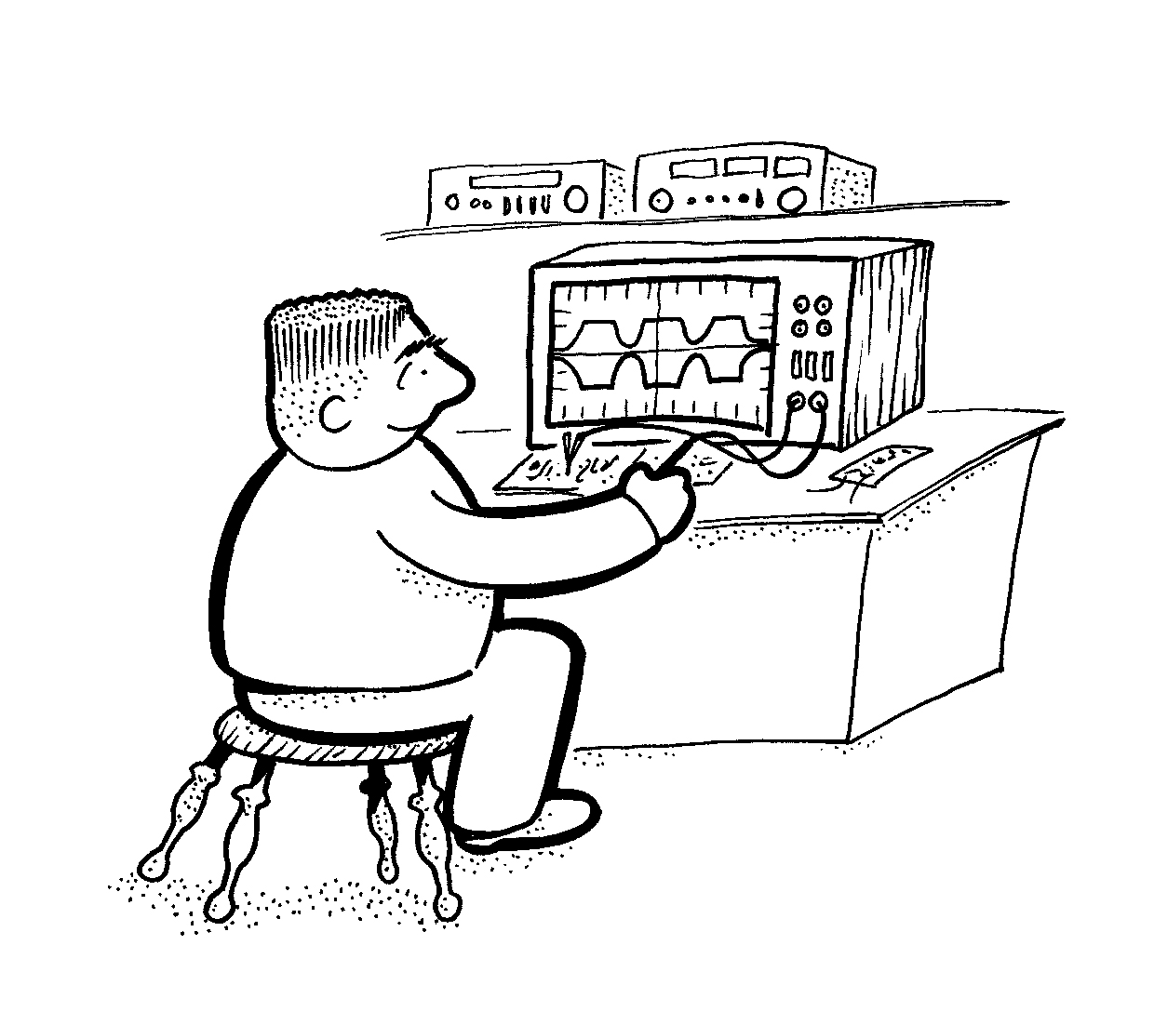
Signals and Emissions
The transmit audio or microphone gain control is typically adjusted for proper Automatic Level Control (ALC) setting on an amateur single sideband transceiver. (G8A09)
Flat-topping of a single-sideband phone transmission is signal distortion caused by excessive drive. (G8A10)
Oscilloscope Waveform Showing “Flattopping”

Slide 7
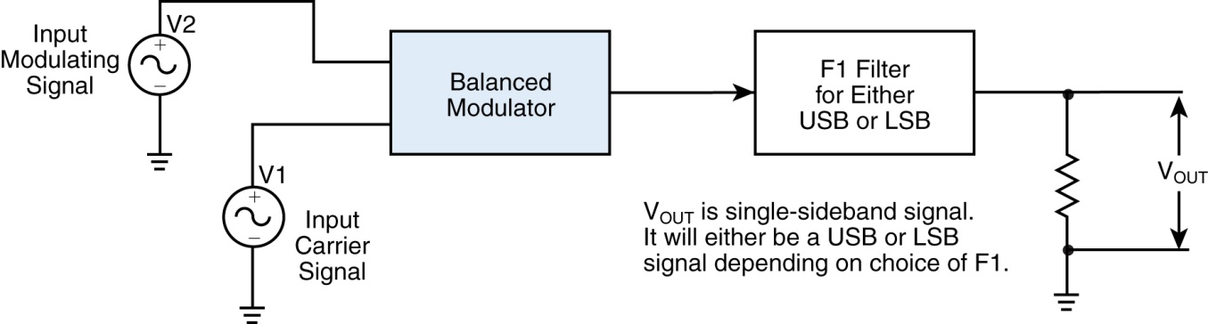
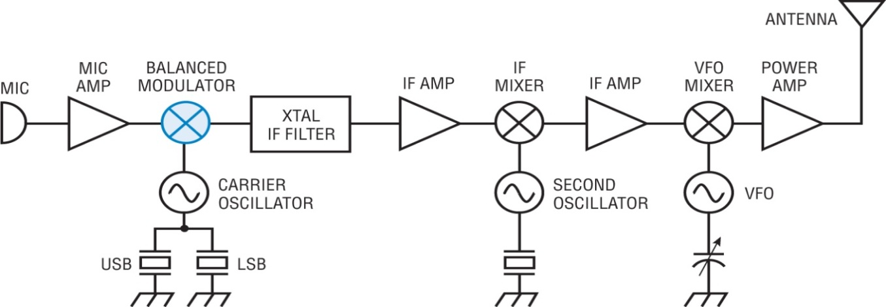
Signals and Emissions
When a modulating audio signal is applied to an FM transmitter, the carrier frequency changes proportionally to the instantaneous amplitude of the modulating signal. (G8A11)
Both upper and lower sidebands would be found at the output of a properly adjusted balanced modulator. (G8A12)
Filtering an SSB Signal
SSB Transmitter Block Diagram

Slide 8
Signals and Emissions
In a receiver the Mixer stage combines a 14.250 MHz input signal with a 13.795 MHz oscillator signal to produce a 455 kHz intermediate frequency (IF) signal. (G8B01)
  A Mixer circuit is used to process signals from the RF amplifier and local oscillator and send the result to the IF filter in a super heterodyne receiver.
14.250 MHz
  In this mixer the output is the sum and the difference of the two applied signals:
    The sum would be 14.250 + 13.795 or 28.045 MHz
    The difference would be 14.250 - 13.795 or 0 .455 MHz
Mixer
First IF amp.
455 kHz
Local oscillator 13.795 MHz
Filtering removes the undesired frequency

Slide 9

Signals and Emissions
If a receiver mixes a 13.800 MHz VFO with a 14.255 MHz received signal to produce a 455 kHz intermediate frequency (IF) signal, a 13.345 MHz signal will produce an image response in the receiver. (G8B02)
    To prevent this many receivers use a tuned preamplifier before the mixer input (sometimes called a preselector).
Heterodyning is another term for the mixing of two RF signals. (G8B03)
The multiplier is the name of the stage in a VHF FM transmitter that generates a harmonic of a lower frequency signal to reach the desired operating frequency. (G8B04)
Very simple mixer

Slide 10
Signals and Emissions
FM phone is often used on the VHF and UHF bands, but frequency modulated (FM) phone is not used below 29.5 MHz because the wide bandwidth is prohibited by FCC rules. (G8B05)
16 kHz is the total bandwidth of an FM-phone transmission having a 5 kHz deviation and a 3 kHz modulating frequency. (G8B06)
    Total Bandwidthis equal to the peak devation + the highest modulating frequency times 2.
      (because the FM signal is symetrical about the carrier frequency).
    In this example the total bandwidth would be (5 KHz + 3KHz ) * 2 or (8 KHz) *2 or 16 KHz.
416.7 Hz is the frequency deviation for a 12.21-MHz reactance-modulated oscillator in a 5-kHz deviation, 146.52-MHz FM-phone transmitter. (G8B07)
  Since the FM deviation is also multiplied, there will be much less than 5 KHz deviation on the oscillator that is being multiplied up to the transmit frequency.
  The multiplier would be 146.52 MHz divided by 12.21 MHz or 12.
  Therefore if we desired 5 KHz of deviation at 146.52 would only need 1/12 of that at 12.21 or the required deviation would be 5,000 Hz divided by 12 or 416.66 Hertz.

Slide 11
Signals and Emissions
It is important to know the duty cycle of the data mode you are using when transmitting because some modes have high duty cycles which could exceed the transmitter's average power rating. (G8B08)
It is good to match receiver bandwidth to the bandwidth of the operating mode because it results in the best signal to noise ratio. (G8B09)
The number 31 in the term PSK31 represents the approximate transmitted symbol rate. (G8B10)
The symbol rate is the pulse rate in pulses/second.
Each symbol can represent or convey one of several data.

Slide 12
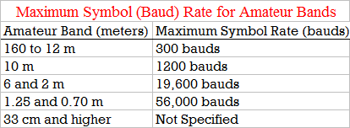
Signals and Emissions
By transmitting redundant information with the data, forward error correction allows the receiver to correct errors in received data packets. (G8B11)
  Forward error correction, FEC, is achieved by sending each character twice.
  Allowing the receiver to correct errors by double-checking the received data.
The relationship between transmitted symbol rate and bandwidth is that higher symbol rates require higher bandwidth. (G8B12)

