Slide 1
General Licensing Class
G7A – G7C
Practical Circuits
Your organization and dates here
Notes:
1

Slide 2
General Class Element 3 Course Presentation
ELEMENT 3 SUB-ELEMENTS
  G1 – Commission’s Rules
  G2 – Operating Procedures
  G3 – Radio Wave Propagation
  G4 – Amateur Radio Practices
  G5 – Electrical Principles
  G6 – Circuit Components
  G7 – Practical Circuits
  G8 – Signals and Emissions
  G9 – Antennas
  G0 – Electrical and RF Safety

Slide 3
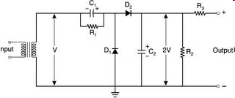
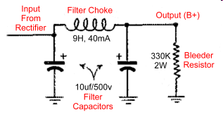
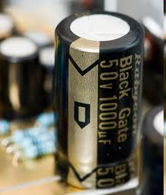
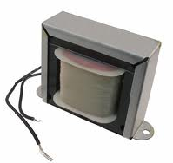
Practical Circuits
A power supply bleeder resistor is a safety feature in that it discharges the filter capacitors. (G7A01)
The output of a rectifier connects to a filter made up of capacitors and inductors. Capacitors and inductors are used in a power-supply filter network. (G7A02)
R1 and R2 are bleeder resistors

Slide 4
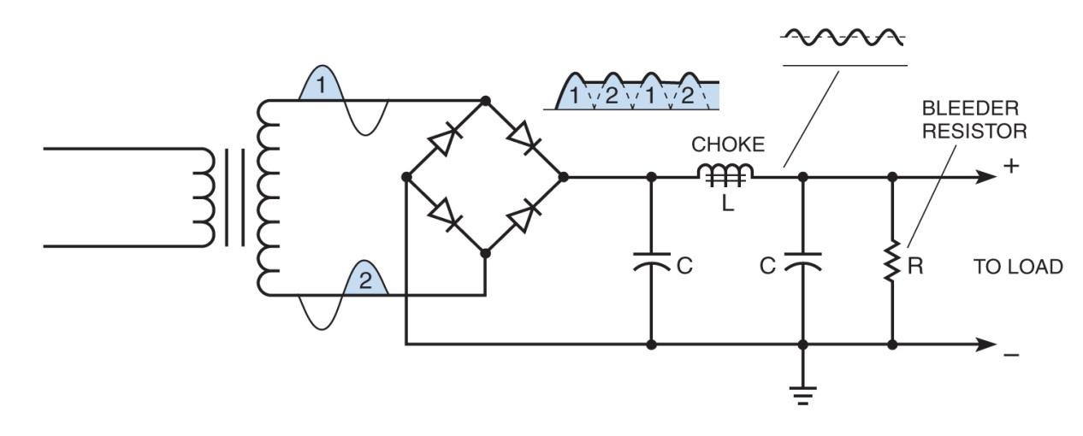
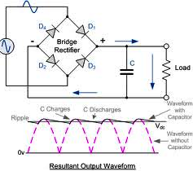
Practical Circuits
The peak-inverse-voltage across the rectifiers in a full-wave power bridge supply is equal to the normal peak output voltage of the power supply. (G7A03)
Notice Waveforms
Full-Wave Bridge Solid State Power Supply with pi network filter and resistive load

Slide 5
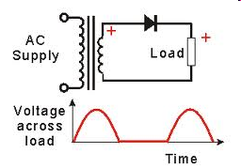
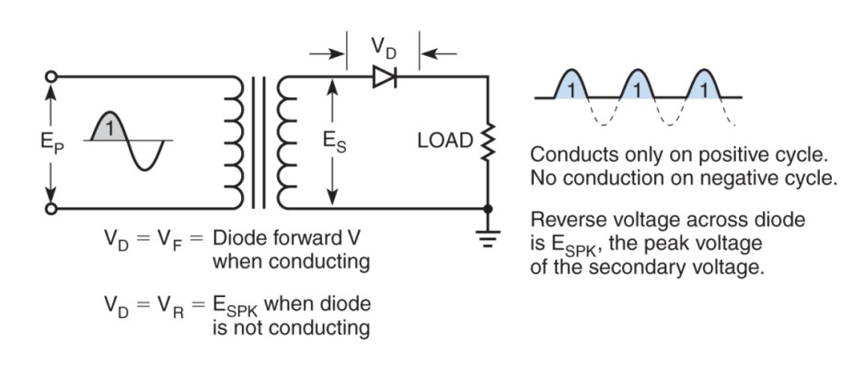
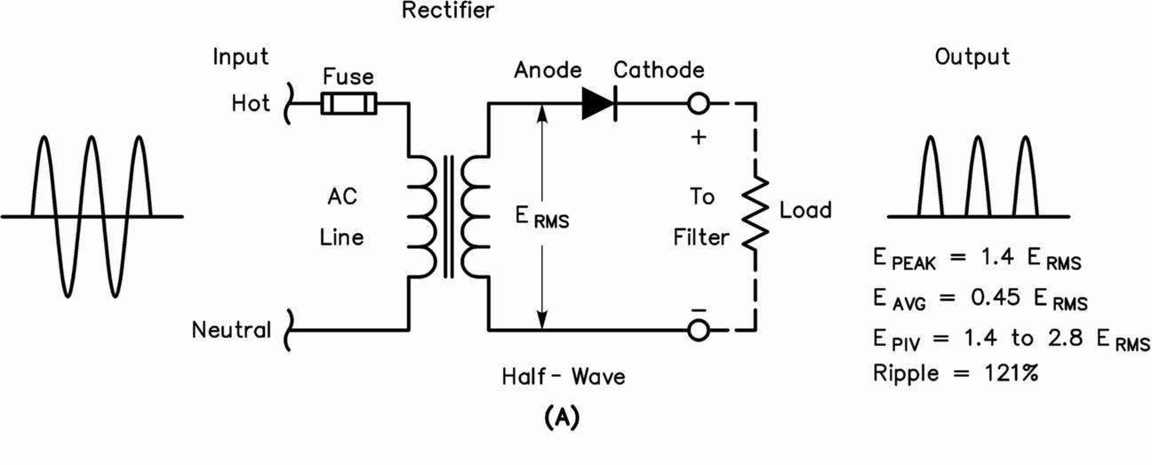
Practical Circuits
The peak-inverse-voltage across the rectifiers in a half-wave power supply is two times the normal output voltage of the power supply. (G7A04)
180 degrees is the portion of the AC cycle that is converted to DC by a half-wave rectifier. (G7A05)
Half-wave rectifier power supply

Slide 6
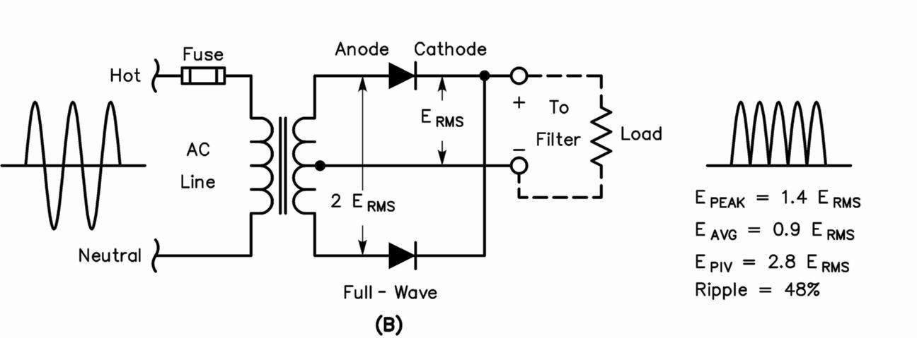
Practical Circuits
360 degrees is the portion of the AC cycle is converted to DC by a full-wave rectifier. (G7A06)
A series of DC pulses at twice the frequency of the AC input is the output waveform of an unfiltered full-wave rectifier connected to a resistive load (G7A07)
Full-wave rectifier power supply

Slide 7
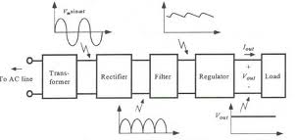
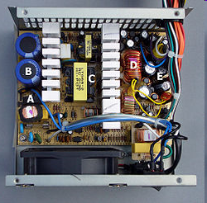
Practical Circuits
One advantage of a switched-mode power supply as compared to a linear power supply is that high frequency operation allows the use of smaller components.(G7A08)
Regulated supply showing outputs
Interior view of a switched-mode
power supply:
A - bridge rectifier
B - Input filter capacitors
C - Transformer
D - output filter coil
E - output filter capacitors

Slide 8
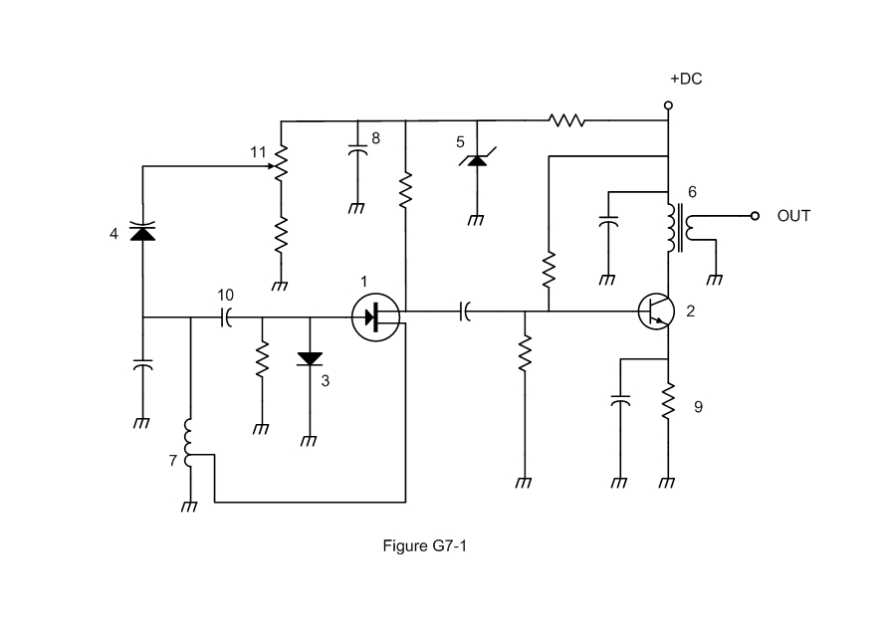
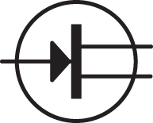
Practical Circuits
Symbol 1 in figure G7-1 represents a field effect transistor. (G7A09)
Schematic symbol for:
Field Effect Transistor.

Slide 9
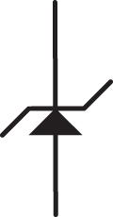
Practical Circuits
Symbol 5 in figure G7-1 represents a Zener diode. (G7A10)
Schematic symbol for:
Zener Diode.

Slide 10

Practical Circuits
Symbol 2 in figure G7-1 represents an NPN junction transistor. (G7A11)
Schematic symbol for:
NPN Junction Transistor

Slide 11

Practical Circuits
Symbol 6 in Figure G7-1 represents a multiple-winding transformer. (G7A12)
Schematic symbol for:
Multiple-winding transformer.

Slide 12

Practical Circuits
Symbol 7 in Figure G7-1 represents a tapped inductor. (G7A13)
Schematic symbol for:
Tapped Inductor.

Slide 13
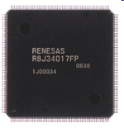
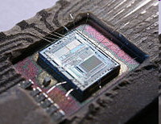
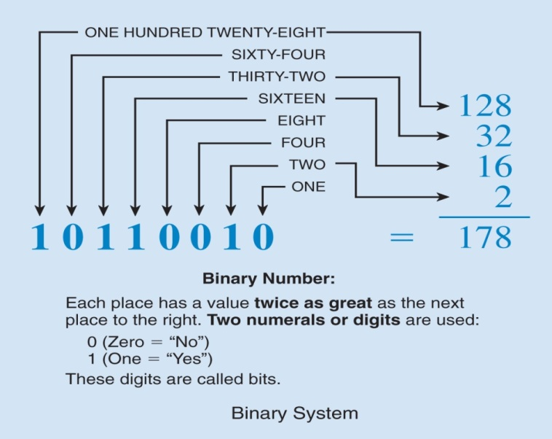
Practical Circuits
Complex digital circuitry can often be replaced by a microcontroller. (G7B01)
An advantage of using the binary system when processing digital signals is that binary "ones" and "zeros" are easy to represent with an "on" or "off" state. (G7B02)
LSI Devices
DVD Recorder
Intel 8742
In digital systems, binary numbers are used to write and keep track of the many possible combinations of the two electrical states

Slide 14
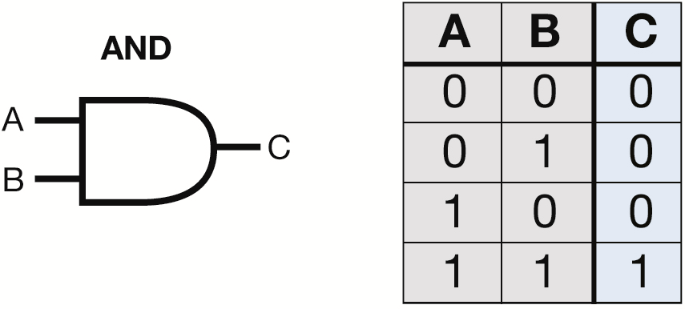
Practical Circuits
For a two input AND gate, the output is high only when both inputs are high. (G7B03)
Truth table for AND Gate

Slide 15
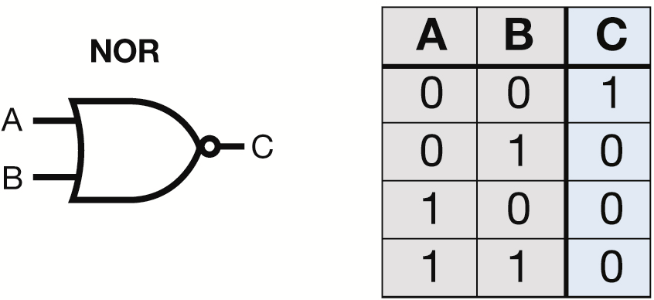
Practical Circuits
For a two input NOR gate, the output is low when either or both inputs are high. (G7B04)
Truth table for NOR Gate

Slide 16
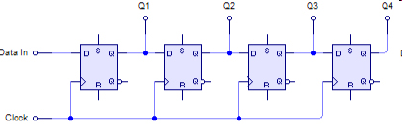
Practical Circuits
Integrated circuits that provide more complex logic functions, such as counters and shift registers, are also available. A 3-bit binary counter has 8 states. (G7B05)
    There are 8 states in a 3-bit binary counter.
        000 001 010 011
        100 101 110 111
A shift register is a clocked array of circuits that passes data in steps along the array. (G7B06)
4-Bit SIPO Shift Register

Slide 17
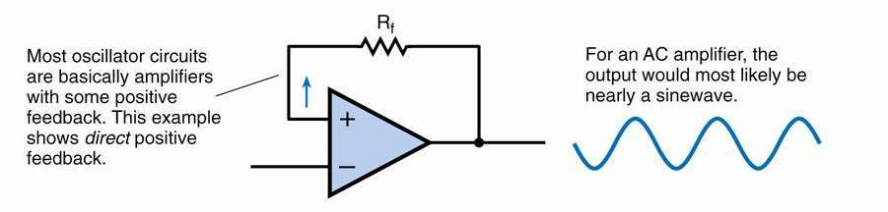
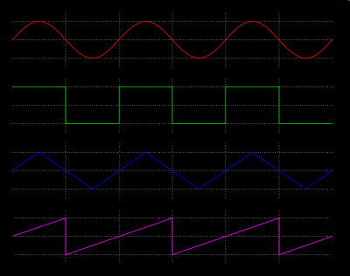
Practical Circuits
The basic components of virtually all sine wave oscillators are a filter and an amplifier operating in a feedback loop. (G7B07)
Sine wave
Square wave
Triangle wave
Sawtooth wave
Voltage waveforms

Slide 18
Practical Circuits
To determine the efficiency of an RF power amplifier, divide the RF output power by the DC input power. (G7B08)
  Example:
    A 100 watt 2 meter power amplifier that draws 10 amperes from a 13.8 Volt Power supply has an efficiency of 72%.
      Efficiency = 100 watts / (13.8 * 10)
      Efficiency = 100/138
      Efficiency = 72%

Slide 19
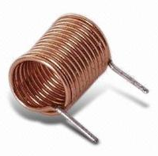
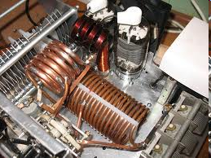
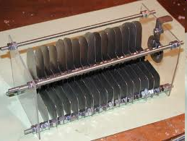
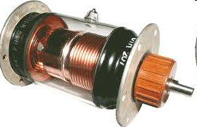
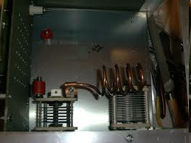
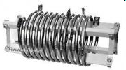
Practical Circuits
The inductance and capacitance in the tank circuit determines the frequency of an LC oscillator. (G7B09)
Inductors
(variable) Capacitors
Tank Circuits

Slide 20
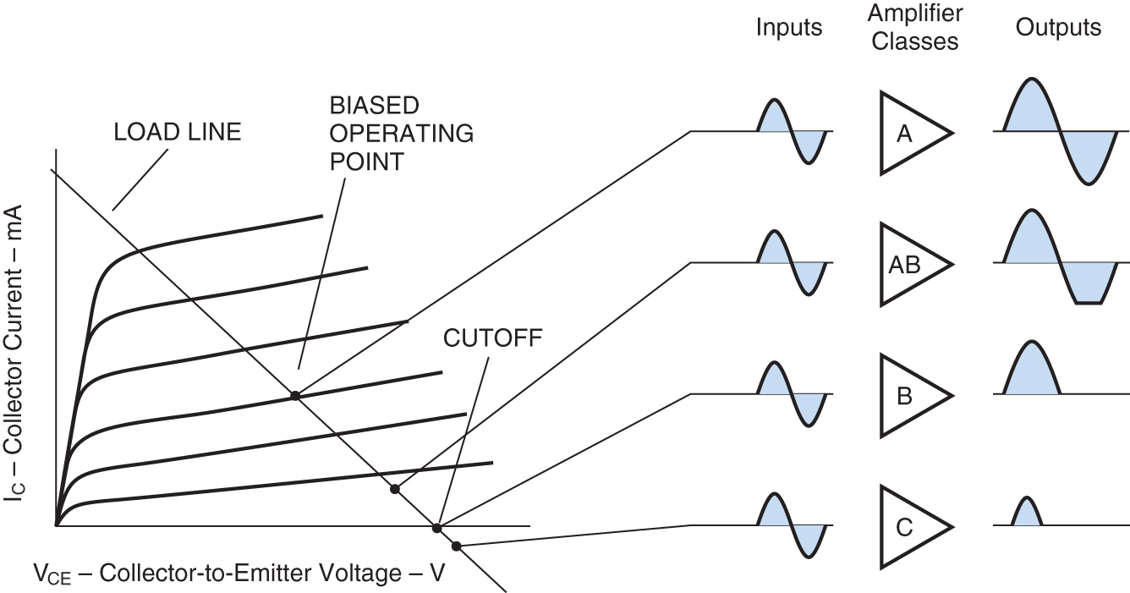
Practical Circuits
Linear amplifiers are usually Class A amplifiers. Low distortion is a characteristic of a Class A amplifier. (G7B10)
    This is because 100 % of the waveform is amplified.
    They are, therefore, most appropriate for amplifying phone signals.
The Class C amplifier is not linear. A Class C power stage is appropriate for amplifying a CW modulated signal. (G7B11)
Class C amplifiers have the highest efficiency. (G7B12)
Lowest Distortion
Highest Efficiency
Various Classes of Transistorized Amplifiers

Slide 21
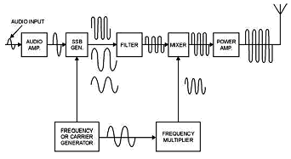
Practical Circuits
A filter is used to process signals from the balanced modulator and send them to the mixer in a single-sideband phone transmitter. (G7C01)
    Filters are also used in amateur radio transmitters.
SSB Transmitter Block Diagram

Slide 22
Practical Circuits
A balanced modulator is the circuit used to combine signals from the carrier oscillator and speech amplifier and send the result to the filter in a typical single-sideband phone transmitter. (G7C02)
Actual circuit
Block diagram

Slide 23
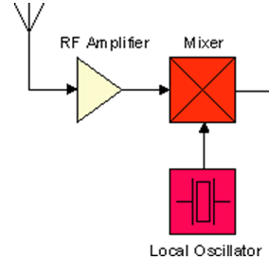

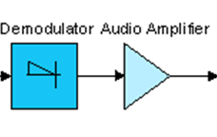
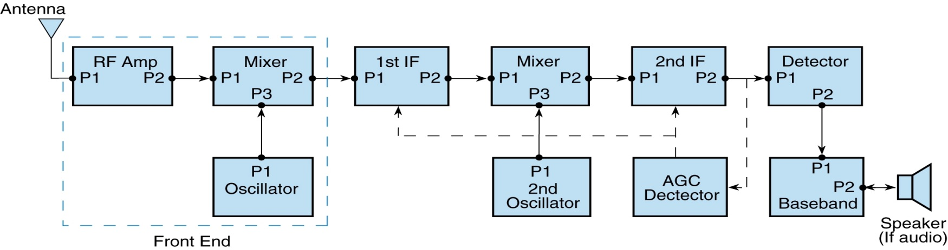
Practical Circuits
A mixer is the circuit used to process signals from the RF amplifier and local oscillator and send the result to the IF filter in a superheterodyne receiver. (G7C03)
IF Amplifier Stages
Single conversion receiver
One mixer (single conversion)
Two mixers (dual conversion)
Dual conversion receiver

Slide 24
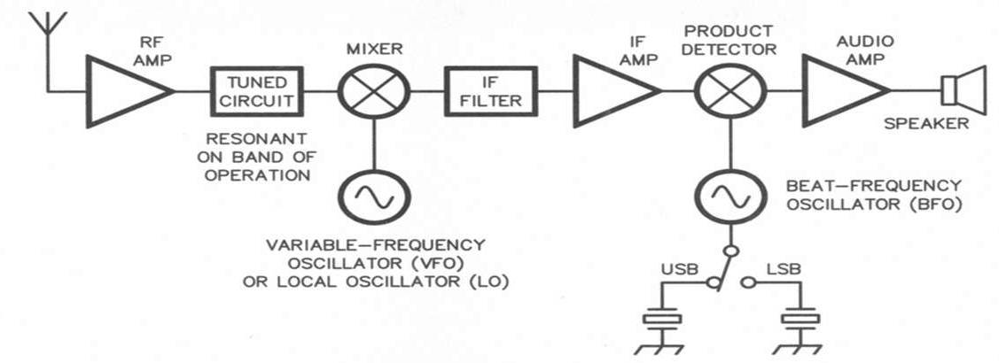
Practical Circuits
A product detector is the circuit is used to combine signals from the IF amplifier and BFO and send the result to the AF amplifier in a single-sideband receiver. (G7C04)
Remember:
(a) Product detector is used in AM/SSB and CW.
(b) Discriminator is in FM

Slide 25
Practical Circuits
An advantage of a transceiver controlled by a direct digital synthesizer (DDS) is that it provides variable frequency with the stability of a crystal oscillator. (G7C05)
    Digital circuits called a synthesizer control the receive and transmit frequencies.
The impedance of a low-pass filter should be about the same as the impedance of the transmission line into which it is inserted. (G7C06)

Slide 26
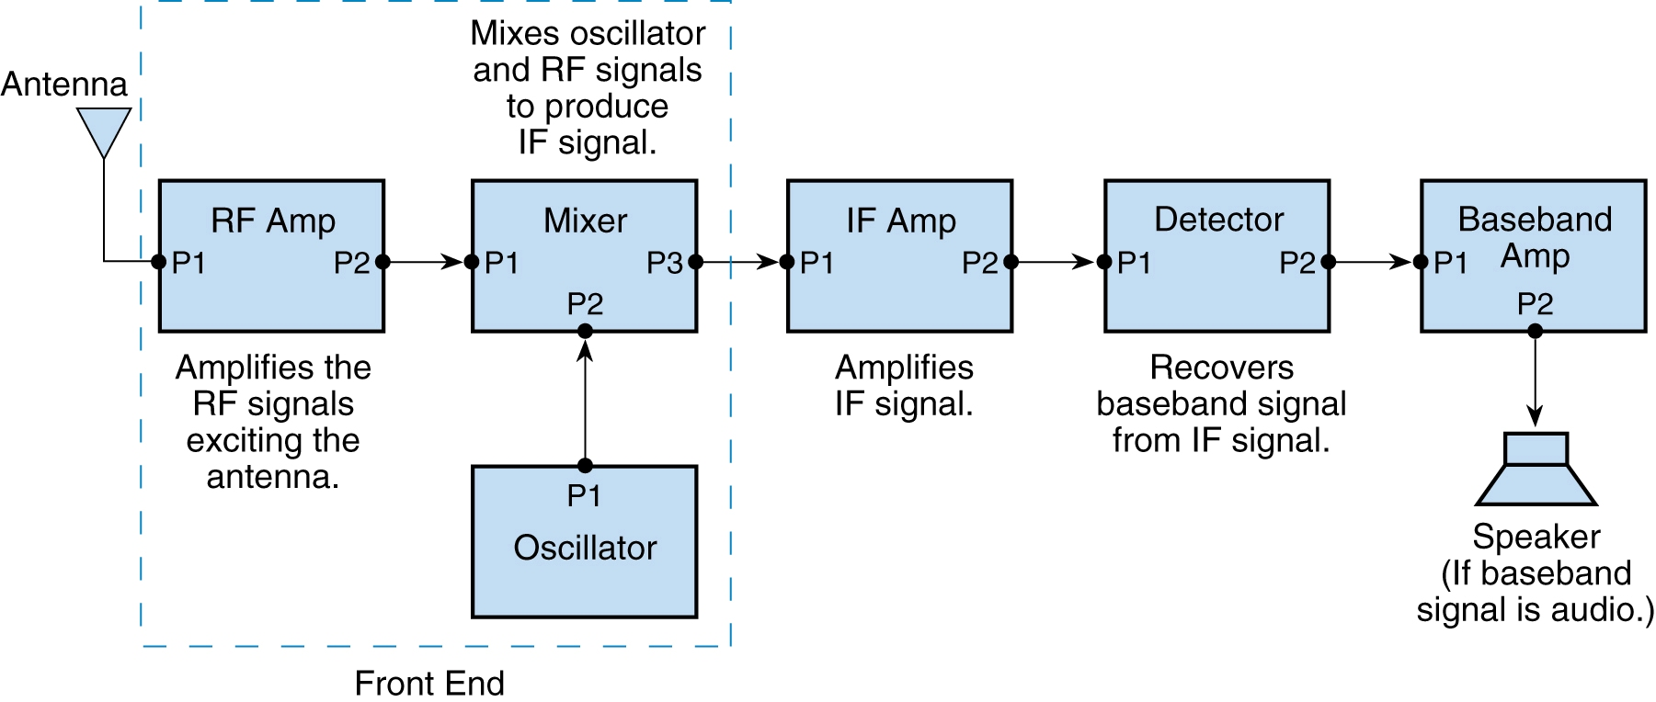
Practical Circuits
The simplest combination of stages that implement a superheterodyne receiver is HF oscillator, mixer, detector. (G7C07)
Simple Generic Superheterodyne Receiver

Slide 27
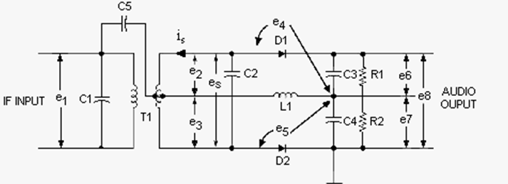
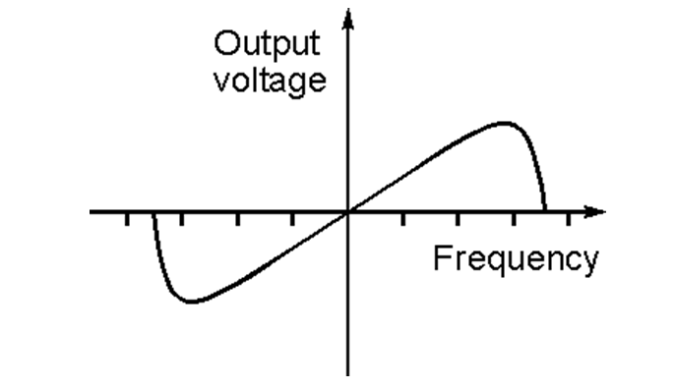
Practical Circuits
A discriminator circuit is used in many FM receivers to convert signals coming from the IF amplifier to audio. (G7C08)
    FM receivers have different types of circuits than the superheterodyne receivers designed for AM, CW and SSB.
The following is needed for a Digital Signal Processor IF filter. (G7C09)
    An analog to digital converter
    A digital processor chip
    A digital to analog converter
Discriminator circuit
Frequency to voltage conversion
All of the choices are correct.

Slide 28
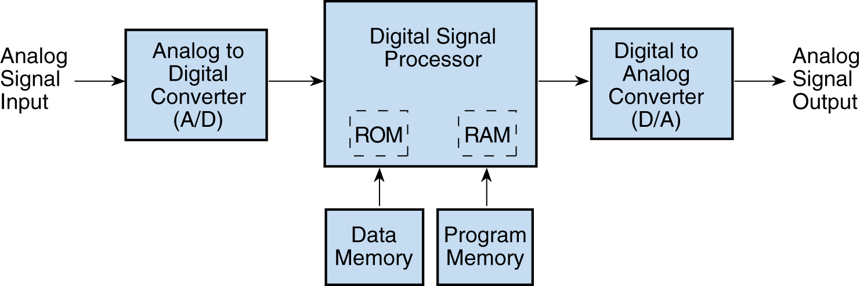
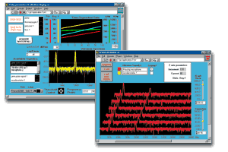
Practical Circuits
Digital Signal Processor filtering is accomplished by converting the signal from analog to digital and using digital processing followed by converting back to analog. (G7C10)
The term "software defined radio" (SDR) means a radio in which most major signal processing functions are performed by software. (G7C11)
Basic Digital Signal Processing (DSP) System

