Slide 1
General Licensing Class
G6A – G6C
Circuit Components
Your organization and dates here
Notes:
1

Slide 2
General Class Element 3 Course Presentation
ELEMENT 3 SUB-ELEMENTS
  G1 – Commission’s Rules
  G2 – Operating Procedures
  G3 – Radio Wave Propagation
  G4 – Amateur Radio Practices
  G5 – Electrical Principles
  G6 – Circuit Components
  G7 – Practical Circuits
  G8 – Signals and Emissions
  G9 – Antennas
  G0 – Electrical and RF Safety

Slide 3
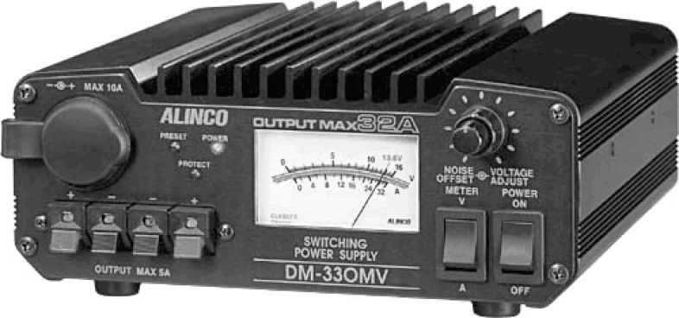
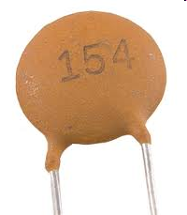
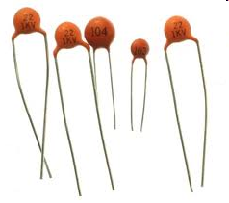
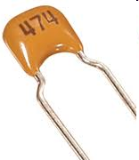
Circuit Components
Low equivalent series resistance is an important characteristic for capacitors used to filter the DC output of a switching power supply. (G6A01)
Electrolytic capacitors are often used in power-supply circuits to filter the rectified AC. (G6A02)
An advantage of ceramic capacitors as compared to other types of capacitors is comparatively low cost. (G6A03)
Modern switching power supplies incorporate “crowbar protection” to provide overvoltage protection.

Slide 4
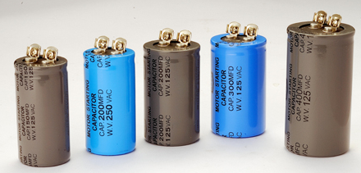
Circuit Components
High capacitance for given volume is an advantage of an electrolytic capacitor. (G6A04)
The effect of lead inductance in a capacitor used at VHF frequencies and above is that effective capacitance may be reduced because of the lead inductance. (G6A05)
The resistance of a carbon resistor will change depending on the resistor's temperature coefficient rating if the ambient temperature is increased. (G6A06)
Electrolytic Capacitors

Slide 5
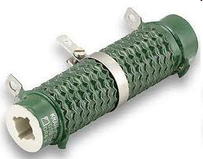
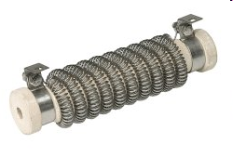
Circuit Components
A reason not to use wire-wound resistors in an RF circuit is that the resistor's inductance could make circuit performance unpredictable. (G6A07)
A thermistor is a device having a controlled change in resistance with temperature variations. (G6A08)
Wire wound resistors can act like an inductor at certain frequencies.

Slide 6
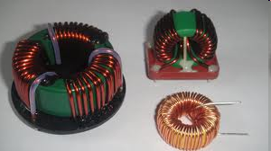
Circuit Components
The advantages of using a ferrite core with a toroidal inductor (G6A09):
  Large values of inductance may be obtained
  The magnetic properties of the core may be optimized for a specific range of frequencies
  Most of the magnetic field is contained in the core
All of these choices are correct.

Slide 7
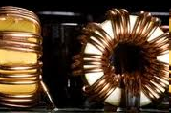
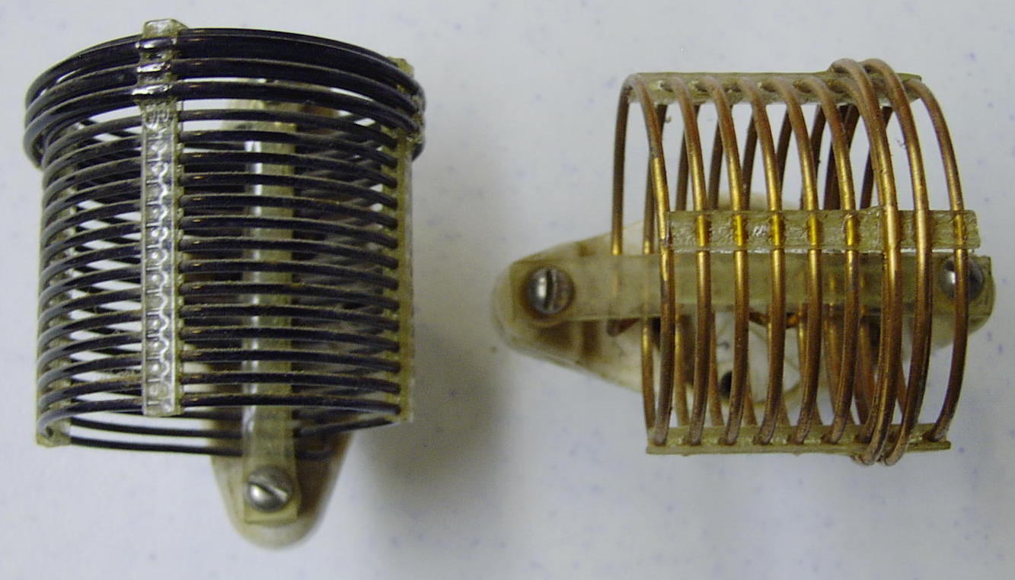
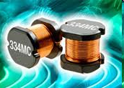
Circuit Components
The winding axes of solenoid inductors should be placed at right angles to minimize their mutual inductance. (G6A10)
It is important to minimize the mutual inductance between two inductors to reduce unwanted coupling between circuits. (G6A11)

Slide 8

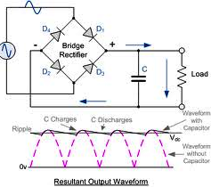
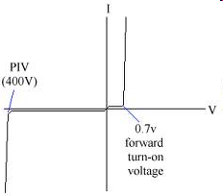
Circuit Components
Filter choke is a common name for an inductor used to help smooth the DC output from the rectifier in a conventional power supply. (G6A12)
An effect of inter-turn capacitance in an inductor is that the inductor may become self resonant at some frequencies.(G6A13)
The peak-inverse-voltage rating of a rectifier is the maximum voltage the rectifier will handle in the non-conducting direction. (G6B01)
Capacitor: consists of metal separated by a layer(s) of a non conductor.
Non-conducting region
Notice Waveforms

Slide 9
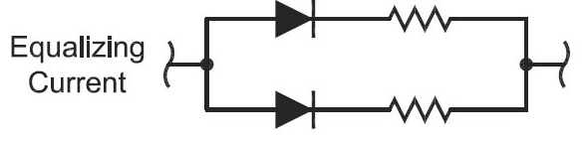
Circuit Components
The two major ratings that must not be exceeded for silicon-diode rectifiers are peak inverse voltage; average forward current. (G6B02)
The approximate junction threshold voltage of a germanium diode is 0.3 volts. (G6B03)
    This is the voltage drop across the diode junction when it is conducting in the forward direction.
When two or more diodes are connected in parallel to increase current handling capacity, the purpose of the resistor connected in series with each diode is to ensure that one diode doesn't carry most of the current. (G6B04)

Slide 10
Circuit Components
The approximate junction threshold voltage of a silicon diode is 0.7 volts. (G6B05)
    This is the voltage drop across the diode junction when it is conducting in the forward direction
Lower capacitance is an advantage of using a Schottky diode in an RF switching circuit as compared to a standard silicon diode. (G6B06)
    It is desirable to have low capacity across the diode junction in higher frequencies where the capacitive reactance forms a significant path around the diode when reverse (Back) biased in the non conductive state.
The stable operating points for a bipolar transistor used as a switch in a logic circuit are its saturation and cut-off regions. (G6B07)
    Saturation is where the transistor is Base biased for maximum emitter to collector current flow
    Cut-off is where the transistor base is biased for minimum emitter to collector current flow

Slide 11
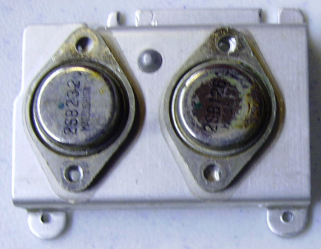
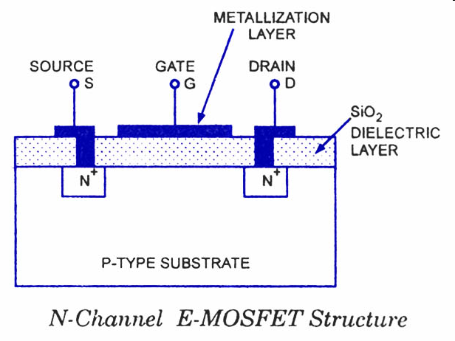
Circuit Components
The cases of some large power transistors must be insulated from ground to avoid shorting the collector or drain voltage to ground. (G6B08)
In a MOSFET, the gate is separated from the channel with a thin insulating layer. (G6B09)
Power Transistors
Insulating wafer

Slide 12
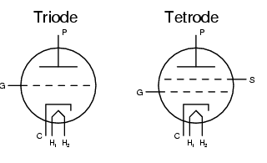
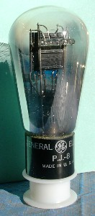
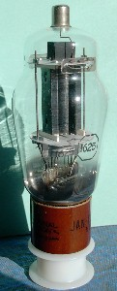
Circuit Components
The control grid is the element of a triode vacuum tube used to regulate the flow of electrons between cathode and plate. (G6B10)
H=Heater/Filament; C=Cathode; S=Screen Grid; P=Plate

Slide 13
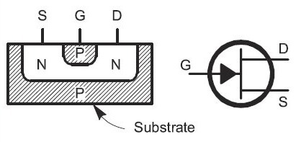
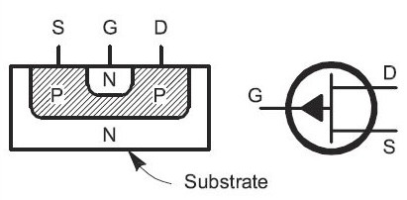
Circuit Components
A Field Effect Transistor is the solid state device most like a vacuum tube in its general operating characteristics. (G6B11)
    In the construction of a MOSFET the gate is separated from the channel with a thin insulating layer.
    The Gate is similar to the grid of a tube, it controls current flow.

Slide 14
Circuit Components
The primary purpose of a screen grid in a vacuum tube is to reduce grid-to-plate capacitance. (G6B12)
High discharge current is an advantage of the low internal resistance of Nickel Cadmium batteries. (G6B13)
10.5 volts is the minimum allowable discharge voltage for maximum life of a standard 12 volt lead acid battery. (G6B14)
It is never acceptable to recharge a carbon-zinc primary cell. (G6B15)

Slide 15
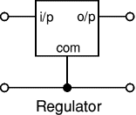
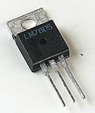
Circuit Components
A linear voltage regulator, is an example of an analog integrated circuit.(G6C01)
Schematic symbols and actual linear voltage regulators

Slide 16
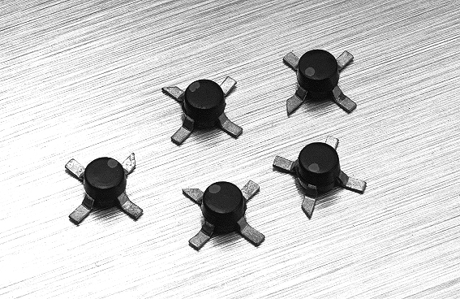
Circuit Components
The term MMIC means Monolithic Microwave Integrated Circuit. (G6C02)
Low power consumption is an advantage of CMOS integrated circuits compared to TTL integrated circuits. (G6C03)
    CMOS is the most commonly used digital logic family of integrated circuits.
The term ROM means Read Only Memory. (G6C04)
MMIC devices
Signal connections

Slide 17
Circuit Components
ROM is characterized as “non-volatile,” meaning the stored information is maintained even if power is removed. (G6C05)
Analog is also the term that describes an integrated circuit operational amplifier. (G6C06)
High power consumption is one disadvantage of an incandescent indicator compared to a LED. (G6C07)
Schematic symbol
Integrated circuit

Slide 18
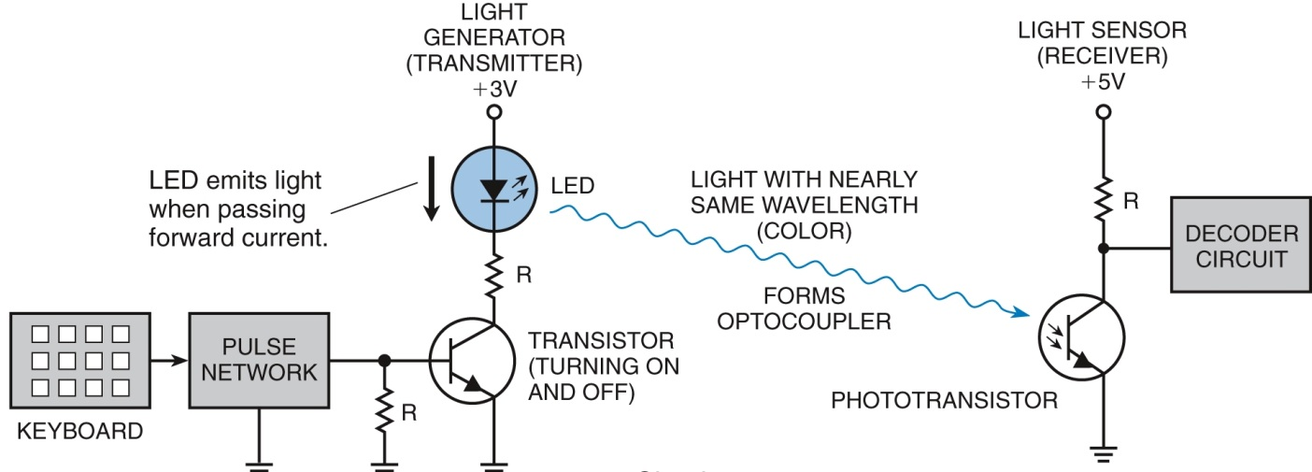
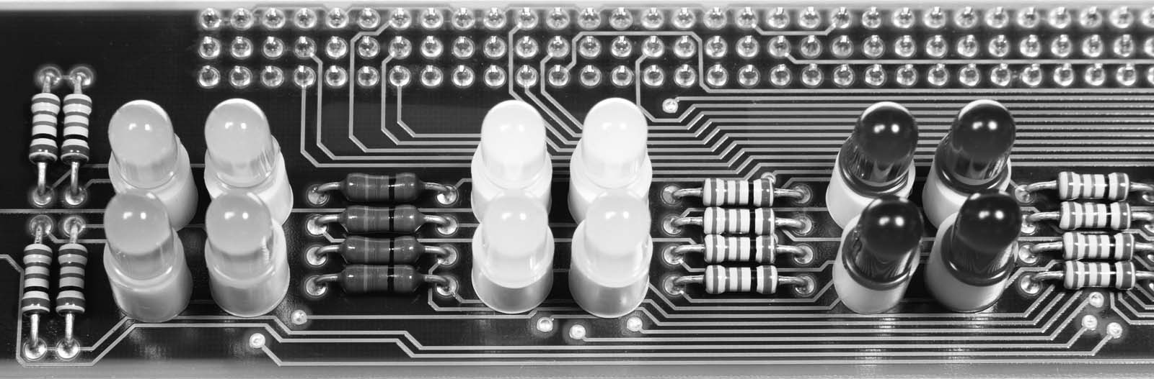
Circuit Components
An LED is forward biased when emitting light. (G6C08)
Array of LEDs and resistors

Slide 19

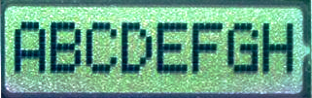
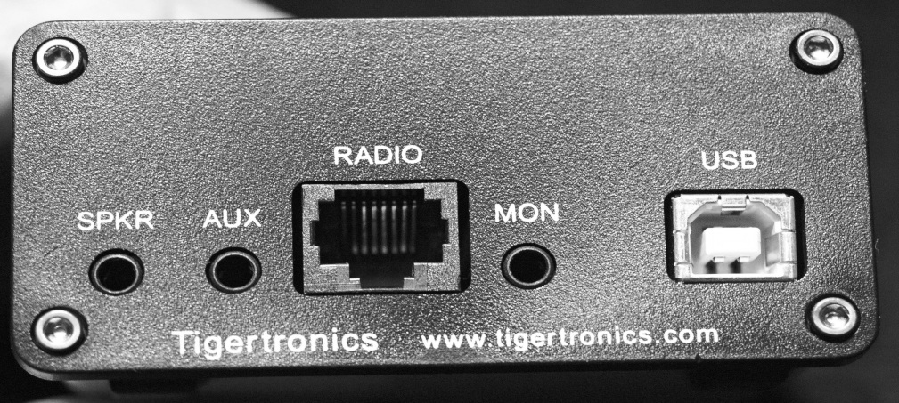
Circuit Components
LCDs do not emit light. Therefore, a liquid crystal display requires ambient or back lighting. (G6C09)
A computer and transceiver are two devices in an amateur radio station that might be connected using a USB interface. (G6C10)
The universal serial bus (USB) has made it simple to connect your ham radio to your computer.

Slide 20
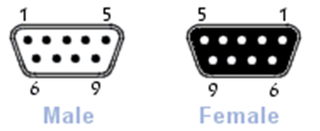
Circuit Components
A microprocessor is a computer on a single integrated circuit. (G6C11)
A DE-9 connector would be a good choice for a serial data port. (G6C12)
    Usually called a DB-9, but DE-9 is the original name. (and for the exam)
Basic microprocessor

Slide 21
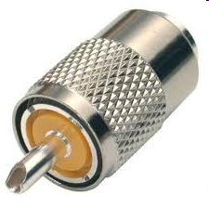
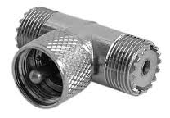
Circuit Components
A PL-259 connector is commonly used for RF service at frequencies up to 150 MHz.(G6C13)
An RCA Phono connector is commonly used for audio signals in Amateur Radio stations. (G6C14)
Male PL-259
PL-259 T-Connector
RCA Connectors

Slide 22
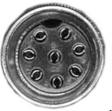
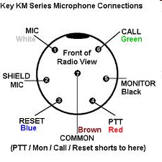

Circuit Components
The main reason to use keyed connectors instead of non-keyed types is reduced chance of incorrect mating.(G6C15)

Slide 23
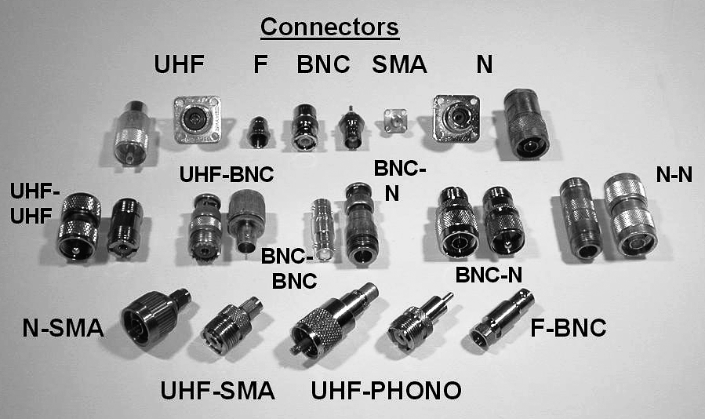
Circuit Components
The type-N connector is a moisture-resistant RF connector useful to 10 GHz. (G6C16)
Type-N
Type-N

Slide 24
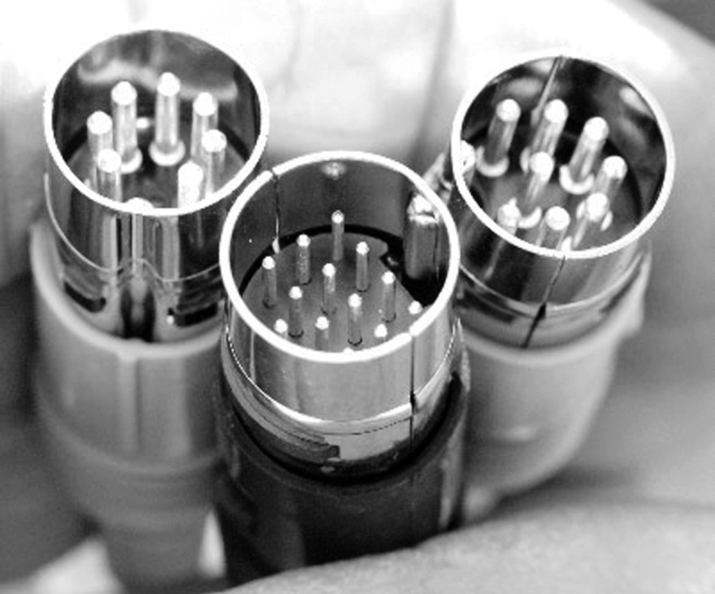
Circuit Components
The general description of a DIN type connector is a family of multiple circuit connectors suitable for audio and control signals. (G6C17)
DIN Connectors

Slide 25
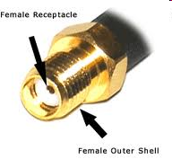
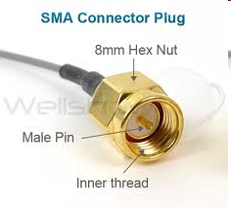
Circuit Components
The SMA connector is a small threaded connector suitable for signals up to several GHz. (G6C18)
A high quality SMA connector is useable to 18 GHz and beyond

