Slide 1
General Licensing Class
G5A – G5C
Electrical Principles
Your organization and dates here
Notes:
1

Slide 2
General Class Element 3 Course Presentation
ELEMENT 3 SUB-ELEMENTS
  G1 – Commission’s Rules
  G2 – Operating Procedures
  G3 – Radio Wave Propagation
  G4 – Amateur Radio Practices
  G5 – Electrical Principles
  G6 – Circuit Components
  G7 – Practical Circuits
  G8 – Signals and Emissions
  G9 – Antennas
  G0 – Electrical and RF Safety

Slide 3


Electrical Principles
Impedance Z, is the opposition to the flow of current in an AC circuit. (G5A01)
Reactance is opposition to the flow of alternating current caused by capacitance or inductance. (G5A02)
X_{L}=2πFL
1
X_{C}=
2πFC
When X_{L} equals X_{C}, it creates a special frequency called ‘resonant frequency’

Slide 4
Electrical Principles
Resonance occurs in a circuit when X_{L} is equal to X_{C}.
This is X_{L}=X_{C}
Therefore…..
What we do to the left side of the equation, we must do to the right side, and what we do to the numerator we must do to the denominator, to maintain equality
1
Mulitplied both sides by F and divided both sides by 2πL
F²=
(2πL)(2πC)
F²=
1
Multiplied denominator
(2π)²(LC)

Slide 5
Electrical Principles
F²=
1
From previous slide
(2π)² LC
Take square root of both sides of equation
1
F=
2π √LC
This is the resonant frequency formula.

Slide 6
Electrical Principles
Reactance causes opposition to the flow of alternating current in an inductor. (G5A03)
Reactance causes opposition to the flow of alternating current in a capacitor. (G5A04)
As the frequency of the applied AC increases, the reactance of an inductor increases. (G5A05)
As the frequency of the applied AC increases, the reactance of a capacitor decreases. (G5A06)
When the impedance of an electrical load is equal to the internal impedance of the power source, the source can deliver maximum power to the load. (G5A07)
See X_{L} formula
See X_{C} formula

Slide 7
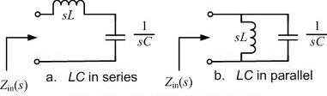
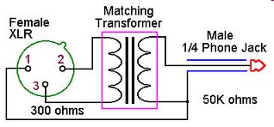
Electrical Principles
Impedance matching is important so the source can deliver maximum power to the load. (G5A08)
Ohm is the unit used to measure reactance. (G5A09)
Ohm is the unit used to measure impedance. (G5A10)
One method of impedance matching between two AC circuits is to insert an LC network between the two circuits. (G5A11)

Slide 8
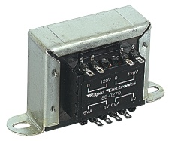
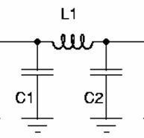

Electrical Principles
One reason to use an impedance matching transformer is to maximize the transfer of power. (G5A12)
Devices that can be used for impedance matching at radio frequencies (G5A13)
  A transformer
  A Pi-network
  A length of transmission line
All of these choices are correct

Slide 9
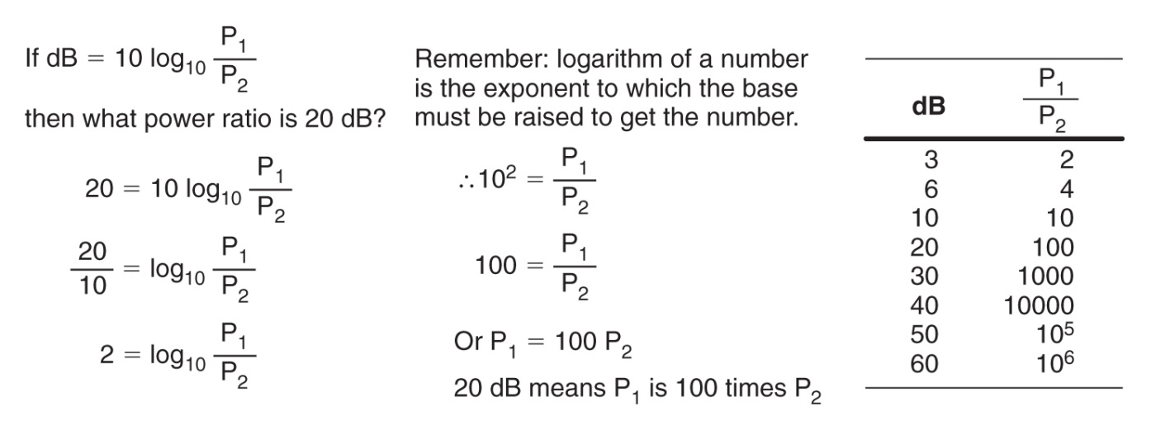
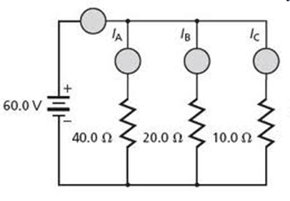
Electrical Principles
A two-times increase or decrease in power results in a change of approximately 3 db. (G5B01)
The total current entering a parallel circuit equals the sum of the currents through each branch. (G5B02)
Definition of a Decibel
I_{T} = I₁ + I₂ + I₃

Slide 10
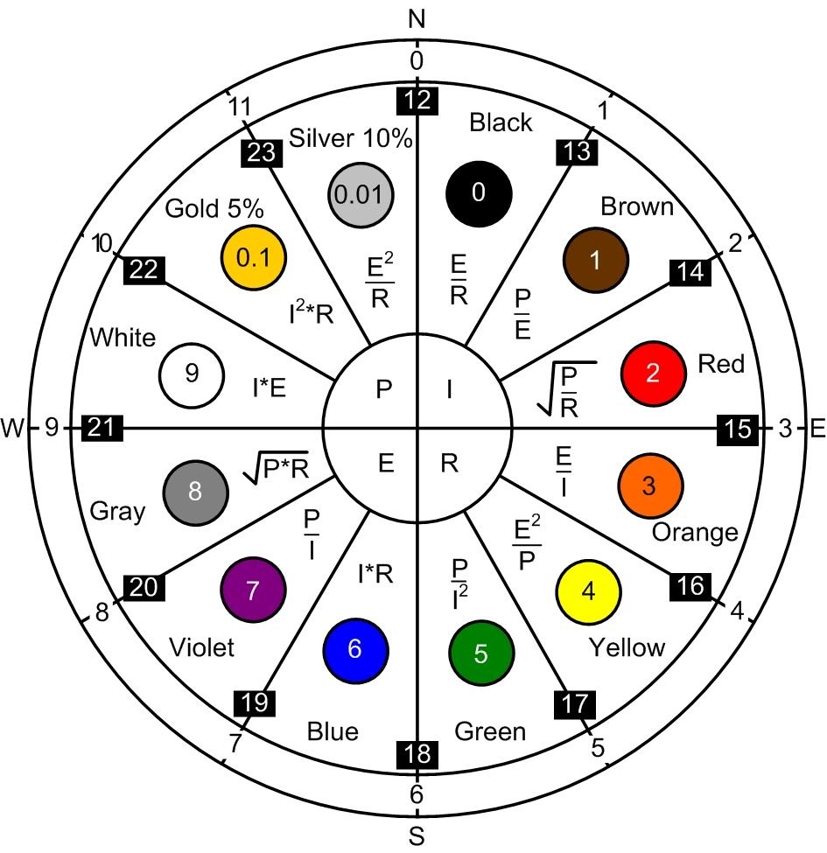
Electrical Principles
200 watts of electrical power are used if 400 VDC is supplied to an 800-ohm load. (G5B03)
    See P on chart
    P=E²/R
    P=(400)²/800
    P=160,000 / 800
    P= 200 Watts

Slide 11

Electrical Principles
2.4 watts of electrical power are used by a 12-VDC light bulb that draws 0.2 amperes. (G5B04)
    P= E * I
    P=(12) * 0.2
    P= 2.4 Watts
Approximately 61 milliwatts are being dissipated when a current of 7.0 milliamperes flows through 1.25 kilohms. (G5B05)
    P= I² R
    P =(0.007)² * 1250
    P = 0.000049 * 1250
    P=0.0613 watts
    0.061 Watts = 61.3 Milliwatts
See P on chart
See P on chart

Slide 12
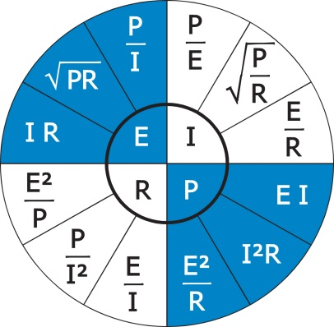
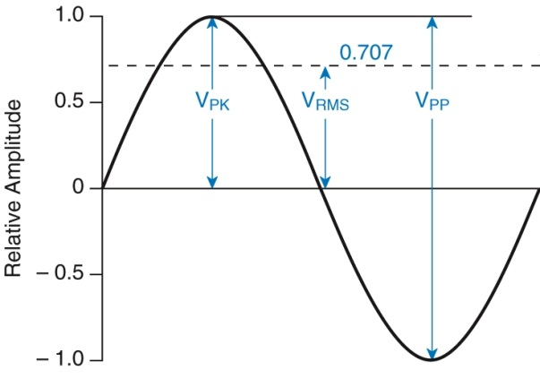
Electrical Principles
The output PEP from a transmitter is 100 watts if an oscilloscope measures 200 volts peak-to-peak across a 50-ohm dummy load connected to the transmitter output. (G5B06)
  PEP =[ (200 / 2) x .707] ² / R
  PEP= [70.7] ² / 50
  PEP= 4,998 / 50
  PEP= 99.97 Watts

Slide 13
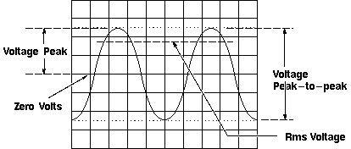
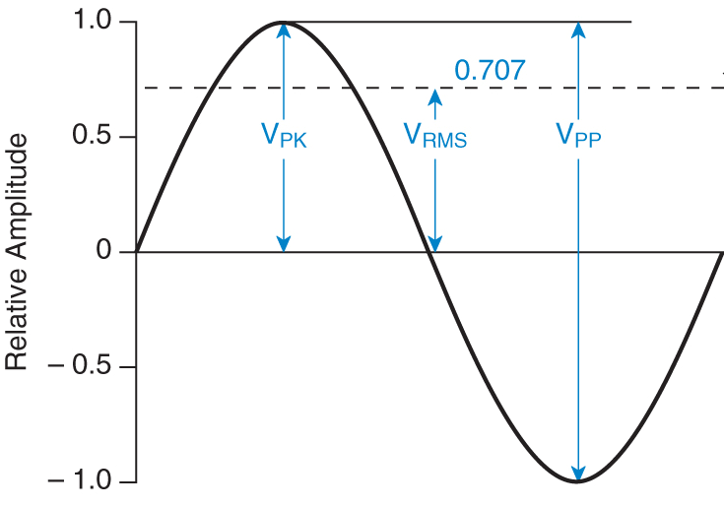
Electrical Principles
The RMS value of an AC signal is the voltage that causes the same power dissipation as a DC voltage of the same value. (G5B07)
  If you combined two or more sine wave voltages, the RMS voltage would be the square root of the average of the sum of the squares of each voltage waveform.

Slide 14
Electrical Principles
339.4 volts is the peak-to-peak voltage of a sine wave that has an RMS voltage of 120 volts. (G5B08)
    Peak to Peak = 2 (1.41 * RMS)
    PP= 2(1.41 * 120)
    PP= 2(169.68)
    PP = 339.36 Volts
12 volts is the RMS voltage of a sine wave with a value of 17 volts peak. (G5B09)
    RMS = Peak * 0.707
    RMS = 17 * 0.707
    RMS = 12 Volts

Slide 15

Electrical Principles
The percentage of power loss that would result from a transmission line loss of 1 dB would be approx. 20.5 %. (G5B10)
The ratio of peak envelope power to average power for an unmodulated carrier is 1.00. (G5B11)
245 volts would be the voltage across a 50-ohm dummy load dissipating 1200 watts. (G5B12)
    See E on chart
    E =√ (P*R)
    E = √ (1200*50)
    E = √ 60,000
    E = 244.9 Volts RMS

Slide 16
Electrical Principles
1060 watts is the output PEP of an unmodulated carrier if an average reading wattmeter connected to the transmitter output indicates 1060 watts. (G5B13)
625 watts is the output PEP from a transmitter if an oscilloscope measures 500 volts peak-to-peak across a 50-ohm resistor connected to the transmitter output. (G5B14)
  PEP =[ (500 / 2) x .707] ² / R
  PEP= [ 250 * .707] ² / 50
  PEP= [176.75] ² / 50
  PEP= 31,240. 56 / 50
  PEP = 624.81 Watts

Slide 17
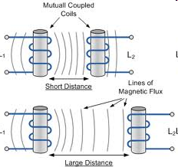
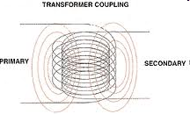
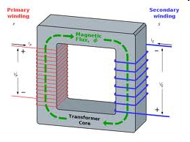
Electrical Principles
Mutual inductance causes a voltage to appear across the secondary winding of a transformer when an AC voltage source is connected across its primary winding. (G5C01)
Mutual Inductance examples

Slide 18
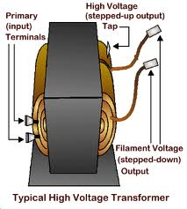
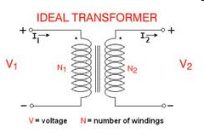
Electrical Principles
The source of energy is normally connected to the primary winding in a transformer. (G5C02)
  The simplest transformer has two windings: a primary winding and a secondary winding.

Slide 19

Electrical Principles
A resistor in series should be added to an existing resistor in a circuit to increase circuit resistance. (G5C03)
The total resistance of three 100-ohm resistors in parallel is 33.3 ohms. (G5C04)
  For identical resistors in parallel simply divide the resistance of one resistor by the number of resistors to find the total network resistance.
  R = resistor value / number of resistors
  R = 100 / 3
  R = 33.333 Ohms
150 ohms is the value of each resistor which, when three of them are connected in parallel, produce 50 ohms of resistance, and the same three resistors in series produce 450 ohms. (G5C05)
The resistance of a carbon resistor will change depending on the resistor's temperature coefficient rating if the ambient temperature is increased. (G6A06)
Or the long way.

Slide 20

Electrical Principles
The turns ratio of a transformer used to match an audio amplifier having a 600-ohm output impedance to a speaker having a 4-ohm impedance is 12.2 to 1. (G5C07)
This is a ‘turns ratio’ problem.
N_{P}
N_{S}
Z_{P}
Z_{S}
Z_{P} = primary impedance
Z_{S} = secondary impedance
N_{P} = turns on the primary
N_{S} = turns on the secondary
=
600
4
=
=
150
=
12.2
This is a ‘turns ratio’ problem.

Slide 21
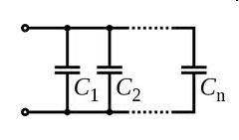

Electrical Principles
The equivalent capacitance of two 5000 picofarad capacitors and one 750 picofarad capacitor connected in parallel is 10750 picofarads. (G5C08)
    Capacitors in parallel simply add together,
    therefore the total capacity would be:
    5000 pf + 5000pf + 750 pf
    10750 pf
Capacitors in parallel formula.
Capacitors in parallel.

Slide 22
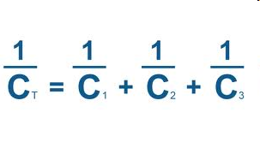
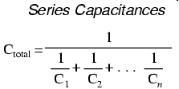
Electrical Principles
The capacitance of three 100 microfarad capacitors connected in series 33.3 microfarads. (G5C09)
  For identical capacitors in series simply divide the capacitance of one capacitor by the number of Capacitors.
  C=capacitance value / number of capacitors
  C = 100 / 3
  C = 33.333 microfarads
(Only for equal values.)

Slide 23


Electrical Principles
The inductance of three 10 millihenry inductors connected in parallel is 3.3 millihenrys. (G5C10)
  For identical inductors in parallel simply divide the inductance of one inductor by the number of inductors.
  L=Inductor value / number of inductors
  L = 10 / 3
  L = 3.333 millihenrys
The inductance of a 20 millihenry inductor in series with a 50 millihenry inductor is 70 millihenrys (G5C11)
  Inductors in series simply add.
  Therfore L = 20 + 50
  L = 70 millihenrys.
Or the long way.
Just like resistors in series.

Slide 24
Electrical Principles
The capacitance of a 20 microfarad capacitor in series with a 50 microfarad capacitor is 14.3 microfarads. (G5C12)
  C_{T}= 1/ [(1/C₁) + (1/C₂)]
  C_{T} = 1/ [(1/20) + (1/50)]
  C_{T} = 1/ [(.050)+(1/.020)]
  C_{T} = (1/.07)
  C_{T} = 14.285 microfarads

Slide 25
Electrical Principles
A capacitor in parallel should be added to a capacitor in a circuit to increase the circuit capacitance. (G5C13)
An inductor in series should be added to an inductor in a circuit to increase the circuit inductance. (G5C14)
5.9 ohms is the total resistance of a 10 ohm, a 20 ohm, and a 50 ohm resistor in parallel. (G5C15)
  R_{T}= 1/ [(1/R₁) + (1/R₂) + (1/R₃)]
  R_{T}= 1/ [(1/10) + (1/20) + (1/50)]
  R_{T} = 1/ [(0.1) + (0.05) + (0.02)]
  R_{T} =1/ .17
  R_{T} = 5.88 ohms
    Remember that the total resistance in a parallel circuit will always be less than the smallest resistor in the parallel network.

