Slide 1
General Licensing Class
G4A – G4E
Amateur Radio Practices
Your organization and dates here
Notes:
1

Slide 2
General Class Element 3 Course Presentation
ELEMENT 3 SUB-ELEMENTS
  G1 – Commission’s Rules
  G2 – Operating Procedures
  G3 – Radio Wave Propagation
  G4 – Amateur Radio Practices
  G5 – Electrical Principles
  G6 – Circuit Components
  G7 – Practical Circuits
  G8 – Signals and Emissions
  G9 – Antennas
  G0 – Electrical and RF Safety

Slide 3
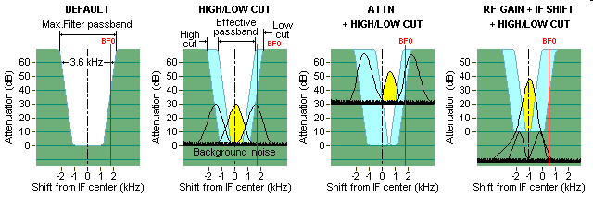
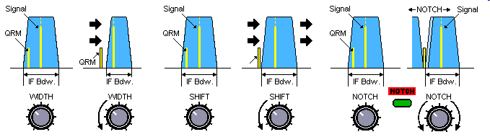
Amateur Radio Practices
The purpose of the "notch filter" found on many HF transceivers is to reduce interference from carriers in the receiver passband. (G4A01)

Slide 4
Amateur Radio Practices
An advantage of selecting the opposite or "reverse" sideband when receiving CW signals on a typical HF transceiver is that it may be possible to reduce or eliminate interference from other signals. (G4A02)
Operating a transceiver in "split" mode means that the transceiver is set to different transmit and receive frequencies. (G4A03)
A pronounced dip on the plate current meter of a vacuum tube RF power amplifier indicates correct adjustment of the plate tuning control. (G4A04)
The purpose of using Automatic Level Control (ALC) with a RF power amplifier is to reduce distortion due to excessive drive. (G4A05)

Slide 5
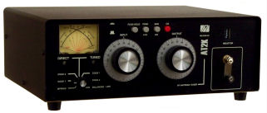
Amateur Radio Practices
An antenna coupler is often used to enable matching the transmitter output to an impedance other than 50 ohms. (G4A06)
Excessive drive power can lead to permanent damage when using a solid-state RF power amplifier. (G4A07)
The correct adjustment for the load or coupling control of a vacuum tube RF power amplifier is to adjust for maximum power output without exceeding maximum allowable plate current. (G4A08)
A time delay sometimes included in a transmitter keying circuit to allow time for transmit-receive changeover operations to complete properly before RF output is allowed. (G4A09)

Slide 6
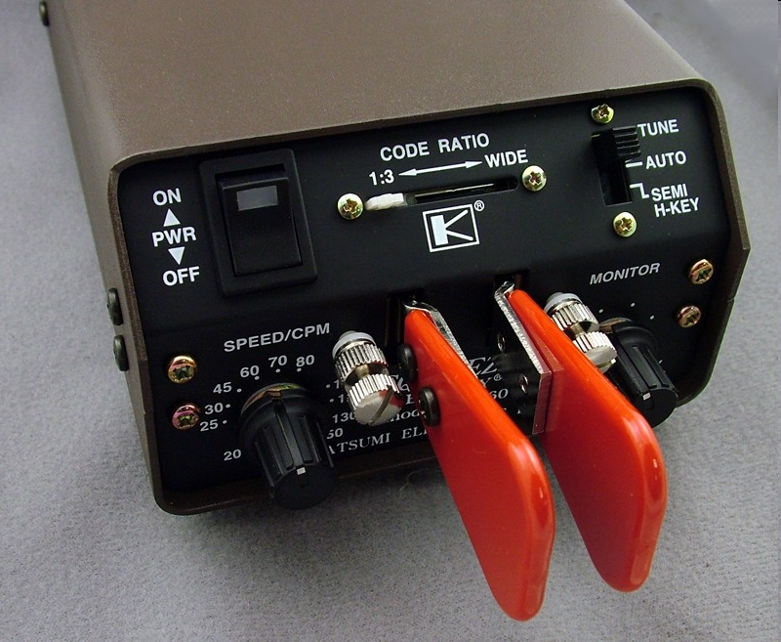
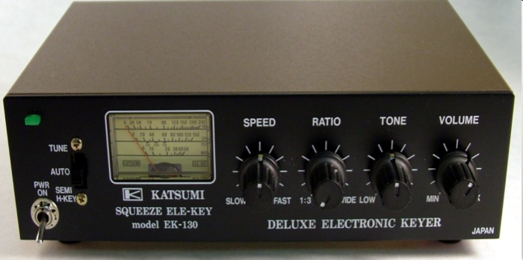
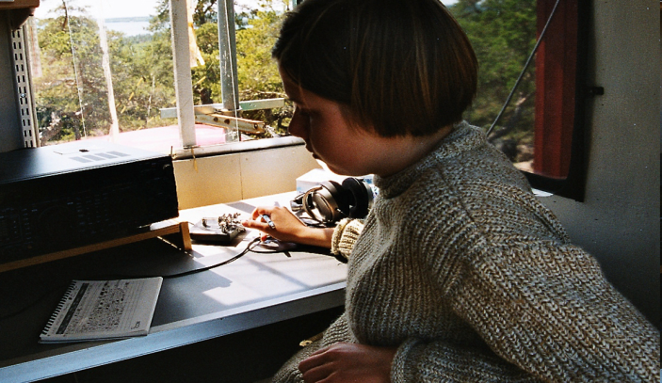
Amateur Radio Practices
The purpose of an electronic keyer, for example, is automatic generation of strings of dots and dashes for CW operation. (G4A10)

Slide 7
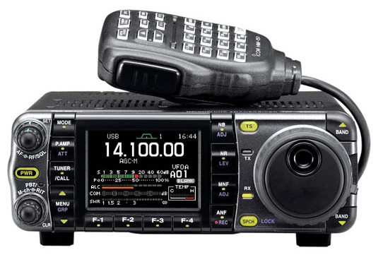
Amateur Radio Practices
One use for the IF shift control on a receiver is to avoid interference from stations very close to the receive frequency. (G4A11)
A common use for the dual VFO feature on a transceiver is to permit ease of monitoring the transmit and receive frequencies when they are not the same. (G4A12)
One reason to use the attenuator function that is present on many HF transceivers is to reduce signal overload due to strong incoming signals. (G4A13)
Icom 7000
Dual function switch: Pre-amp & Attenuator.

Slide 8
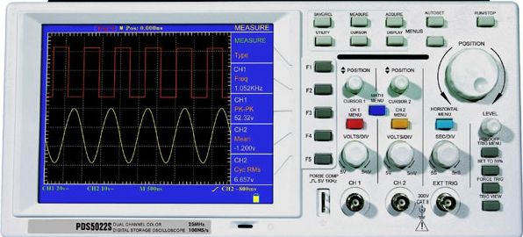
Amateur Radio Practices
When transmitting PSK31 data signals, transceiver audio input should be adjusted so that the transceiver ALC system does not activate. (G4A14)
    ALC is the Automatic Level Control
An oscilloscope is an item of test equipment that contains horizontal and vertical channel amplifiers. (G4B01)
Dual Trace Oscilloscope

Slide 9
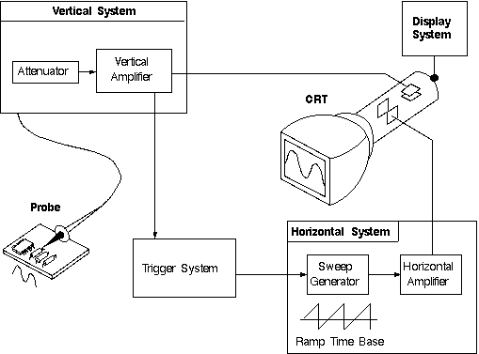
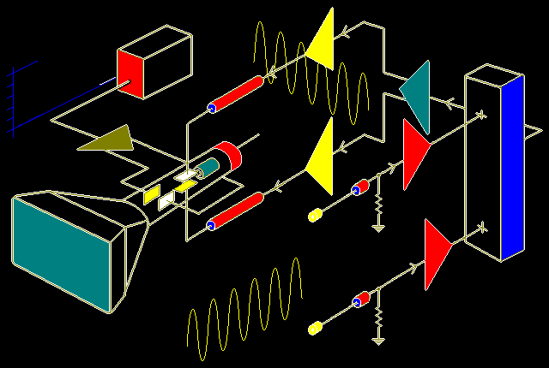
Amateur Radio Practices
An oscilloscope is an item of test equipment that contains horizontal and vertical channel amplifiers. (same statement as previous slide) (G4B01)
V & H Channel Amplifiers

Slide 10
Amateur Radio Practices
One advantage of an oscilloscope versus a digital voltmeter is that complex waveforms can be measured. (G4B02)
An oscilloscope is the best instrument to use when checking the keying waveform of a CW transmitter. (G4B03)

Slide 11
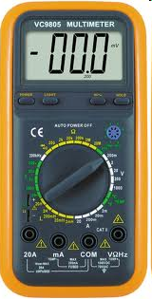
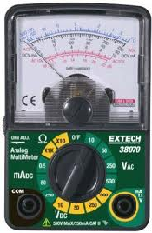
Amateur Radio Practices
The attenuated RF output of the transmitter is the signal source that is connected to the vertical input of an oscilloscope when checking the RF envelope pattern of a transmitted signal. (G4B04)
High input impedance is desirable for a voltmeter because it decreases the loading on circuits being measured. (G4B05)
An advantage of a digital voltmeter as compared to an analog voltmeter is that it has better precision for most uses. (G4B06)
Digital Voltmeter
Analog Voltmeter

Slide 12
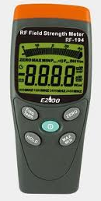
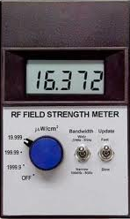
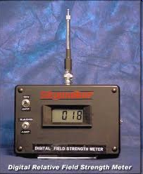
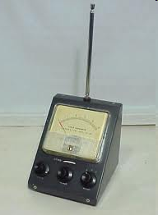
Amateur Radio Practices
One other use for a field strength meter is close-in radio direction-finding. (G4B07)
A field-strength meter may also be used to monitor relative RF output when making antenna and transmitter adjustments. (G4B08)
The radiation pattern of an antenna can be determined with a field strength meter. (G4B09)

Slide 13
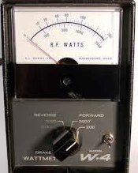
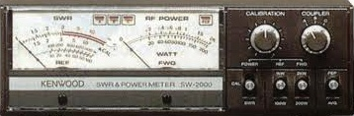
Amateur Radio Practices
Standing wave ratio can also be determined with a directional wattmeter. (G4B10)
The antenna and feed line must be connected to an antenna analyzer when it is being used for SWR measurements. (G4B11)

Slide 14
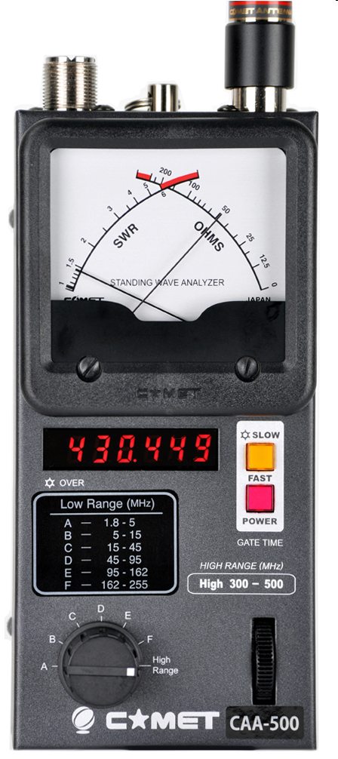
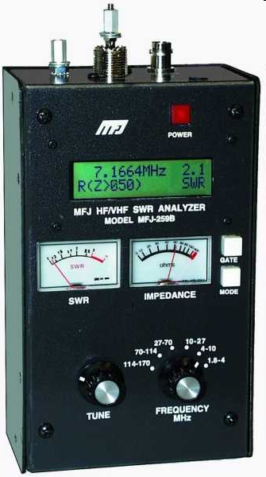
Amateur Radio Practices
Strong signals from nearby transmitters can affect the accuracy of measurements when making measurements on an antenna system with an antenna analyzer. (G4B12)
A use for an antenna analyzer, other than measuring the SWR of an antenna system, is determining the impedance of an unknown or unmarked coaxial cable. (G4B13)
Comet CAA-500
MFJ-259B

Slide 15
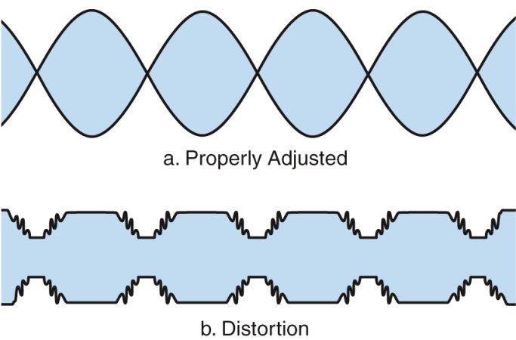
Amateur Radio Practices
When adjusting tuned circuits, the use of an instrument with analog readout may be preferred over an instrument with a numerical digital readout. (G4B14)
One test that is often run on a SSB transmitter is the two-tone test. A two-tone test analyzes the linearity of a transmitter. (G4B15)
Two non-harmonically related audio signals are used to conduct a two-tone test. (G4B16)

Slide 16
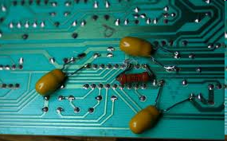
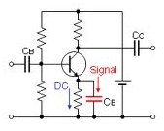
Amateur Radio Practices
Bypass capacitors might be useful in reducing RF interference to audio-frequency devices. (G4C01)
Arcing at a poor electrical connection could be a cause of interference covering a wide range of frequencies. (G4C02)
Distorted speech is heard from an audio device or telephone if there is interference from a nearby single-sideband phone transmitter. (G4C03)
On-and-off humming or clicking is one effect that a nearby CW transmitter may have on an audio device or telephone system. (G4C04)

Slide 17
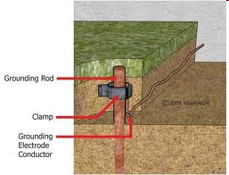
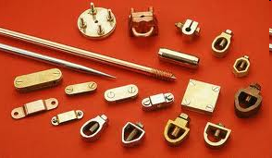
Amateur Radio Practices
If you receive an RF burn when touching your equipment while transmitting on an HF band, assuming the equipment is connected to a ground rod, the ground wire has high impedance on that frequency. (G4C05)
    This is because at some frequencies the ground wire is inductive and may become resonant at some frequencies
    Using a lower inductance ground wire will reduce this problem.
    Could be a ¼ wavelength and a good antenna.
One effect that can be caused by a resonant ground connection is high RF voltages on the enclosures of station equipment. (G4C06)

Slide 18
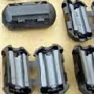
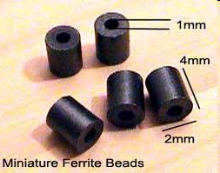
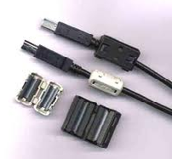
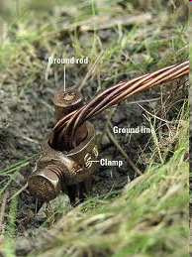
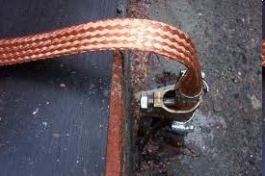
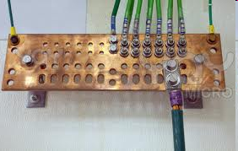

Amateur Radio Practices
One good way to avoid unwanted effects of stray RF energy in an amateur station is to connect all equipment grounds together at a single point. (G4C07)
Placing a ferrite bead around the cable would reduce RF interference caused by common-mode current on an audio cable. (G4C08)
Connect all ground conductors to a single point to avoid a ground loop. (G4C09)

Slide 19
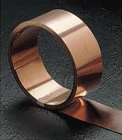
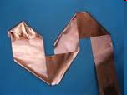
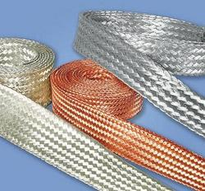
Amateur Radio Practices
If you receive reports of "hum" on your station's transmitted signal, this could be a symptom of a ground loop somewhere in your station. (G4C10)
One use for a Digital Signal Processor in an amateur station is to remove noise from received signals. (G4C11)
An advantage of a receiver Digital Signal Processor IF filter as compared to an analog filter is that a wide range of filter bandwidths and shapes can be created. (G4C12)
A Digital Signal Processor (DSP) filter can perform automatic notching of interfering carriers. (G4C13)

Slide 20
Amateur Radio Practices
The purpose of a speech processor as used in a modern transceiver is to increase the intelligibility of transmitted phone signals during poor conditions. (G4D01)
A speech processor increases average power of a transmitted single sideband phone signal. (G4D02)
An incorrectly adjusted speech processor can cause: (G4D03)
    Distorted speech
    Splatter
    Excessive background pickup
        All of these choices are correct.

Slide 21
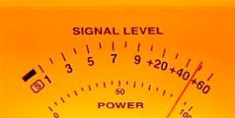

Amateur Radio Practices
An S meter measures received signal strength. (G4D04)
Assuming a properly calibrated S meter, an S meter reading of 20 dB over S-9 is 100 times stronger compared to an S-9 signal. (G4D05)
“S” Meters are based on S9 representing 50uV

Slide 22
Amateur Radio Practices
An S meter is found in a receiver. (G4D06)
    Most commercial receivers have an S meter.
To make the S-meter reading on a distant receiver rise from S8 to S9, you would have to raise the power output of your transmitter approximately 4 times. (G4D07)
0 dB | = | 0 times change
3 dB | = | 2 times change
6 dB | = | 4 times change
9 dB | = | 8 times change
10 dB | = | 10 times change

Slide 23
Amateur Radio Practices
When the displayed carrier frequency is set to 7.178 MHz, a 3 kHz LSB signal occupies 7.175 to 7.178 MHz. (G4D08)
With the displayed carrier frequency set to 14.347 MHz, a 3 kHz USB signal occupies 14.347 to 14.350 MHz. (G4D09)
  When operating USB, your signal occupies a space starting at the displayed carrier frequency and extending up 3 kHz.
When operating in the 40 meter General Class phone segment when using 3 kHz wide LSB, your displayed carrier frequency should be 3 kHz above the edge of the segment. (G4D10)
When operating in the 20 meter General Class band, your displayed carrier frequency should be no less than 3 kHz below the edge of the band when using 3 kHz wide USB. (G4D11)

Slide 24
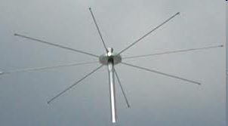
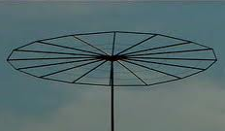
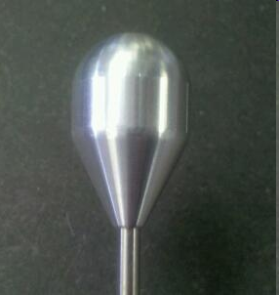
Amateur Radio Practices
A "capacitance hat" on a mobile antenna is a device to electrically lengthen a physically short antenna. (G4E01)
The purpose of a "corona ball" on a HF mobile antenna is to reduce high voltage discharge from the tip of the antenna. (G4E02)
    They dissipate static build up from movement through the air caused by vehicle movement

Slide 25
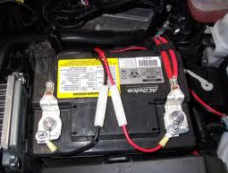
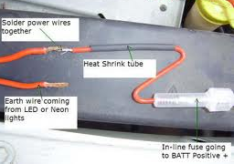
Amateur Radio Practices
A direct, fused power connection to the battery using heavy gauge wire would be the best for a 100-watt HF mobile installation. (G4E03)

Slide 26
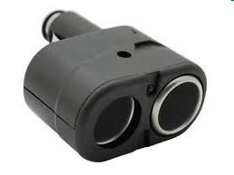
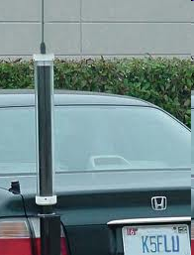
Amateur Radio Practices
It is best NOT to draw the DC power for a 100-watt HF transceiver from an automobile's auxiliary power socket because the socket's wiring may be inadequate for the current being drawn by the transceiver. (G4E04)
The antenna system is the one thing that most limits the effectiveness of an HF mobile transceiver operating in the 75 meter band. (G4E05)
    It is not possible to put a full ¼ wavelength 75 meter antenna on a mobile.
    Any antenna for these frequencies would be inefficient.
One disadvantage of using a shortened mobile antenna as opposed to a full size antenna is that operating bandwidth may be very limited. (G4E06)

Slide 27
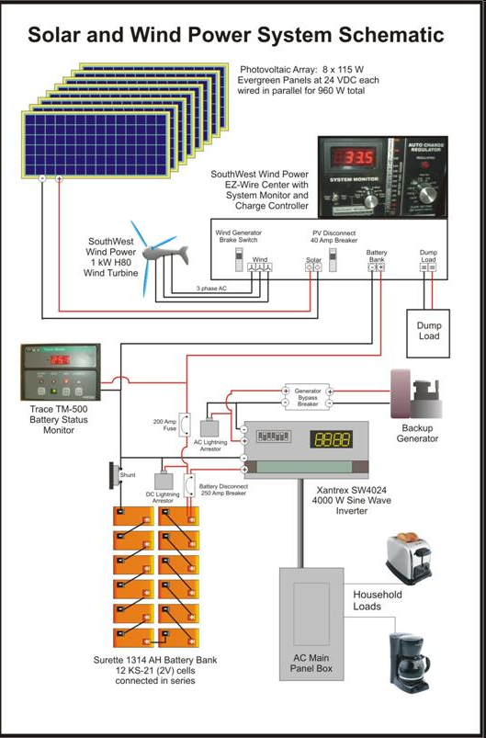
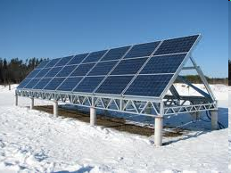
Amateur Radio Practices
The vehicle control computer is most likely to cause interfering signals to be heard in the receiver of an HF mobile installation in a recent model vehicle. (G4E07)
The process by which sunlight is changed directly into electricity is called photovoltaic conversion. (G4E08)
Solar panels
Schematic of Solar Panel for Charging Storage Batteries.

Slide 28


Amateur Radio Practices
The approximate open-circuit voltage from a modern, well-illuminated photovoltaic cell is 0.5 VDC. (G4E09)
The reason a series diode is connected between a solar panel and a storage battery that is being charged by the panel is that the diode prevents self discharge of the battery though the panel during times of low or no illumination. (G4E10)
One disadvantage of using wind as the primary source of power for an emergency station is that a large energy storage system is needed to supply power when the wind is not blowing. (G4E11)
Brightview power storage, Cryoenergy Systems, energy storage

