Slide 1
General Licensing Class
G3A – G3C
Radio Wave Propagation
Your organization and dates here
Notes:
1

Slide 2
General Class Element 3 Course Presentation
ELEMENT 3 SUB-ELEMENTS
  G1 – Commission’s Rules
  G2 – Operating Procedures
  G3 – Radio Wave Propagation
  G4 – Amateur Radio Practices
  G5 – Electrical Principles
  G6 – Circuit Components
  G7 – Practical Circuits
  G8 – Signals and Emissions
  G9 – Antennas
  G0 – Electrical and RF Safety

Slide 3
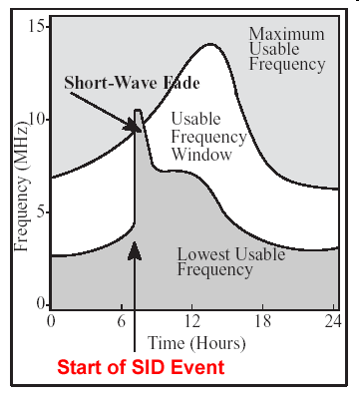
Radio Wave Propagation
The sunspot number is a measure of solar activity based on counting sunspots and sunspot groups. (G3A01)
The effect a Sudden Ionospheric Disturbance has on the daytime ionospheric propagation of HF radio waves is that it disrupts signals on lower frequencies more than those on higher frequencies. (G3A02)
A Sudden Ionic Disturbance (SID) is a phenomenon that can have a drastic effect on propagation.
During an SID, the sun emits a great deal of ultraviolet and X-ray radiation.

Slide 4
Radio Wave Propagation
8 minutes is approximately how long it takes for the increased ultraviolet and X-ray radiation from solar flares to affect radio-wave propagation on the Earth. (G3A03)
21 MHz and higher are the amateur radio HF frequencies that are least reliable for long distance communications during periods of low solar activity. (G3A04)
The solar-flux index is a measure of solar radiation at 10.7 cm. (G3A05)
10.7 cm wavelength = 2.80 GHz

Slide 5
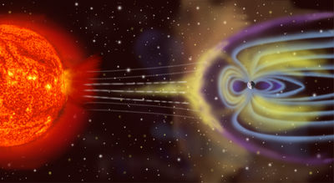
Radio Wave Propagation
Geomagnetic activity, such as a geomagnetic storm, can also affect radio propagation. A geomagnetic storm is a temporary disturbance in the Earth's magnetosphere. (G3A06)
At any point in the solar cycle, the 20 meter band usually supports worldwide propagation during daylight hours. (G3A07)
One of the effects a geomagnetic storm can have on radio-wave propagation is degraded high-latitude HF propagation. (G3A08)

Slide 6
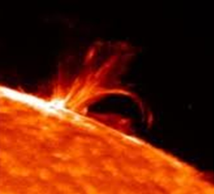
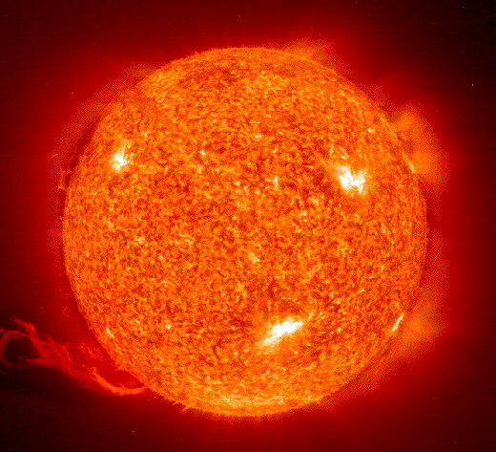
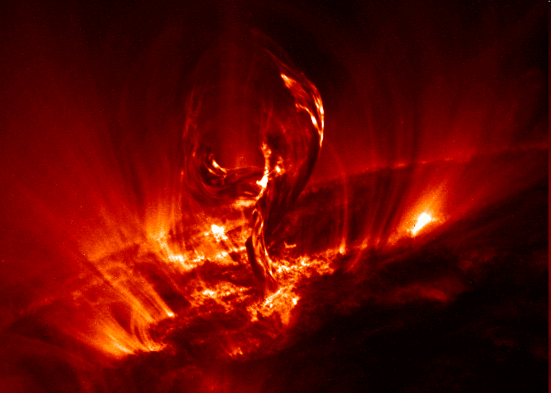
Radio Wave Propagation
The effect that high sunspot numbers have on radio communications is that long-distance communication in the upper HF and lower VHF range is enhanced. (G3A09)
The sunspot cycle is a long-term phenomenon. There are other phenomena that affect radio wave propagation in the short term. For example, the Sun’s rotation on its axis causes HF propagation conditions to vary periodically in a 28-day cycle. (G3A10)
Solar flares and sunspots affect radiowave propagation

Slide 7
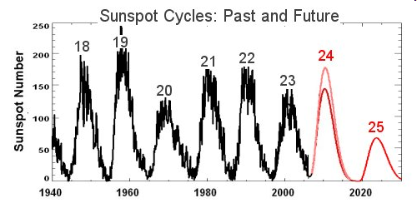
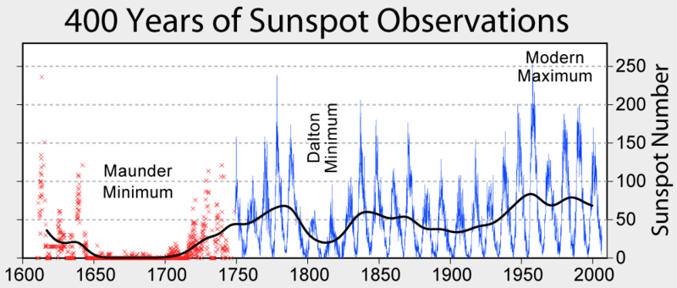
Radio Wave Propagation
The phenomenon that most affects amateur radio communications on the HF bands is the sunspot cycle. The typical sunspot cycle is approximately 11 years long. (G3A11)
Notice 11 year cycles
2011 is coming into cycle 24.

Slide 8
Radio Wave Propagation
There are two indices that give an indication of the stability of the Earth’s magnetic field. The K-index indicates the short term stability of the Earth’s magnetic field. (G3A12)
The A-index indicates the long term stability of the Earth’s geomagnetic field. (G3A13)
K Index | A Index | HF Skip Conditions
K1 - K4 | A0 - A7 | Bands are normal
K4 | A8 - A15 | Bands are unsettled
K4 | A16 - A30 | Bands are unpredictable
K5 | A30 - A50 | Lower bands are unstable
K6 | A50 - A99 | Few skywaves below 15 MHz
K7 - K9 | A100 - A400 | Radio blackout is likely
 |  | Go fishing or watch for an aurora.

Slide 9
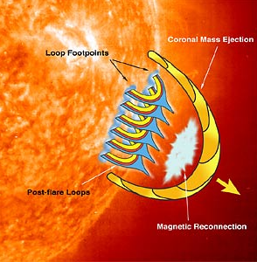
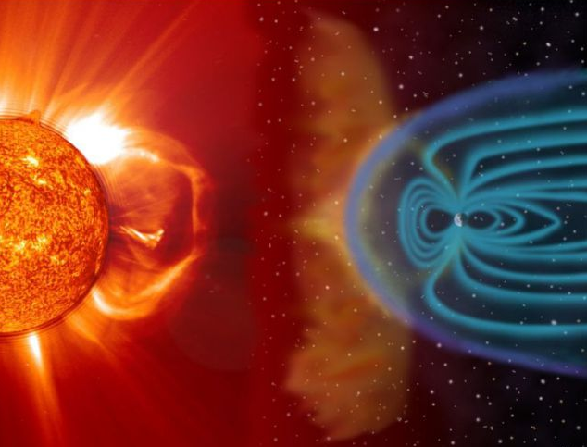
Radio Wave Propagation
HF communications are disturbed by the charged particles that reach the Earth from solar coronal holes. (G3A14)
It takes 20 to 40 hours for charged particles from Coronal Mass Ejections (CME) to affect radio-wave propagation on the Earth. (G3A15)
A coronal mass ejection (CME) is a massive burst of solar wind and magnetic fields rising above the solar corona or being released into space.
Coronal Mass Ejections take 20 – 40 hours to reach the earth where ultraviolet and X-Ray radiation from solar flares take 8 minutes.

Slide 10

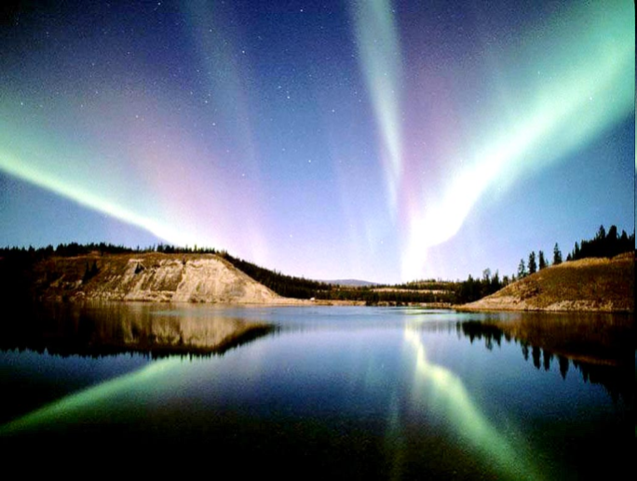
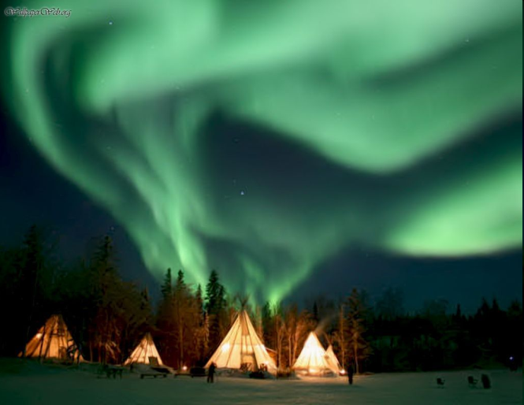
Radio Wave Propagation
A possible benefit to radio communications resulting from periods of high geomagnetic activity is that the aurora that can reflect VHF signals. (G3A16)
Geomagnetic disturbances caused by the Sun result in the Northern Lights.

Slide 11
Radio Wave Propagation
While signals most often take the shortest path from point to point, sometimes the best path for radio propagation is in the opposite direction, also called the “long path.” A well-defined echo might be heard if a sky-wave signal arrives at your receiver by both short path and long path propagation. (G3B01)
A good indicator of the possibility of sky-wave propagation on the 6 meter band is that there is short skip sky-wave propagation on the 10 meter band. (G3B02)
When selecting a frequency for lowest attenuation when transmitting on HF, select a frequency just below the MUF. (G3B03)

Slide 12
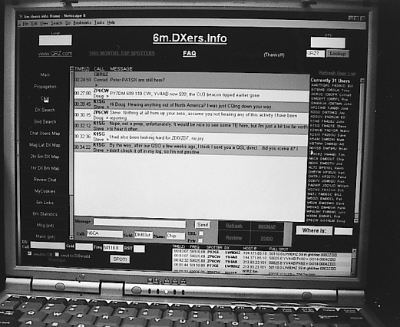
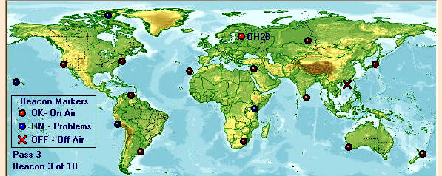
Radio Wave Propagation
A reliable way to determine if the Maximum Usable Frequency (MUF) is high enough to support skip propagation between your station and a distant location on frequencies between 14 and 30 MHz is to listen for signals from an international beacon. (G3B04)
There are websites that provide skywave DX conditions.

Slide 13
Radio Wave Propagation
When they are sent into the ionosphere, radio waves with frequencies below the Maximum Usable Frequency (MUF) and above the Lowest Usable Frequency (LUF) are bent back to the Earth. (G3B05)
When they are sent into the ionosphere, radio waves with frequencies below the Lowest Usable Frequency (LUF) are completely absorbed by the ionosphere. (G3B06)
LUF stands for the Lowest Usable Frequency for communications between two points. (G3B07)
MUF stand for the Maximum Usable Frequency for communications between two points. (G3B08)

Slide 14
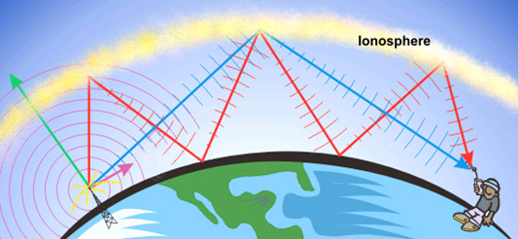
Radio Wave Propagation
2,500 miles is the approximate maximum distance along the Earth's surface that is normally covered in one hop using the F2 region. (G3B09)

Slide 15
Radio Wave Propagation
1,200 miles is the approximate maximum distance along the Earth's surface that is normally covered in one hop using the E region. (G3B10)
No HF radio frequency will support ordinary skywave communications over the path when the Lowest Usable Frequency (LUF) exceeds the Maximum Usable Frequency (MUF). (G3B11)
The following factors affect the Maximum Usable Frequency (MUF) (G3B12)
      Path distance and location
      Time of day and season
      Solar radiation and ionospheric disturbances
All of these choices are correct.

Slide 16
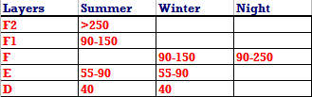
Radio Wave Propagation
The ionospheric layer closest to the surface of the Earth is the D layer. (G3C01)
Where the Sun is overhead, ionospheric layers reach their maximum height. (G3C02)
Altitudes in Miles of Ionospheric Layers
Day
The ionosphere is what makes long-distance radio communications possible on the shortwave bands.
The ionosphere is made up of three layers of charged particles, labeled D, E, and F.

Slide 17
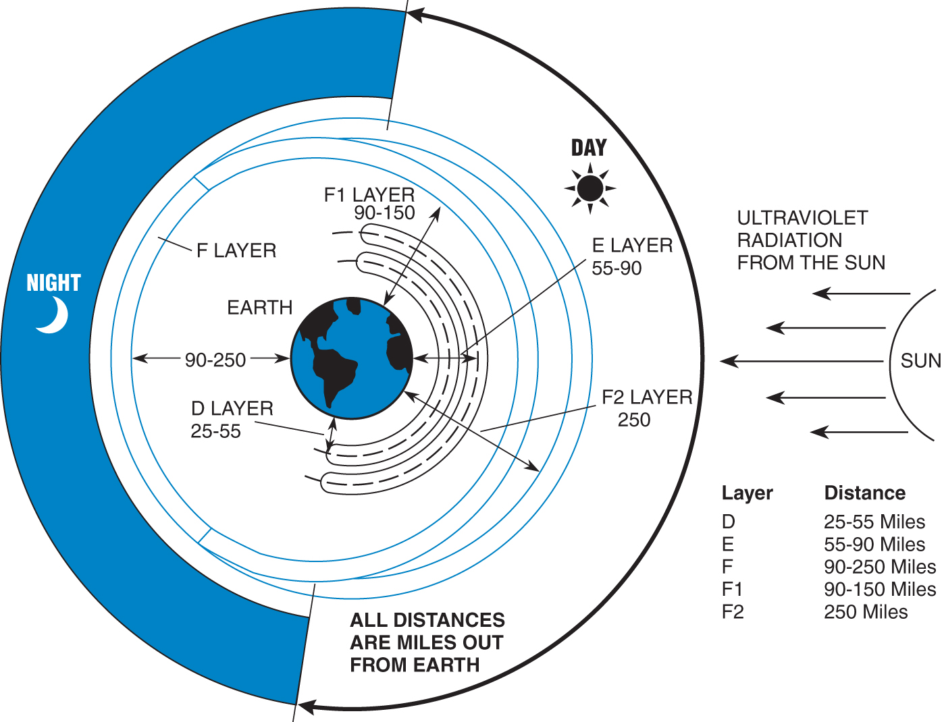
Radio Wave Propagation
The F2 region is mainly responsible for the longest distance radio wave propagation because it is the highest ionospheric region. (G3C03)

Slide 18
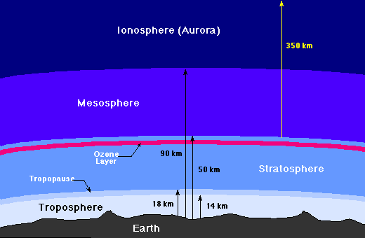
Radio Wave Propagation
Layers of the Atmosphere

Slide 19
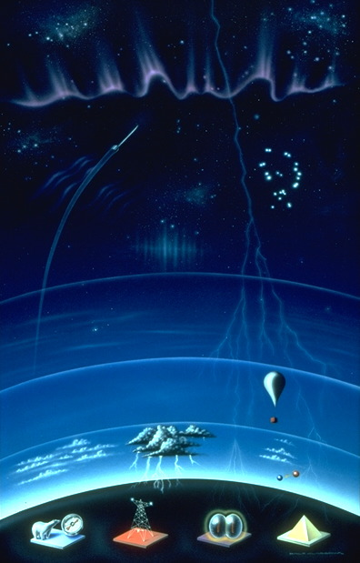
Radio Wave Propagation
Atmospheric Layers
Terms we’ve heard before from space shuttle launches.
Now apply them to Ham Radio
Ionosphere
31 – 400 miles
Stratosphere
6 – 31 miles
Troposphere
0 – 6 miles

Slide 20
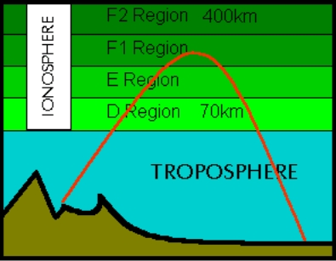
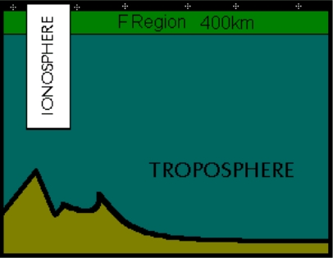
Radio Wave Propagation
Regions in the Ionosphere
During the day....
The “D” Region is closest to Earth
The “D” Region absorbs MF/HF radio signals
The “F2” Region is most responsible for long distance communication
At night....
The “D” & “E” Regions disappear
The “F1” & “F2” Regions combine into one with reduced ionization

Slide 21
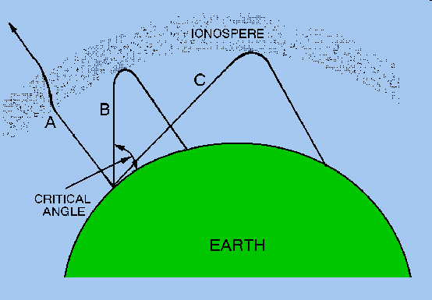
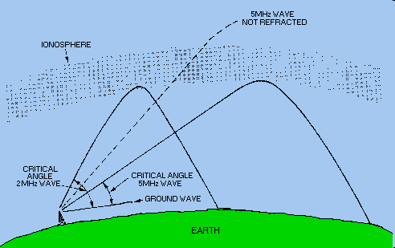
Radio Wave Propagation
The highest takeoff angle that will return a radio wave to the Earth under specific ionospheric conditions is called the critical angle. (G3C04)
One factor that affects how well the ionosphere will reflect a signal is the angle at which the signal impinges upon it.
If the angle is too high, it will pass right through the ionosphere and not be reflected back to earth.

Slide 22
Radio Wave Propagation
Long distance communication on the 40, 60, 80 and 160 meter bands is more difficult during the day because the D layer absorbs signals at these frequencies during daylight hours. (G3C05)
When they are sent into the ionosphere, radio waves with frequencies below the Lowest Usable Frequency (LUF) are completely absorbed by the ionosphere. (G3B06)
LUF stands for the Lowest Usable Frequency for communications between two points. (G3B07)
HF scatter signals in the skip zone are usually weak because only a small part of the signal energy is scattered into the skip zone. (G3C08)

Slide 23
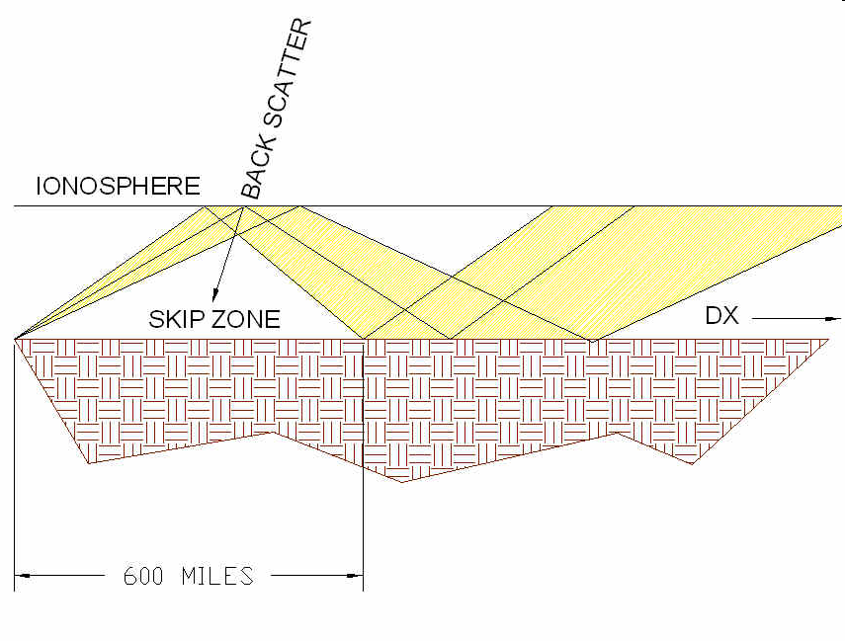
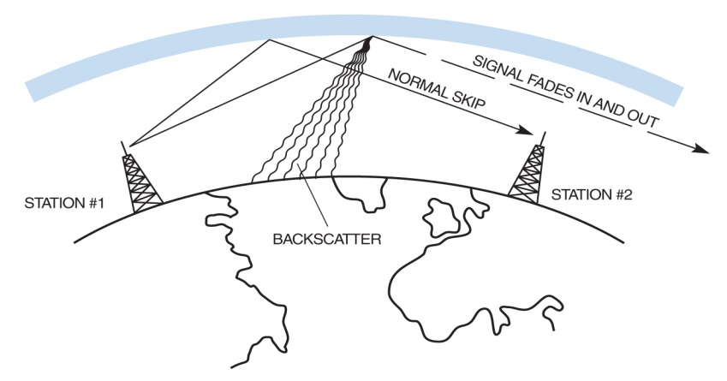
Radio Wave Propagation
One interesting propagation phenomenon is scatter propagation. Scatter propagation allows a signal to be detected at a distance too far for ground wave propagation but too near for normal sky-wave propagation. (G3C09)
Scatter

Slide 24
Radio Wave Propagation
An indication that signals heard on the HF bands are being received via scatter propagation is that the signal is heard on a frequency above the Maximum Usable Frequency. (G3C10)
Horizontal dipoles placed between 1/8 and 1/4 wavelength above the ground will be most effective for skip communications on 40 meters during the day. (G3C11)
  Antennas used for DXing should have low takeoff angles.
  One thing that affects the takeoff angle of an antenna is its height above ground.

Slide 25
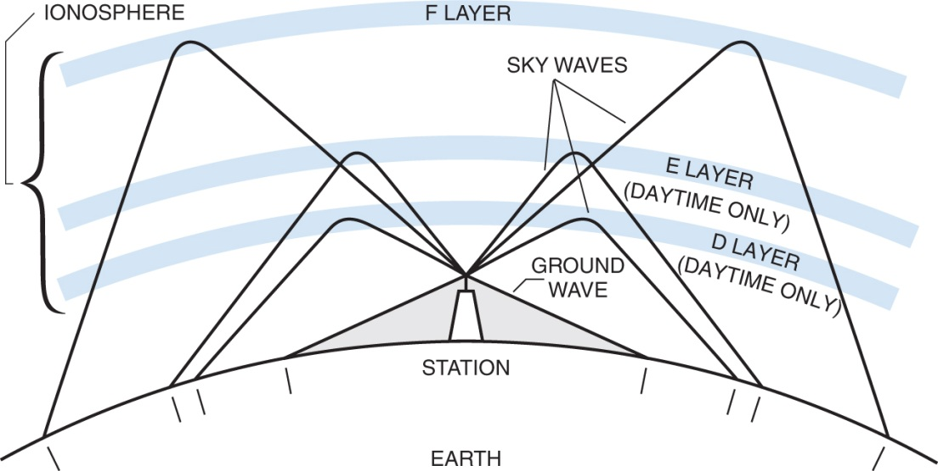
Radio Wave Propagation
The D layer is the ionospheric layer that is the most absorbent of long skip signals during daylight hours on frequencies below 10 MHz. (G3C12)
F Layer
F Layer
E Layer
E Layer
D Layer
D Layer

Slide 26
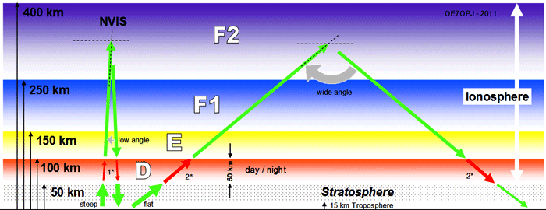
Radio Wave Propagation
Near Vertical Incidence Sky-wave (NVIS) propagation is short distance HF propagation using high elevation angles. (G3C13)
The antenna sends the signal at an angle of close to 90 degrees, and if conditions are right, the ionosphere reflects that signal back to the earth at a very short distance from the transmitting station.

