Slide 1
General Licensing Class
G2A – G2E
Operating Procedures
Your organization and dates here
Notes:
1

Slide 2
General Class Element 3 Course Presentation
ELEMENT 3 SUB-ELEMENTS
  G1 – Commission’s Rules
  G2 – Operating Procedures
  G3 – Radio Wave Propagation
  G4 – Amateur Radio Practices
  G5 – Electrical Principles
  G6 – Circuit Components
  G7 – Practical Circuits
  G8 – Signals and Emissions
  G9 – Antennas
  G0 – Electrical and RF Safety

Slide 3
Operating Procedures
Upper sideband is the sideband most commonly used for voice communications on frequencies of 14 MHz or higher. (G2A01)
      Make sure you use the correct sideband
Lower sideband is the mode most commonly used for voice communications on the 160, 75, and 40 meter bands. (G2A02)
Upper sideband is most commonly used for SSB voice communications in the VHF and UHF bands. (G2A03)

Slide 4
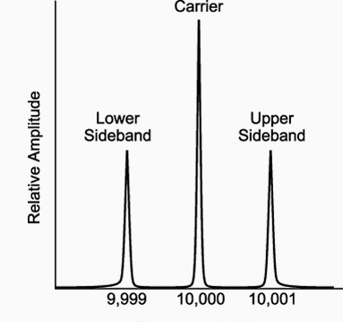
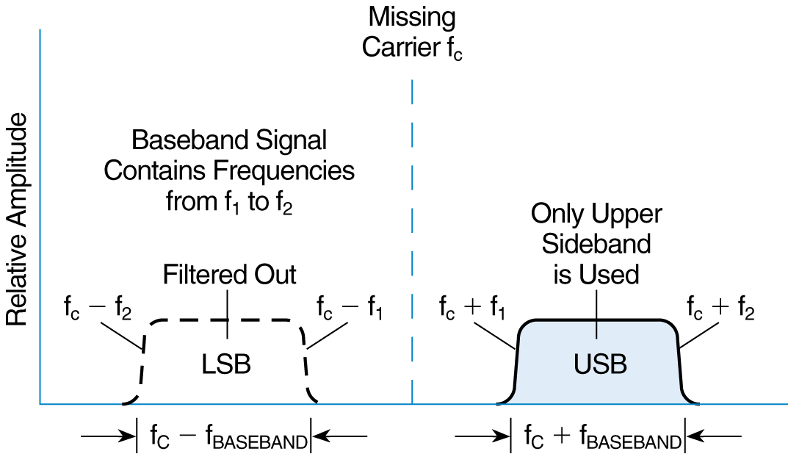
Operating Procedures
Accordingly, upper sideband is most commonly used for voice communications on the 17 and 12 meter bands (G2A04)
Single sideband is the mode of voice communication most commonly used on the high frequency amateur bands. (G2A05)

Slide 5
Operating Procedures
Because only one sideband is transmitted, less bandwidth used and higher power efficiency are advantages when using single sideband as compared to other analog voice modes on the HF amateur bands. (G2A06)
When using single sideband (SSB) voice mode, only one sideband is transmitted; the other sideband and carrier are suppressed. (G2A07)
The recommended way to break into a conversation when using phone is to say your call sign during a break between transmissions from the other stations. (G2A08)
The reason most amateur stations use lower sideband on the 160, 75 and 40 meter bands is that current amateur practice is to use lower sideband on these frequency bands. (G2A09)

Slide 6

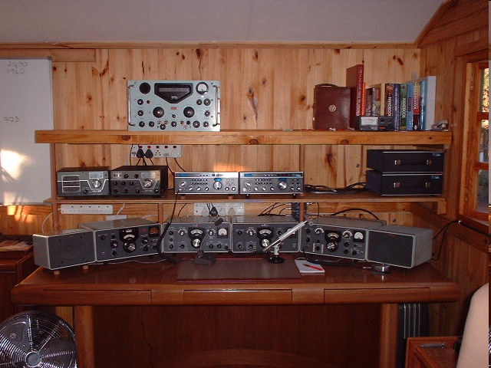
Operating Procedures
VOX allows "hands free" operation. (G2A10)
  When operating SSB, many amateurs like to use the VOX, or voice-operated control, feature of their transceivers.
The expression "CQ DX" usually indicates The caller is looking for any station outside their own country. (G2A11)
Using a headset with an attached mike on VOX will keep both hands free when you’re taking on the worldwide bands while at your home station.
A DX station like this one, on top of a hill, will enjoy some great contacts world wide.

Slide 7
Operating Procedures
No one has priority access to frequencies, common courtesy should be a guide. (G2B01)
The first thing you should do if you are communicating with another amateur station and hear a station in distress break in is to acknowledge the station in distress and determine what assistance may be needed. (G2B02)
If propagation changes during your contact and you notice increasing interference from other activity on the same frequency, as a common courtesy, move your contact to another frequency. (G2B03)
Before amateur stations may provide communications to broadcasters for dissemination to the public, the communications must directly relate to the immediate safety of human life or protection of property and there must be no other means of communication reasonably available before or at the time of the event.(G1B04)

Slide 8
Operating Procedures
The customary minimum frequency separation between SSB signals under normal conditions is approximately 3 kHz. (G2B05)
A practical way to avoid harmful interference when selecting a frequency to call CQ on CW or phone is to send "QRL?" on CW, followed by your call sign; or, if using phone, ask if the frequency is in use, followed by your call sign. (G2B06)
To comply with good amateur practice when choosing a frequency on which to initiate a call, follow the voluntary band plan for the operating mode you intend to use. (G2B07)
A portion of bands that are used in a voluntary basis called the “DX window” should not be used for stateside U.S. contacts. (G2B08)

Slide 9
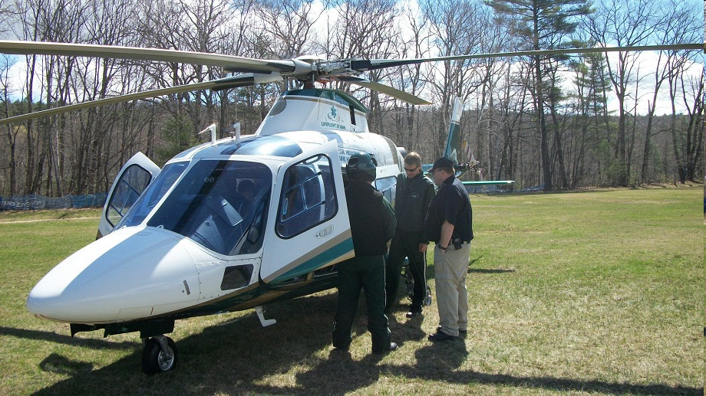
Operating Procedures
Only a person holding an FCC issued amateur operator license may be the control operator of an amateur station transmitting in RACES to assist relief operations during a disaster. (G2B09)
In an emergency, authorized hams participating in a RACES organization may communicate from a police helicopter.

Slide 10

Operating Procedures
If the situation is really dire, more specifically when the President’s War Emergency Powers have been invoked, the FCC may restrict normal frequency operations of amateur stations participating in RACES. (G2B10)

Slide 11
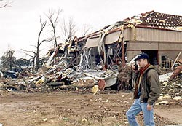
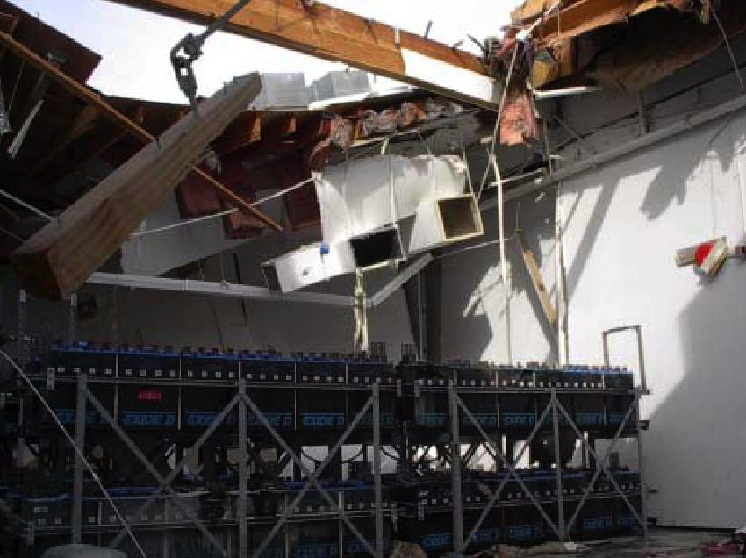
Operating Procedures
If you find yourself in an emergency situation, you should send a distress call on whatever frequency has the best chance of communicating the distress message. (G2B11)
An amateur station is allowed to use any means at its disposal to assist another station in distress at any time during an actual emergency. (G2B12)

Slide 12

Operating Procedures
When using full break-in telegraphy (QSK), transmitting stations can receive between code characters and elements. (G2C01)
  If a CW station sends "QRS", send slower. (G2C02)
When a CW operator sends "KN" at the end of a transmission, it means the operator is listening only for a specific station or stations. (G2C03)
  This is called a ‘prosign’ and is used on CW only.
When a CW operator sends "CL" at the end of a transmission, it means “closing station,” or that the operator is going off the air. (G2C04)
If another station wishes to interrupt, you will hear its signal between your dots and dashes

Slide 13
Operating Procedures
The best speed to use answering a CQ in Morse Code is the speed at which the CQ was sent. (G2C05)
The term “zero beat” in CW operation means matching your transmit frequency to the frequency of a received signal. (G2C06)
When sending CW, a “C” added to the RST report means a chirpy or unstable signal. (G2C07)
AR is the prosign that is sent to indicate the end of a formal message when using CW. (G2C08)

Slide 14
Operating Procedures
  Q signals are three letter combinations
      that begin with the letter ‘Q’
  The Q signal "QSL" means, “I acknowledge receipt.” (G2C09)
  The Q signal "QRQ" means “send faster.” (G2C10)
  The Q signal “QRV” means, “I am ready to receive messages.” (G2C11)

Slide 15
Operating Procedures
QRM
Something is causing interference
I am troubled by static/noise.
I am running low power.
Send faster ( ____ WPM)
Send more slowly ( ___ WPM)
I am going off the air.
I am ready
Who is calling me?
Your signal is fading.
I received the message.
I will communicate with ________ directly.
I am changing frequency to _____.
My location is _______.
QRN
QRP
QRQ
These four are the only ones on the exam.
QRS
QRT
QRV
QRZ
QSB
QSL
QSO
QSY
15
QTH
15
Notes:
15

Slide 16
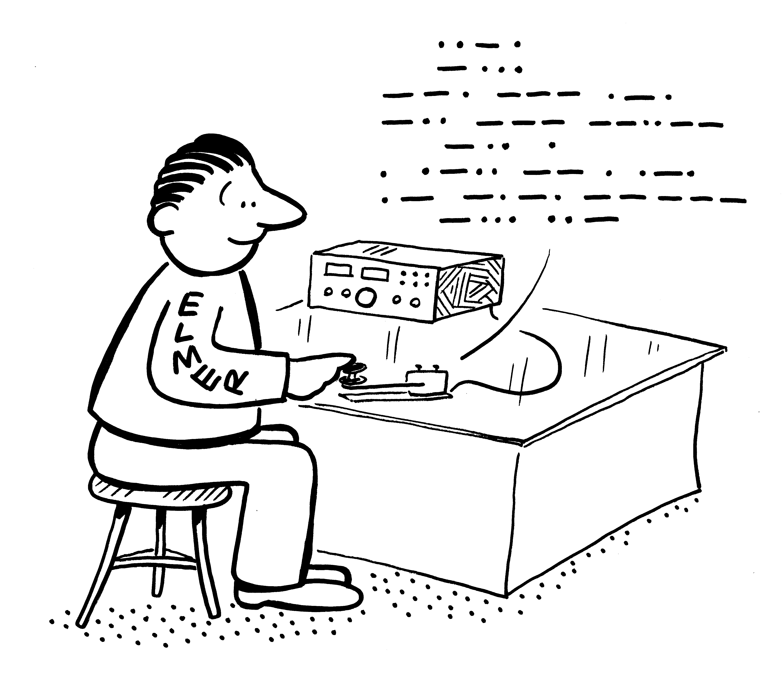
Operating Procedures
READABILITY (R) for Voice + CW
1 – Unreadable
2 – Barely readable, occasional
words distinguishable
3 – Readable with considerable
difficulty
4 – Readable with practically
no difficulty
5 – Perfectly readable

Slide 17
Operating Procedures
SIGNAL STRENGTH (S) for Voice + CW
1 – Faint, barely perceptible signals
2 – Very weak signals
3 – Weak signals
4 – Fair signals
5 – Fairly good signals
6 – Good signals
7 – Moderately strong signals
8 – Strong signals
9 – Extremely strong signals

Slide 18
Operating Procedures
Tone (T) Use on CW only
1 – Very rough, broad signals, 60 cycle AC may be present
2 – Very rough AC tone, harsh, broad
3 – Rough AC tone, rectified but not filtered
4 – Rough note, some trace of filtering
5 – Filtered rectified AC but strongly ripple-modulated
6 – Filtered tone, definite trace of ripple modulation
7 – Near pure tone, trace of ripple modulation
8 – Near perfect tone, slight trace of modulation
9 – Perfect tone, no trace of ripple or modulation of any kind

Slide 19
Operating Procedures
  The Amateur Auxiliary to the FCC is made up of volunteer amateurs. (G2D01)
      Formally enlisted to monitor the airwaves
      Report violations and band intrusions to local:
        FCC Compliance
        Information Bureau office
  Encouraging amateur regulation and compliance with the rules are objectives of the Amateur Auxiliary. (G2D02)

Slide 20
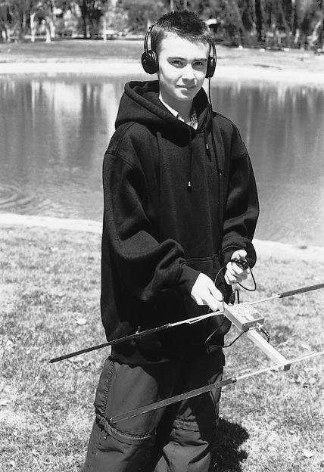
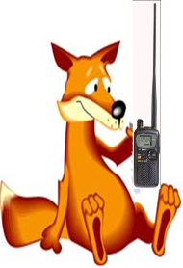
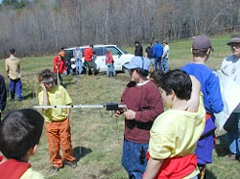
Operating Procedures
Direction finding used to locate stations violating FCC rules with “hidden transmitter hunts” are of help to the Amateur Auxiliary. (G2D03)
Use of directional antennas can track down almost any signal on the air.

Slide 21
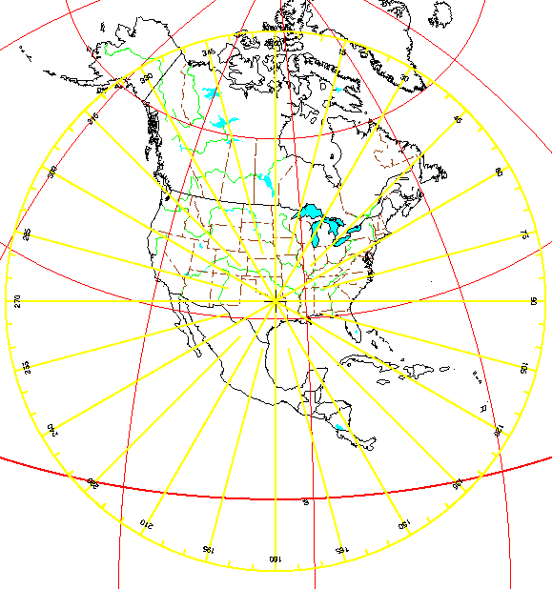
Operating Procedures
To figure where to point a directional antenna you’d use an azimuthal projection map. An azimuthal projection map is a world map projection centered on a particular location. (G2D04)
Centered on Dallas, Texas

Slide 22
Operating Procedures
It is permissible to communicate with amateur stations in countries outside the areas administered by the Federal Communications Commission, when the contact is with amateurs in any country except those whose administrations have notified the ITU that they object to such communications (G2D05)
Most communications take place on the “short path,” that is the most direct path between two stations. At times, however, propagation may favor the long path. A directional antenna is pointed 180 degrees from its short-path heading when making a “long-path” contact with another station. (G2D06)
Another one from the Tech ! !

Slide 23
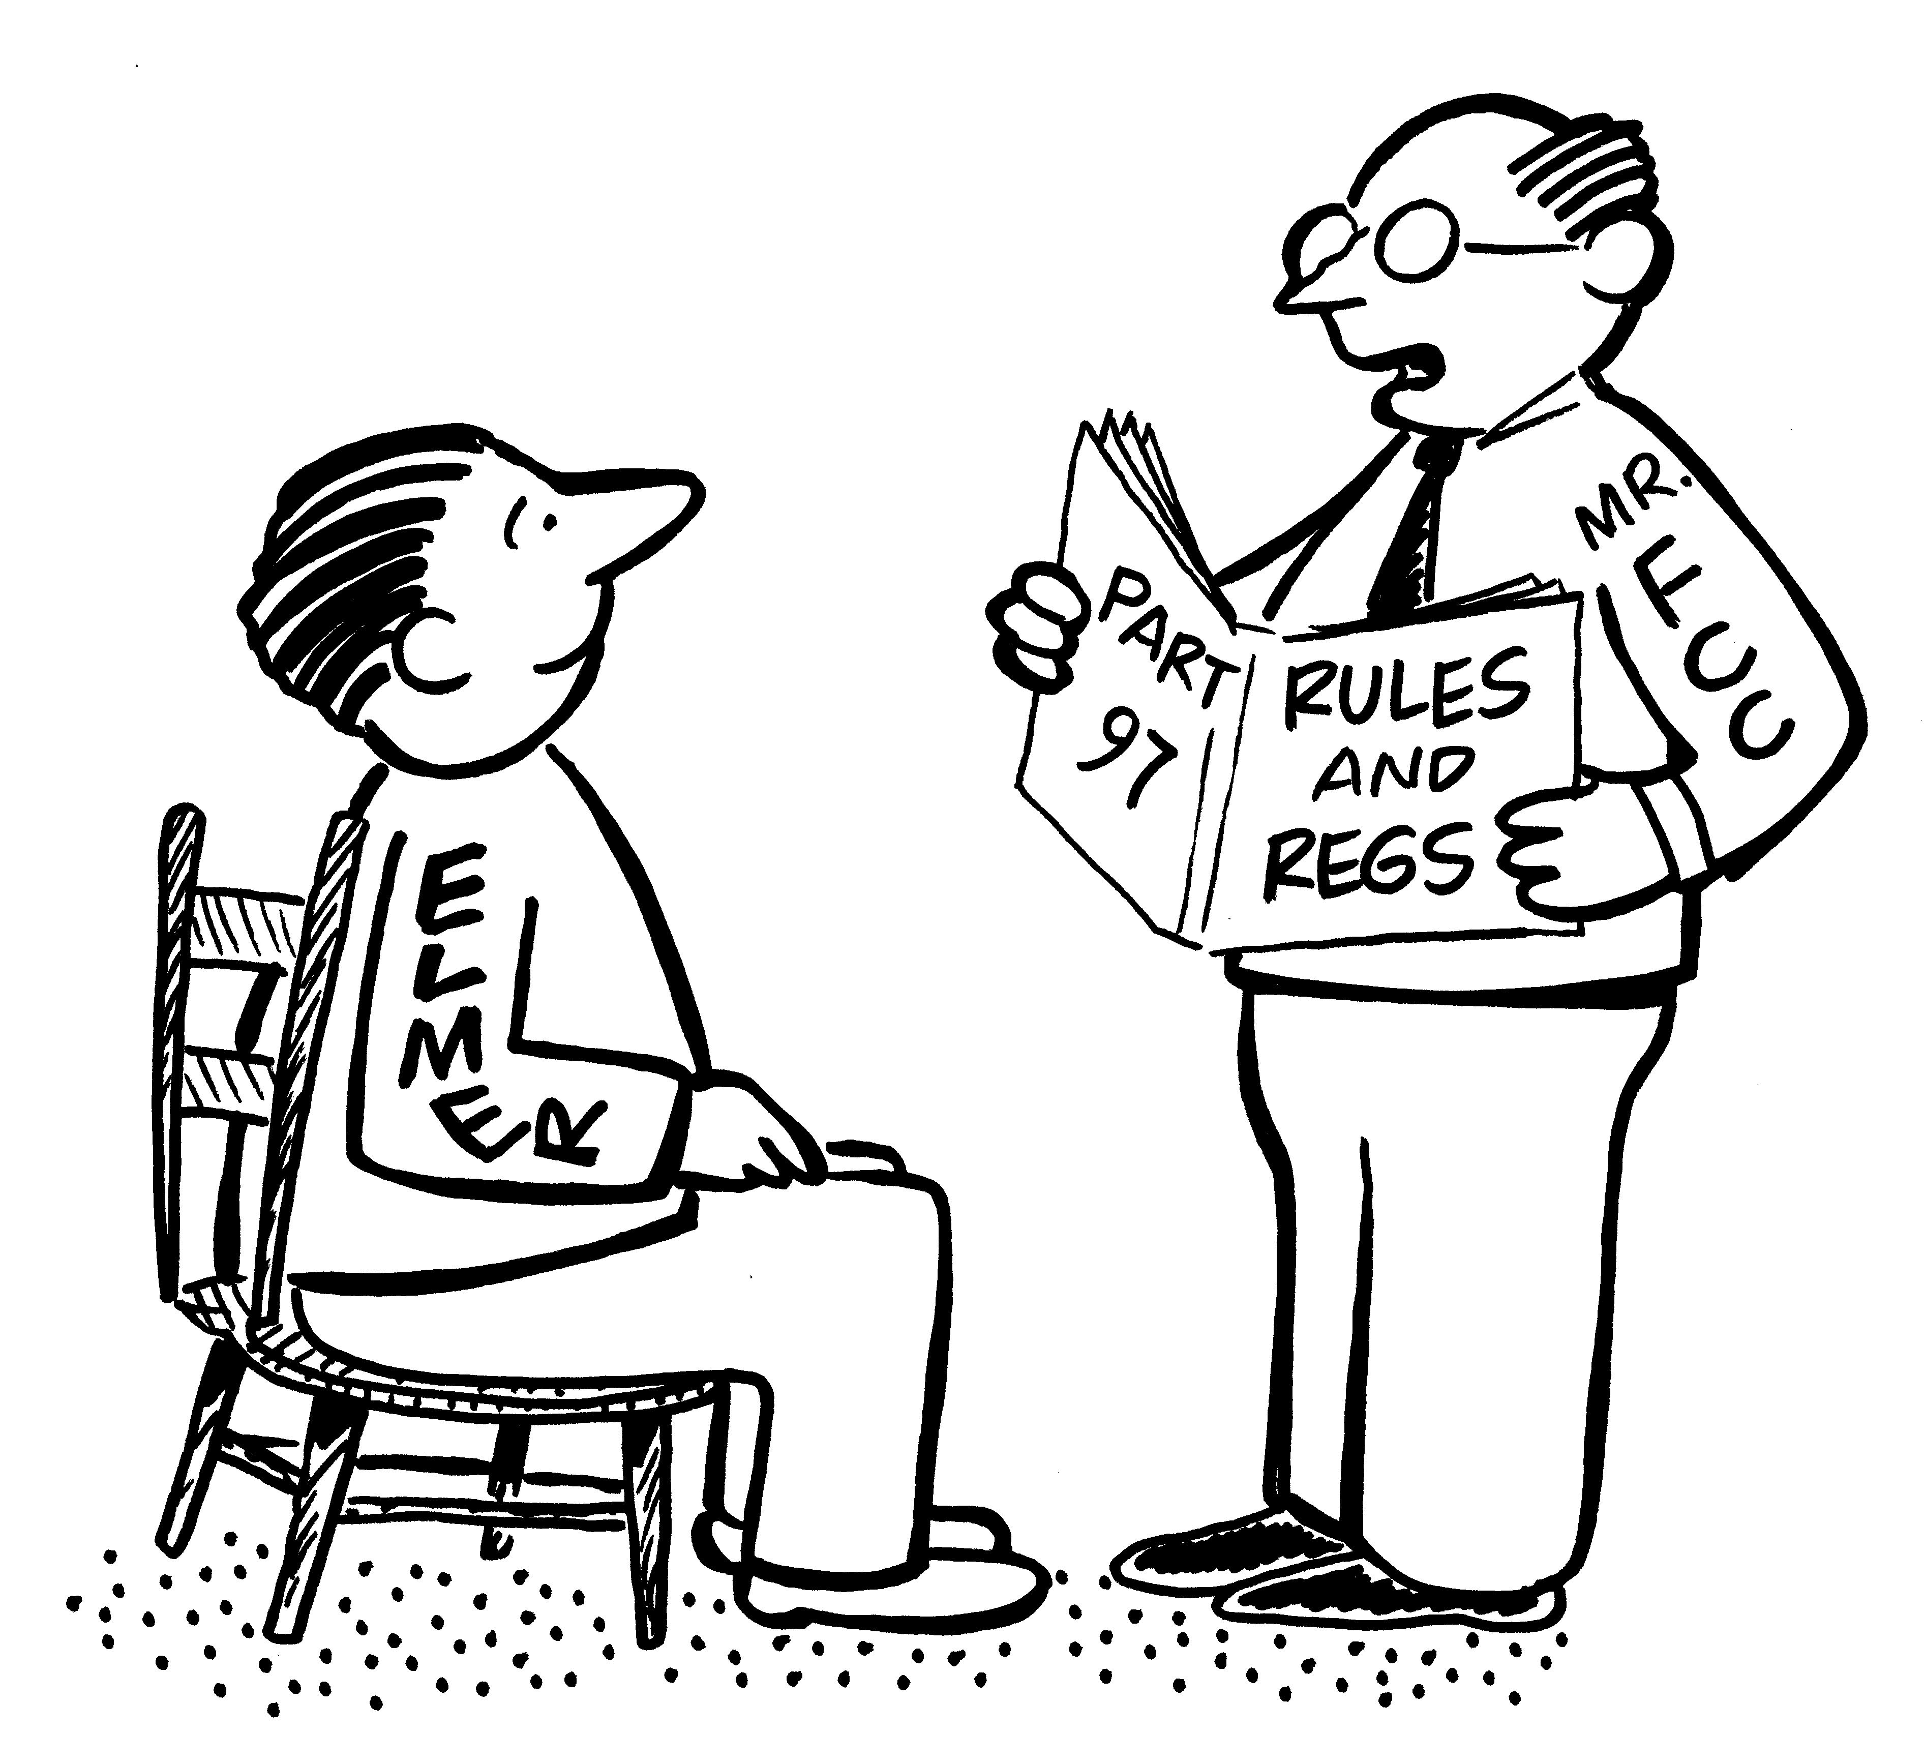
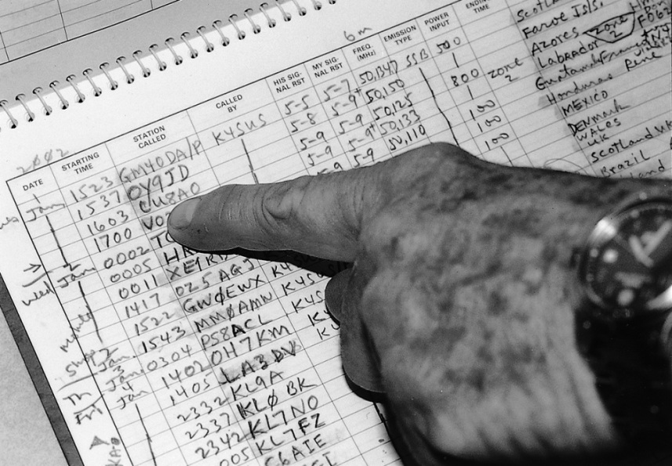
Operating Procedures
FCC rules require records be kept of the gain of your antenna on the 60 meter band if your antenna is other than a dipole. (G2D07)
    Dipole gain is zero;
    Must not exceed 50 watts effective radiated power output.
    Notes kept in station logbook as permanent record
  Many amateurs keep a log, even though the FCC does not require it, to help with a reply if the FCC requests information on who was control operator of your station at a given date and time. (G2D08)

Slide 24
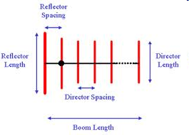
Operating Procedures
  The following information is traditionally contained in a station log:(G2D09)
      Date and time of contact
      Band and/or frequency of the contact
      Call sign of station contacted and the signal report given
QRP operation refers to low power transmit operation. (G2D10)
A unidirectional antenna would be the best HF antenna to use for minimizing interference. (G2D11)
  By definition: An antenna that has a single well-defined direction of maximum gain
        A Yagi or a beam

Slide 25
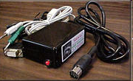
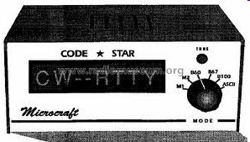
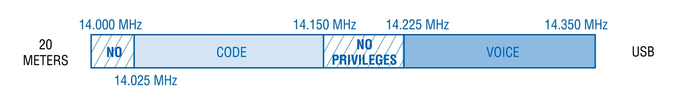
Operating Procedures
LSB is the mode normally used when sending an RTTY signal via AFSK with an SSB transmitter. (G2E01)
The number of data bits sent in a single PSK31 character varies.(G2E02)
The header is the part of a data packet that contains the routing and handling information. (G2E03)
14.070 - 14.100 MHz is the segment of the 20 meter band that is most often used for data transmissions. (G2E04)
You can connect a PSK-31 and RTTY data reader to your radio to decode messages.
14.100 MHz
14.070 MHz

Slide 26
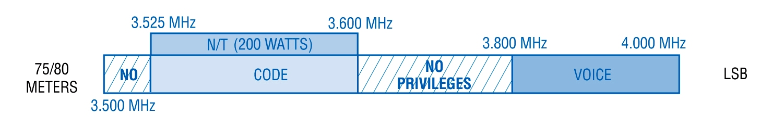
Operating Procedures
Baudot code is a 5-bit code, with additional start and stop bits. (G2E05)
170 Hz is the most common frequency shift for RTTY emissions in the amateur HF bands. (G2E06)
The abbreviation "RTTY" stands for radioteletype. (G2E07)
3585 – 3600 kHz is the segment of the 80 meter band most commonly used for data transmissions. (G2E08)
Below the RTTY segment, near 14.070 MHz is the segment of the 20 meter band where most PSK31 operations are commonly found. (G2E09)
3585 kHz
3600 kHz
14.070 MHz

Slide 27
Operating Procedures
A major advantage of MFSK16 compared to other digital modes is that it offers good performance in weak signal environments without error correction. (G2E10)
The abbreviation "MFSK" stand for Multi (or Multiple) Frequency Shift Keying. (G2E11)
When the receiving station responds to an ARQ data mode packet containing errors, it requests the packet be retransmitted. (G2E12)
      ARQ, Automatic Repeat Request. Request to re-transmit the packet.
In the PACTOR protocol, an NAK response to a transmitted packet means the receiver is requesting the packet be re-transmitted. (G2E13)
Receiving station will quickly transmit ACK for perfect copy.

