Slide 1
General Licensing Class
G1A – G1E
Commission’s Rules
Your organization and dates here
Notes:
1

Slide 2
General Class Element 3 Course Presentation
ELEMENT 3 SUB-ELEMENTS
  G1 – Commission’s Rules
  G2 – Operating Procedures
  G3 – Radio Wave Propagation
  G4 – Amateur Radio Practices
  G5 – Electrical Principles
  G6 – Circuit Components
  G7 – Practical Circuits
  G8 – Signals and Emissions
  G9 – Antennas
  G0 – Electrical and RF Safety

Slide 3
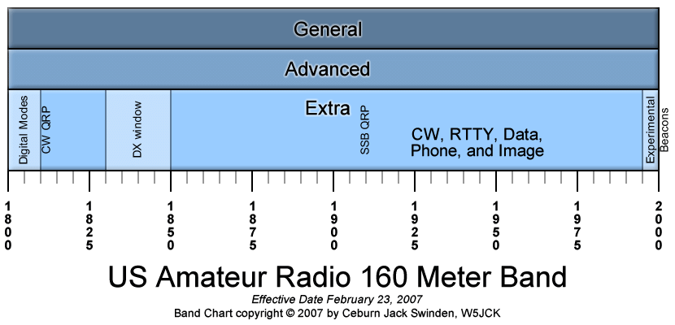
Commission’s Rules
General class control operator frequency privileges
  A General Class license holder is granted all amateur frequency privileges on the following: (G1A01)
160
60
30
17
12
10
Meters
    CW, RTTY, data, phone, and image

Slide 4
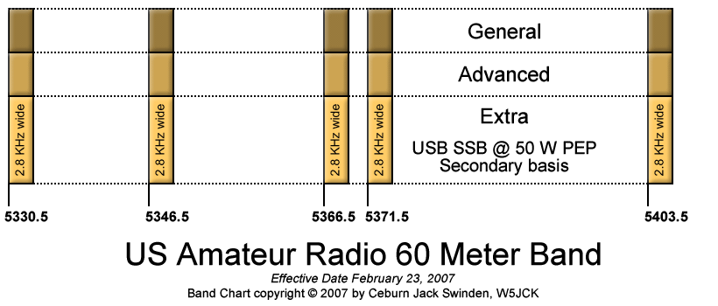
Commission’s Rules
General class control operator frequency privileges (cont)
  A General Class license holder is granted all amateur frequency privileges on the following: (G1A01)
160
60
30
17
12
10
Meters
USB (Upper Side Band) Phone only
4

Slide 5
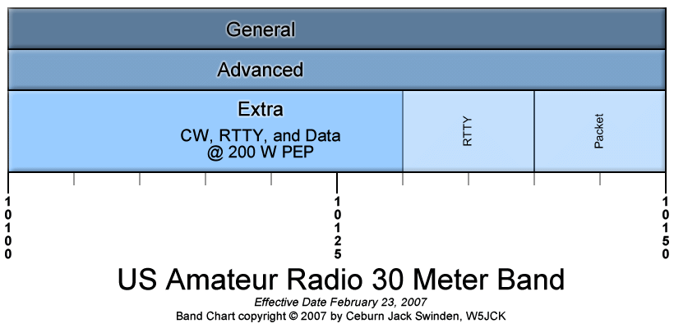
Commission’s Rules
General class control operator frequency privileges (cont)
  A General Class license holder is granted all amateur frequency privileges on the following: (G1A01)
160
60
30
17
12
10
Meters
    CW, RTTY, and Data

Slide 6
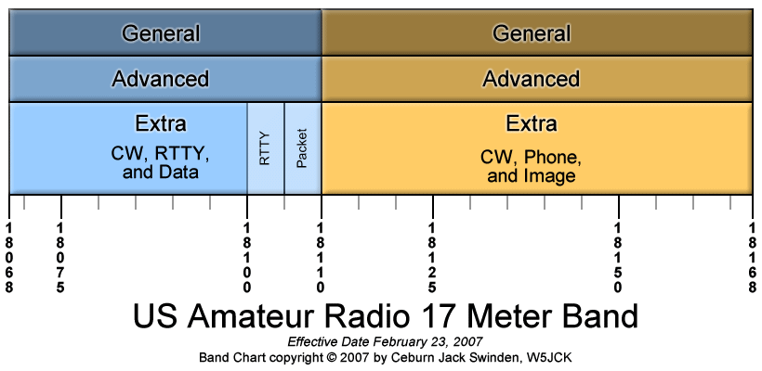
Commission’s Rules
General class control operator frequency privileges (cont)
  A General Class license holder is granted all amateur frequency privileges on the following: (G1A01)
160
60
30
17
12
10
Meters
    CW, RTTY, data, phone, and image

Slide 7
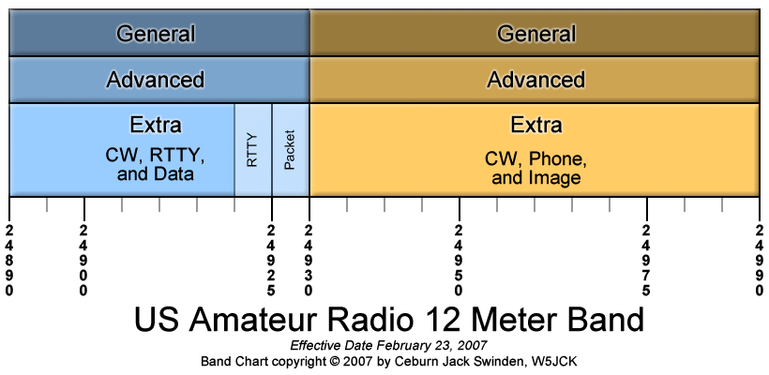
Commission’s Rules
General class control operator frequency privileges (cont)
  A General Class license holder is granted all amateur frequency privileges on the following: (G1A01)
160
60
30
17
12
10
Meters
    CW, RTTY, data, phone, and image

Slide 8
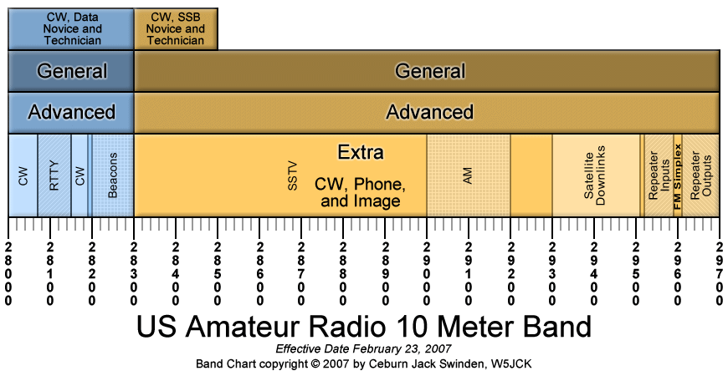
Commission’s Rules
General class control operator frequency privileges (cont)
  A General Class license holder is granted all amateur frequency privileges on the following: (G1A01)
160
60
30
17
12
10
Meters
    CW, RTTY, data, phone, and image

Slide 9
Commission’s Rules
General class control operator frequency privileges (recap)
  A General Class license holder is granted all amateur frequency privileges on the following: (G1A01)
      160 meters
      60 meters
      30 meters
      17 meters
      12 meters
      10 meters
    All of these bands…..all privileges.
(answer is six bands)
9

Slide 10
Commission’s Rules
  Phone operation is prohibited on the 30-meter band. (G1A02)
  and
  Image transmission is prohibited on the 30-meter band. (G1A03)
    CW, RTTY, and Data
10

Slide 11
Commission’s Rules
60 meters is the only band with restricted communications on specific channels rather than frequency ranges. (G1A04)
  Five discreet, upper sideband voice channels
  No Morse code and no data transmissions
11

Slide 12





Commission’s Rules
Recap
No carrier…suppressed only.
12

Slide 13
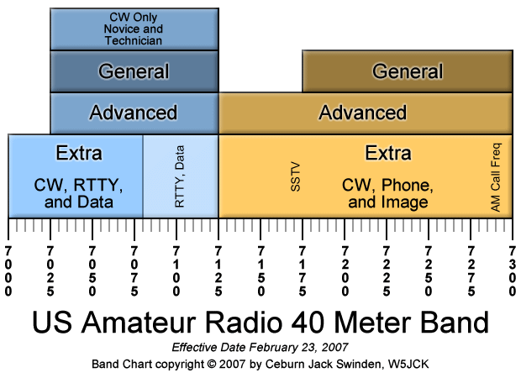
Commission’s Rules
General class control operator frequency privileges
  7.250 MHz frequency is in the General Class portion of the 40-meter band. (G1A05)
7250 kHz
CW, RTTY and data … CW, phone and image

Slide 14
Commission’s Rules
General class control operator frequency privileges
  24.940 MHz frequency is in the 12-meter band (G1A06)
24.940 MHz
14
CW, RTTY and data … CW, phone and image

Slide 15
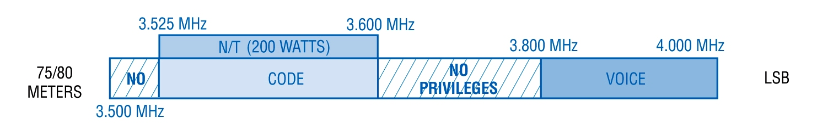
Commission’s Rules
A frequency of 3,900 kHz is within the General Class portion of the 75 meter band. (G1A07)
3.900 MHz
Notice areas where there are no privileges for General Class.
Generally on this band:
phone operation is called 75 meters; CW operation is called 80 meters.

Slide 16
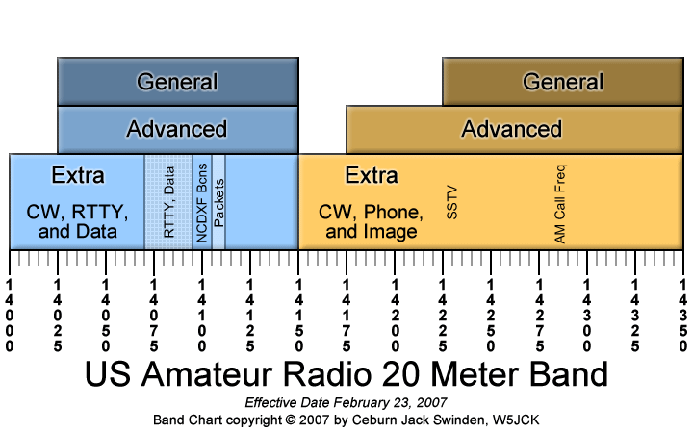
Commission’s Rules
General class control operator frequency privileges
  The 14,305 kHz frequency is within the General class portion of the 20-meter phone band. (G1A08)
14,305 kHz
16
CW, RTTY, phone, image, and data …

Slide 17
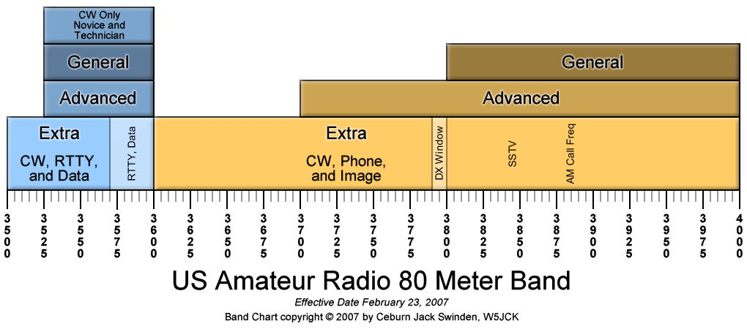
Commission’s Rules
General class control operator frequency privileges
  3560 kHz frequency is within the General class portion of the 80-meter band. (G1A09)
17
3560 kHz
CW, RTTY, phone, and data …

Slide 18
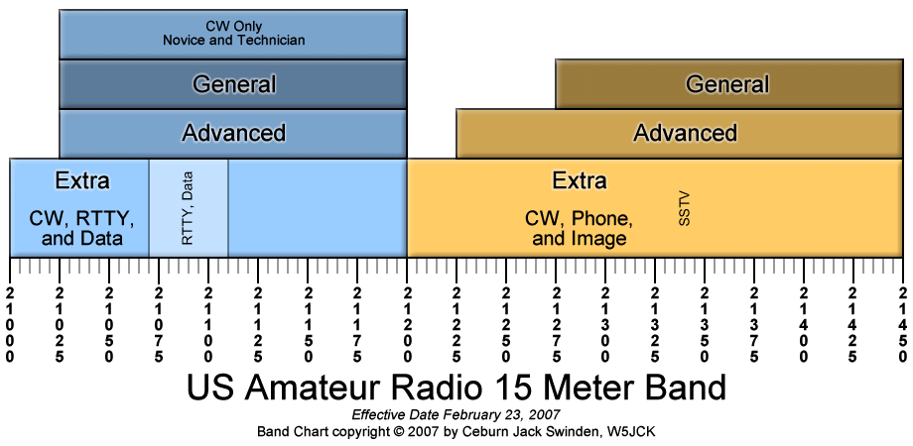
Commission’s Rules
General class control operator frequency privileges
  The 21,300 kHz frequency is within the General class portion of the 15-meter phone band. (G1A10)
21,300 kHz
CW, RTTY, data, phone and image
18

Slide 19
Commission’s Rules
General class control operator frequency privileges
  The following frequencies are available to a control operator holding a General Class license: (G1A11)
28.020 MHz
28.350 MHz
28.550 MHz
All of these answers are correct
19
28.020
28.350
28.550

Slide 20
Commission’s Rules
General class control operator frequency privileges
  When a General Class licensee is not permitted to use the entire voice portion of a particular band, the upper end or portion of the voice segment is generally available to them. (G1A12)
20

Slide 21
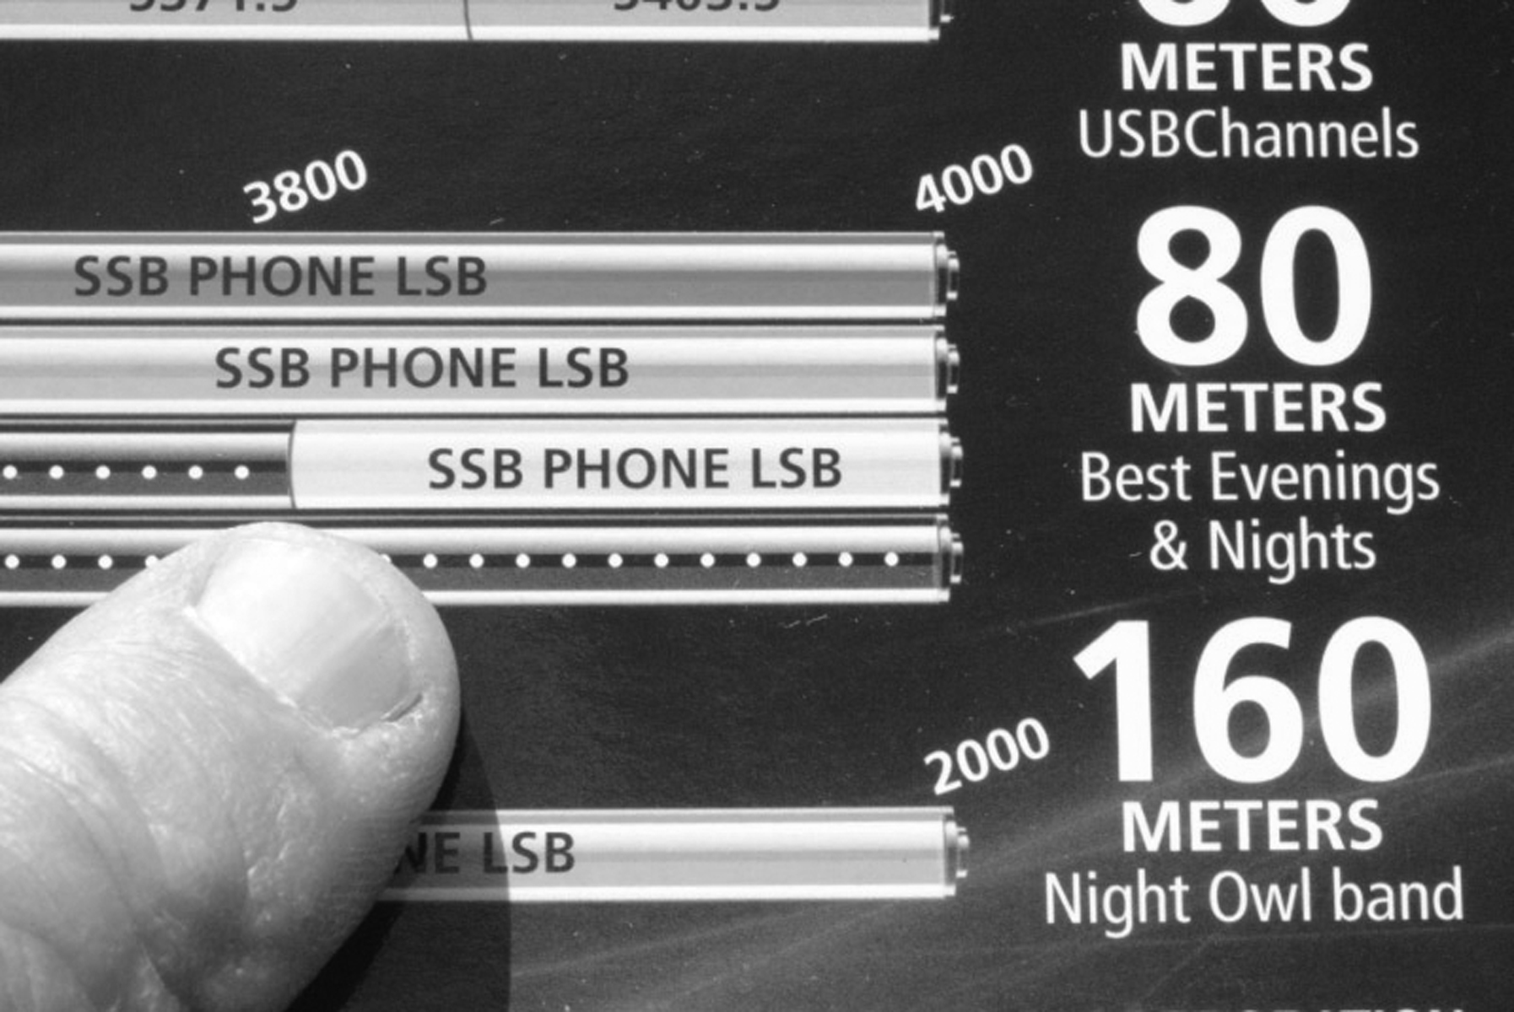
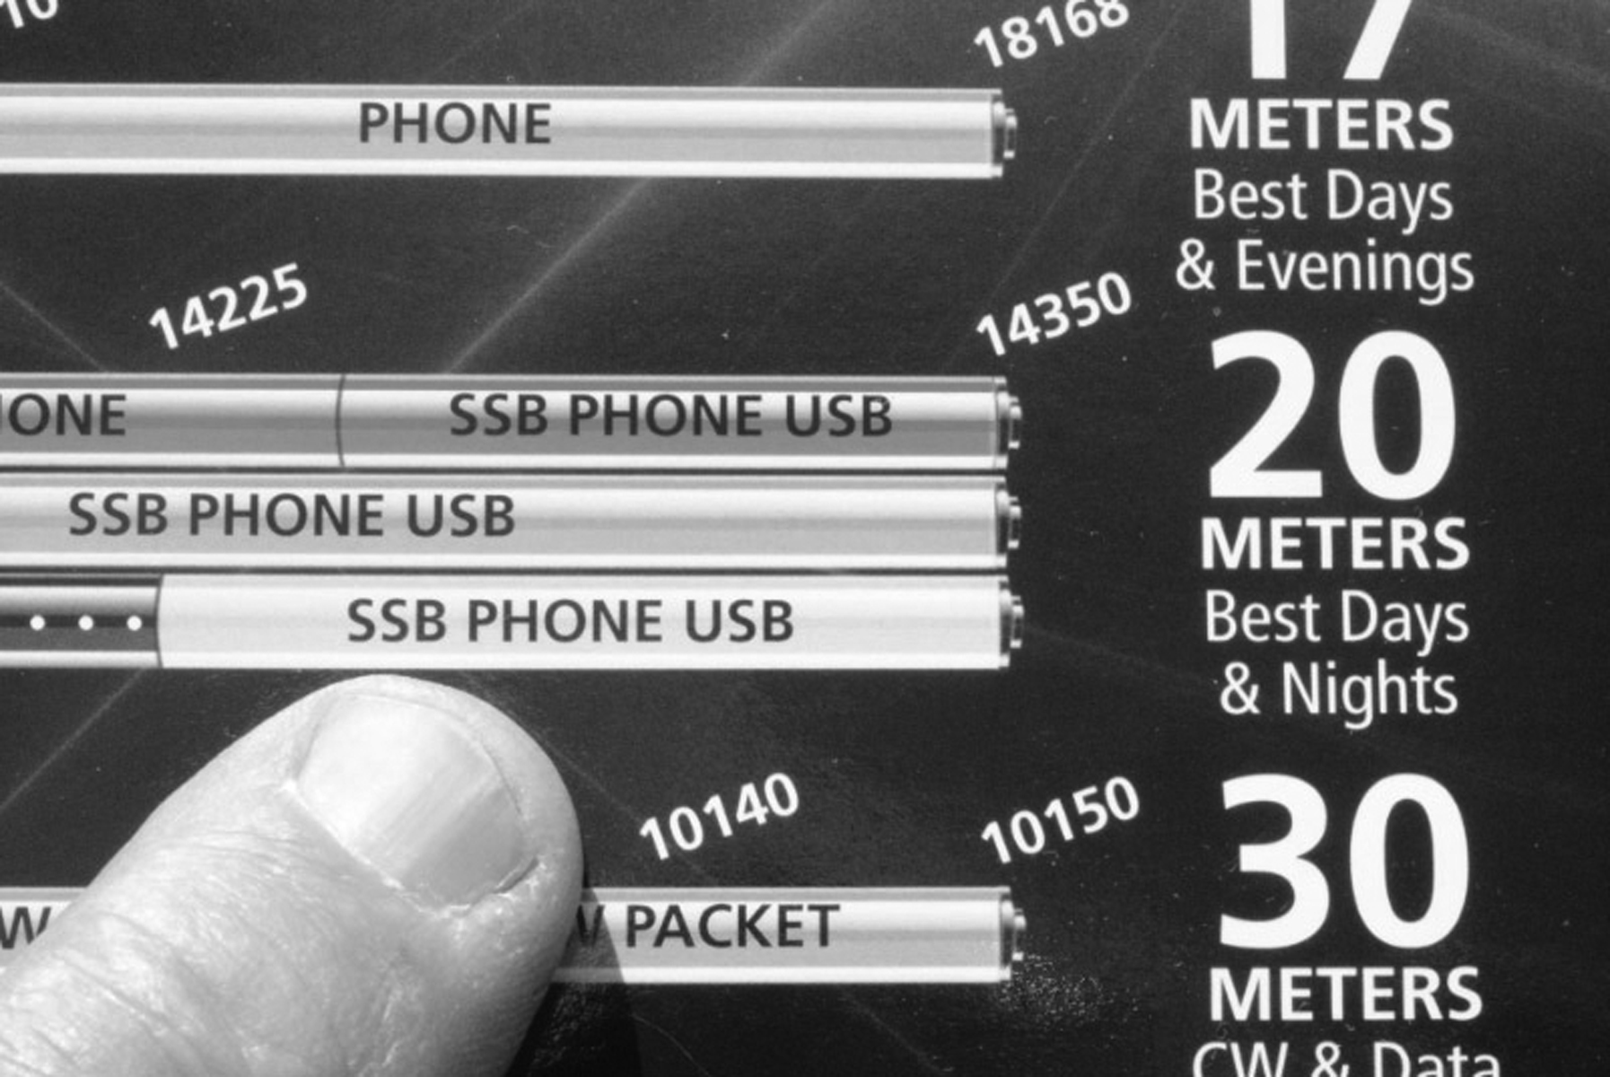
Commission’s Rules
    Voice privileges are usually at the top end of the band….except for 60 meters which has specific 5 channels of voice.
There are NO amateur bands shared with the Citizens Radio Service. (G1A13)
21

Slide 22
Commission’s Rules
FCC rules designate Amateur Service as a secondary user on certain bands, as such amateur stations are permitted to use such bands only if there is no harmful interference to primary users. (G1A14)
    Primary users have priority use
Move to a clear frequency when operating on 30 meters or 60 meters if a station in the primary service interferes with your contact. (G1A15)
    Secondary users do not have priority use
22

Slide 23
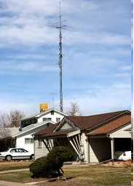
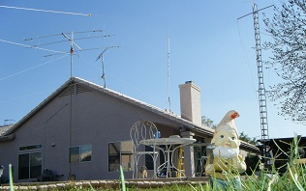
Commission’s Rules
200 feet is the maximum height above ground to which an antenna structure may be erected without requiring notification to the FAA and registration with the FCC, provided it is not at or near a public use airport. (G1B01)
Maximum Antenna Height without FCC Approval.
200 Ft.

Slide 24
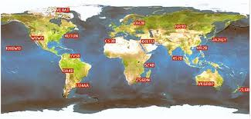
Commission’s Rules
One of the conditions with which beacon stations must comply is that there must be no more than one beacon signal in the same band from a single location.(G1B02)
Observation of propagation and reception is a purpose of a beacon station as identified in the FCC Rules.(G1B03)
Beacon stations are found at 14.100 MHz, 18.110 MHz, 21.150 MHz, 24.930 MHz, 28.200-28.300 MHz, and on 2 meters below 144.300 MHz.
24

Slide 25
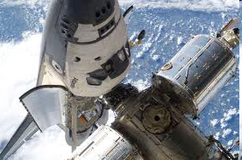
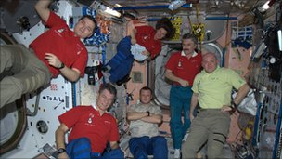
Commission’s Rules
Before amateur stations may provide communications to broadcasters for dissemination to the public, the communications must directly relate to the immediate safety of human life or protection of property and there must be no other means of communication reasonably available before or at the time of the event.(G1B04)
Music may be transmitted by an amateur station ONLY when it is an incidental part of a manned spacecraft retransmission (G1B05)
An amateur station is permitted to transmit secret codes to control a space station. (G1B06)
Wasn’t this in the Tech license?

Slide 26
Commission’s Rules
Abbreviations or procedural signals in the Amateur Service may be used if they do not obscure the meaning of a message. (G1B07)
When choosing a transmitter frequency in compliance with good amateur practice:(G1B08)
      Review FCC Part 97 Rules regarding permitted frequencies and emissions.
      Follow generally accepted band plans agreed to by the Amateur Radio community.
      Before transmitting, listen to avoid interfering with ongoing communication.
Remember this from the Tech?
All of these choices are correct
26

Slide 27
Commission’s Rules
An amateur station may transmit communications in which the licensee or control operator has a pecuniary (monetary) interest only when other amateurs are being notified of the sale of apparatus normally used in an amateur station and such activity is not done on a regular basis (G1B09)
100 watts PEP output is the power limit for beacon stations.(G1B10)
The FCC requires an amateur station to be operated in conformance with good engineering and good amateur practice in all respects not specifically covered by the Part 97 rules (G1B11)
The FCC determines “good engineering and good amateur practice” as applied to the operation of an amateur station in all respects not covered by the Part 97 rules (G1B12)
Remember this from the Tech? Boy, this is getting easier.
27

Slide 28
Commission’s Rules
  The maximum transmitting power an amateur station may use on 10.140 MHz is 200 watts PEP output. (G1C01)
10.140 MHz
CW, RTTY and data
28

Slide 29
Commission’s Rules
The maximum transmitting power an amateur station may use on the Amateur Radio 12 meter band is 1500 watts PEP output. (G1C02)
29
CW, RTTY and data … CW, phone and image

Slide 30
Commission’s Rules
2.8 kHz is the maximum bandwidth permitted by FCC rules for Amateur Radio stations transmitting on USB frequencies in the 60 meter band. (G1C03)
      Only Upper Sideband
        Turn off speech processor to prevent exceeding 2.8 kHz
The power output limitation on the 14 MHz band is the minimum power necessary to carry out the desired communications. (G1C04)
      Technically this applies to all transmissions by an Amateur Radio operator
30

Slide 31
Commission’s Rules
The maximum transmitting power a station with a General Class control operator may use on the 28 MHz band (10 Meter Band) is 1500 watts PEP output. (G1C05)
31

Slide 32
Commission’s Rules
General class control operator frequency privileges
  A General Class license holder is permitted to run up to 1500 watts of Peak Envelope Power on the 1.8 MHz band. (G1C06)
  1500 watts on all bands except 60 meters and 30 meters.
  However, always run the minimum power necessary.
    CW, RTTY, data, phone, and image

Slide 33
Commission’s Rules
300 baud is the maximum symbol rate permitted for RTTY or data emission transmission on the 20 meter band.(G1C07)
300 baud is the maximum symbol rate permitted for RTTY or data emission transmitted at frequencies below 28 MHz.(G1C08)
56 kilobaud is the maximum symbol rate permitted for RTTY or data emission transmitted on the 1.25 meter and 70 centimeter bands.(G1C09)
1200 baud is the maximum symbol rate permitted for RTTY or data emission transmissions on the 10 meter band.(G1C10)
19.6 kilobaud is the maximum symbol rate permitted for RTTY or data emission transmissions on the 2 meter band.(G1C11)

Slide 34
Commission’s Rules
The temporary way to identify when transmitting using phone on General Class frequencies if you have a CSCE for the required elements but your upgrade from Technician has not appeared in the FCC database is to give your call sign followed by “slant AG”. (G1D01)
An accredited VE holding a General Class operator license may only administer the Technician examination. (G1D02)
If you are a Technician Class operator and have a CSCE for General Class privileges you may operate on any General or Technician Class band segment. (G1D03)

Slide 35

Commission’s Rules
A requirement for administering a Technician Class operator examination is that at least three VEC accredited General Class or higher VEs must be present. (G1D04)
An FCC General Class or higher license and VEC accreditation is sufficient for you to be an administering VE for a Technician Class operator license examination. (G1D05)
You must add the special identifier "AG" after your call sign if you are a Technician Class licensee and have a CSCE for General Class operator privileges, but the FCC has not yet posted your upgrade on its web site whenever you operate using General Class frequency privileges. (G1D06)
Volunteer Examiners are accredited by a Volunteer Examiner Coordinator. (G1D07)
35

Slide 36
Commission’s Rules
  For a non-U.S. citizen to be an accredited Volunteer Examiner the person must hold a U.S. amateur radio license of General class or above.
  Volunteer Examiners are accredited by a Volunteer Examiner Coordinator.
  You may participate as a VE in administering an amateur radio license examination after you have been granted a General class license and have received your VEC accreditation.
Allowed License Exams by VE License Class
VE License Class | Allowed Examinations
General | Element 2 (Technician)
Advanced | Element 3 (General) Element 2 (Technician)
Amateur Extra | Element 4 (Amateur Extra) Element 3 (General) Element 2 (Technician)
36

Slide 37
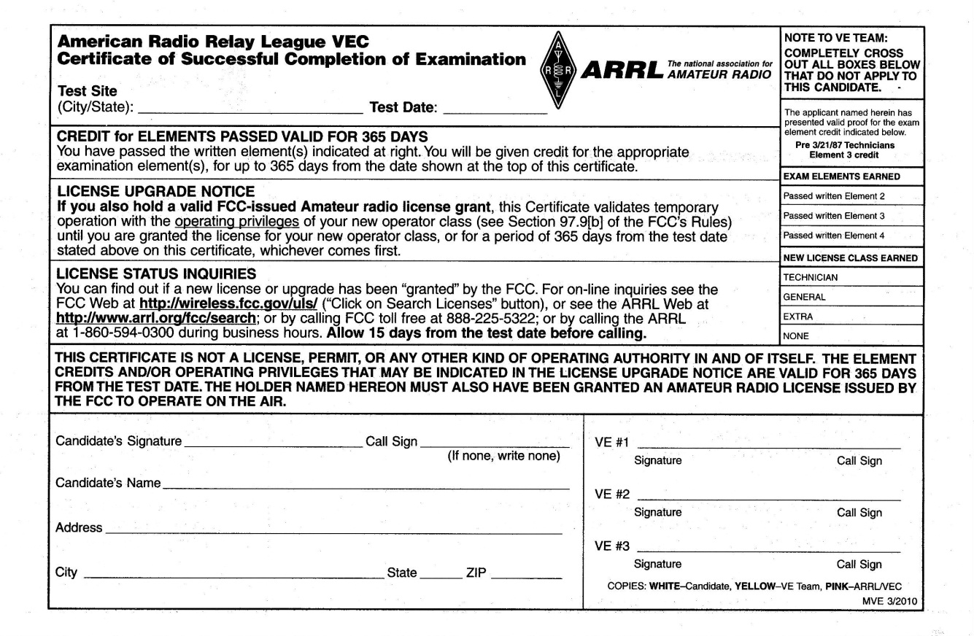

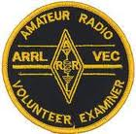
Commission’s Rules
    For a non-U.S. citizen to be an accredited Volunteer Examiner, the person must hold a U.S. Amateur Radio license of General Class or above. (G1D08)
A Certificate of Successful Completion of Examination (CSCE) is valid for exam element credit for a period of 365 days. (G1D09)

Slide 38
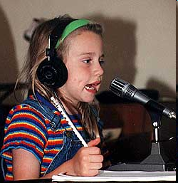
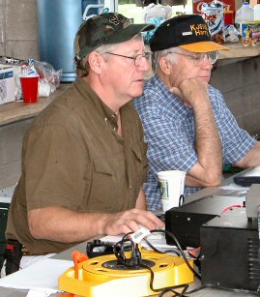
Commission’s Rules
18 years is the minimum age that one must be to qualify as an accredited Volunteer Examiner. (G1D10)
If a third party’s amateur license had ever been revoked, it would disqualify that third party from participating in stating a message over an amateur station. (G1E01)
There is no age limit to become an amateur radio operator.

Slide 39
Commission’s Rules
A 10 meter repeater may retransmit a 2 meter signal from a Technician, ONLY if there is an active duty control operator holding a General Class or higher. (G1E02)
39

Slide 40
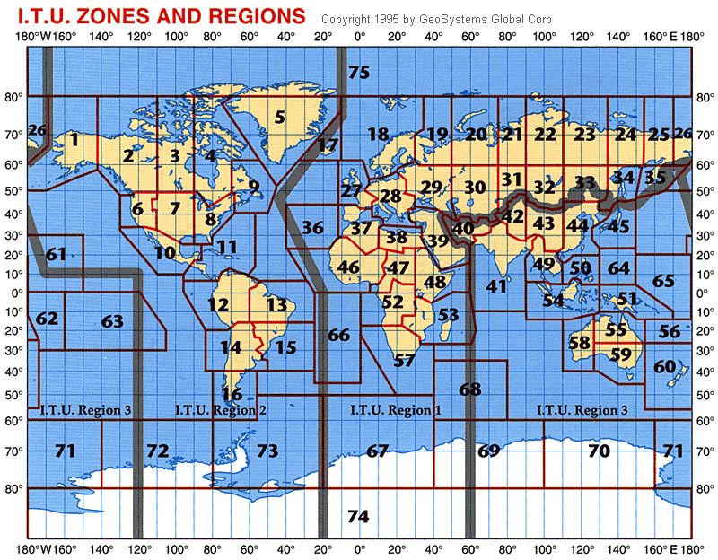
Commission’s Rules
An Amateur Radio operator holding an FCC-issued General Class license is authorized to be a control operator in ITU Region 2 operating in the 7.175 to 7.300 MHz band. (G1E03)

Slide 41
Commission’s Rules
Conditions that require an Amateur Radio station to take specific steps to avoid harmful interference to other users or facilities (G1E04)
    When operating within one mile of an FCC Monitoring Station
    When using a band where the Amateur Service is secondary
    When a station is transmitting spread spectrum emissions
Only messages relating to Amateur Radio or remarks of a personal character, or messages relating to emergencies or disaster relief may be transmitted by an amateur station for a third party in another country. (G1E05)
In the event of interference between a coordinated repeater and an uncoordinated repeater, the licensee of the non-coordinated repeater has primary responsibility to resolve the interference. (G1E06)
All of these choices are correct

Slide 42
Commission’s Rules
Third party traffic is prohibited with every foreign country, unless there is a third party agreement in effect with that country, except for messages directly involving emergencies or disaster relief communications. (G1E07)
For a non-licensed person to communicate with a foreign Amateur Radio station from a US amateur station at which a licensed control operator is present, the foreign amateur station must be in a country with which the United States has a third party agreement. (G1E08)
You must use English language when identifying your station if you are using a language other than English in making a contact using phone emission. (G1E09)
Wow ! ! ! More from the Tech license, not so tough is it?

Slide 43
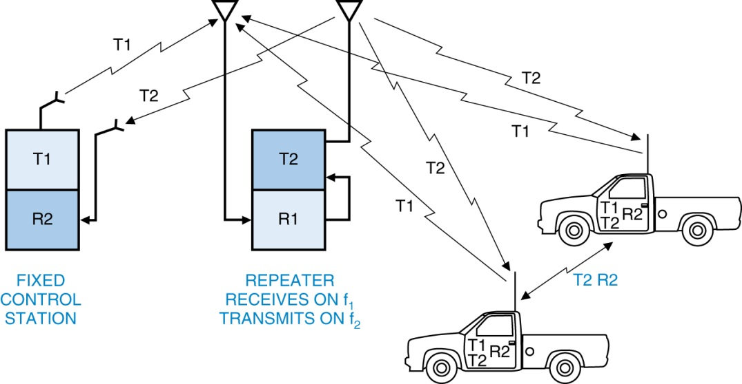
Commission’s Rules
The portion above 29.5 MHz is the portion of the 10 meter band that is available for repeater use. (G1E10)
FM Repeater output
FM Repeater input
29.620
29.640
29.660
29.680
29.520
29.540
29.560
29.580
The 10 meter FM repeater Simplex frequency is 29.000, no offset.

