Slide 1
General Licensing Class
G0A – G0B
Electrical and RF Safety
Your organization and dates here
Notes:
1

Slide 2
General Class Element 3 Course Presentation
ELEMENT 3 SUB-ELEMENTS
G1 – Commission’s Rules
G2 – Operating Procedures
G3 – Radio Wave Propagation
G4 – Amateur Radio Practices
G5 – Electrical Principles
G6 – Circuit Components
G7 – Practical Circuits
G8 – Signals and Emissions
G9 – Antennas
G0 – Electrical and RF Safety

Slide 3
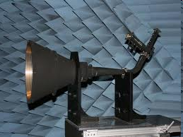
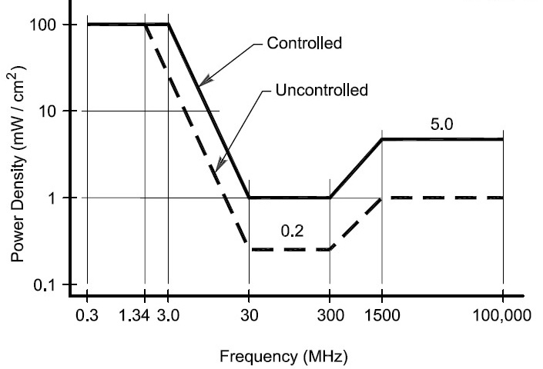
Electrical and RF Safety
One way that RF energy can affect human body tissue is that it heats body tissue. (G0A01)
The following properties are important in estimating whether an RF signal exceeds the maximum permissible exposure (MPE) (G0A02)
Its duty cycle
Its frequency
Its power density
Never stand in front of a microwave feedhorn antenna
On transmit, it radiates a highly concentrated beam of RF energy
All of these choices are correct.
3

Slide 4
Electrical and RF Safety
You can determine that your station complies with FCC RF exposure regulations: (G0A03)
By calculation based on FCC OET Bulletin 65
By calculation based on computer modeling
By measurement of field strength using calibrated equipment
"Time averaging" in reference to RF radiation exposure means the total RF exposure averaged over a certain time. (G0A04)
All of these choices are correct.
The general equation for time averaging exposure equivalence is:
S_{exp} t_{exp} = S_{limit} t_{avg}
4

Slide 5
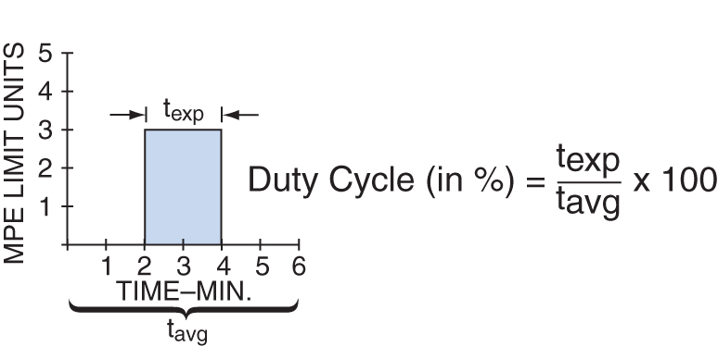
Electrical and RF Safety
If an evaluation of your station shows RF energy radiated from your station exceeds permissible limits you must take action to prevent human exposure to the excessive RF fields. (G0A05) (G0A06 – Deleted by QPC)
When evaluating RF exposure, a lower transmitter duty cycle permits greater short-term exposure levels. (G0A07)
An amateur operator must perform a routine RF exposure evaluation to ensure compliance with RF safety regulations when transmitter power exceeds levels specified in part 97.13. (G0A08)
Duty Cycle
5

Slide 6
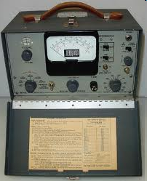
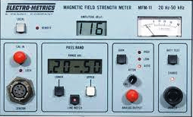
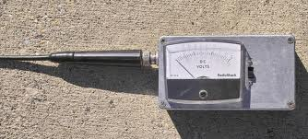
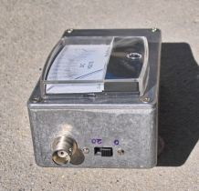
Electrical and RF Safety
A calibrated field-strength meter with a calibrated antenna can be used to accurately measure an RF field. (G0A09)
Jerrod Model 704B
Electro-metrics em-7530
Homebrew by KA7OEI of Utah Amateur Radio Club
6

Slide 7
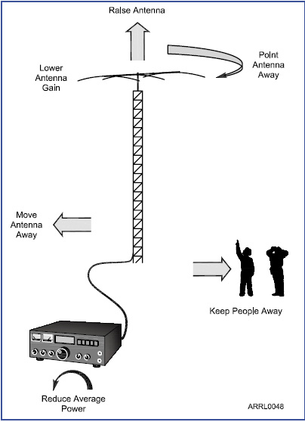
Electrical and RF Safety
If an evaluation shows that a neighbor might receive more than the allowable limit of RF exposure from the main lobe of a directional antenna, take precautions to ensure that the antenna cannot be pointed in their direction. (G0A10)
If you install an indoor transmitting antenna, make sure that MPE limits are not exceeded in occupied areas. (G0A11)
MPE = Maximum Permissible Exposure
Turn off the transmitter and disconnect the feed line whenever you make adjustments or repairs to an antenna. (G0A12)
7

Slide 8
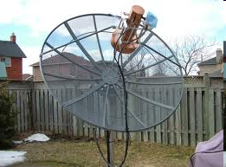
Electrical and RF Safety
When installing a ground-mounted antenna, it should be installed so no one can be exposed to RF radiation in excess of maximum permissible limits. (G0A13)
Only the hot wires in a four-conductor line cord should be attached to fuses or circuit breakers in a device operated from a 240-VAC single-phase source. (G0B01)
Notice wood safety fence.
Keep a safe distance away from antenna during all transmissions.
8

Slide 9
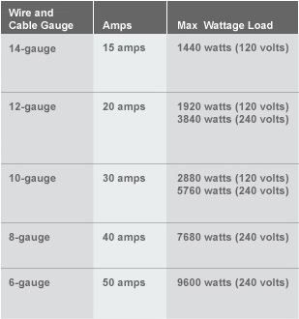
Electrical and RF Safety
According to the code, AWG number 12 is the minimum wire size that may be safely used for a circuit that draws up to 20 amperes of continuous current. (G0B02)
15 amperes is the size of fuse or circuit breaker that would be appropriate to use with a circuit that uses AWG number 14 wiring. (G0B03)
9

Slide 10
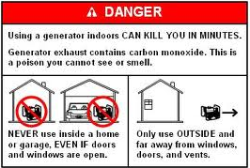
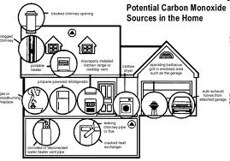
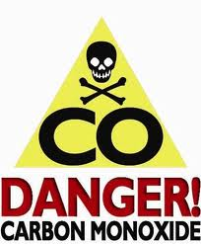
Electrical and RF Safety
Danger of carbon monoxide poisoning is a primary reason for not placing a gasoline-fueled generator inside an occupied area. (G0B04)
Carbon Monoxide is serious stuff, don’t take it lightly!
10

Slide 11
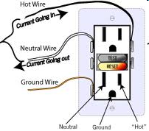
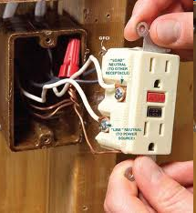
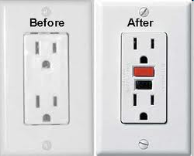
Electrical and RF Safety
Current flowing from one or more of the hot wires directly to ground will cause a Ground Fault Circuit Interrupter (GFCI) to disconnect the 120 or 240 Volt AC line power to a device. (G0B05)
11

Slide 12
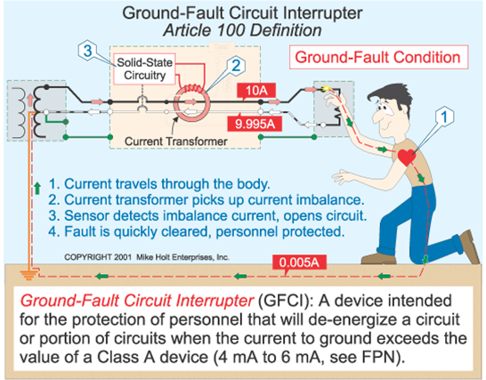
RF & Electrical Safety
12

Slide 13
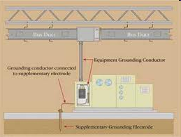
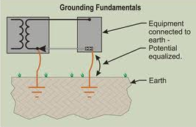
Electrical and RF Safety
The metal enclosure of every item of station equipment must be grounded because it ensures that hazardous voltages cannot appear on the chassis. (G0B06)
Enclosures, chassis, and all metal housings should be common grounded.
13

Slide 14
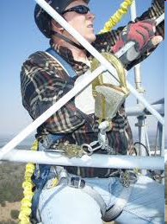
Electrical and RF Safety
One of the practices that should be observed for safety when climbing on a tower using a safety belt or harness is to always attach the belt safety hook to the belt D-ring with the hook opening away from the tower. (G0B07)
Always disconnect the feedline from the transmitter before going up a tower to work on antenna…prevents accidental RF radiation exposure.
Always think safety first when working on towers.
14

Slide 15
Electrical and RF Safety
Any person preparing to climb a tower that supports electrically powered devices should make sure all circuits that supply power to the tower are locked out and tagged. (G0B08)
Soldered joints should not be used with the wires that connect the base of a tower to a system of ground rods because a soldered joint will likely be destroyed by the heat of a lightning strike. (G0B09)
One danger from lead-tin solder is that lead can contaminate food if hands are not washed carefully after handling. (G0B10)
15

Slide 16
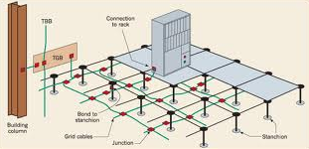
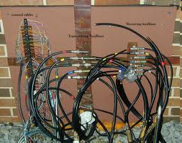
Electrical and RF Safety
Good engineering practice for lightning protection grounds includes bonding them together with all other grounds. (G0B11)
Notice green cable as common ground under floor and connected to building column.
Notice wide copper straps
16

Slide 17
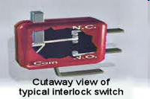
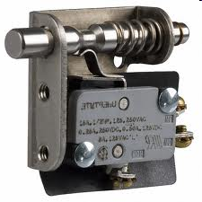
Electrical and RF Safety
The purpose of a transmitter power supply interlock is to ensure that dangerous voltages are removed if the cabinet is opened. (G0B12)
When powering your house from an emergency generator, you must disconnect the incoming utility power feed. (G0B13)
17

Slide 18
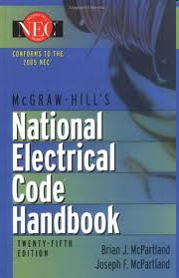
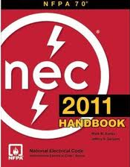
Electrical and RF Safety
Electrical safety inside the ham shack is covered by the National Electrical Code. (G0B14)
RF exposure limits to the human body are covered by ANSI, not by the NEC.
18

Slide 19
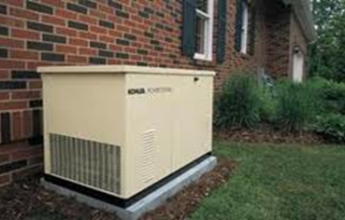
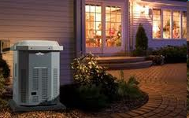
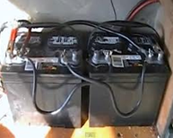
Electrical and RF Safety
For an emergency generator installation, the generator should be located in a well ventilated area. (G0B15)
Gasoline-powered generators may emit exhaust gases that could be hazardous.
When being charged, a lead acid storage battery may give off explosive hydrogen gas. (G0B16)
19

