Slide 1
The Salvation Army of Waterloo/Cedar Falls

Slide 2
Our Mission
The Salvation Army, and international movement, is an evangelical part of the universal Christian church. Its message is based on the Bible. Its ministry is motivated by the love of God. Its mission is to preach the gospel of Jesus Christ and to meet human needs in His name without discrimination.

Slide 3
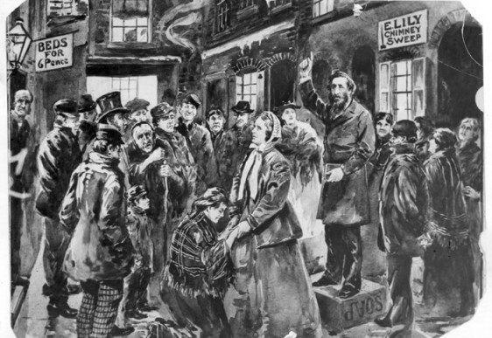
Soup, Soap, and Salvation
The Salvation Army was founded in the slums of London in 1865 by William Booth.
Disenfranchised by the church’s view on poverty, Booth took the more practical approach of meeting basic needs first. In Booth’s opinion, the path to a changed heart began with immediate need.

Slide 4
The Salvation Army is both a Church and a Social-Service Agency
Emphatically practical and spiritual
“There is no reward equal to that of doing the most good to the most people in the most need.” Evangeline Booth

Slide 5
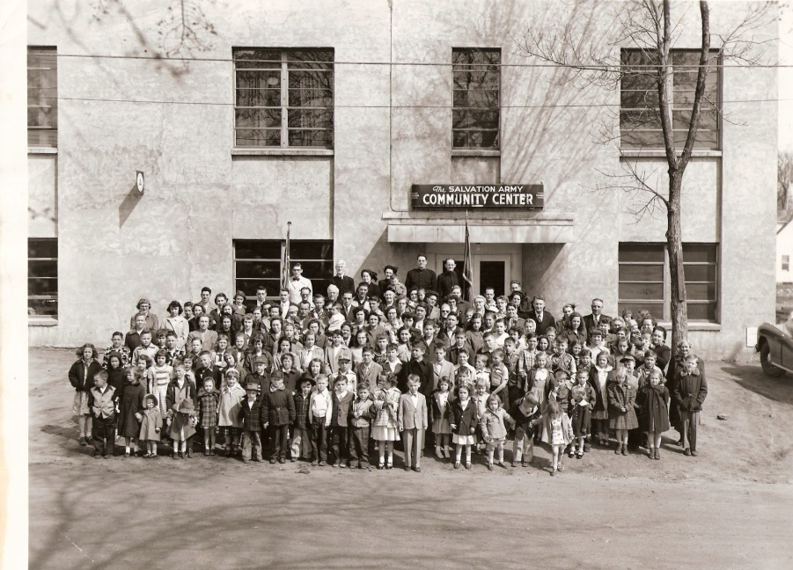
The Salvation Army in the Cedar Valley
The Salvation Army was first opened in Waterloo in July of 1899. In the 117 years since, roughly 6 generations of families have benefitted from the work of The Salvation Army in the Cedar Valley.

Slide 6
More than Red Kettles
The Salvation Army is famous for its Red Kettle Christmas fundraising. It is what The Salvation Army does with those funds that is the most important part of our story.
Did You Know: The Salvation Army spends 82 cents of every $1.00 on direct services to those in need.

Slide 7
Spiritual
The Salvation Army is a church. Weekly worship services, led by the Corps officers, are held Sunday mornings in the Chapel.
Sunday School for all ages precedes the worship service.

Slide 12
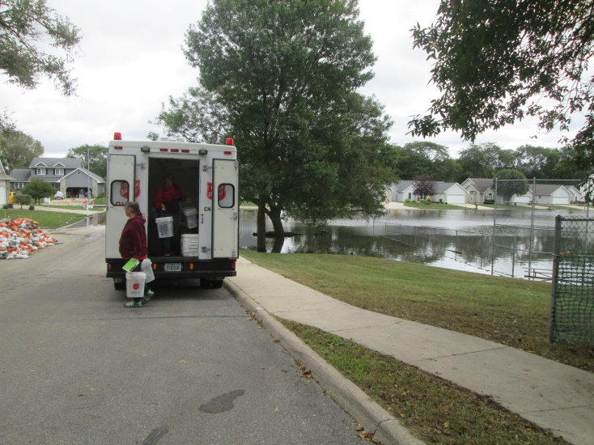
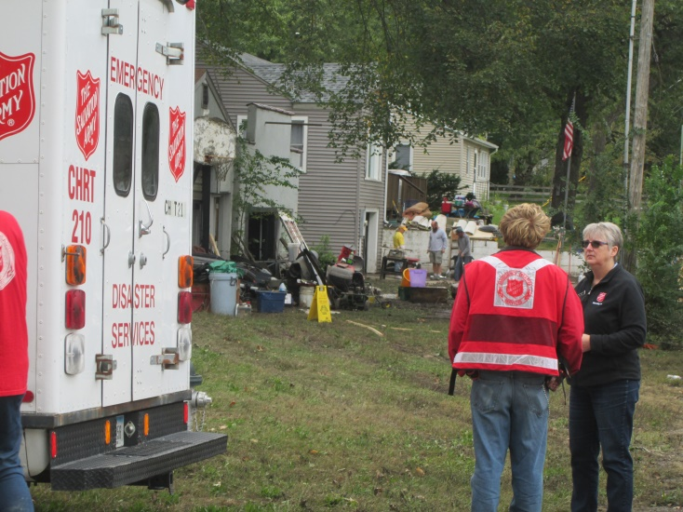
Disaster Relief
The Salvation Army is often among the first on the scene when disaster strikes. Officers, staff, and volunteers are trained to meet all kinds of emergencies by providing food, shelter, clothing, and spiritual comfort. Disaster canteens are a familiar sight to firemen, policemen, and victims alike.

Slide 13
Emergency Assistance
Qualified applicants may receive limited financial assistance, clothing referrals, and vouchers for rent, utilities, medications, and other emergent needs. Assistance is based on household size and income.

Slide 14
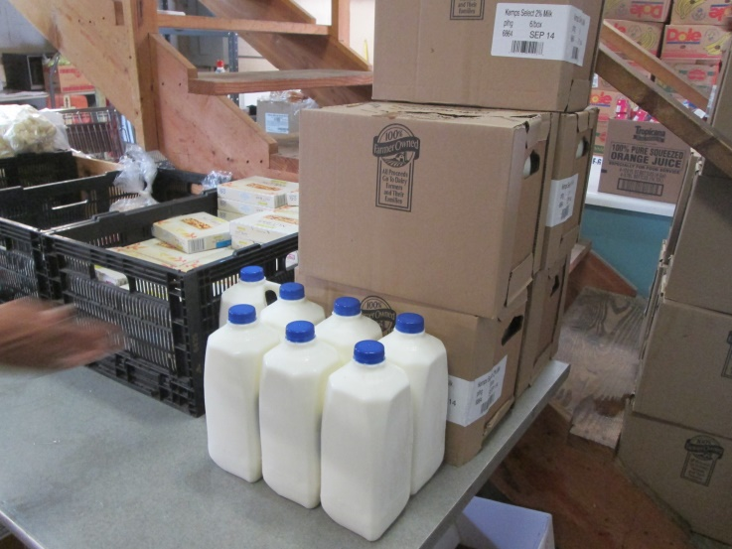
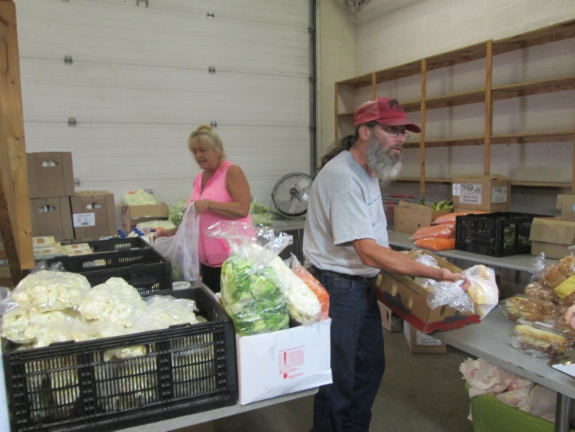
Emergency Food Pantry
Food boxes are provided to needy, qualified individuals and families. Boxes include staple items such as canned goods, meat protein, fresh produce, and dairy items as available. Food boxes often provide 3 meals per day for 4 days.

Slide 15
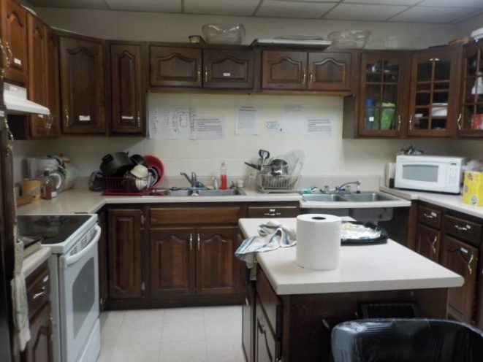
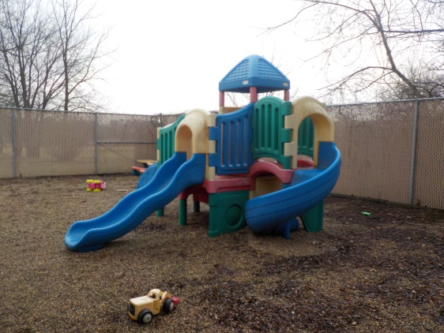
Emergency Shelters
The Salvation Army operates two separate shelters in the Cedar Valley. Those in the shelters attend regular meetings with a Case Manager to set and track goals in areas of money management, health, employment and skill development. It’s an encouraging environment that champions positive choices and personal accountability. Residents set and achieve goals while learning valuable life skills.
Women & Children’s Shelter (32 beds)
Men’s Shelter (18 beds)

Slide 16
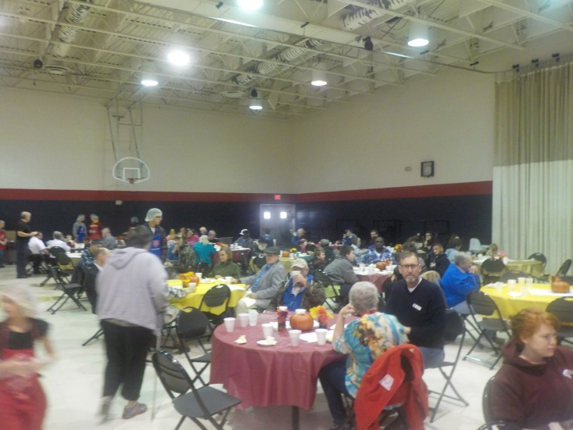
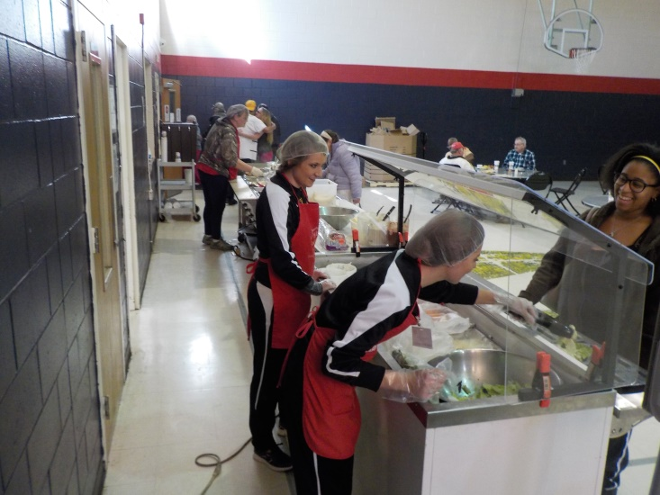
Daily Meal Program
Approximately 150 free, nutritious meals are cooked and served each week day by dedicated staff and volunteers to those in need. The Meal Program helps meet three separate needs in the Cedar Valley:
The homeless population in need of food for basic survival
Those on fixed or low-income budgets who need help stretching their funds
An outlet for socialization for those who would normally eat alone

Slide 17
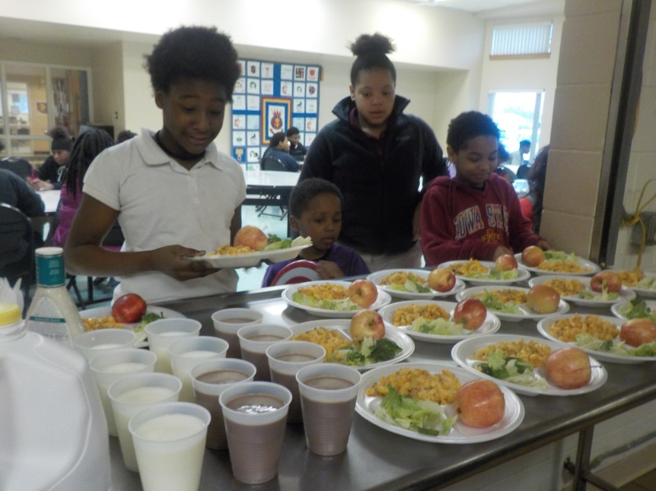
Family Activity Center
During the school year, the Family Activity Center is open weekdays to students after school. During the summer, the Center’s hours extend to daytime. While in the Center, students experience a structured, engaging environment that allows them to focus on different areas.
Enrichment Time
Service
Basketball Outreach

Slide 18
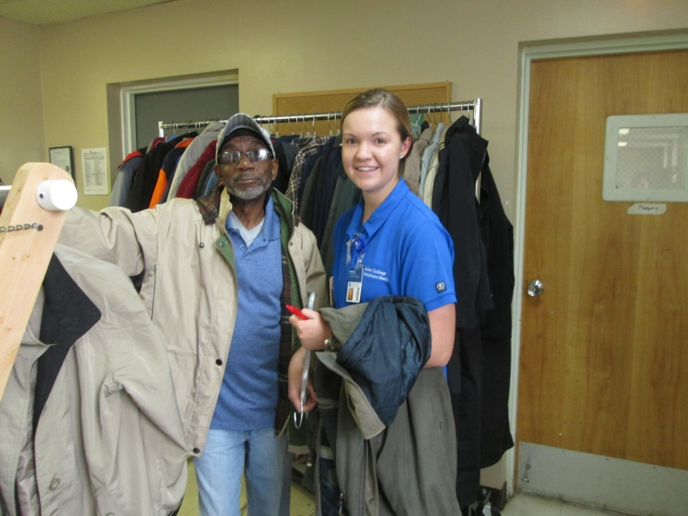
Seasonal Assistance
Coat Giveaway
Thanksgiving and Christmas Meals
Bell Ringers
Christmas Assistance

Slide 19
ACE-SAP Free Clinic
Through partnership with Allen College, the Allen Community Engagement – Salvation Army Partnership (ACE-SAP) Free Clinic provides all of the same benefits of a family doctor at no cost to those most in need.
Operating from The Salvation Army, care is provided by registered nurses who are students in Allen College’s nurse practitioner program and overseen by a certified nurse practitioner instructor.
Clinic hours vary. No appointment necessary.

Slide 20
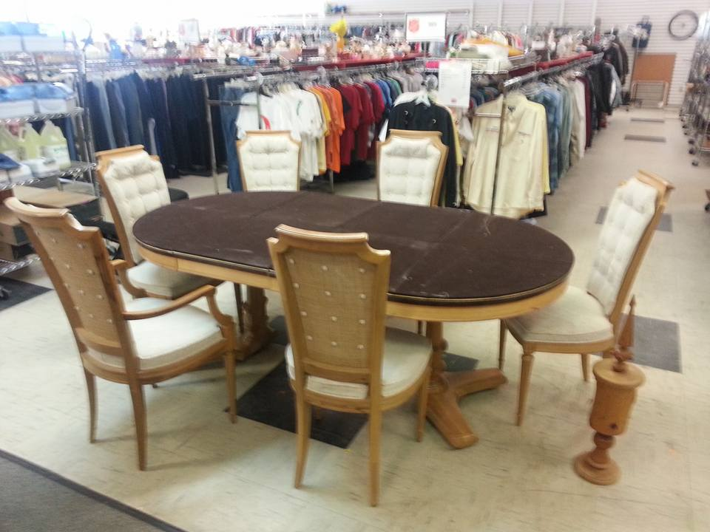
Family Thrift Store
The Salvation Army Family Thrift Store offers affordable clothing, household items, furniture, books, toys, dishware, and many other great items.
The Thrift Store is dedicated to providing quality items at low cost to the Cedar Valley while supporting the work of The Salvation Army Corps.
Located at: 415 E. 7th St, Waterloo
(Corner of 7th & Franklin)

Slide 21
Ways to Support The Salvation Army of Waterloo/ Cedar Falls
Donate Goods!
The Salvation Army welcomes the donation of items to our Thrift Store and Corps. Donated goods are passed along to those most in need. From a gallon of milk to a vehicle, we need and use all donated goods.
Donate Funds!
The Salvation Army is almost entirely privately funded. Through generous donations from individuals, families and businesses, The Salvation Army invests all donations back into the Cedar Valley through its services and programs.
Volunteer!
The Salvation Army relies on the dedicated service of hundreds of volunteers each year. Volunteers aid in all areas of operation, allowing The Salvation Army to use its resources on direct aid to the less fortunate.
Stop By:
89 Franklin Street
Waterloo, IA, 50703
Mail:
PO Box 867
Waterloo, IA, 50704
Call:
319-235-9358
Visit:
www.sawaterloo.org

Slide 22
Heart to God. Hand to Man.
Doing The Most Good

