Slide 1
A Century of Ham Radio
WØMG Presentation 08 March 2014
ARRL
The national association for
Amateur Radio®
CENTENNIAL

Slide 2
A Century of Ham Radio
WØMG Presentation 08 March 2014
ARRL Centennial QSO Party?
A year-long operating event that celebrates hams making contacts.
  Accumulate points.
  Work new stations.
  Make new friends all over the world.
QSO Party is made up of two main activities:
  WIAW operating in each state and most territories
  Centennial Points Challenge (accumulation of points from qualifying contacts throughout 2014) To have points listed online in the Points Challenge competition, logs must be submitted through the Logbook of the World (LoTW) system.

Slide 3
A Century of Ham Radio
WØMG Presentation 08 March 2014
WIAW will be on the air from every state and most territories and it will be easy to work WAS working only W1AW portable operations.
  This is the first ARRL-sponsored operating event where every member is worth at least one point.
  Earn awards based upon points, working all states or working W1AW portable in every state and territory. This is an on-the-air event like no other.

Slide 4
A Century of Ham Radio
WØMG Presentation 08 March 2014
Operating Period:
  0000Z, January 1, 2014 through 2359Z, December 31, 2014
  W1AW will operate portable from each state and many territories throughout the year. Each state will be operated twice so if you miss one operation, you can pick-up the next.

Slide 5
A Century of Ham Radio
WØMG Presentation 08 March 2014
Participation:
  Everyone may participate. Only ARRL members and appointees/elected officials/W1AW are worth points.
  See “QSO Points Table” for a complete list of QSO point values.

Slide 6
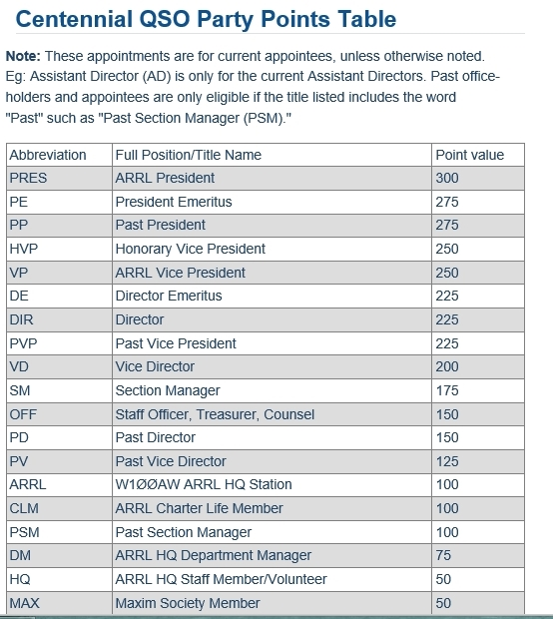
A Century of Ham Radio
WØMG Presentation 08 March 2014

Slide 7
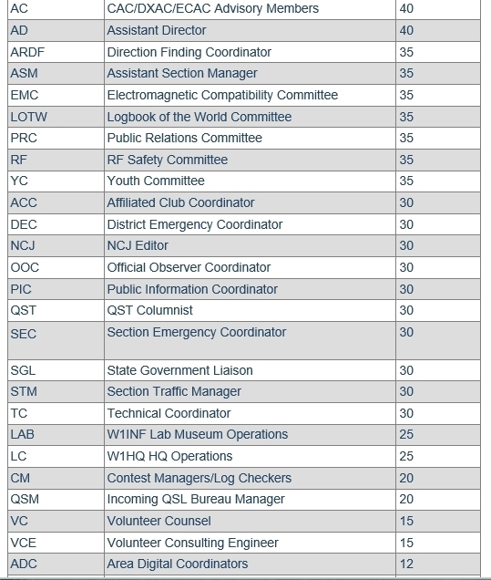
A Century of Ham Radio
WØMG Presentation 08 March 2014

Slide 8
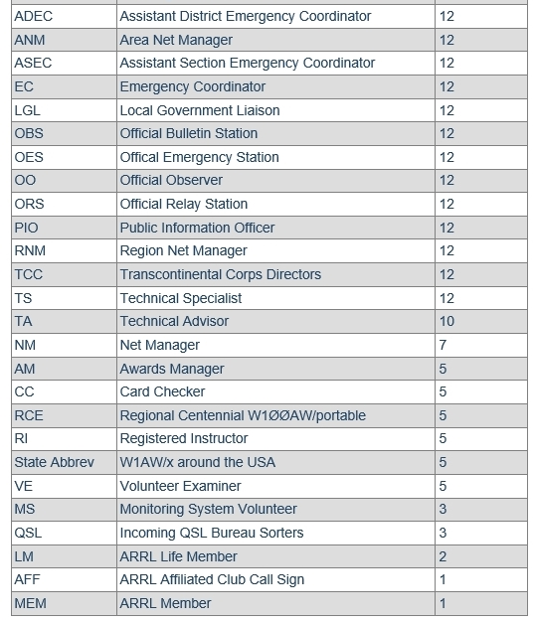
A Century of Ham Radio
WØMG Presentation 08 March 2014

Slide 9
A Century of Ham Radio
WØMG Presentation 08 March 2014
Bands and Modes:
  To count for points, all QSOs must be two-way (no cross-band or cross-mode), using any of the modes CW, Phone (FM, SSB, AM, digital voice), or Digital (any digital mode, i.e. PSK31, RTTY, etc.) You are encouraged to work stations on each mode, but you may not work someone on three modes on the same frequency.
  QSOs must be made within the following bands (some bands show suggested frequencies for modes that are not allowed in the USA – stations outside the USA may use the frequencies if they desire for the QSO Party.

Slide 10
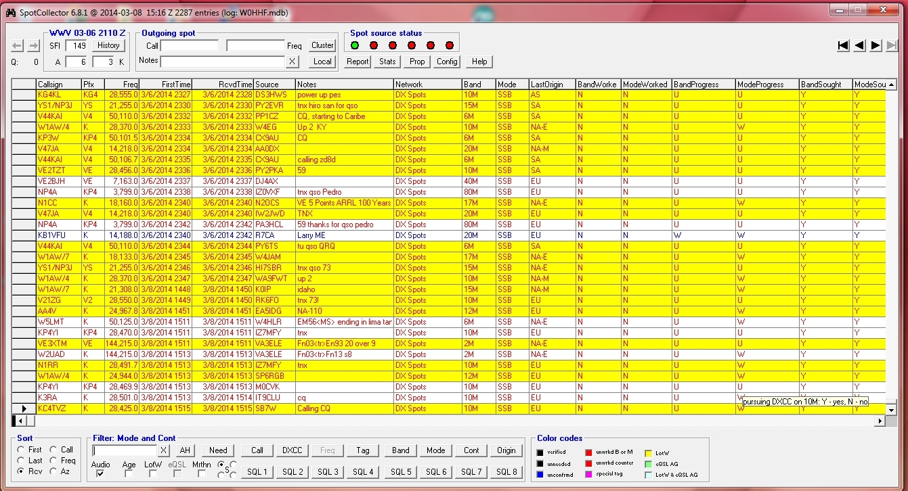
A Century of Ham Radio
WØMG Presentation 08 March 2014
How I find WIAW/W100AW participating stations:
  DXLabs Spot Collector:

Slide 11
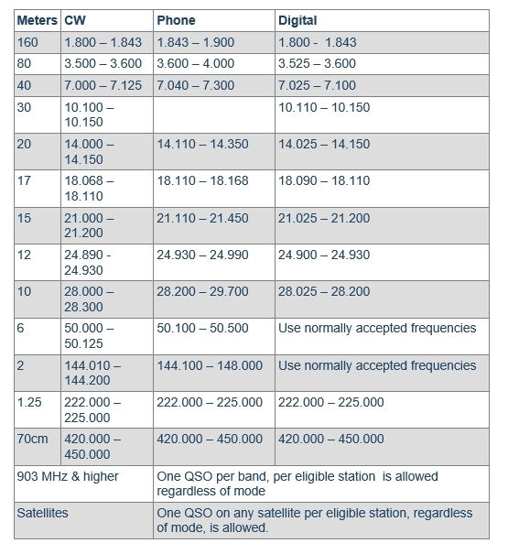
A Century of Ham Radio
WØMG Presentation 08 March 2014

Slide 12
A Century of Ham Radio
WØMG Presentation 08 March 2014
QSO Information Exchange:
  Many stations will try to keep their QSOs short and at a minimum the exchange should include a signal report. The ARRL abbreviation (see Centennial QSO Points Table) is optional.
  QSOs DO NOT have to be contest style and it isn’t necessary to exchange the ARRL organizational information.
  A centennial database will be used to assign point values to logs submitted electronically. For those who do not use electronic submission, they will need to obtain the QSO information from their contacts.
  This event IS NOT a contest, so feel free to make contacts in any way you like. If you are a station looking for QSOs, try to operate with the same style as the station you contact.

Slide 13
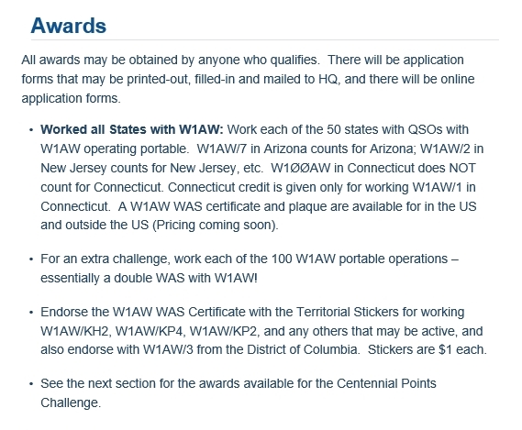
A Century of Ham Radio
WØMG Presentation 08 March 2014

Slide 14
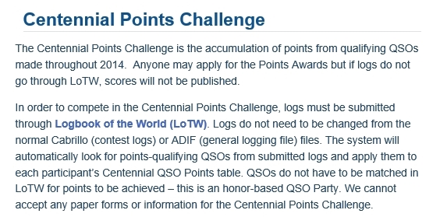
A Century of Ham Radio
WØMG Presentation 08 March 2014

Slide 15
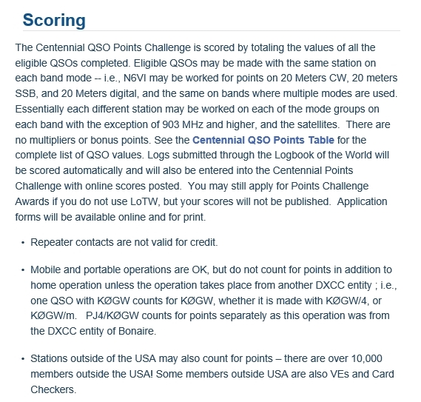
A Century of Ham Radio
WØMG Presentation 08 March 2014

Slide 16
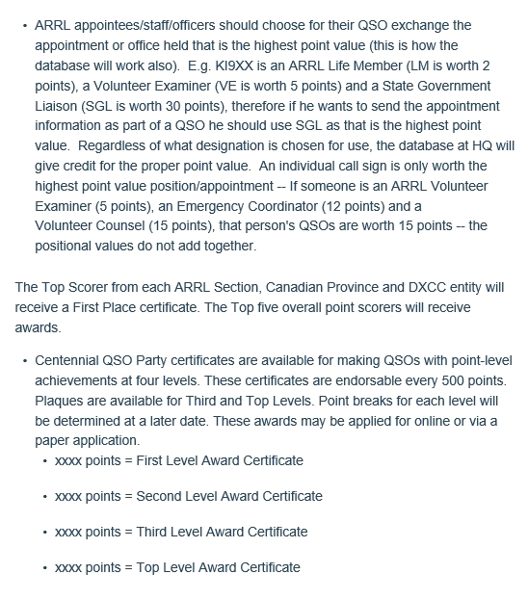
A Century of Ham Radio
WØMG Presentation 08 March 2014

Slide 17
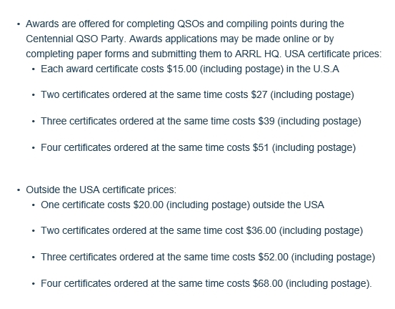
A Century of Ham Radio
WØMG Presentation 08 March 2014

Slide 18
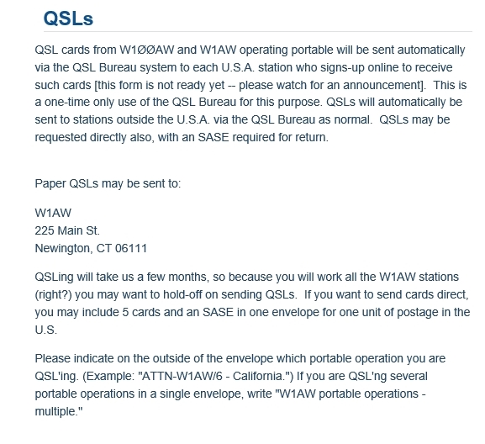
A Century of Ham Radio
WØMG Presentation 08 March 2014

Slide 19
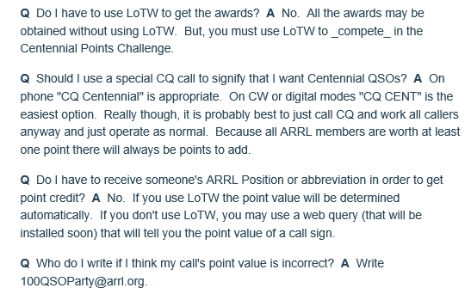
A Century of Ham Radio
WØMG Presentation 08 March 2014
QUESTIONS:
  www.arrl.org/centennial-qso-party

Slide 20
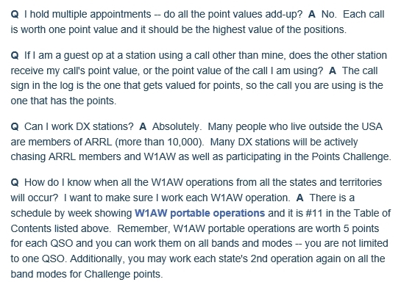
A Century of Ham Radio
WØMG Presentation 08 March 2014

Slide 21
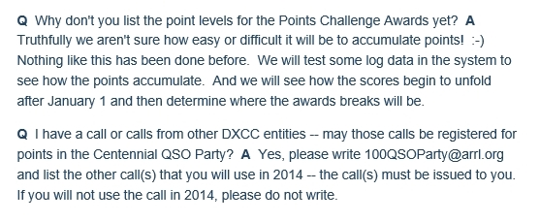
A Century of Ham Radio
WØMG Presentation 08 March 2014

