Slide 1
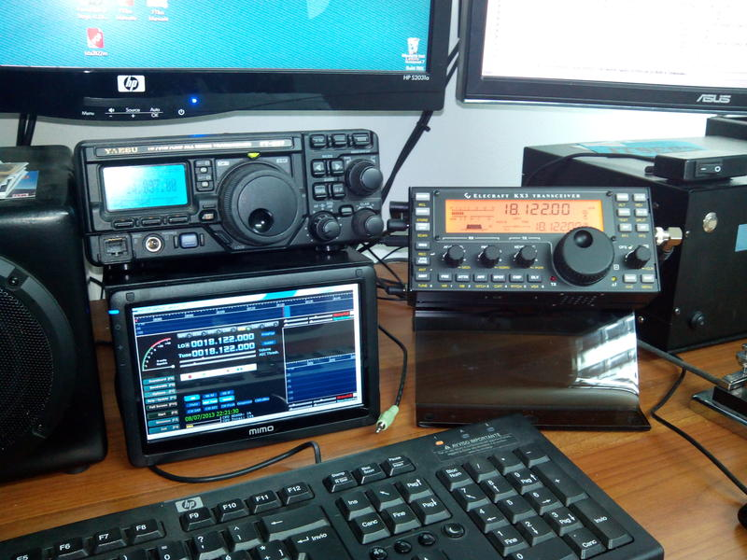
Technology for Your Station

Slide 2
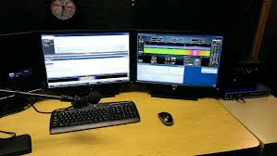
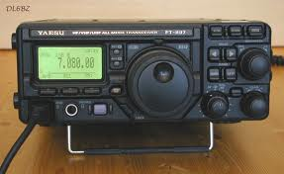
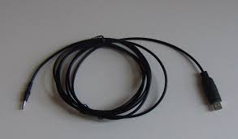
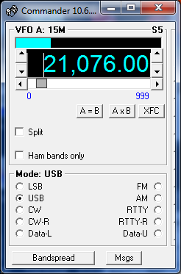
Hardware: Rig Interface (optional)
Rig control
Frequency & mode

Slide 3
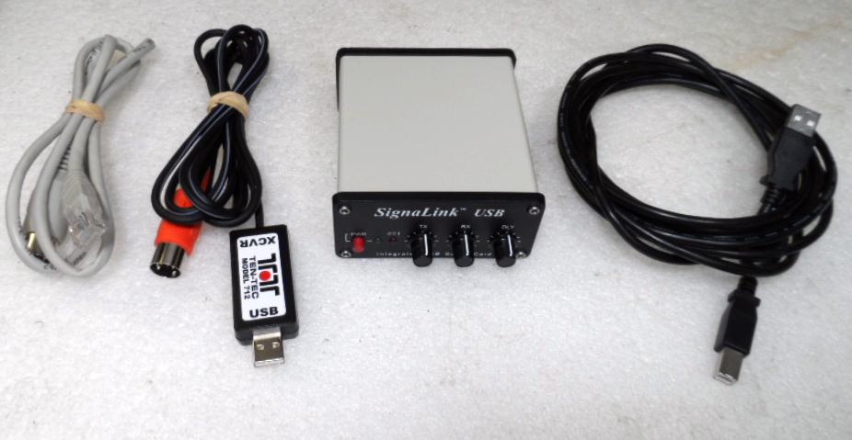
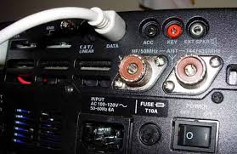
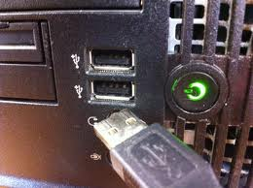
Audio Interface – external sound card
Radio Data port
Computer USB
PSK-31, AFSK (RTTY), Olivia, JT65, SSTV

Slide 4
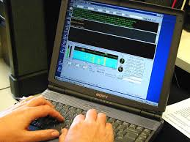
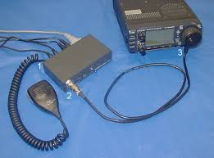
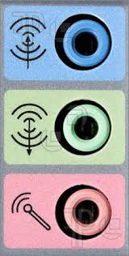
Audio Interface – internal sound card
Audio out keys VOX
Audio in decodes
PSK-31, AFSK (RTTY), Olivia, JT65, SSTV

Slide 5
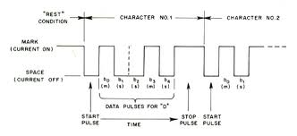
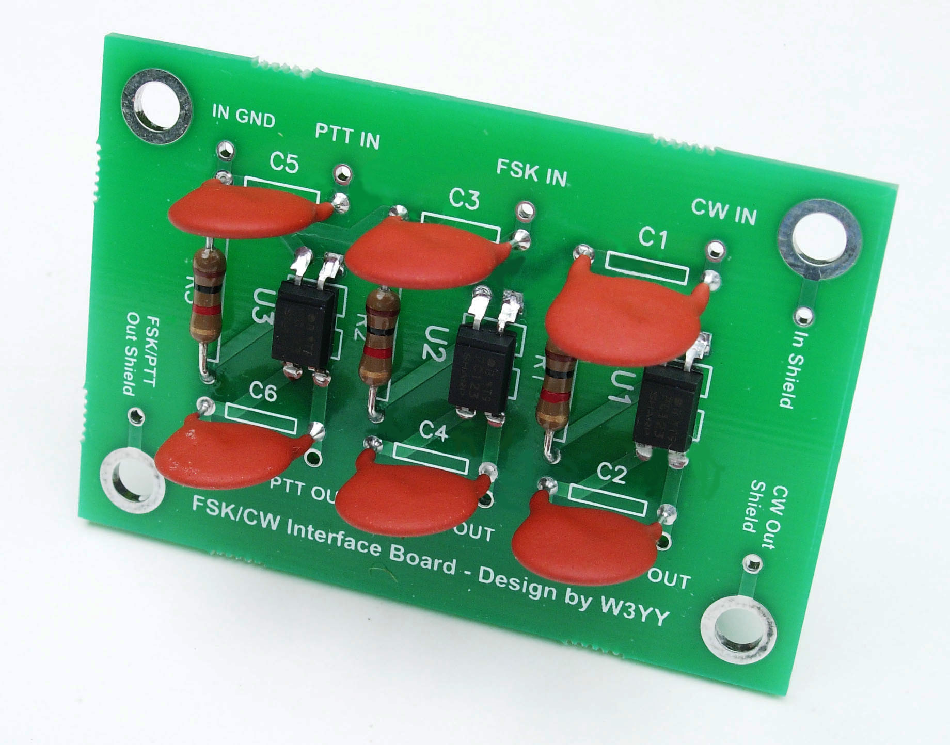
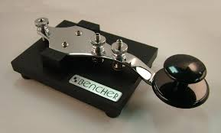
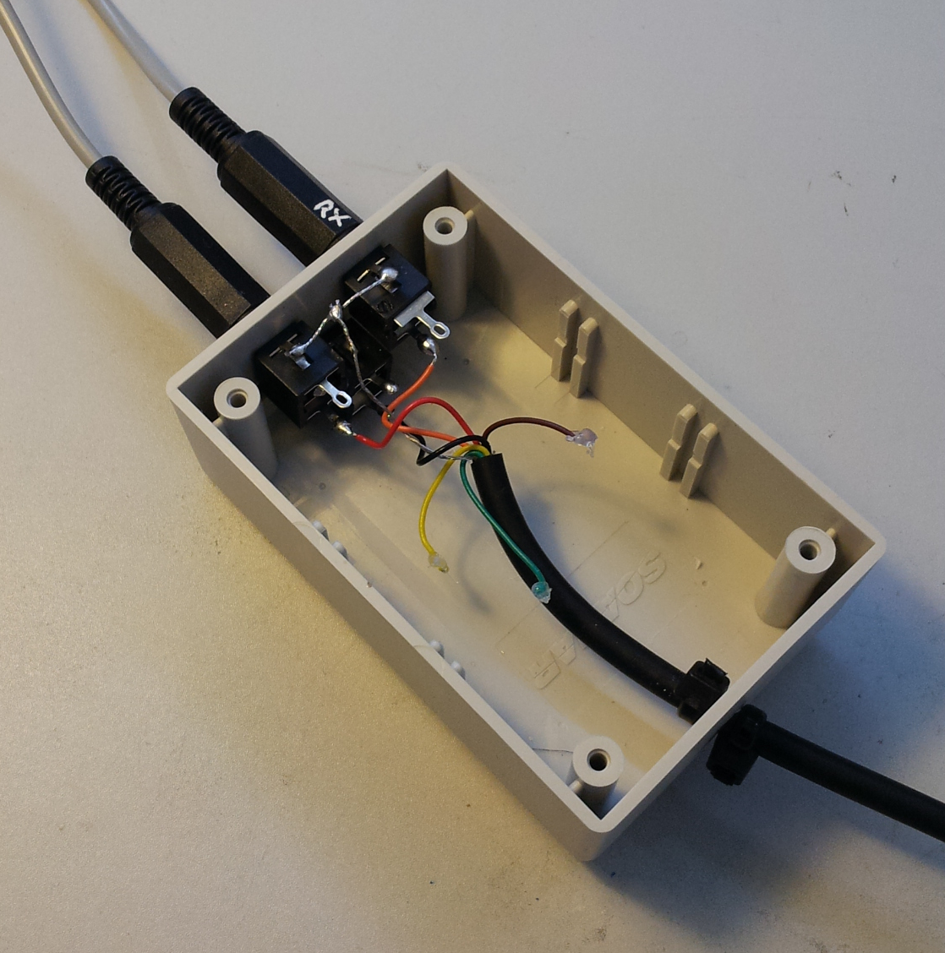
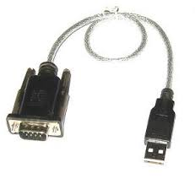
FSK RTTY Interface (optional)
An alternative to “AFSK”
Direct keying of transmitter to generation mark and space tones

Slide 6
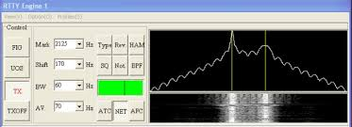
AFSK vs. FSK RTTY: Tuning considerations

Slide 7
DXLabs: Rig Control, Logging, QSL confirmation
Control panel
QSL capture window
Rig control
Logbook
eQSL
LoTW

Slide 8
DXLabs: DX spotting, DX Cluster, QSL analysis
Control panel
Rig control
DX spotting – “DX cluster”
Logbook

Slide 9
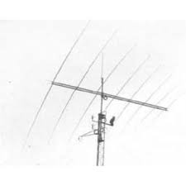
DXView: DXCC information, bearing, and rotator control
Control panel
DX view – location, bearing, contact history, rotator control
Rig control
DX spotting – “DX cluster”
Decoded call signs
Logbook

Slide 10
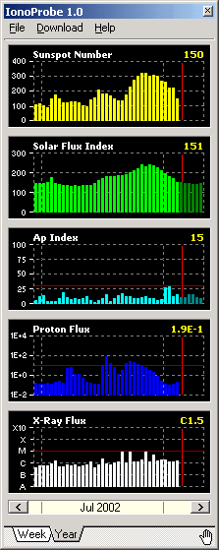
DXView: Mapping, Propagation, QSO Plots
Control panel
DX view – location, bearing, contact history, rotator control
Gray line & real time plots of DX spots
Ionosphere – MUF, F2 & E layer data, D layer density
IonoProbe

Slide 11
DXView: Mapping and Google Earth
Control panel
DX view – location, bearing, contact history, rotator control
Gray line & real time plots of DX spots
Google Earth
Ionosphere – Propagation

Slide 12
DXLabs: Propagation Reports
Control panel
Number of DX spots by frequency and time of day
Maximum Useable Frequency
forecasts

Slide 13
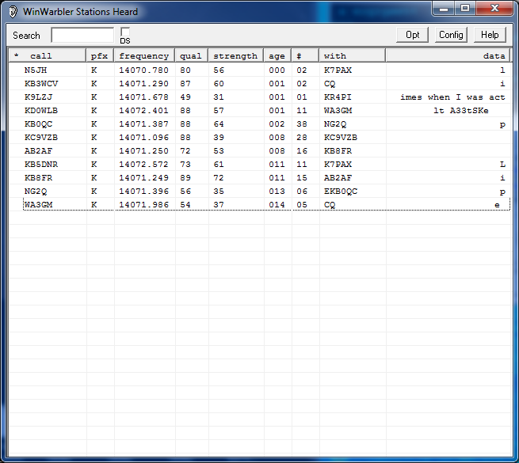
DXLabs: WinWarbler for PSK31
Control panel
WinWarbler: PSK-31 digital interface
PSK-31 spectrum broadband decoder

Slide 14
DXLabs: WinWarbler for RTTY
Control panel
WinWarbler: RTTY digital interface

Slide 15
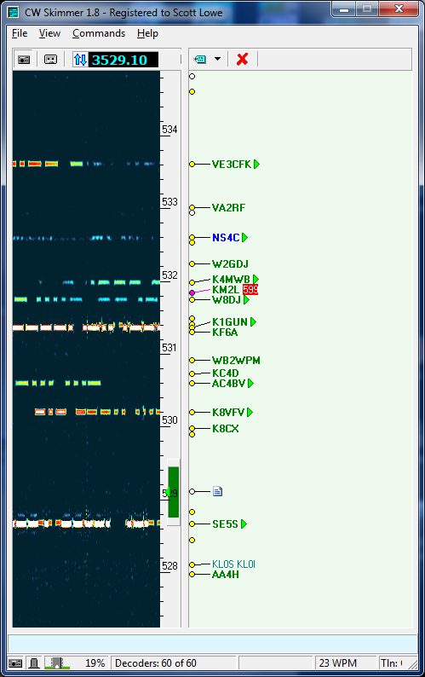
DXLabs: WinWarbler for CW
Control panel
WinWarbler: CW keyer
CW skimmer
spectrum

Slide 16
WSJT-X for JT65 and JT9
JT Alerts
PSKreporter
JT macros plug-in adds 36 custom macros
Integrates to DXLabs for logging QSOs
JT65 and JT9 is designed for very weak signal moon bounce and worldwide QRP communications.
JT macros

Slide 17
PSKreporter: Real-time reverse beaconing
All digital modes are plotted on the “PSKreporter” in realtime and they are heard around the world.
URL for PSKreporter: http://pskreporter.info/pskmap.html

Slide 18
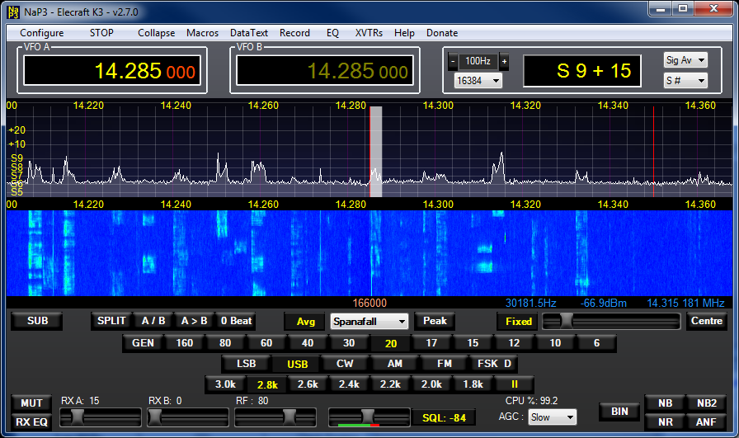
NaP3 (pan adapter software - free)

Slide 19
LP-Bridge (virtual port software - free)
Allows programs to share the same Com port to run multiple programs

