Slide 1
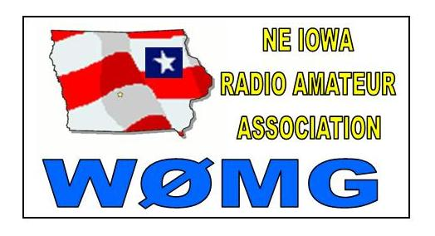
Obtaining Your
Amateur Radio License
If you don’t have an amateur radio license, it is relatively easy to get one. It is no longer necessary to learn Morse Code. Qualifying for a Technician Class FCC-issued license involves passing a 35 question multiple choice closed book exam, with a passing grade of 74%.
There are 426 potential questions, all of which are published in advance along with the correct answers. Practice exams are available on the internet at several sites. Several training books are available, such as Technician Class Amateur Radio License Preparation written by Gordon West. Note that the question pool was revised in June 2014, so that updated training materials will be necessary. There are two additional levels of license, a General Class or Extra Class License which involves additional examinations.
Contacting Us
If your would like to contact the club you have several ways of doing it.
By Radio – We run a net on our repeater every Sunday night at 9:PM
By Joining us for breakfast at Hy-Vee at 400 University Ave. In Waterloo.
By Attending a monthly club meeting.
You can email the president at pres@w0mg.net
Our Web Page at www.w0mg.net and click on “Contact Us”
Our Facebook page at Northeast Iowa Radio Amateur Association
Blackhawk County
Iowa
Est. 1928
W0GEN Rev. 6/21/16

Slide 2
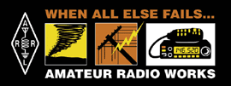
Who are we?
The Northeast Iowa Radio Amateur Association has been serving Blackhawk County and the surrounding area since 1928. Our members come from all walks of life. The club website is www.w0mg.org.
The club has been associated with the American Radio Relay League (ARRL) since 1949.
Our Social Times
The club meets at 7PM on the second Saturday of each month in the lower level of the American Red Cross building, 2530 University Ave. in Waterloo, Ia. unless notification is given on www.w0mg.net and/or during the weekly net.
A breakfast is held at Hy-Vee, 4000 University Ave., Waterloo on Mondays at 9 AM ending around 10:30 AM or later.
Membership / Attendance is open to all licensed amateurs and anyone interested in ham radio.
There is no club meeting in August.
The November meeting is our Christmas party and elections.
Use our Repeater
While we have several repeaters available to the public, one of our club repeaters is located in Cedar Falls on top of the water tower at University and Cedar Heights Drive.
The frequency is 146.940 MHz with a PL tone of 136.5 required. All licensed hams are welcome to use the repeater. For additional repeater information go to www.w0mg.org.
Sunday Night Net
The club runs the 146.940 MHz Blackhawk County ARES net every Sunday night at 9 PM on our repeater. The purpose of this net is to test your radio and pass news and traffic and to encourage use of the 2 Meter Band. All licensed hams are welcome to check in.

